Slide 1
DAC - DevOps
Atul Kahate

Slide 2
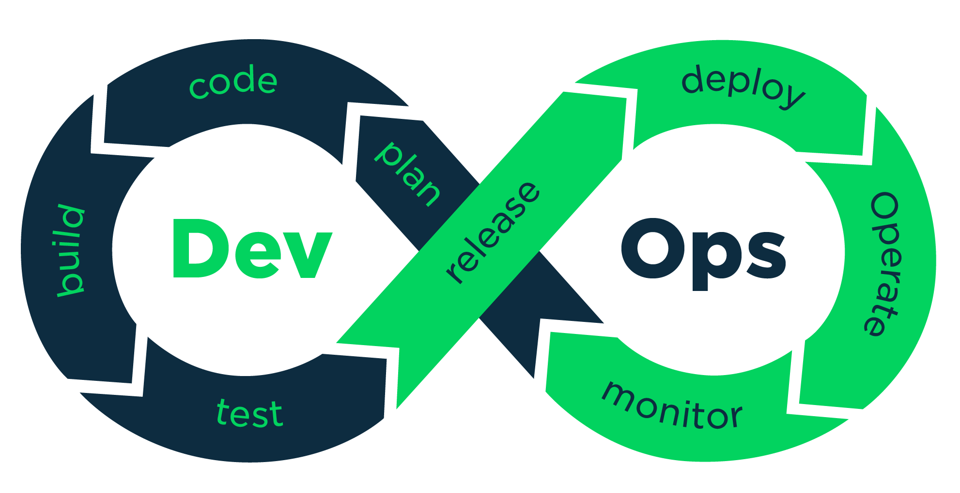
DevOps

Slide 3
Modern Software Development Approach
Monolithic
Nano/Microservices
Stateful
Stateless
Synchronous
Asynchronous
A->Call->B
A->Msg->B
HTTP GET/POST
HTTP GET/POST/PUT…
SOAP/XML
REST/JSON

Slide 4

Impact on the Way We Deploy Applications
Put everything into a single WAR file and deploy it on the web server
Each Microservice has its own WAR file, own Database
Order Application
Billing Application
Payment Application
Order Microservice
Billing Microservice
Payment Microservice

Slide 5
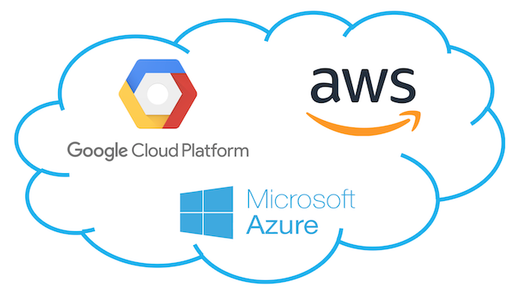
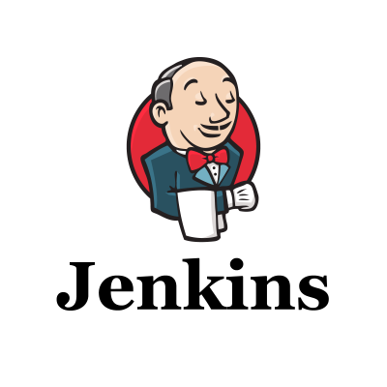

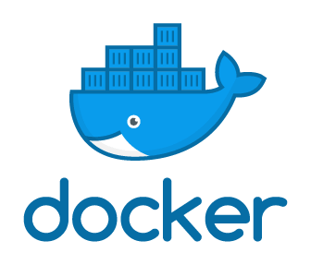
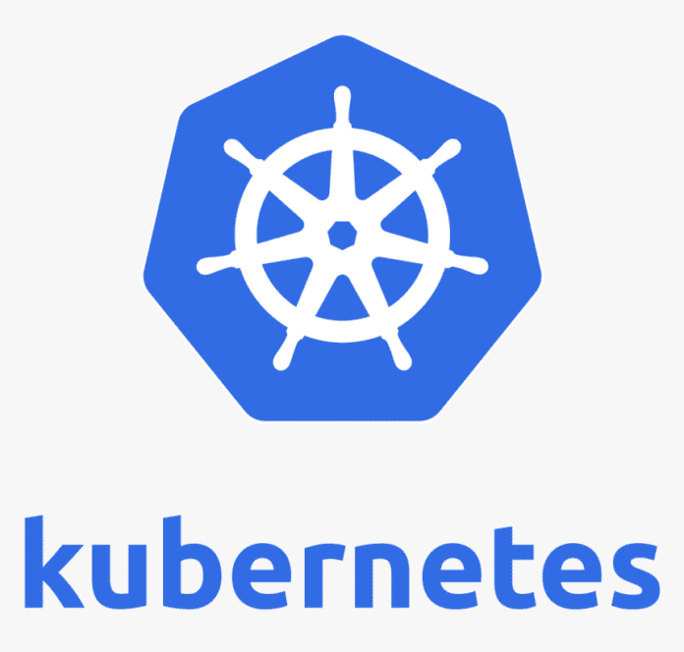
DevOps Tools
Order Microservice
During Development, for Version Control
Pipeline
After Creation of WAR file
Orchestration

Slide 6
Docker

Slide 7
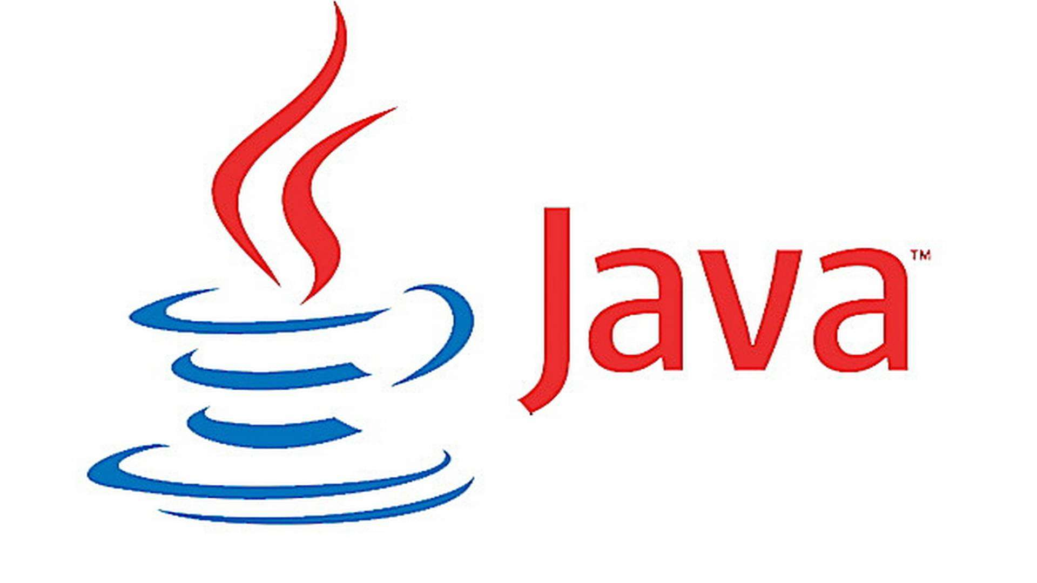
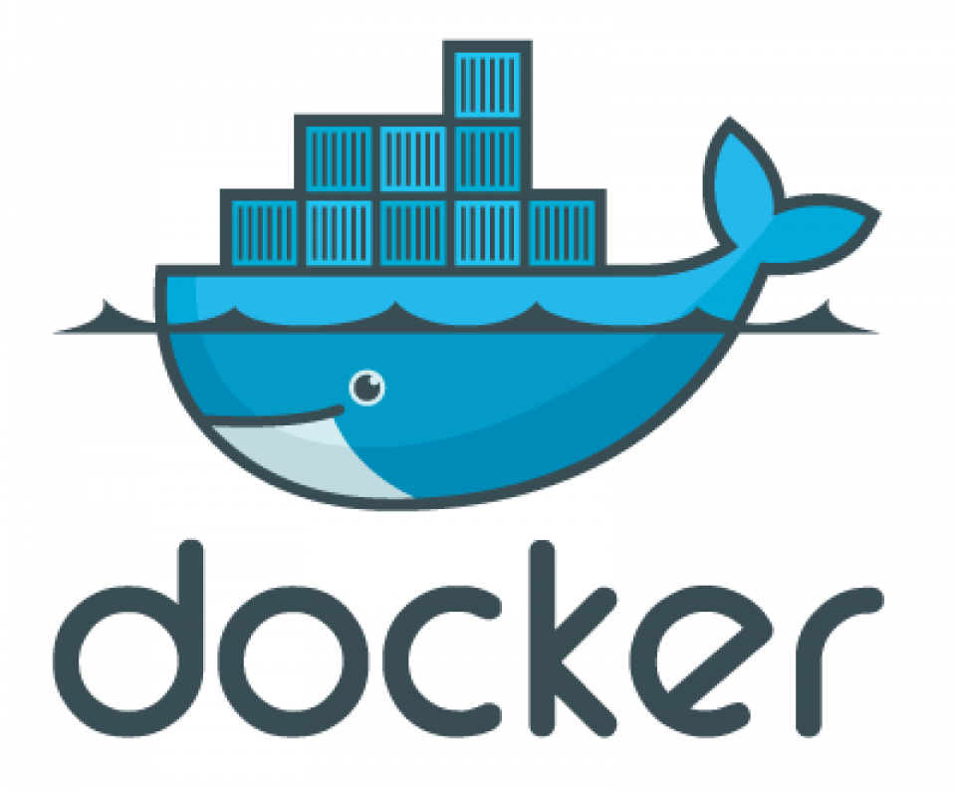

What is Docker?
Docker is a container technology
Why container? Because it contains everything needed to execute an application
Takes the virtualization concept to the next level
HelloWorld.class

Slide 8
Installing Docker
Windows: Use Docker Desktop
Linux (Ubuntu): https://docs.docker.com/engine/install/ubuntu/

Slide 9
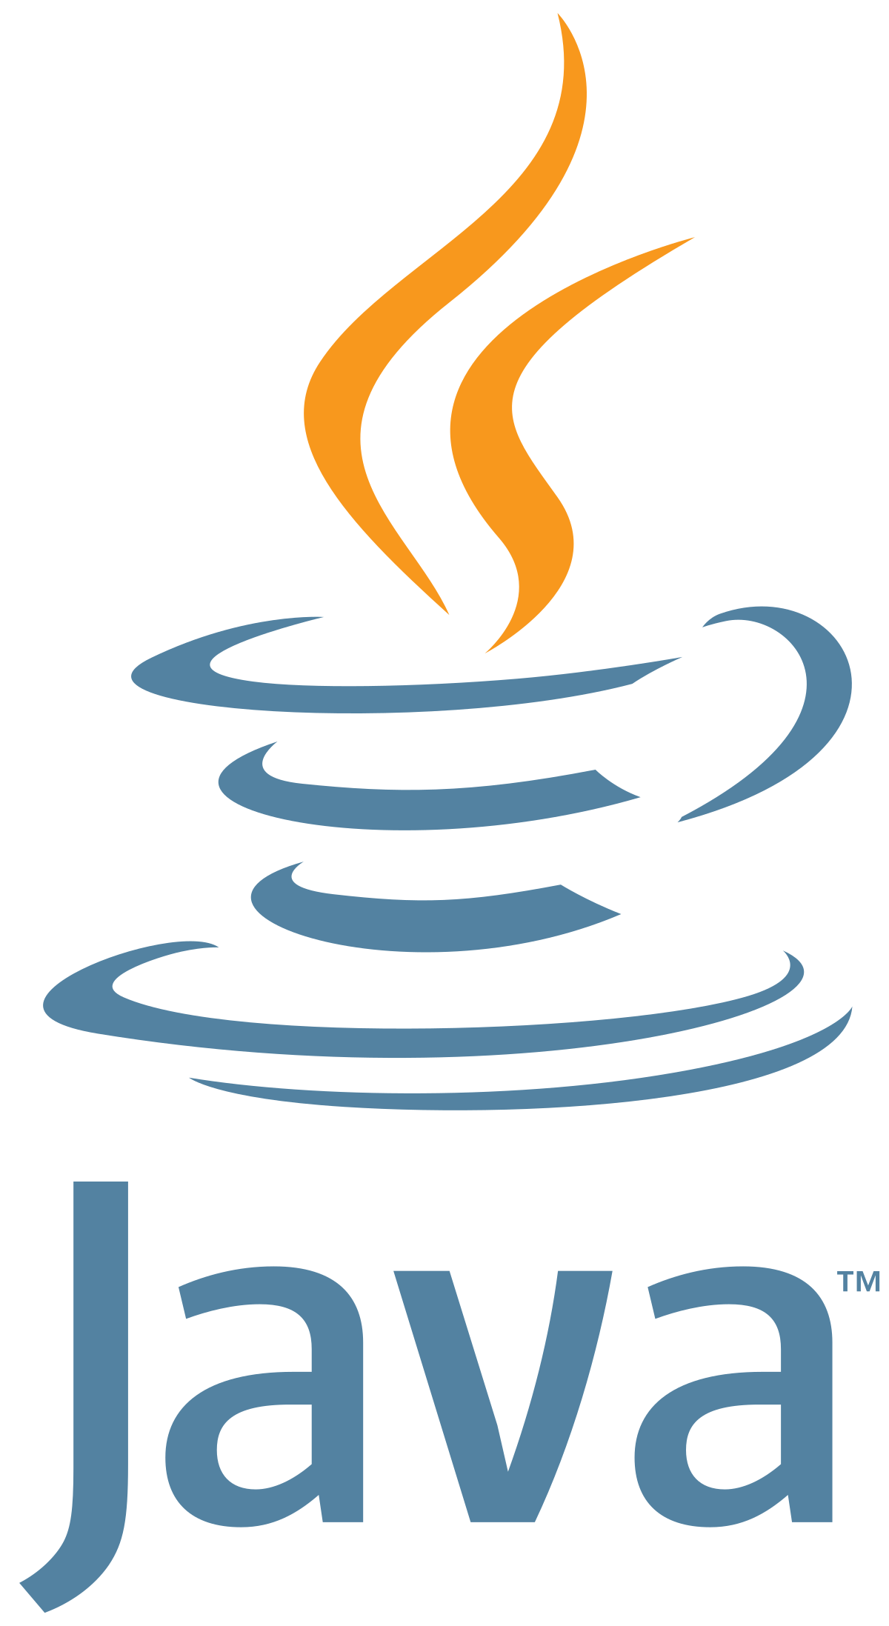

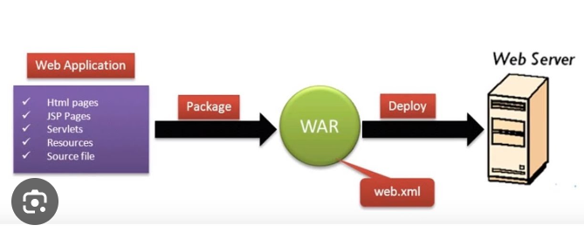
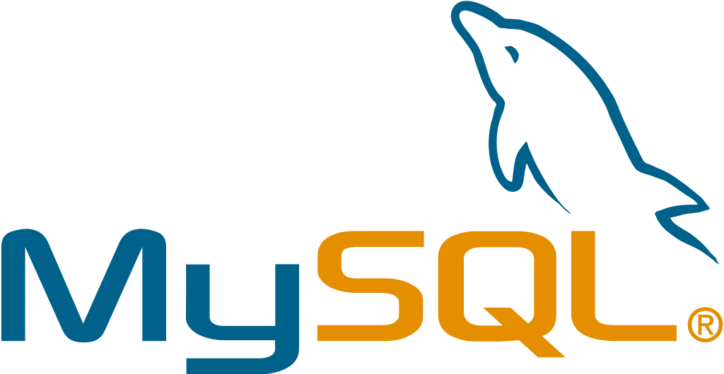
Deployment: Earlier and Now

Slide 10

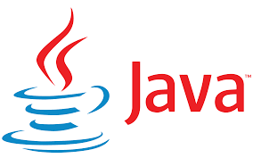
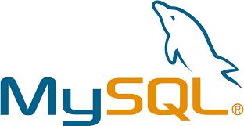

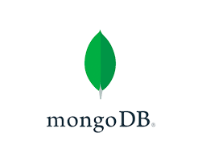
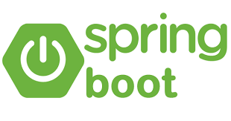
How to use Container Technology
Create a Docker Image (docker build command)
Docker Image
Take anywhere and run – it will always work and will always produce consistent output

Slide 11
How to use Container Technology
Execute the built Docker Image (docker run command)
Docker Image
Docker Container

Slide 12
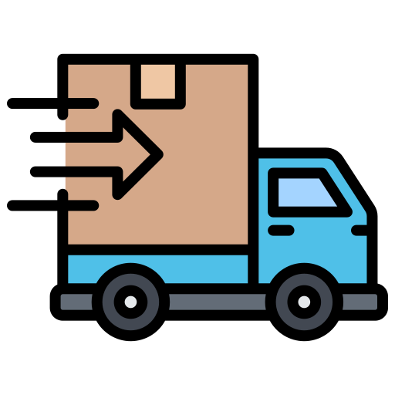
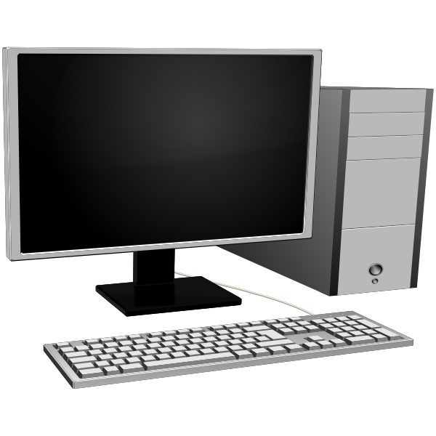
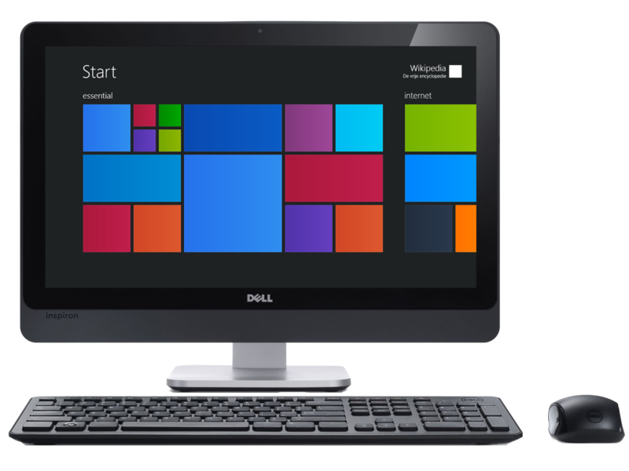
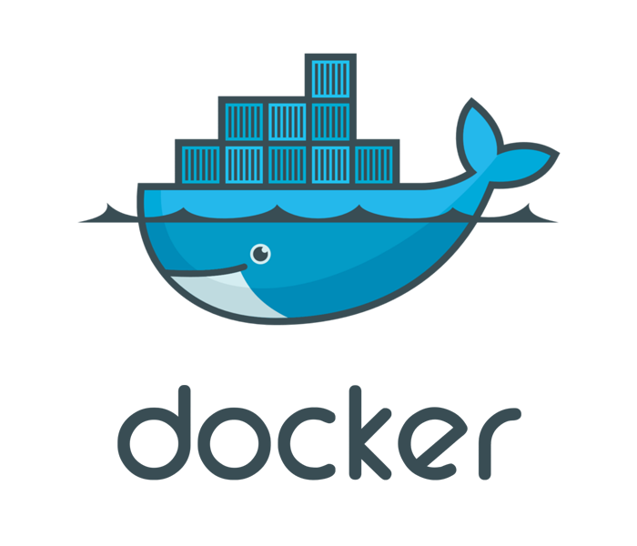
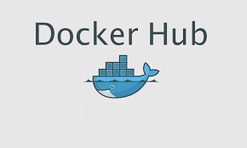
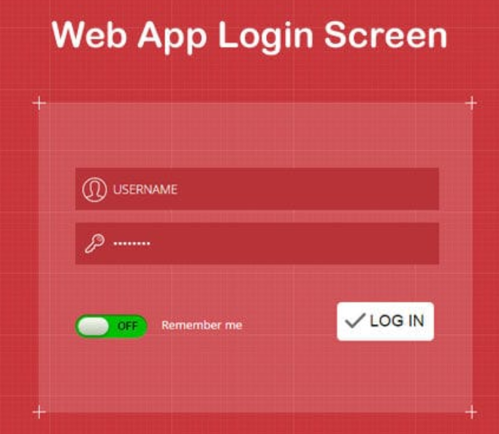
How to Use Docker?
Build Docker Image
Ship Docker Image
Run Docker Container

Slide 13
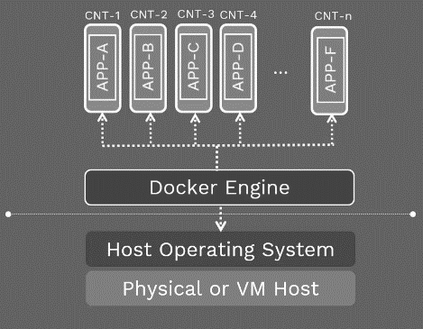
Docker Infrastructure

Slide 14
Using Ready Containers
Desktop application
docker run hello-world
Web application
docker run -p 9999:8080 tomcat:8.0
Try localhost:9999
Giving name to a container: docker run -d --name my-tomcat-container -p 9999:8080 tomcat:8.0

Slide 15
Run Tomcat Inside a Docker Container
Running the latest Tomcat version
docker run -d --name my-latest-tomcat-container -p 8888:8080 tomcat:latest

Slide 16
Accessing Tomcat
Try accessing localhost:8080
We will get 404 – Reason: webapps directory in Tomcat Docker container is empty as a security measure
Do the following:
Try accessing localhost:8888 - Error
docker exec -it my-latest-tomcat-container /bin/bash
rm -r webapps
mv webapps.dist webapps
cd /usr/local/tomcat/bin
./startup.sh
Now try accessing localhost:8088 or curl localhost:8088

Slide 17
Creating Our Own ‘Hello World’ Image in Docker

Slide 18
‘Hello World’ in Java using Docker
Create HelloWorld.java in C:\lectures\CDAC\Cloud\docker\hello-world-java\HelloWorld.java
public class HelloWorld {
public static void main(String[] args) {
System.out.println("Hello, World");
}
}
Compile: javac HelloWorld.java
Test: java HelloWorld

Slide 19
Create Dockerfile
C:\lectures\CDAC\Cloud\docker\hello-world-java\Dockerfile
# Use the official OpenJDK image as a parent image
FROM openjdk:latest
# Set the working directory to /app
WORKDIR /app
# Copy the current directory contents into the container at /app
COPY . /app
# Compile the Java code
RUN javac HelloWorld.java
# Run the program when the container starts
CMD ["java", "HelloWorld"]
These will be created/added because of the commands in Dockerfile
HelloWorld.class
app folder
We want JDK, but it comes with Oracle Linux User Space (not Kernel)
OpenJDK
Oracle Linux
Docker (VM with a Linux Kernel)
These two are already there
Our OS (Host)

Slide 20
End Result
These will be created/added because of the commands in Dockerfile
HelloWorld.class
.app folder
HelloWorld.class
Layer 4
We want JDK, but it comes with Oracle Linux User Space (not Kernel)
OpenJDK
.app folder
Layer 3
OpenJDK
Layer 2
Oracle Linux
Oracle Linux
Layer 1
Docker (VM with a Linux Kernel)
Resulting Docker Image
These two are already there
Our OS (Host)

Slide 21
Java Application with User Input

Slide 22
Create PrimeNumber.java (C:\lectures\CDAC\Cloud\docker\javainputdocker)
import java.util.Scanner;
public class PrimeNumber {
public static void main(String[] args) {
Scanner sc = new Scanner(System.in);
System.out.println("Prime number check ... Please enter a number: ");
int num = sc.nextInt();
boolean isPrime = true;
for(int i = 2; i < num/2; i++) {
if(num % i == 0) {
isPrime = false;
break;
}
}
if(isPrime)
System.out.println(num + " is a prime number");
else
System.out.println(num + " is not a prime number");
sc.close();
}
}

Slide 23
Dockerfile (C:\lectures\CDAC\Cloud\docker\javainputdocker)
FROM openjdk:12-alpine
COPY . /usr/src/myjavaapp
WORKDIR /usr/src/myjavaapp
RUN javac PrimeNumber.java
CMD ["java", "PrimeNumber"]

Slide 24
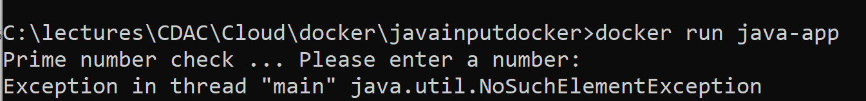
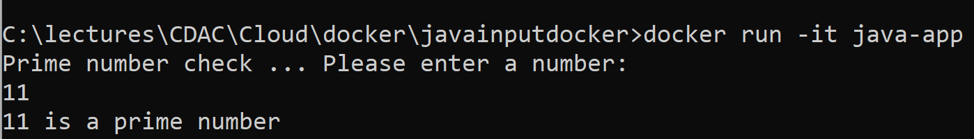
Build image and run
docker build -t java-app .
docker container run java-app
To resolve: docker container run -it java-app

Slide 25
Interactive Terminal
The -it option is made up of two things: interactive and terminal
It allows us to open a terminal inside the container, almost like SSHing inside it
We can run any allowed commands inside the container now
Example: Launch an Ubuntu container and then install Curl
sudo docker container run -it --name ubuntu ubuntu
apt-get update
apt-get install -y curl
curl google.com
exit

Slide 26
Common Docker Commands
docker build: Builds a Docker image from a Dockerfile.
Example: docker build -t my-image .
Docker container run: Runs a Docker container based on a Docker image.
Example: docker run my-image
docker container list: Lists running Docker containers.
Example: docker container list or docker ps

Slide 27
Common Docker Commands
docker container stop: Stops a running Docker container.
Example: docker stop container-name
docker container rm: Removes a Docker container.
Example: docker rm container-name
docker images: Lists Docker images.
Example: docker images

Slide 28
Common Docker Commands
docker rmi: Removes a Docker image.
Example: docker rmi image-name
docker container exec: Runs a command inside a running Docker container.
Example: docker exec -it container-name /bin/bash
docker pull: Pulls a Docker image from a registry.
Example: docker pull image-name
docker push: Pushes a Docker image to a registry.
Example: docker push image-name

Slide 29
Docker Networks
Docker has a default network called bridge network
All containers we create are automatically put in the bridge network
These containers cannot access each other
Suppose we start a Tomcat container and a MySQL container – both will run inside the same bridge network and yet they will not be able to access each other
Solution: Create our own custom network

Slide 30
Creating Tomcat and MySQL Containers Together Inside a Network
C:\lectures\CDAC\DAC\docker-compose-tomcat-mysql.yaml (Next slide)
Go to this directory
docker-compose -f docker-compose-tomcat-mysql.yaml up
Both containers should start
Now open a second command prompt and open a terminal inside the MySQL container
docker exec -it my-mysql-container mysql -u root -p
Give password as root_password

Slide 31
YAML File for the Previous Slide
version: '3'
services:
mysql:
image: mysql:latest
container_name: my-mysql-container
environment:
MYSQL_ROOT_PASSWORD: root_password
MYSQL_DATABASE: sample_db
MYSQL_USER: sample_user
MYSQL_PASSWORD: sample_password
ports:
- "3306:3306"
networks:
- mynetwork
volumes:
- mysql_data:/var/lib/mysql
tomcat:
image: tomcat:latest
container_name: my-tomcat-container
ports:
- "9999:8080"
networks:
- mynetwork
depends_on:
- mysql
command: bash -c "apt-get update && apt-get install -y mysql-client && catalina.sh run"
networks:
mynetwork:
volumes:
mysql_data:

Slide 32
Running Tomcat Container But With Our Local webapps Directory
docker run -p 9999:8080 -v "c:/tomcat/webapps:/usr/local/tomcat/webapps" tomcat
Try accessing any Tomcat application on localhost:9999
E.g. localhost:9999/cdac/hello.jsp

Slide 33
Building a Dockerfile of your Spring Boot Application
File: C:\code\spring\expensetrackerapp\Dockerfile
FROM openjdk:8
EXPOSE 8080
COPY build/libs/expensetrackerapp-0.0.1-SNAPSHOT.jar expensetrackerapp-0.0.1-SNAPSHOT.jar
ENTRYPOINT ["java", "-jar", "/expensetrackerapp-0.0.1-SNAPSHOT.jar"]

Slide 34
Docker Swarm Introduction

Slide 35
Docker Swarm
Docker Swarm is a tool that allows us to manage a group of Docker containers as a single unified system
Allows deployment and scaling of applications across multiple containers
Built-in with Docker
Simple to use
Follows 80/20 rule: 20% features for 80% use cases
Easier to troubleshoot

Slide 36
Docker Swarm Hands-on

Slide 37
Problem
Create a new docker image using NGINX. Push it to docker hub. Create a service on Dockerswarm. Keep initial replicas as 1 and then increase the replicas to 10. Reduce the replicas to 2. Create a new image by modifying “index.html”. Push to docker hub and then update the service for a new image.

Slide 38
Step 1: Create a Docker Image with Nginx
Create Dockerfile containing the following:
# Use the official NGINX base image
FROM nginx:latest
# Copy custom index.html to the NGINX web root
COPY index.html /usr/share/nginx/html/

Slide 39
Step 1: Create index.html in the Same Directory
<h1>This is Docker Swarm</h1>

Slide 40
Step 2: Build and Push Image
# Build and tag the Docker image
docker build -t your-dockerhub-username/nginx-custom .
# Log in to Docker Hub
docker login
# Push the Docker image to Docker Hub
docker push your-dockerhub-username/nginx-custom

Slide 41
Step 3: Create a Docker Swarm Service
# Initialize Docker Swarm (if not already initialized)
docker swarm init
# Create a Docker service with initial replicas as 1
docker service create --replicas 1 --name nginx-service -p 80:80 your-dockerhub-username/nginx-custom

Slide 42
Step 4: Scale the Service
# Scale the service to 10 replicas
docker service scale nginx-service=10
docker service ls
docker inspect <id of the service>
# Reduce the replicas to 2
docker service scale nginx-service=2

Slide 43
Step 5: Modify index.html and Create a New Image
FROM your-dockerhub-username/nginx-custom
COPY index.html /usr/share/nginx/html/
Then build and push the image
docker build -t your-dockerhub-username/nginx-custom:v2 -f Dockerfile.nginx_v2 .
docker push your-dockerhub-username/nginx-custom:v2

Slide 44
Step 6: Update the Docker Swarm Service
# Update the Docker service to use the new image
docker service update --image your-dockerhub-username/nginx-custom:v2 nginx-service

Slide 45
Step 7: Leave Docker Swarm
docker swarm leave

Slide 46
Kubernetes

Slide 47
Kubernetes
Docker creates images, which are run as containers
In complex environment, we need multiple copies of the same container to address issues such as redundancy, load balancing
Kubernetes can do this
Aim: Deploy, scale, and manage containerized applications on a group of servers

Slide 48
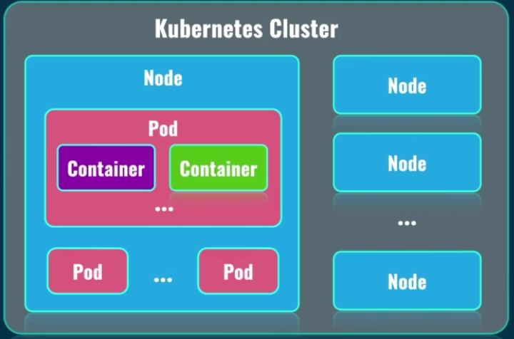
Kubernetes Components

Slide 49
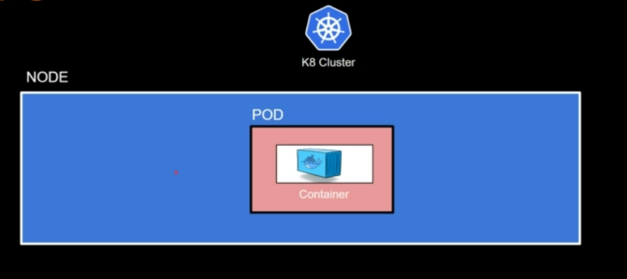
Pod Concept
Kubernetes does not deploy containers directly on the worker nodes.
A container is encapsulated into a Kubernetes object called as Pod.
Pod = A Single instance of an application
A Pod is the smallest object that we can create in Kubernetes.
Remember NPC – Node contains Pod contains Container

Slide 50
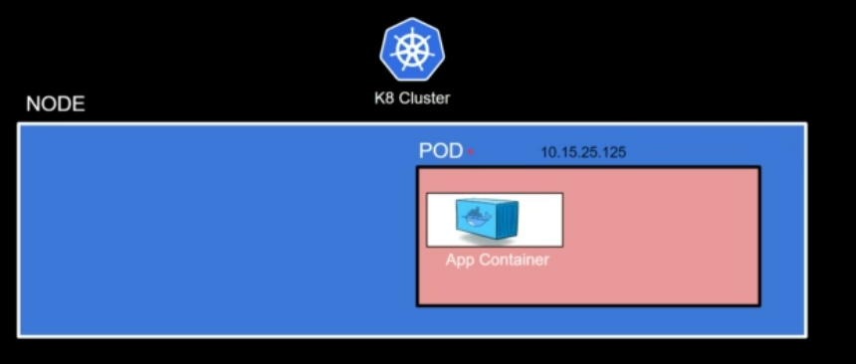
Each Pod has a unique IP address

Slide 51
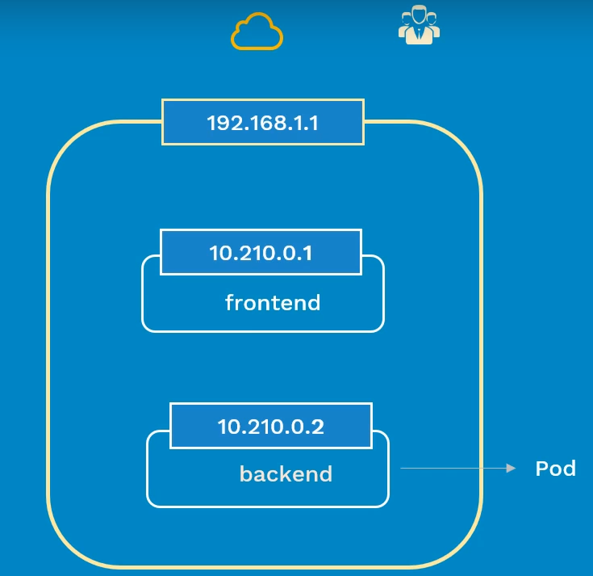
Problem
Each pod has a unique IP address and when a pod dies, its IP address is also released
How can an external application access a pod seamlessly?
Solution: service

Slide 52
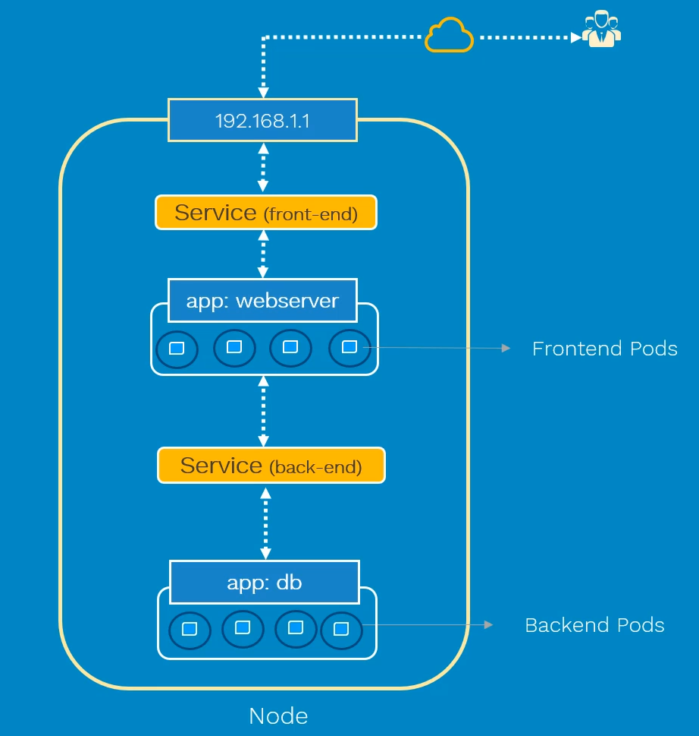
Service Concept
Types of Service:
ClusterIP: Access within the cluster
NodePort: Expose outside
LoadBalancer: Multiple servers

Slide 53
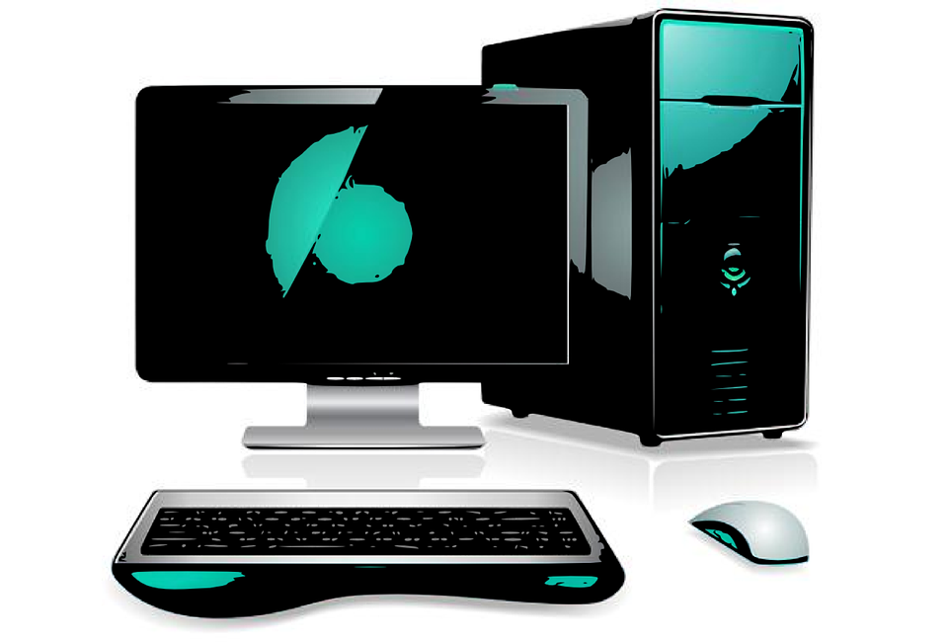
Deployment, ReplicaSet, Service
Deployment
Clients
Pod with its randomly generated internal IP address
RS
Pod with its randomly generated internal IP address
Service with a fixed external IP address
LB
Pod with its randomly generated internal IP address

Slide 54
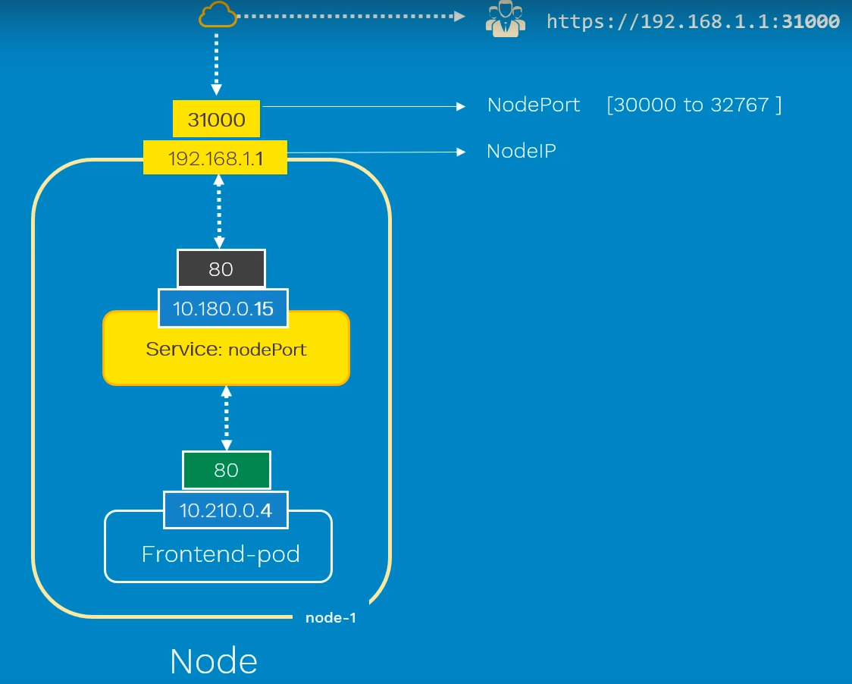
NodePort Service

Slide 55
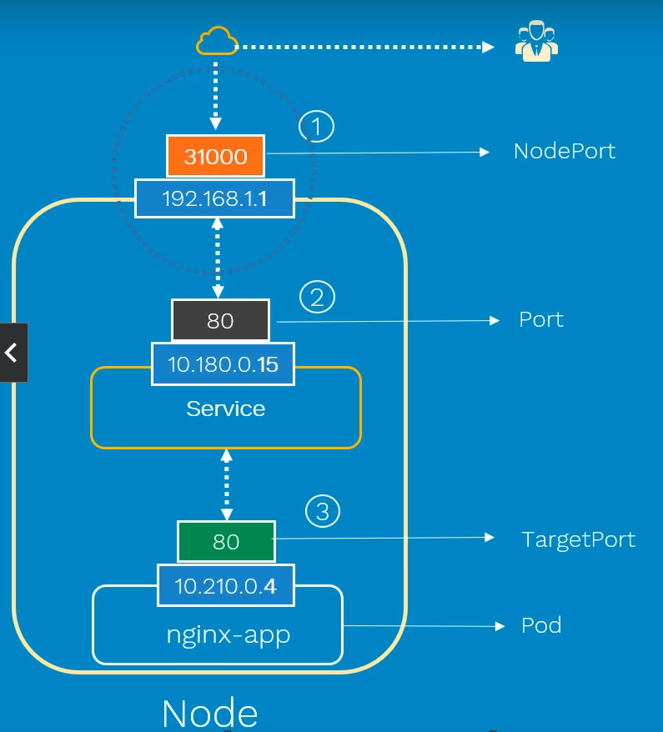
NodePort: Various Ports
Generally, port and
TargetPort values are
kept the same

Slide 56
Kubernetes yaml File for Running Tomcat
C:\lectures\CDAC\DAC \kubernetes-tomcat.yaml
To run: kubectl apply -f kubernetes-tomcat.yaml
kubectl logs <pod id>
Open a terminal inside a pod: kubectl exec tomcat-deployment-865c47d857-8hf6n -it /bin/bash
cd /usr/local/tomcat/webapps/examples
touch hello.jsp
echo "<h1>Hello from CDAC</h1>" > hello.jsp
exit
minikube service tomcat-service
You may have to refresh 1-2 times to get the pod we had modified (remember, replicaset has 3 pods, but we modified only one). In the browser, also try appending file name to the URL, e.g. http://127.0.0.1:63592/examples/hello.jsp)

Slide 57
Kubernetes yaml File for Running Tomcat with Volume
C:\lectures\CDAC\DAC \kubernetes-tomcat-volume.yaml
To run: kubectl apply -f kubernetes-tomcat-volume.yaml
To see log: kubectl logs -f –p <pod name>
Now if you make changes to the pod, they will be retained

Slide 58
Kubernetes yaml File for Tomcat-MySQL
C:\lectures\CDAC\DAC\kubernetes-tomcat-mysql.yaml
Go to that directory
To run: kubectl create -f kubernetes-tomcat-mysql.yaml
Note: Here, no networking is needed unlike Docker, since Tomcat and MySQL will run in the same Kubernetes cluster, so they can access each other
MySQL is ClusterIP, so that it can be accessed only inside the cluster by the Tomcat server, which is a LoadBalancer, so can be accessed from outside

Slide 59
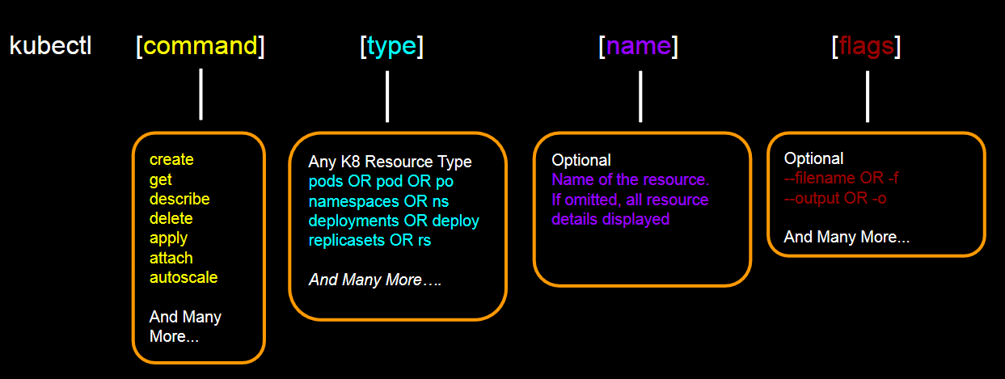
kubectl command

