Slide 1
Who am I?
Ganesh Bankar – Technology lead , Synechron
9 year experience in designing and developing IT solution
PG-DAC, from CDAC- ACTS, Feb -2014
B. Tech SGGSIE&T, Nanded
Certified Microsoft Azure Developer
Certified Java Developer

Slide 2
Micro service Introduction
What is Monolithic App
What are disadvantages
What is Micro service ?
Advantages of Micro Services ?
Disadvantages
Micro Service Design Patterns
Micro services Best Coding

Slide 3

Monolithic App

Slide 4









Monolithic Architecture
Load Balancer
Monolithic App
Account Component
Catalog
Component
Database
Recommendation
Component
Customer Service
Component

Slide 5
Characteristics
Large Codebase
Many Components, no clear ownership
Long deployment cycles

Slide 6
Advantages & Disadvantages
Single codebase
Easy to develop/debug/deploy
Good IDE support
A Central Ops team can efficiently handle
All components have to be coded in the same language
Deployment is Time Consuming
Failure in one module will impact overall apllication

Slide 7

Evolution of a Monolithic App
Shopping Cart
User Accounts
Product Catalog
Customer Service

Slide 8
Why Microservices
Faster and simpler deployments and rollbacks
Flexible Technology Stack
Good Resiliency (If circuit breakers implemented well)
Better Availability (on autoscaling)

Slide 9

MicroServices – separate single purpose services

Slide 10

Netflix Scale
~ 1/3 of the peak Internet traffic a day
~ more than 50M subscribers
~2 Billion Edge API Requests/Day
>500 MicroServices
~300 Engineering Teams (owning many microservices)

Slide 11

Monolithic App Disadvantage
As codebase increases …
Tends to increase “tight coupling” between components
All components have to be coded in the same language
Deployment is Time Consuming
Failure in one module impacts overall application

Slide 12
advantages of Micro services

Slide 13
Microservices Architecture
Load Balancer
API Gateway
Catalog DB
Account Service
Catalog
Service
Customer DB
Recommendation
Service
Customer Service
Service

Slide 14
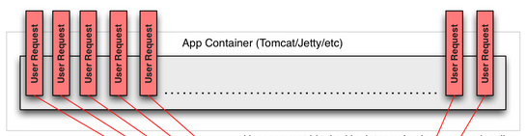

Availability
A single missing “;” brought down the Netflix website for many hours (~2008)

Slide 15


Service Discovery
100s of MicroServices
Need a Service Metadata Registry (Discovery Service)
Registry
Service
(e.g. Netflix Eureka)
Account Service
Catalog
Service
Recommendation
Service
Customer Service
Service
X
Service
Y
Service
Z
Service

Slide 16
Load Balancing
Client Side Load balancers
2. Server Side load blancers
Load balancing logic should be on client side only.

Slide 17
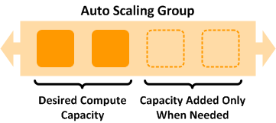
Auto Scaling
Use AWS Auto Scaling Groups to automatically scale your microservices
RPS or CPU/LoadAverage via CloudWatch are typical metrics used to scale
http://docs.aws.amazon.com/AutoScaling/latest/DeveloperGuide/WhatIsAutoScaling.html

Slide 18
MicroServices - Challenges

Slide 19

Challenges
Can lead to chaos if not designed right …

Slide 20
Best Practices
Isolate your services (Loosely Coupled)
Use Client Side Smart LoadBalancers
Dependency Calls
Guard your dependency calls
Cache your dependency call results
Consider Batching your dependency calls
Increase throughput via Async/ReactiveX patterns
Test Services for Resiliency
Latency/Error tests Dependency Service Unavailability
Network Errors

Slide 21
Micro service Design Patterns:

Slide 22
Service Discovery Pattern : To register services
Circuit Breaker Pattern : Resilience4J– for Fault Tolerant
Spring cloud Load Balancer : Load balancing
Database per Service : Creating individual databases
SAGA Pattern : for Distributed Transactions
CQRS Pattern: different database ,service for read and write
…

Slide 23
Takeaways
Monolithic apps – good for small organizations
MicroServices – have its challenges, but the benefits are many
Consider adopting when your organization scales
Leverage Best Practices
An Elastic Cloud provides the ideal environment (Auto Scaling etc.)
NetflixOSS has many libraries/samples to aid you

Slide 24
Contact
LinkedIn: ganesh-bankar

