Slide 1


Slide 2

OUR AIM
Quality education
Stationery supplies
Helping with infrastructure
e-Learning videos (multiple languages)
Fundraising

Slide 3
SCHOOLS
PRATITIH is a one-stop solution for all the problems that schools face.
We help them by distributing the supplies they need. Fundraising for infrastructure, basic needs and other necessities.
We will also provide educational videos through volunteers in many local languages so this will ensure that every child gets proper education in the language that they are comfortable with.

Slide 4
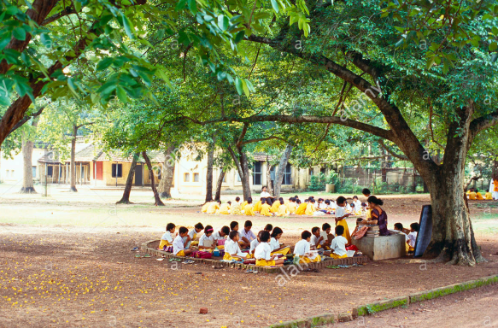
NGOs
All the government-verified NGOs can collaborate and help us with reaching out to the schools, especially which are also not easily accessible.
We, along with the NGOs, will provide the schools with supplies and funds when they need it. The NGOs will be able to contact us and schools directly through the website.

Slide 5
VOLUNTEERS
All the volunteers who are willing to help can join us and post videos of the topics/subjects they can teach in the local language or other languages. The team will verify if the videos are legitimate and then make them public and then the videos will be accessible to the schools.
They can also contribute through donations and by participating in our fundraising events.

Slide 6
THE TEAM
CHATURYA CHINTA
DISHITA DONEPARTHY
ARSHARTH P
DEVI MANOGNA VOLETY

