Slide 1
Digital Portfolio
STUDENT NAME: Arshathdeen R
REGISTER NO AND NMID: 2428C0463,65B36AA035B7F7FA75A4F76AB4B04951
DEPARTMENT: Bsc AI & ML
COLLEGE: KPR College of Arts & Science, Bharathiar University

Slide 2
PROJECT TITLE
School Students Learning Journey Portfolio

Slide 3


AGENDA
Problem Statement
Project Overview
End Users
Tools and Technologies
Portfolio design and Layout
Features and Functionality
Results and Screenshots
Conclusion
Github Link
3/21/2024 Annual Review

Slide 4

PROBLEM STATEMENT
In the current academic environment, students are involved in diverse activities such as coursework, projects, achievements, and extracurricular participation. However, these accomplishments are often stored in scattered formats like resumes, certificates, or paper records, which fail to present a student’s complete learning journey in a professional and engaging manner. This lack of a centralized and well-structured portfolio makes it difficult for students to showcase their skills, growth, and potential effectively, while recruiters, faculty, and institutions struggle to assess students beyond their grades. As a result, many students miss out on valuable opportunities for internships, placements, and recognition.

Slide 5

PROJECT OVERVIEW
The Student Journey Portfolio is a digital platform for students to present their academic achievements, skills, projects, extracurricular activities, and future goals in one place. Unlike a traditional resume, it highlights the entire learning journey through a clean, interactive, and professional design. Key features include sections for About Me, Skills, Courses, Projects, Achievements, Activities, and Contact Info, all displayed in a modern 3D-styled portfolio that helps students stand out in internships, placements, and academic opportunities.

Slide 6

WHO ARE THE END USERS?
Students
Faculty / Mentors
Recruiters / Companies
Institutions / Colleges

Slide 7

TOOLS AND TECHNIQUES
- HTML5
- CSS3 (3D Effects, Gradients)
- JavaScript (Interactivity)
- GitHub Pages (Deployment)
- VS Code (Development)

Slide 8
PORTFOLIO DESIGN AND LAYOUT
- Stylish, modern design with 3D card hover effects
- Sections: About, Projects, Contact
- Responsive layout for desktop and mobile
- Event-themed colors (white & lavender)
- Smooth navigation with sticky navbar
8

Slide 9
FEATURES AND FUNCTIONALITY
Personal Information About Me Skills Featured Courses Projects & Achievements Extracurricular Activities Future Goals Contact Information Interactive 3D UI Responsive Design

Slide 10

RESULTS:
Centralized Portfolio – Combines all student achievements in one place. Professional Showcase – Presents skills and journey in a neat, modern format. Better Opportunities – Increases chances for internships and placements. Digital Identity – Build's a unique personal brand for students.
3/21/2024 Annual Review
10

Slide 11
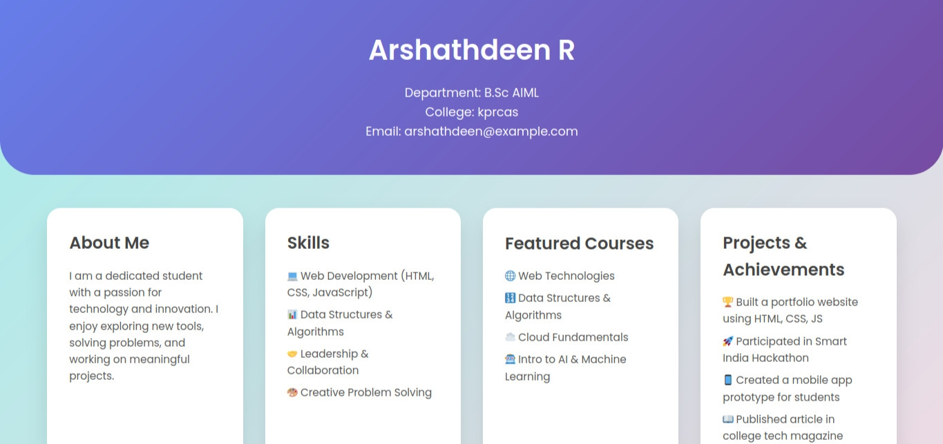
Screen Shot:

Slide 12
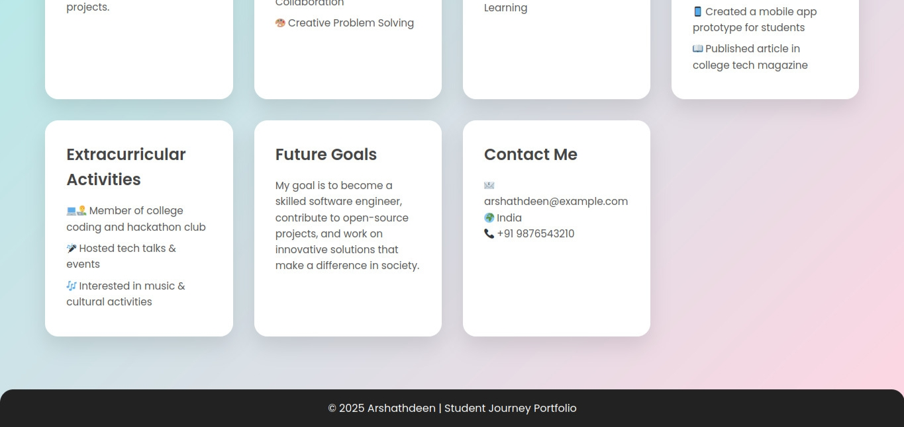

Slide 13
CONCLUSION
The Student Journey Portfolio successfully provides a professional, centralized, and engaging way for students to showcase their academic achievements, skills, and personal growth. It not only highlights their learning journey but also improves visibility for internships, placements, and academic opportunities. Key Takeaways 1. Centralized and professional portfolio for students. 2. Enhances personal branding and career opportunities. 3.Simple, interactive, and modern design
Future Scope 1.Integration with certificates and verifications. 2.Adding AI-based career guidance. 3.Option to connect with LinkedIn / GitHub for auto-updates.
13

Slide 14
Git hub Link: Portfolio Repository: https://github.com/arshath-20/NM

