Slide 1


PRASUNETHON 2.0
NYAYA SAATHI
From Legal Confusion to Clear Action.
AI-assisted legal navigation for citizens — bridging the gap between legal complexity and actionable guidance.
TEAM INFORMATION
S.no | Name | Email id | LinkedIn Link
1. | Aakarsh Bibhaw | cse.arsh@gmail.com | LinkedIn Profile Link
2. | Kakadiya Megh Vipulbhai | kakadiyamegh@gmail.com | LinkedIn Profile Link
3. | Rohit | techop.rohit@gmail.com | LinkedIn Profile Link

Slide 2
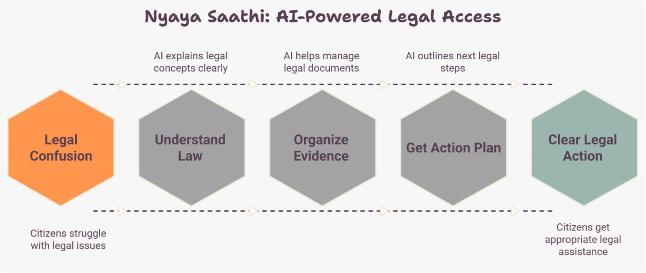
NYAYA SAATHI : AI Legal Assistant
Simplify
Bridge
Verify
Complex legal issues into actionable steps
The gap between citizens and justice
AI-assisted, human-verified guidance

Slide 3
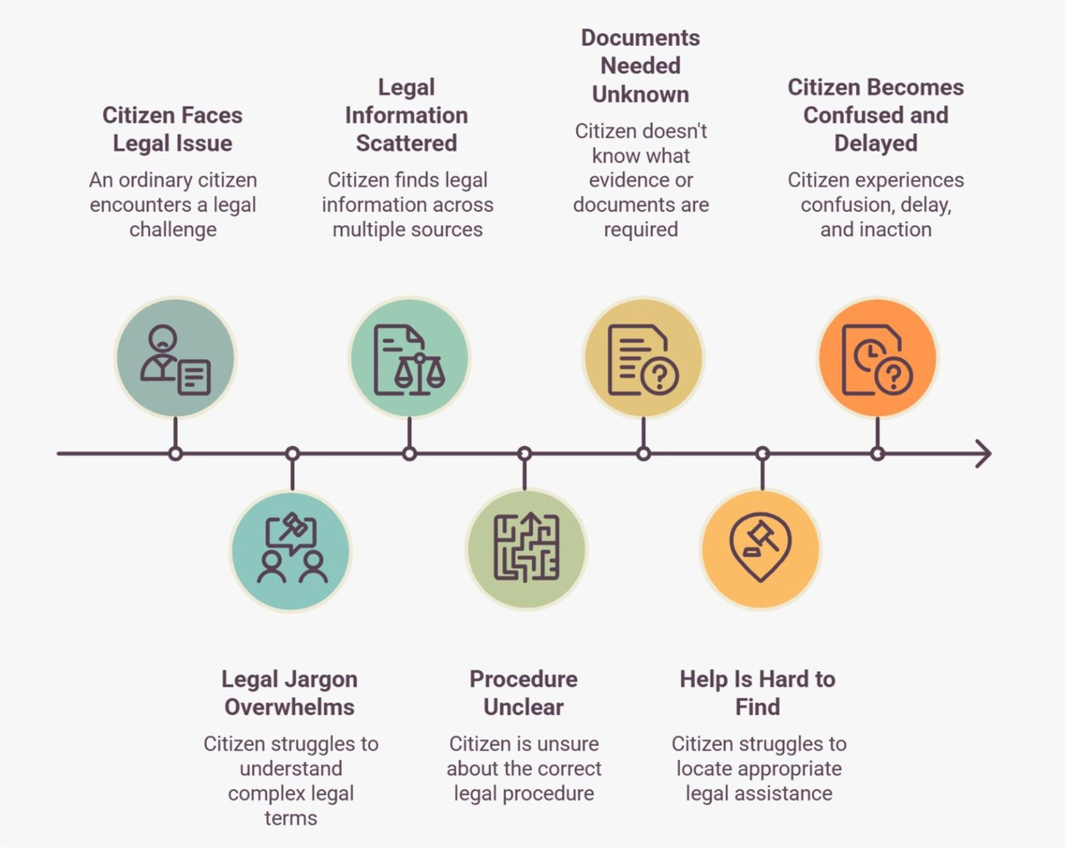
The Legal Help Access Gap
THE PROBLEM

Slide 4

SOLUTION
How Nyaya Saathi Guides You
01
02
Describe Your Problem
AI Understands and Classifies
Submit your legal issue in plain language
NLP identifies the legal category and relevant laws
03
04
Retrieve Verified Legal Info
Analyze Your Evidence
RAG system pulls applicable statutes and precedents
AI extracts and organizes documents you provide
05
06
Generate Action Plan
Human Legal Assistance
Step-by-step guidance with document drafts and next steps
Connect with lawyers when you need expert judgment

Slide 5
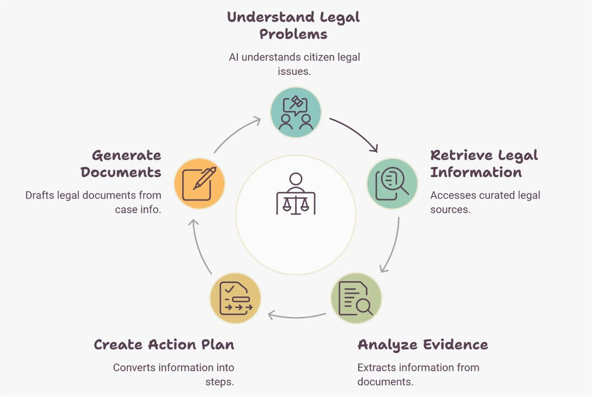
CORE FRAMEWORK
Five Layers of Assistance
Understand
Retrieve
AI analyzes citizen legal issues
Curated legal database, laws, and statutes
Analyze
Plan
Extract and organize user-provided documents
Step-by-step procedural guidance
Draft
AI-generated legal templates and case materials

Slide 6
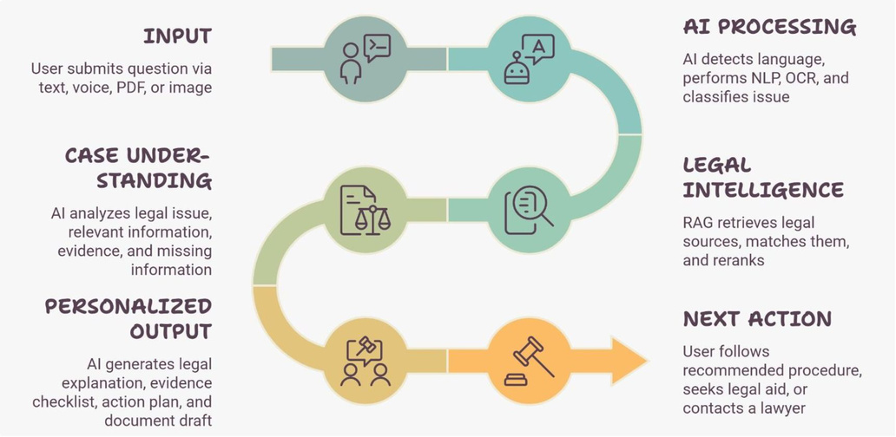
WORKFLOW
From Question to Action
01
02
03
04
INPUT
AI PROCESSING
LEGAL INTELLIGENCE
PERSONALIZED OUTPUT
Text, voice, PDF, or image submission
NLP, OCR, legal issue classification
RAG retrieves laws, matches precedents, ranks results
Explanation, evidence checklist, action plan, document drafts

Slide 7
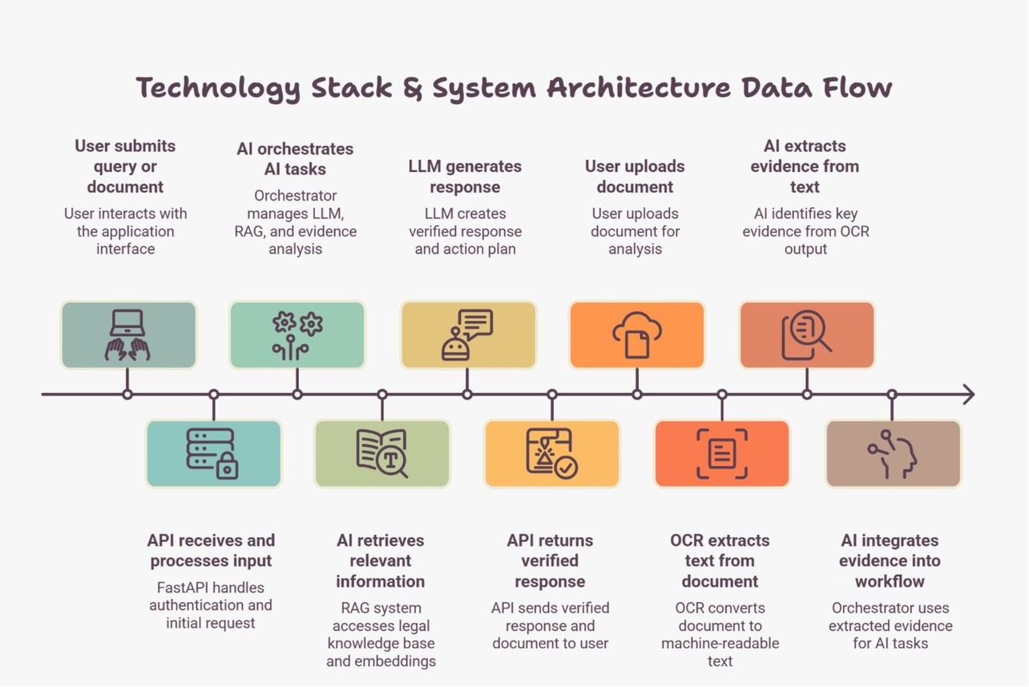
ARCHITECTURE
Technology Stack
Built for accuracy, transparency, and seamless human escalation.

Slide 8

DIFFERENTIATION
Why Nyaya Saathi Wins
Action-Oriented
Document Drafting
Structured Case Info
Reduced Cognitive Load
Human Backup
Personalized next steps and procedures, not just information
AI generates templates and case materials automatically
Organized evidence and clear procedural roadmap from day one
Lawyers available when judgment calls matter most
Citizens don't have to interpret law or figure out what to do
Versus traditional legal search: manual interpretation, high cognitive burden, scattered information, no procedural guidance.

Slide 9
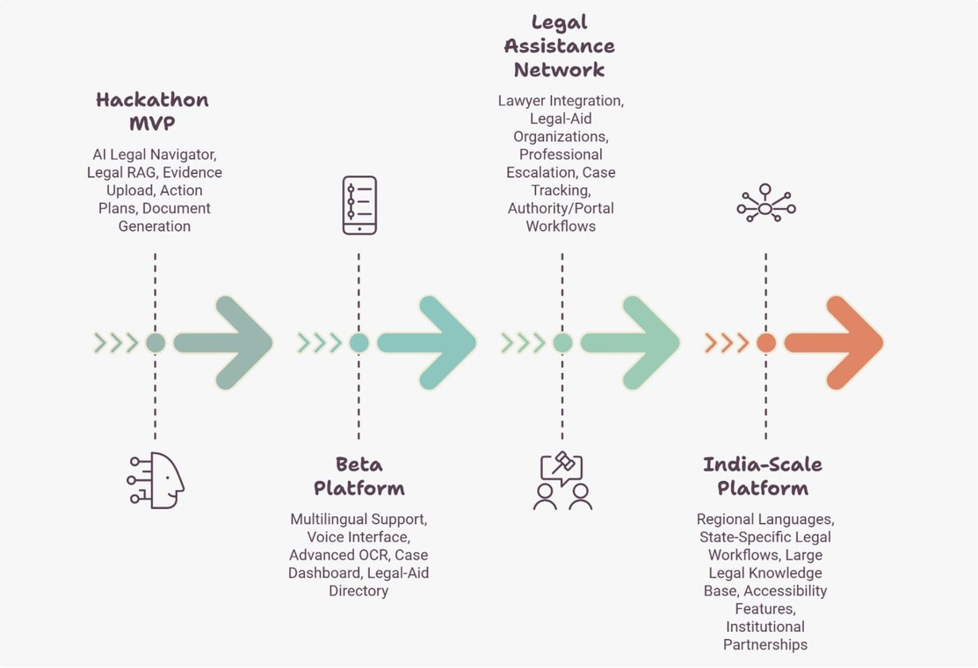
VISION
Roadmap: Legal Navigator to Ecosystem
From core navigator to a connected legal access ecosystem serving millions.

