Slide 1
Project Title : Tic Tac Toe
Name and Roll No: Arshdeep kaur
2210990169

Slide 2
Index
Objective
Introduction
Methodology, Approach & Techniques
Algorithm
Result
Source Code (screenshots)
Conclusion
Reference

Slide 3
Objective
The objective of this project is to create a graphical user interface (GUI) for playing Tic-Tac-Toe. The game allows two players to take turns placing their respective symbols (X and O) on a 3x3 grid.

Slide 4
Introduction
Introduction: The Tic-Tac-Toe project aims to provide an interactive and visually appealing platform for playing the game. By leveraging Python's Tkinter library, the project offers a simple yet engaging user interface where players can enjoy the timeless gameplay of Tic-Tac-Toe against each other.

Slide 5
Methodology, Approach & Techniques
Design Phase: Initially, the design of the GUI and game logic was planned, outlining the layout of the game board, symbol placement, and user interactions.
Implementation: The design was then translated into code using Python and the Tkinter library. Game logic for symbol placement, win-checking, and tie detection was implemented systematically.
Testing: After the initial implementation, rigorous testing was conducted to identify and resolve any bugs or logical errors. Both individual components and the overall functionality of the game were tested.
Refinement: Based on testing feedback, the code was refined and optimized for better performance and user experience. This involved streamlining code, improving error handling, and enhancing visual elements.
Documentation and Deployment: Finally, the project was documented to provide clear instructions for usage and maintenance. Once thoroughly tested and documented, the project was deployed for users to enjoy.

Slide 6
Algorithm
Initialization
Drawing Functions
Logical Functions
Gameplay
Resetting the Game
Main Loop
Event Handling
Displaying Game Results

Slide 7
Result
The result of this project is a fully functional Tic-Tac-Toe game with a graphical user interface implemented using Python's Tkinter library. Players can enjoy the classic game, taking turns placing their symbols on a 3x3 grid, with the game providing feedback on wins, ties, and scores.

Slide 8
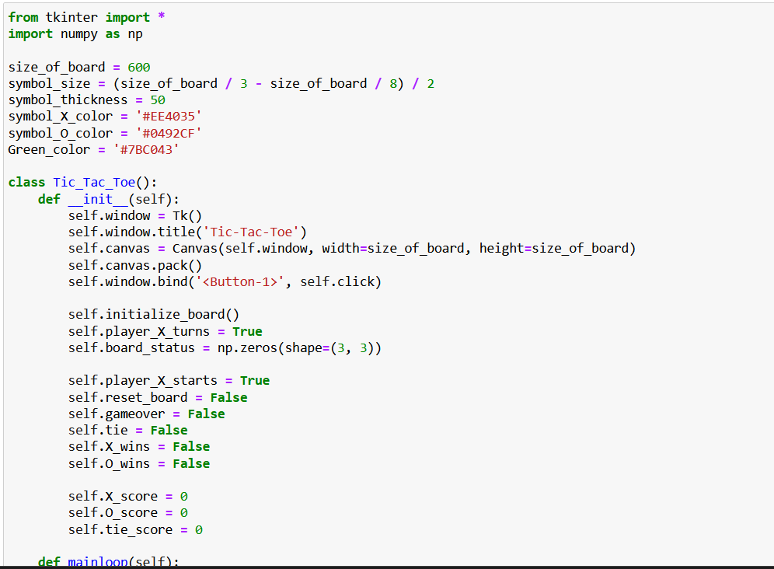
Source Code (screenshots)

Slide 9
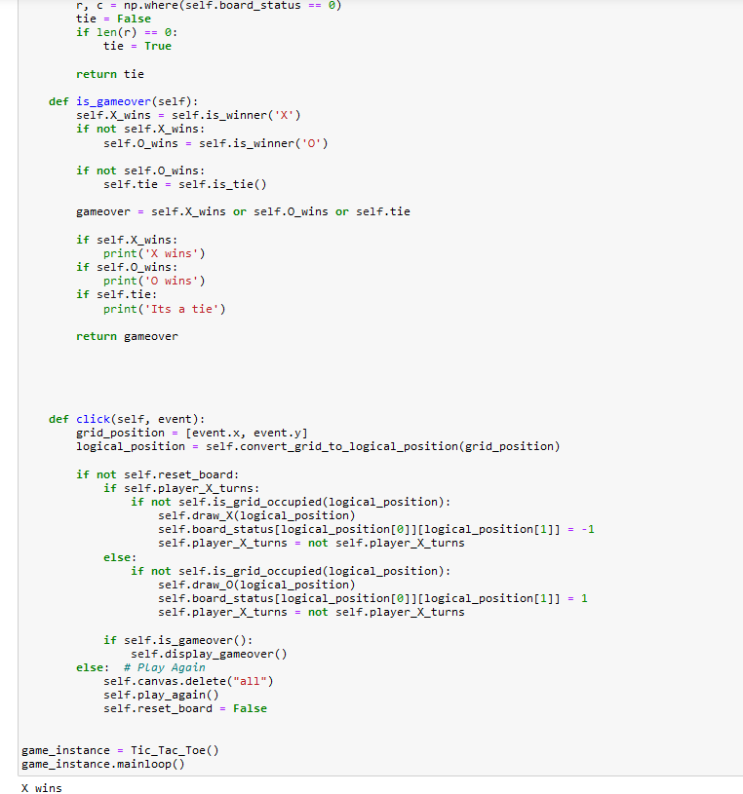

Slide 10
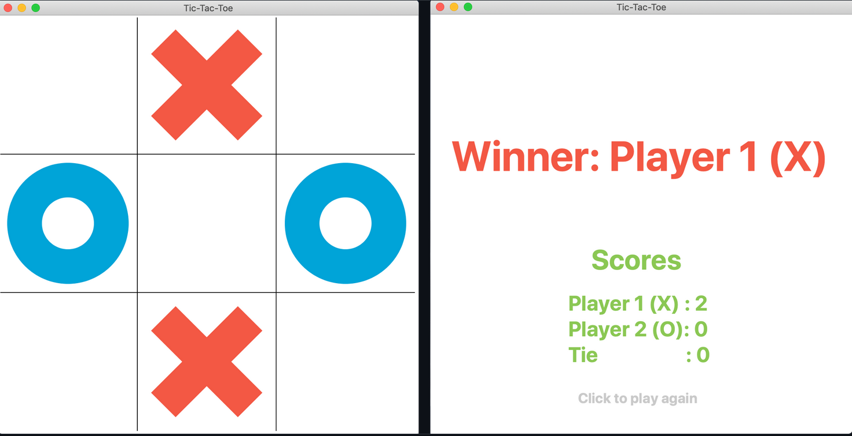

Slide 11
Reference
GeeksForGeeks
Javapoint

Slide 12
The End

