Slide 1


Noida Institute of Engineering and Technology, Greater Noida
Introduction To Cloud Computing
Unit:1
Cloud Computing
Vaibhav Bhatnagar
Assistant Professor
Computer Science and Engineering
Course Details B Tech 7th Sem

Slide 2
Brief Introduction about Cloud computing
Cloud computing provides different facilities and amenities like databases, servers, storage, applications, etc., through the Internet. For example, instead of storing data in local storage on a hard drive, cloud computing helps us in storing and saving data on a remote database. Given that the device we are using has access to the internet, it will have access to the data as well.
Basically, cloud computing is somewhat outsourcing computer programs. These computer programs are hosted by an external party and are located in the cloud. Because of this, the users have no worries about storage and power and can be at ease where their data is concerned. Nowadays, many people are opting for cloud computing for a variety of reasons, including increased productivity, better monetary value, time and speed efficiency, security, and performance.

Slide 3
Contd…
Introduction to Cloud | Cloud Computing Tutorial for Beginners – YouTube
Introduction to Cloud Computing ll Cloud Computing Course ... - YouTube
Cloud Computing - Introduction – YouTube
Introduction to Cloud Computing - YouTube

Slide 4
Unit Content
Introduction to cloud computing
Vendors cloud computing
Why cloud computing
Advantages and disadvantages of cloud computing
Services of cloud computing.
Evolution of cloud computing
Desktop computing
client server computing
cluster computing
grid computing
cloud computing
Underlying Principles of Parallel Computing
Distributed Computing
Characteristics of cloud computing

Slide 5
Unit Objective
Unit | Unit Objective
Unit 1 | To study basic concept of cloud and computing techniques like cluster computing ,grid computing and parallel and distributed computing and features of cloud computing
Unit 2 | To provide a thorough understanding of virtualization: virtualization concept and types of virtualization service oriented architecture and web services.
Unit 3 | To examine about NIST reference architecture and various deployment models and services of cloud computing

Slide 6
Unit Objective
Unit | Unit Objective
Unit 4 | To provide the concept of resource provisioning and methods with cloud security and virtual machine security concept
Unit 5 | To gain familiarity with Advanced concept of cloud computing like hadoop and Google app engine and IAM standards

Slide 7
Topic objective
Topic | Objective
Cloud computing | To Understand the cloud computing and why is it required
Evolution of cloud computing | Study about evolution of various computing techniques
Parallel and distributed computing | Knowledge about parallel and distributed computing
Characteristics | Analysis of importance of cloud computing

Slide 8
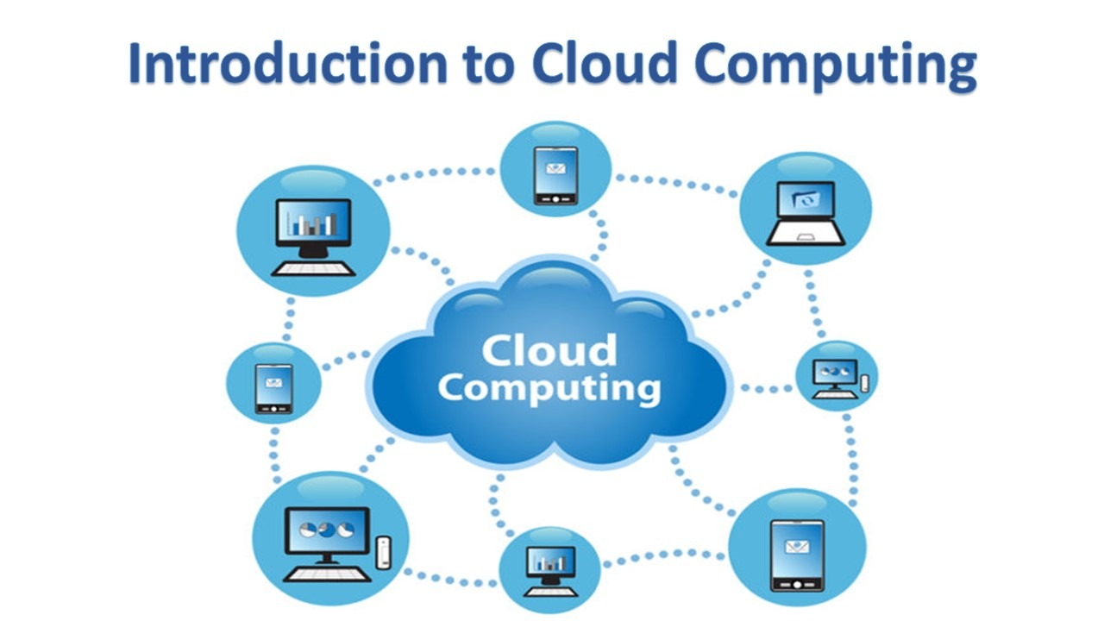
Introduction to Cloud computing(CO1)
Cloud computing is the on demand delivery of compute power, database storage, application and other IT resources through a cloud service platform via internet with pay as you go.
Cloud Computing provides us a means by which we can access the applications as utilities, over the Internet.
It allows us to create, configure, and customize applications online.

Slide 9
Introduction to cloud computing(CO1)
Cloud computing is the on demand delivery of computing services over the internet with pay as you go option.
‘Cloud’ in Cloud Computing refers to availability of computing resources to everyone, everywhere and anytime.

Slide 10
Introduction to Cloud computing(CO1)
Computing refers to services as like: Computing engine, storage, Load balancer, Virtual Machines etc.
Cloud computing relies on sharing of resources to achieve coherence (the quality of being logical and consistent).
Cloud computing is the on-demand availability of computer system resources, especially data storage and computing power, without direct active management by the user.
Cloud Computing provides us a means by which we can aCC(AMTCSE0111)ess the applications as utilities, over the Internet.
It allows us to create, configure, and customize applications and services online.
Example- cloud service platform
Amazon web service
Microsoft Azure
Alibaba
Google
oracle

Slide 11
Cloud computing (CO1)
Whenever you travel through a bus or train, you take a ticket for your destination and hold back to your seat till you reach your destination.
Likewise other passengers also takes ticket and travel in the same bus with you and it hardly bothers you where they go.
When your stop comes you get off the bus thanking the driver.
Cloud computing is just like that bus, carrying data and information for different users and allows to use its service with minimal cost.

Slide 12
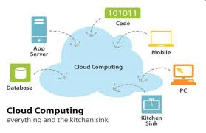
Cloud(CO1..)
The term Cloud refers to a Network or Internet.
- In other words, we can say that Cloud is something, which is present at remote location.
- Cloud can provide services over network, i.e., on public networks or on private networks, i.e., WAN, LAN or VPN.
- Applications such as e-mail, web conferencing, customer relationship management (CRM),all run in cloud.

Slide 13
Cloud Service providers
Amazon web service
Microsoft Azure
Google
Adobe
IBM Cloud Services
Oracle
Vmware
Rackspace
Red Hat
Salesforce
SAP
Verizon Cloud
Dropbox

Slide 14
Common Cloud Services company
Gmail, provided by companies like Google
cloud storage, provided by companies like Dropbox
streaming music, provided by companies like Spotify.
These services, applications and files are stored in the cloud and can be accessed by users via any device.

Slide 15
Cloud providers and services
Name of Company | IaaS | Paas | SaaS
AWS | Amazon EC2 | Amazon Web Services | Amazon Web Services
Microsoft | Microsoft Private Cloud | Microsoft Azure | Microsoft Office 365
Google | – | Google App Engine (Python, Java and many) | Google Applications
IBM | Smart Cloud Enterprise | Smart Cloud Application Services | SaaS Products
Adobe | – | Adobe Creative Cloud | Acrobat, Flashplayer, etc.

Slide 16
Why cloud computing(CO1)
Small as well as large IT companies, follow the traditional methods to provide the IT infrastructure.
That means for any IT company, we need a Server Room that is the basic need of IT companies.
In that server room, there should be a database server, mail server, networking, firewalls, routers, modem, switches, QPS (Query Per Second means how much queries or load will be handled by the server), configurable system, high net speed, and the maintenance engineers.

Slide 17
Why cloud computing(CO1)
To establish such IT infrastructure, we need to spend lots of money.
To overcome all these problems and to reduce the IT infrastructure cost
Cloud Computing comes into existence.

Slide 18
Cloud Computing Advantages(CO1)
Lower IT infrastructure and computer costs for users
Improved performance
Fewer Maintenance issues
Instant software updates

Slide 19
Cloud Computing advantages(CO1)
Improved compatibility between Operating systems
Backup and recovery
Performance and Scalability
Increased storage capacity
Increase data safety

Slide 20
Cloud Computing Disadvantages(CO1)
Network Dependency
Limited features
No longer in control
No redundancy/bandwidth issue
Technical Issues

Slide 21
Operations using Cloud Computing(CO1)
There are the following operations that we can do using cloud computing:
Developing new applications and services
Storage, back up, and recovery of data, Hosting blogs and websites
Delivery of software on demand
Analysis of data, Streaming videos and audios

Slide 22
Cloud Computing Services(CO1)
The various cloud based services commonly offered are:
Web Based Cloud Computing: Companies use the functionality provided by web services and do not have to develop a full application for their needs.
Infrastructure as a Service (IaaS): Organizations make use of the unlimited storage potential of the cloud infrastructure. They can expand and shrink their storage space as needed without having to worry about dedicated servers on site.
Software as a Service (SaaS): It allows people to access the functionality of a particular software without worrying about storage or other issues.
Platform as a Service (PaaS): Companies can run their applications on the cloud service’s platform without having to worry about maintaining hard drives and servers.
Utility Services: Companies that need to store a lot of data can store all of their data remotely and can even create a virtual data center.
Managed Services: These are applications used by the cloud service providers, such as anti-spam service.
Service Commerce: It is the creation of a hub of applications that can be used by an organization's members. It provides organisations the applications they need along with the services they desire.

Slide 23
Cloud Computing Services(IaaS)
It offers the fundamental infrastructure of virtual servers, network, and data storage drives.
It allows for the flexibility, reliability and scalability that many businesses seek with the cloud
removes the need for hardware in the office

Slide 24
Cloud Computing Services(PaaS)
Cloud computing providers deploy the infrastructure and software framework.
Businesses can develop and run their own applications.
Web applications can be created quickly and easily via PaaS
PaaS solutions are scalable and ideal for business environments where multiple developers are working on a single project..

Slide 25
Cloud Computing Services(SaaS)
This cloud computing solution involves the deployment of software over the internet to various businesses.
pay via subscription or a pay-per-use model.

Slide 26
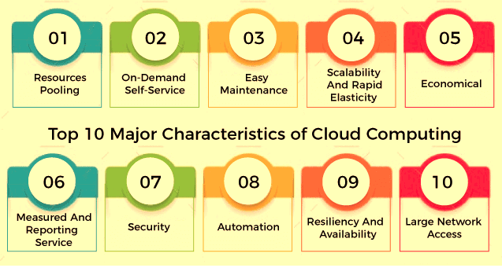
Features/Characteristics of cloud computing

Slide 27
Features/Characteristics of cloud computing
1. Resources Pooling
Resource pooling is one of the essential features of cloud computing. Resource pooling means that a cloud service provider can share resources among multiple clients, each providing a different set of services according to their needs
2. On-Demand Self-Service
It is one of the important and essential features of cloud computing. This enables the client to continuously monitor server uptime, capabilities and allocated network storage.
3. Easy Maintenance
This is one of the best cloud features. Servers are easily maintained, and downtime is minimal or sometimes zero. Cloud computing powered resources often undergo several updates to optimize their capabilities and potential. Updates are more viable with devices and perform faster than previous versions.
4. Scalability And Rapid Elasticity
A key feature and advantage of cloud computing is its rapid scalability. This cloud feature enables cost-effective handling of workloads that require a large number of servers but only for a short period. Many customers have workloads that can be run very cost-effectively due to the rapid scalability of cloud computing.
5. Economical
This cloud feature helps in reducing the IT expenditure of the organizations. In cloud computing, clients need to pay the administration for the space used by them. There is no cover-up or additional charges that need to be paid. Administration is economical, and more often than not, some space is allocated for free.

Slide 28
Features/Characteristics of cloud computing
6. Measured And Reporting Service
Reporting Services is one of the many cloud features that make it the best choice for organizations. The measurement and reporting service is helpful for both cloud providers and their customers.
7. Security
Data security is one of the best features of cloud computing. Cloud services make a copy of the stored data to prevent any kind of data loss. If one server loses data by any chance, the copied version is restored from the other server.
8. Automation
Automation is an essential feature of cloud computing. The ability of cloud computing to automatically install, configure and maintain a cloud service is known as automation in cloud computing. In simple words, it is the process of making the most of the technology and minimizing the manual effort. However, achieving automation in a cloud ecosystem is not that easy.
9. Resilience
Resilience in cloud computing means the ability of a service to quickly recover from any disruption. The resilience of a cloud is measured by how fast its servers, databases and network systems restart and recover from any loss or damage. Availability is another key feature of cloud computing. Since cloud services can be accessed remotely, there are no geographic restrictions or limits on the use of cloud resources.
10. Large Network Access
A big part of the cloud's characteristics is its ubiquity. The client can access cloud data or transfer data to the cloud from any location with a device and internet connection. These capabilities are available everywhere in the organization and are achieved with the help of internet.

Slide 29
Types of cloud computing
PUBLIC CLOUD : The Public Cloud allows systems and services to be easily accessible to the general public. Public cloud may be less secure because of its openness, e.g., e-mail.
PRIVATE CLOUD : The Private Cloud allows systems and services to be accessible within an organization. It offers increased security because of its private nature.

Slide 30
Types of cloud computing
COMMUNITY CLOUD : The Community Cloud allows systems and services to be accessible by group of organizations.
HYBRID CLOUD : The Hybrid Cloud is mixture of public and private cloud.
However, the critical activities are performed using private cloud while the non-critical activities are performed using public cloud.

Slide 31
Evolution of cloud computing (CO1..)
Before emerging the cloud computing, there was various computing technique.
Desktop computing
a personal computer small enough to fit conveniently in an
individual workspace
personal computer a small digital computer based on a microprocessor and designed to be used by one person at a time

Slide 32
client/server computing (co1)
In client/server computing, a server takes requests from client computers and shares its resources, applications and/or data with one or more client computers on the network,
a client is a computing device that initiates contact with a server in order to make use of a shareable resource. OR
which is basically a centralized storage in which all the software applications, all the data and all the controls are resided on the server side. Example banking

Slide 33
Cluster computing
Sharing the computation tasks among multiple computers and those computers or machines form the cluster.
It works on the distributed system with the networks.

Slide 34
Cluster computing
Several types of cluster computing are used based upon the business implementations, performance optimization and the architectural preference such as load balancing clusters, high availability (HA) clusters, high performance (HP) clusters.
Some of the advantages are processing speed, cost efficiency, scalability, high availability of resources.

Slide 35
Grid computing
Grid computing is the use of widely distributed computer resources to reach a common goal.
Grid computing is distinguished from conventional high-performance computing systems such as cluster computing
Grid computers have each node set to perform a different task/application. Grid computers also tend to be more heterogeneous and geographically dispersed

Slide 36
Grid computing
Heterogeneous server
Different operating system
Different applications server
Database server
File server
Mail server
Web server

Slide 37
Cloud computing
It’s a combination
of cluster and grid computing.
grid of clusters
Companies
Toyota
wall mart and Tata group
City bank
Software companies-
SAP, oracle , Microsoft dynamics
Maintenance company
IBM, Dell, HP, SUN

Slide 38
computing models
1. IaaS (Infrastructure as a Service)
2. PaaS (Platform as a Service)
3. SaaS (Software as a Service)
4. Cloud Computing Deployment Models
There are three cloud computing models used for deployment:
Public cloud
Private cloud
Hybrid cloud

Slide 39
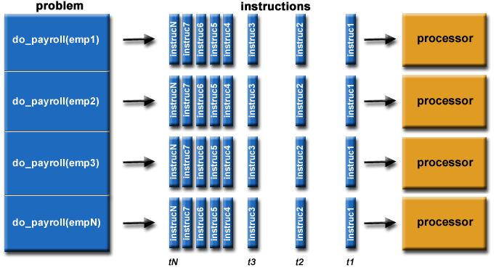
Parallel computing(CO1)
Parallel computing is a type of computation in which many calculations or the execution of processes are carried out simultaneously.
Large problems can often be divided into smaller ones, which can then be solved at the same time.
It saves time and money as many resources working together will reduce the time.

Slide 40
Cluster and grid computing(CO1)
Cluster computing
Grid computing
a group of computers are linked together so that they can act like a single entity .
It is the technique of linking two or more computers into a network (LAN) or homogenous network
take advantage of the parallel processing power of those computers.
In Cluster computing network, whole system works as a unit.
Computers of Grid Computing can be present at different locations and are usually connected by internet or a low
Grid computer can have homogeneous or heterogeneous network.
In Grid Computing, each node is independently managing each own resources.

Slide 41
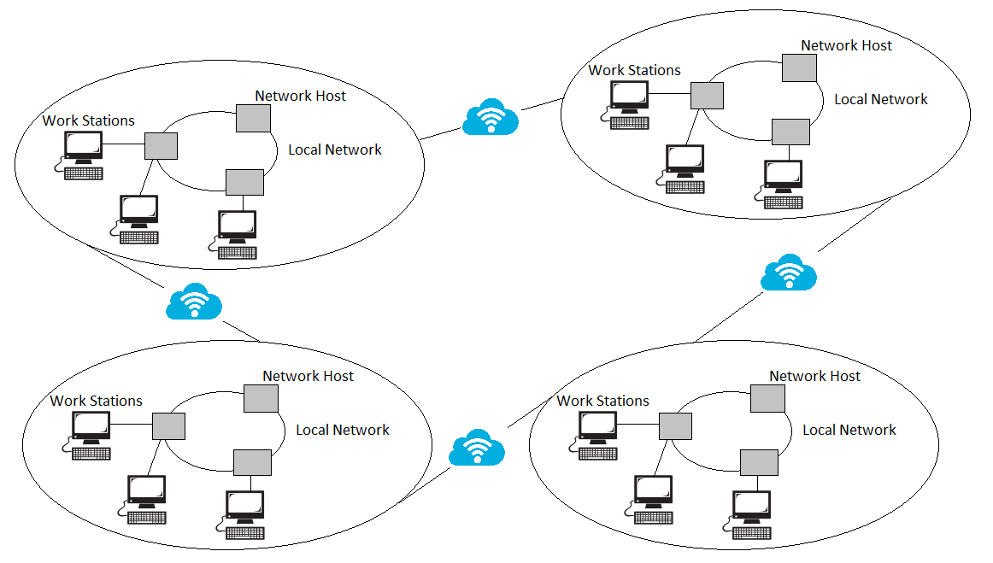
Distributed computing(CO1)
A distributed computer system consists of multiple software components that are on multiple computers, but run as a single system.
The computers that are in a distributed system can be physically close together and connected by a local network, or they can be geographically distant and connected by a wide area network
Such systems are independent of the underlying software

Slide 42
Evolution phases
The evolution of cloud computing can be bifurcated into three basic phases:
1. The Idea Phase- This phase incepted in the early 1960s with the emergence of utility and grid computing and lasted till pre-internet bubble era. Joseph Carl Robnett Licklider was the founder of cloud computing.
2. The Pre-cloud Phase- The pre-cloud phase originated in 1999 and extended to 2006. In this phase the internet as the mechanism to provide Application as Service.
3. The Cloud Phase- The much talked about real cloud phase started in the year 2007 when the classification of IaaS, PaaS, and SaaS got formalized. The history of cloud computing has witnessed some very interesting breakthroughs launched by some of the leading computer/web organizations of the world.

Slide 43
Continue
On the basis of above computing, there was emerged of cloud computing concepts that later implemented.
At around in 1961, John MacCharty suggested in a speech at MIT that computing can be sold like a utility, just like a water or electricity
In 1999, Salesforce.com started delivering of applications to users using a simple website.
The applications were delivered to enterprises over the Internet, and this way the dream of computing sold as utility were true.
.

Slide 44
continue
In 2002, Amazon started Amazon Web Services, providing services like storage, computation and even human intelligence.
starting with the launch of the Elastic Compute Cloud in 2006 a truly commercial service open to everybody existed.
In 2009, Google Apps also started to provide cloud computing enterprise applications.
Of course, all the big players are present in the cloud computing evolution, some were earlier, some were later. In 2009, Microsoft launched Windows Azure

Slide 45
Characteristics of cloud computing(CO1)
On-demand self-service.
Broad network access
Resource pooling.
Rapid elasticity.
Measured service.

Slide 46
Cloud Eco-system
In a cloud computing ecosystem, there are a number of computers, servers, and data storage equipment that together make the cloud of computing services.
A cloud ecosystem is a complex system of interdependent components that all work together to enable cloud services. In nature, an ecosystem is composed of living and nonliving things that are connected and work together.
In cloud computing, the ecosystem consists of hardware and software as well as cloud customers, cloud engineers, consultants, integrators and partners

Slide 47
Cloud computing applications
Cloud service providers provide various applications in the field of art, business, data storage and backup services, education, entertainment, management, social networking, etc.
Art Applications
Cloud computing offers various art applications for quickly and easily design attractive cards, booklets, and images. Some most commonly used cloud art applications are given below

Slide 48
Cloud computing applications
Business Applications
Business applications are based on cloud service providers. Today, every organization requires the cloud business application to grow their business. It also ensures that business applications are 24*7 available to users.
There are the following business applications of cloud computing -
MailChimp
MailChimp is an email publishing platform which provides various options to design, send, and save templates for emails.
Salesforce
Salesforce platform provides tools for sales, service, marketing, e-commerce, and more. It also provides a cloud development platform.

Slide 49
Cloud computing applications
Chatter
Chatter helps us to share important information about the organization in real time.
Bitrix24
Bitrix24 is a collaboration platform which provides communication, management, and social collaboration tools.
Paypal
Paypal offers the simplest and easiest online payment mode using a secure internet account. Paypal accepts the payment through debit cards, credit cards, and also from Paypal account holders.
Slack
Slack stands for Searchable Log of all Conversation and Knowledge. It provides a user-friendly interface that helps us to create public and private channels for communication.
Quickbooks
Quickbooks works on the terminology "Run Enterprise anytime, anywhere, on any device." It provides online accounting solutions for the business. It allows more than 20 users to work simultaneously on the same system

Slide 50
Cloud computing applications
Data Storage and Backup Applications
Cloud computing allows us to store information (data, files, images, audios, and videos) on the cloud and access this information using an internet connection. As the cloud provider is responsible for providing security, so they offer various backup recovery application for retrieving the lost data.
A list of data storage and backup applications in the cloud are given below -
Box.com
Box provides an online environment for secure content management, workflow, and collaboration. It allows us to store different files such as Excel, Word, PDF, and images on the cloud. The main advantage of using box is that it provides drag & drop service for files and easily integrates with Office 365, G Suite, Salesforce, and more than 1400 tools.
Mozy
Mozy provides powerful online backup solutions for our personal and business data. It schedules automatically back up for each day at a specific time.
Joukuu
Joukuu provides the simplest way to share and track cloud-based backup files. Many users use joukuu to search files, folders, and collaborate on documents.

Slide 51
Cloud computing applications
Google G Suite
Google G Suite is one of the best cloud storage and backup application. It includes Google Calendar, Docs, Forms, Google+, Hangouts, as well as cloud storage and tools for managing cloud apps. The most popular app in the Google G Suite is Gmail. Gmail offers free email services to users.
Education Applications
Cloud computing in the education sector becomes very popular. It offers various online distance learning platforms and student information portals to the students. The advantage of using cloud in the field of education is that it offers strong virtual classroom environments, Ease of accessibility, secure data storage, scalability, greater reach for the students, and minimal hardware requirements for the applications.

Slide 52
Cloud computing applications
There are the following education applications offered by the cloud -
i. Google Apps for Education
Google Apps for Education is the most widely used platform for free web-based email, calendar, documents, and collaborative study.
ii. Chromebooks for Education
Chromebook for Education is one of the most important Google's projects. It is designed for the purpose that it enhances education innovation.
iii. Tablets with Google Play for Education
It allows educators to quickly implement the latest technology solutions into the classroom and make it available to their students.
iv. AWS in Education
AWS cloud provides an education-friendly environment to universities, community colleges, and schools.

Slide 53
Cloud computing applications
Entertainment Applications
Entertainment industries use a multi-cloud strategy to interact with the target audience. Cloud computing offers various entertainment applications such as online games and video conferencing.
i. Online games
Today, cloud gaming becomes one of the most important entertainment media. It offers various online games that run remotely from the cloud. The best cloud gaming services are Shaow, GeForce Now, Vortex, Project xCloud, and PlayStation Now.
ii. Video Conferencing Apps
Video conferencing apps provides a simple and instant connected experience. It allows us to communicate with our business partners, friends, and relatives using a cloud-based video conferencing. The benefits of using video conferencing are that it reduces cost, increases efficiency, and removes interoperability.

Slide 54
Cloud computing applications
Social Applications
Social cloud applications allow a large number of users to connect with each other using social networking applications such as Facebook, Twitter, Linkedln, etc.
There are the following cloud based social applications -
i. Facebook
Facebook is a social networking website which allows active users to share files, photos, videos, status, more to their friends, relatives, and business partners using the cloud storage system. On Facebook, we will always get notifications when our friends like and comment on the posts.
ii. Twitter
Twitter is a social networking site. It is a microblogging system. It allows users to follow high profile celebrities, friends, relatives, and receive news. It sends and receives short posts called tweets.
iii. Yammer
Yammer is the best team collaboration tool that allows a team of employees to chat, share images, documents, and videos.
iv. LinkedIn
LinkedIn is a social network for students, freshers, and professionals.

Slide 55
How does cloud computing work
Assume that you are an executive at a very big corporation. Your particular responsibilities include to make sure that all of your employees have the right hardware and software they need to do their jobs.
To buy computers for everyone is not enough. You also have to purchase software as well as software licenses and then provide these softwares to your employees as they require. Whenever you hire a new employee.
you need to buy more software or make sure your current software license allows another user. It is so stressful that you have to spend lots of money.

Slide 56
How does cloud computing work
But, there may be an alternative for executives like you. So, instead of installing a suite of software for each computer, you just need to load one application. That application will allow the employees to log-in into a Web-based service which hosts all the programs for the user that is required for his/her job.
Remote servers owned by another company and that will run everything from e-mail to word processing to complex data analysis programs. It is called cloud computing, and it could change the entire computer industry
In a cloud computing system, there is a significant workload shift. Local computers have no longer to do all the heavy lifting when it comes to run applications. But cloud computing can handle that much heavy load easily and automatically.
Hardware and software demands on the user's side decrease. The only thing the user's computer requires to be able to run is the cloud computing interface software of the system, which can be as simple as a Web browser and the cloud's network takes care of the rest.

Slide 57
Cloud computing technology
Virtualization
Service-Oriented Architecture (SOA)
Grid Computing
Utility Computing

Slide 58
Cloud computing technology
Virtualization
Virtualization is the process of creating a virtual environment to run multiple applications and operating systems on the same server. The virtual environment can be anything, such as a single instance or a combination of many operating systems, storage devices, network application servers, and other environments.
The concept of Virtualization in cloud computing increases the use of virtual machines. A virtual machine is a software computer or software program that not only works as a physical computer but can also function as a physical machine and perform tasks such as running applications or programs as per the user's demand.

Slide 59
Cloud computing technology
Service-Oriented Architecture (SOA)
Service-Oriented Architecture (SOA) allows organizations to access on-demand cloud-based computing solutions according to the change of business needs. It can work without or with cloud computing. The advantages of using SOA is that it is easy to maintain, platform independent, and highly scalable.
Service Provider and Service consumer are the two major roles within SOA.
Applications of Service-Oriented Architecture
There are the following applications of Service-Oriented Architecture -
It is used in the healthcare industry.
It is used to create many mobile applications and games.
In the air force, SOA infrastructure is used to deploy situational awareness systems.

Slide 60
Cloud computing technology
Grid Computing
Grid computing is also known as distributed computing.
It is a processor architecture that combines various different computing resources from multiple locations to achieve a common goal.
In grid computing, the grid is connected by parallel nodes to form a computer cluster. These computer clusters are in different sizes and can run on any operating system.

Slide 61
Utility Computing
Utility computing is the most trending IT service model. It provides on-demand computing resources (computation, storage, and programming services via API) and infrastructure based on the pay per use method.
It minimizes the associated costs and maximizes the efficient use of resources.
The advantage of utility computing is that it reduced the IT cost, provides greater flexibility, and easier to manage.
Large organizations such as Google and Amazon established their own utility services for computing storage and application.

Slide 62
Data center
a data center is a physical facility that organizations use to house their critical applications and data.
A data center's design is based on a network of computing and storage resources that enable the delivery of shared applications and data.
The key components of a data center design include routers, switches, firewalls, storage systems, servers, and application-delivery controllers.
Cloud data centers
In this off-premises form of data center, data and applications are hosted by a cloud services provider such as Amazon Web Services (AWS), Microsoft (Azure), or IBM Cloud or other public cloud provider.

Slide 63
Daily Quiz
Uniprocessor computing is known as
(a) Centralized computing
(b) Distributed computing
(c) None of the above
Which of the following is/are distributed system?
(a) Internet
(b) Workgroups
(c) Both a and b
(d) None of these
Which is/are true regarding cloud computing?
(a) It does not provide ubiquitous access
(b) It provides on-demand network access
(c) Resources can be released with no management effort
(d) None of these

Slide 64
Daily Quiz
Which are essential characteristics of cloud computing?
(a) On-demand self service
(b) Resource pooling
(c) Rapid elasticity
(d) None of these
What is Cloud Computing replacing?
a)Corporate data centers
b)Expensive personal computer hardware
c)Expensive software upgrades
d)All of the above
Which of these companies is not a leader in cloud computing?
Google
Microsoft
Amazon
Blackboard

Slide 65
Daily Quiz
Which of these should a company consider before implementing cloud computing technology?
Employee satisfaction
Potential cost reduction
Information sensitivity
All of the above
Cloud" in cloud computing represents what?
Internet
Wireless
Hard drives
People
Which is not a major cloud computing platform?
Google 101
IBM Deep blue
Microsoft Azure
Amazon EC2

Slide 66
Daily Quiz
Utility computing is a model where service provider (a) makes computing resources available to the customer as needed (b) makes computing resources available to the customer for some amount of time (c) Can’t say – implementation dependent
In utility computing model, the service provider charges the customer (a) at a flat rate (b) based on the usage (c) None of these
Cloud computing is a distributed computing model. (a) True (b) False
Amazon Web Services is an example of (a) SaaS (b) PaaS (c) IaaS (d) None of these
Email service on cloud is an example of (a) SaaS (b) PaaS (c) None of these
Google App Engine is an example of (a) SaaS (b) PaaS (c) IaaS
Which of these is/are managed by the user in PaaS? (a) Data (b) Application (c) Runtime (d) All of these Ans: a,b (Hint: Data and application are managed by the user in platform as a service.)

Slide 67
Weekly Assignment
QUESTIONS | CO’s
Q1: Define cloud computing and its advantages and disadvantages. | CO1
Q2: Explain the evolution of cloud computing. | CO1
Q3: List out the important characteristics of cloud computing. | CO1
Q4: Explain the need of cloud computing. | CO1
Q5: List out some cloud computing vendors and the services they provide. | CO1
Q.6 Describe distributed computing and parallel computing. | CO1
Q.7 Explain grid computing. How it is different from cloud computing | CO1

Slide 68
Faculty Video Links, YouTube & NPTEL Video Links and Online Courses Details
YouTube /other Video Links
https://www.youtube.com/watch?v=NzZXz3fJf6o&list=PLShJJCRzJWxhz7SfG4hpaBD5bKOloWx9J (NPTEL COURSE)
https://www.youtube.com/watch?v=8aR4HLjBzfw
https://www.youtube.com/watch?v=OcKm6vLJcA0&t=5s
https://www.youtube.com/watch?v=ygwfCS-vCj8

Slide 69
MCQs
Which are essential characteristics of cloud computing?
(a) On-demand self service
(b) Resource pooling
(c) Rapid elasticity
(d) None of these
What is the disadvantage of cloud computing?
(a) It requires constant internet connection.
(b) It does not support group collaboration.
(c) It provides limited storage.
(d) None of these
Cloud computing is a distributed computing model.
(a) True (b) False

Slide 70
MCQ
Point out the wrong statement :
Abstraction enables the key benefit of cloud computing: shared, ubiquitous access
Virtualization assigns a logical name for a physical resource and then provides a pointer to that physical resource when a request is made
All cloud computing applications combine their resources into pools that can be assigned on demand to users.
_________ computing refers to applications and services that run on a distributed network using virtualized resources. a) Distributed b) Cloud c) Soft d) Parallel
.Which of the following is essential concept related to Cloud? a) Reliability b) Productivity c) Abstraction d) All of the mentioned
The technology used to distribute service requests to resources is referred to as _____________ a) load performing b) load scheduling c) load balancing d) all of the mentioned

Slide 71
MCQ
Which of the following is Cloud Platform by Amazon? a) Azure b) AWS c) Cloudera d) All of the mentioned
Which of the following benefit is related to creates resources that are pooled together in a system that supports multi-tenant usage? a) On-demand self-service b) Broad network access c) Resource pooling d) All of the mentioned
The _____ is something that you can obtain under contract from your vendor. a) PoS b) QoS c) SoS d) All of the mentioned

Slide 72
Glossary Question
i. Amazon Web Service ii.Cloud Computing iii.Elasticity iv.Cloud storage
Answer the questions _
a.Data is stored in facilities and managed by a hosting Company…..
b. Delivery of information technology…..
c. Suite of cloud computing services that makes a comprehensive cloud platform …..
d.The ability of a system to adapt changing workload by pooled resources ……

Slide 73
Glossary Question
1)Public 2) Private 3)Hybrid 4)Community
a. It is operated only within a single organization
b. It allows systems and services to be easily accessible
c. Cloud allows systems and services to be accessible by group of organizations.
d. Non-critical activities are performed using public cloud

Slide 74
Glossary Question
1)Public 2) Private 3)Hybrid 4)Community
a. It is operated only within a single organization
b. It allows systems and services to be easily accessible
c. Cloud allows systems and services to be accessible by group of organizations.
d. Non-critical activities are performed using public cloud

Slide 75
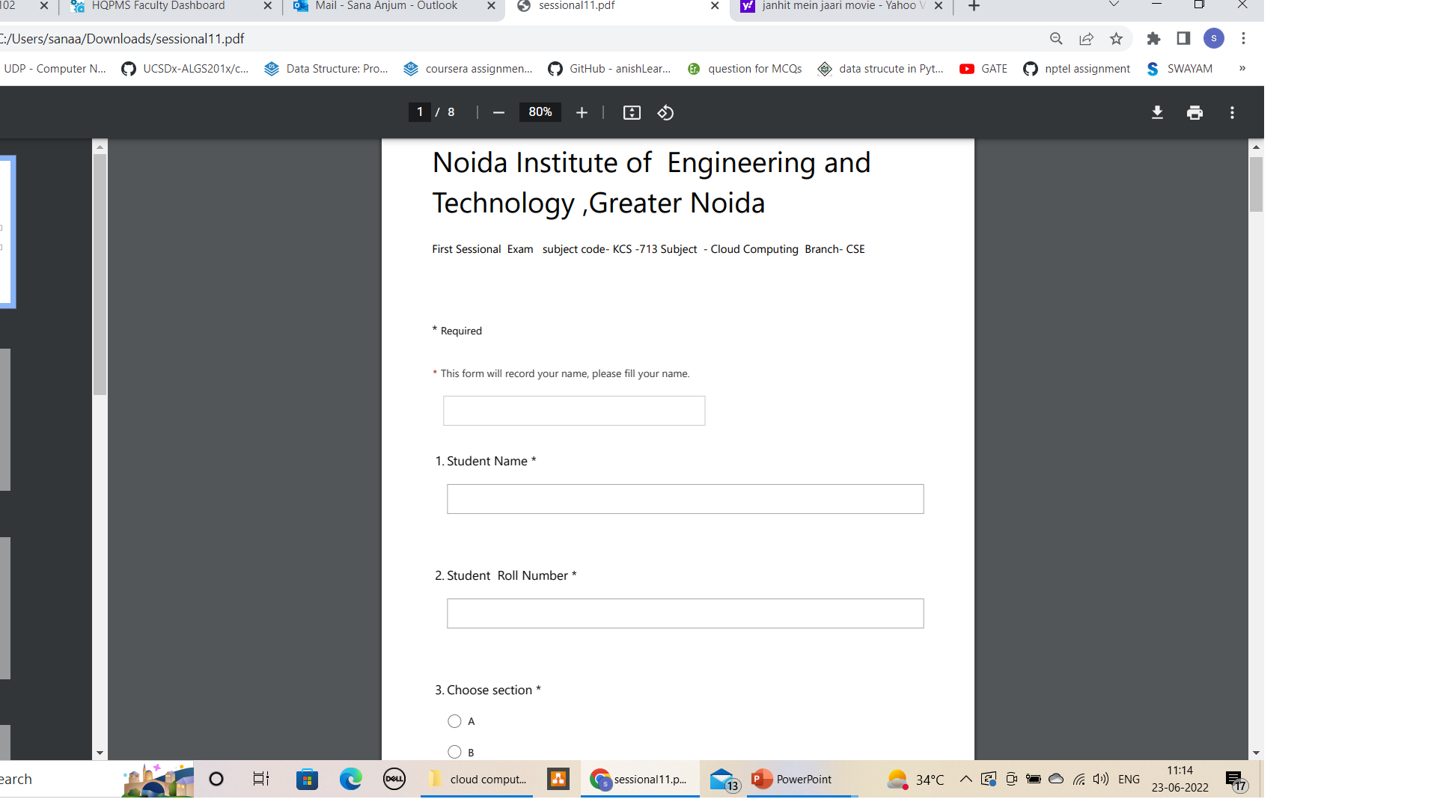
Old Sessional Paper

Slide 76
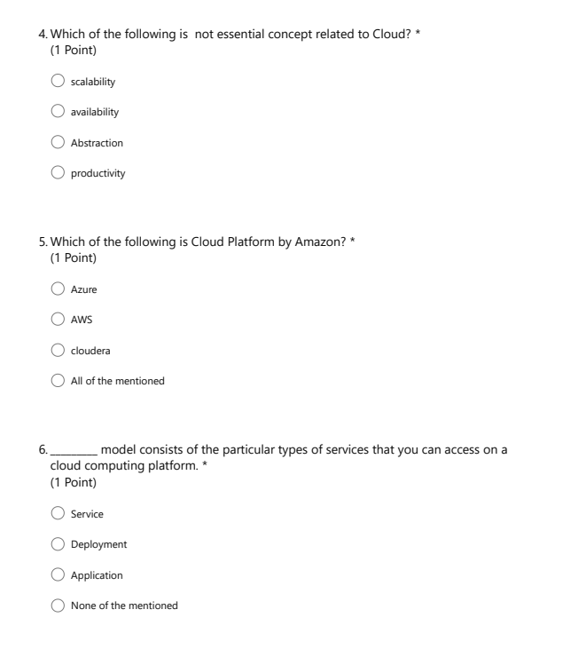
Old Sessional Paper

Slide 77
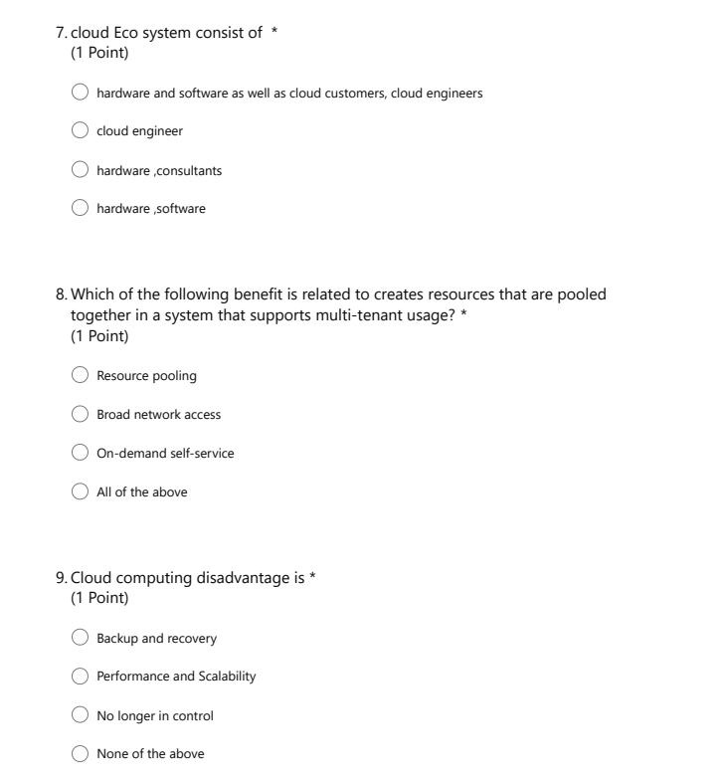
Old Sessional Paper

Slide 78
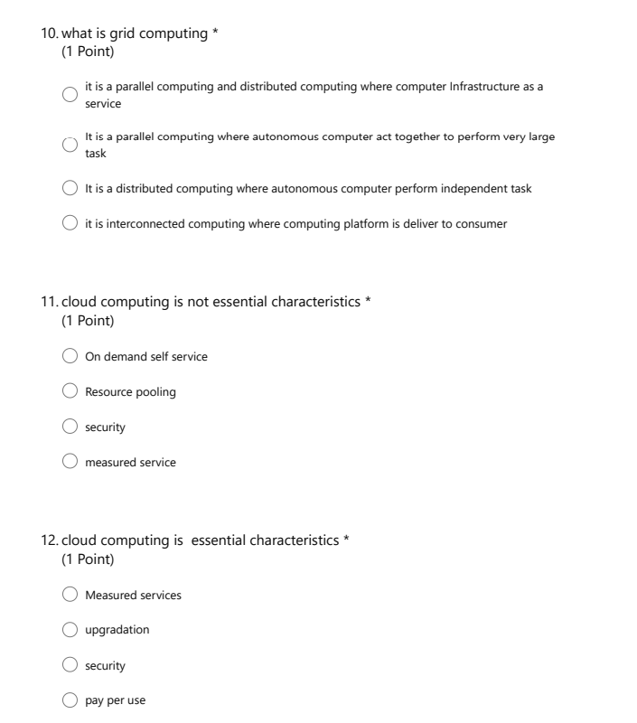
Old Sessional Paper

Slide 79
University Exam Paper
B. TECH.
(SEM VII) THEORY EXAMINATION 2019-20 CLOUD COMPUTING
Time: 3 Hours Total Marks: 70
Note: 1. Attempt all Sections. If require any missing data; then choose suitably.
SECTION A
Attempt all questions in brief. 2 x 7 = 14
What is Cloud Eco System?
Differentiate between distributed Computing and Cloud Computing.
Explain Grid Computing.
Explain Hybrid Cloud.
Differentiate between public and private cloud.
What do you mean by full virtualization?
What are the major challenges faced in cloud?

Slide 80
University Exam Paper
Attempt any one part of the following: 7 x 1 = 7
What are the major functionalities of Hadoop API?
Explain the Cloud management and Services Creation Tools?
Attempt any one part of the following: 7 x 1 = 7
What do you understand by service oriented architecture (SOA)? How does it support cloud computing?
Draw the architecture and explain the importance of workflow management systems in cloud.
Attempt any one part of the following: 7 x 1 = 7
Identify NIST cloud computing reference architecture with a neat schematic diagram.
Explain the migration of memory, files and network resources in detail.

Slide 81
University Exam Paper
SECTION B
Attempt any three of the following: 7 x 3 = 21
Illustrate the cloud adoption discussing its several policies.
What is a Hypervisor? Explain in detail with necessary illustrations.
What is the difference between process virtual machines, host VMMs and native VMMs.
What are cloud security challenges? How is security provided to data at various stages in context of cloud?
SECTION C
Attempt any one part of the following: 7 x 1 = 7
How Cloud Computing provides scalability and fault tolerance?
Explain Virtual LAN(VLAN) and Virtual SAN(VSAN) in cloud computing.
Attempt any one part of the following: 7 x 1 = 7
Explain the Cloud Computing security architecture using suitable block diagram.
What is the importance of a virtual machine? What role do they play in cloud computing plain the characteristics and type of virtualization in Cloud Computing

Slide 82
Expected Questions for University Exam
Define cloud computing.
Write short notes on “on demand self service” and “elasticity of demand”
Discriminate between cluster computing and grid computing.
List out essential characteristics of cloud computing.
Explain cloud computing evolution in terms of computing technique.
Identify the need of cloud computing with example.
Discuss the services of various cloud vendors.

Slide 83
Recap
cloud computing is the on-demand availability of computer system resources, especially data storage and computing power over the internet
there are number of vendors provide different services to the user over internet.
Amazon web service ,Microsoft azure ,oracle,salesforce,alibaba are the popular vendors.
cloud computing technique emerge after various computing technique .
Cloud computing is a combination of grid and cluster computing.
There are number of features of cloud computing like on demand self service and rapid elasticity security etc.

Slide 84
References
Thank You

