Slide 1

PRESENTATION
On
Hangman Android Game Application
Course Name : Diploma in Software Design
By ARSHDEEP KAUR

Slide 2

Hangman Game Brief
This Android app is a game made to simulate the classical game of Hangman;
In which there will be a 'question' who will present the player with a word whose letter are blanked out, and the player will then have to guess what the word is correctly. A wrong guess would result in the player's avatar in the game, a stick figure, getting closer and closer to be 'hanged'.
Hence , the eponymous name of the game.

Slide 3
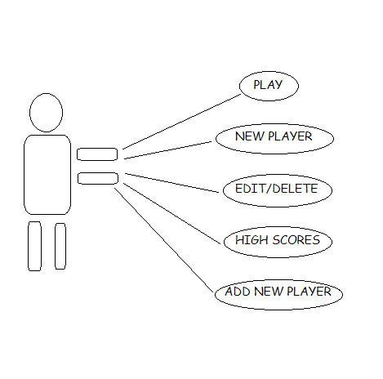
User Case : Main Menu Diagram

Slide 4
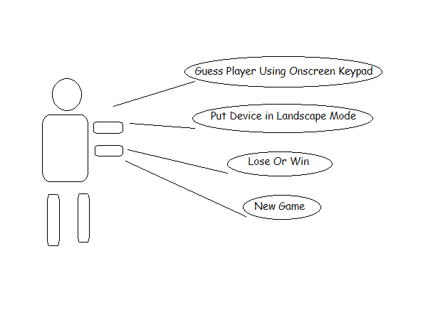
User Case: In Game Diagram

Slide 5
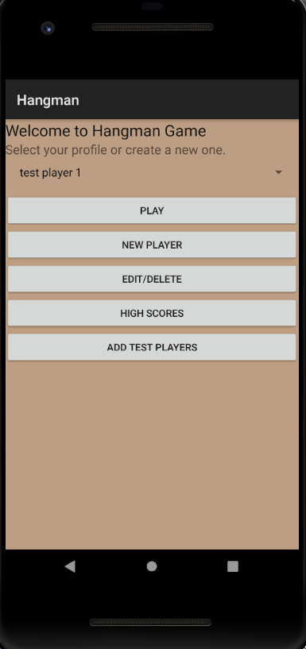

View 1. This Screen shall be displayed when
First launch the application.
Note: Touch events are received through buttons which are placed conveniently on the screen

Slide 6
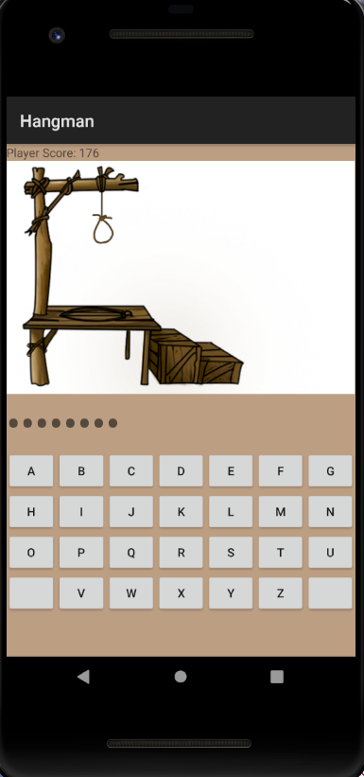
View 2. This Dialog will be displayed when the user touches the play button on the main screen.

Slide 7
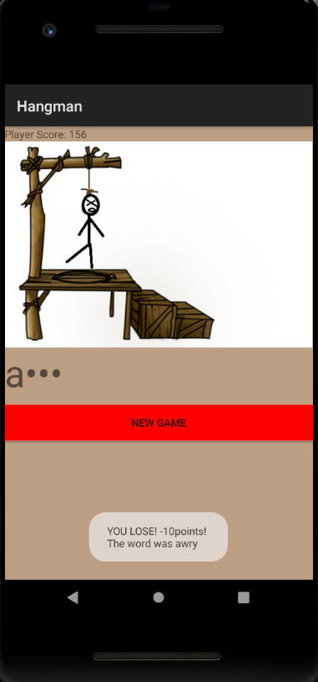
View 3. This Screen shall be displayed when the user starts playing and lose the game..

Slide 8
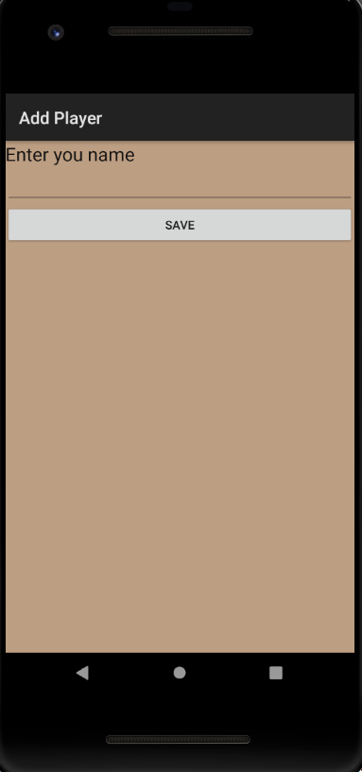
View 4. This Dialog showing the save the player option to the user.

Slide 9
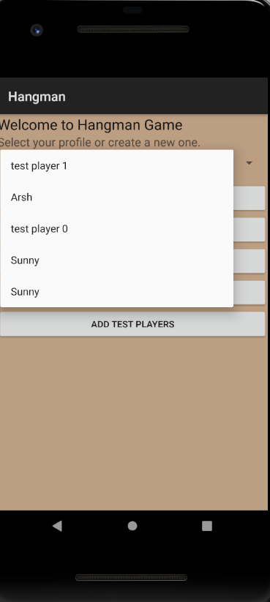
View 5. This Scree displaying all the test player and if user wants to add a new profile.

Slide 10
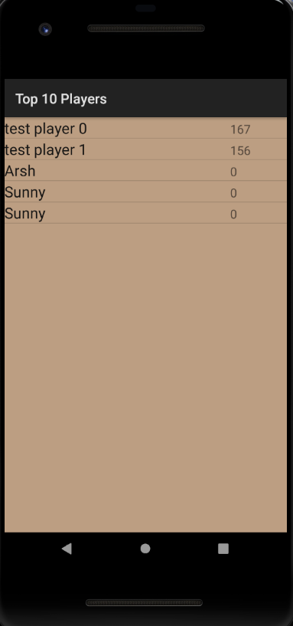
View 6. This Screen shows all the top players as per their highest scores.

Slide 11
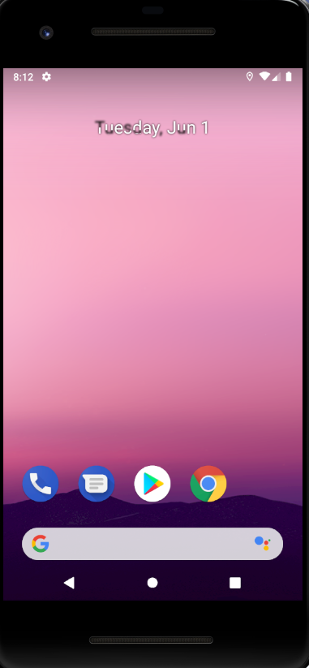
View 7. This Screen will be displayed when user exit the game.

Slide 12
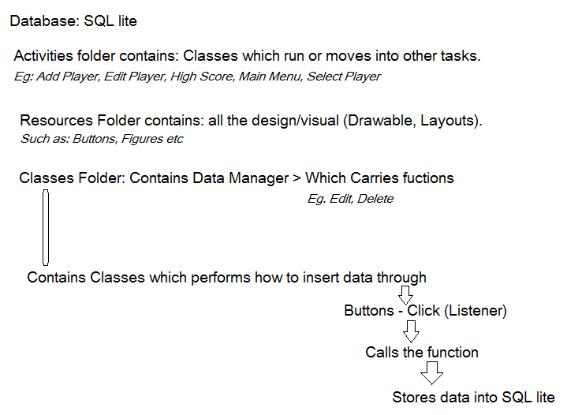
Backend Coding: how stuff works

Slide 13


