Slide 1
E- Project presentation
FIRST FASHOIN

Slide 2
GROUP MEMBERS
STUDENT ENROLLMENT | STUDENT NAME
Student1499709 | Muhmmad Hassan
Student1499602 | Wasil Owaiz
Student1498912 | Arsh Murad
Student1499698 | Muhmmad Maroof

Slide 3
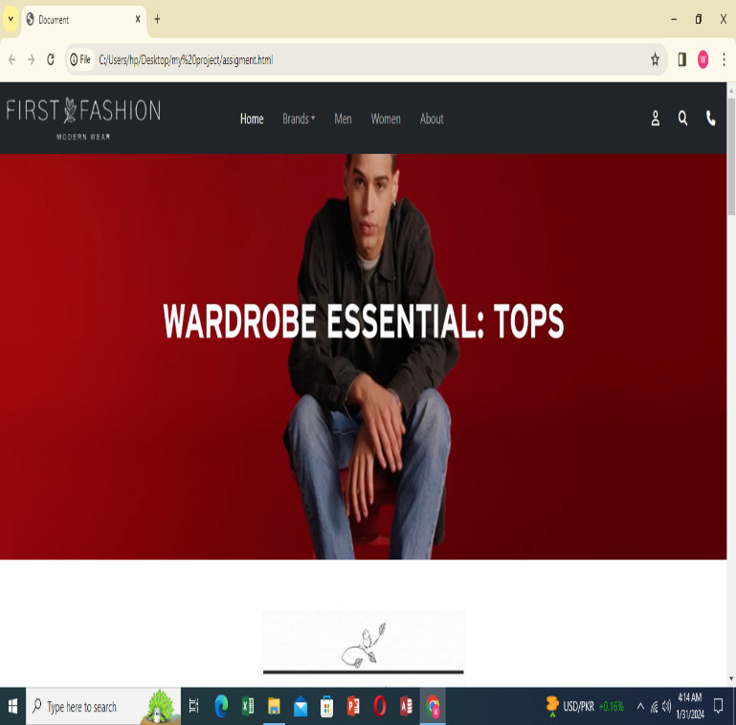
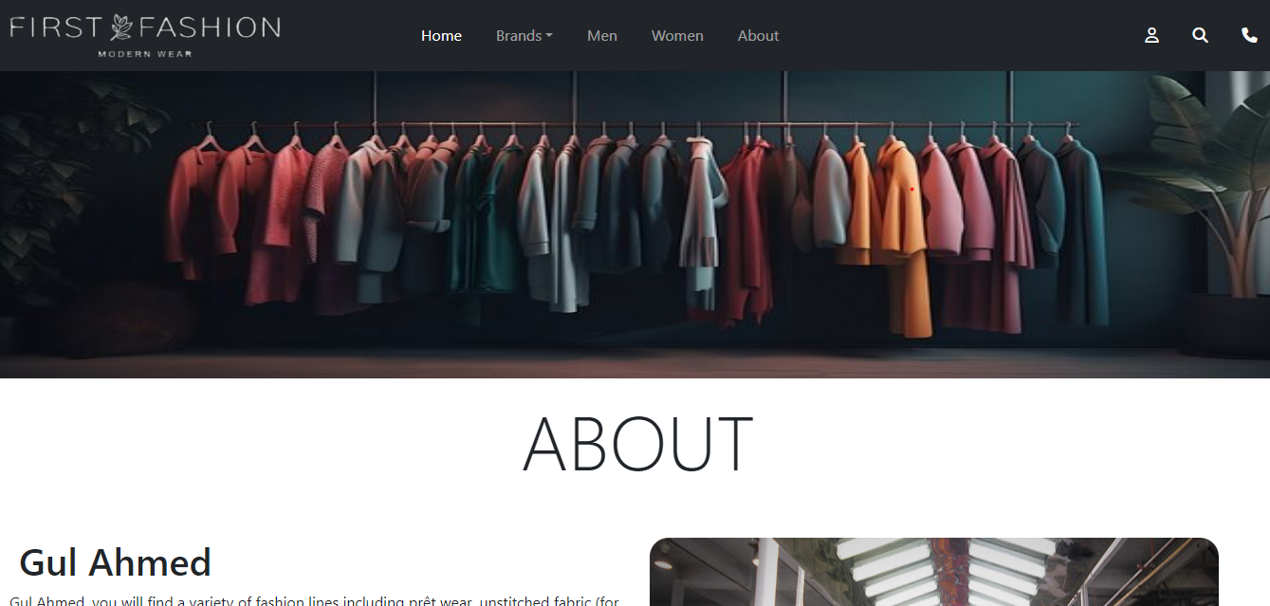
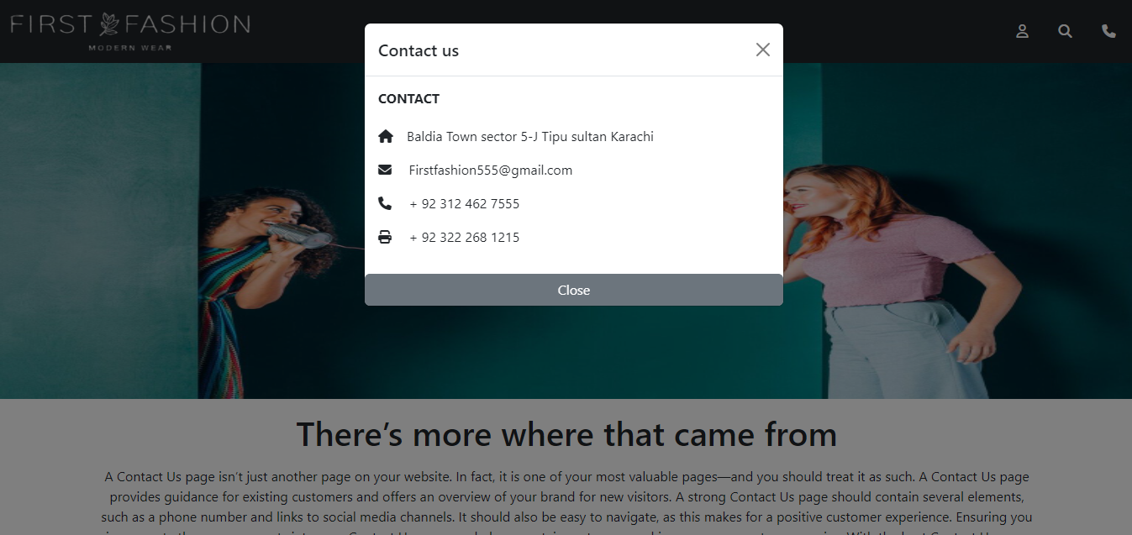
Web Snap Shot
HOME
ABOUT
CONTACT

Slide 4
THANK YOU

