Slide 1
Learn house
Mentor: Zhe Yang @ Vmware
Jiaqi Mu @ University of Illinois at Urbana Champaign
Priyama Biswas @ Arizona State University
Arpita Sheth @ Stony Brook University
Neha Ellur @ Stony Brook University
4-hour Introduction to Machine Learning

Slide 2

Why Machine Learning?
We use Machine Learning everyday, everywhere

Slide 3
Intro To Machine Learning
How to tackle real life Problems with Machine Learning
Tricks of Feature Selection and Feature Engineering with hands on examples
Exercise after each sub topic

Slide 4
Prerequisites
Basic Programming skills
DB language like SQL/Postgres (Not Mandatory)
Python
sklearn: http://scikit-learn.org/stable/index.html
Installation:
pip install scikit-learn
Ref: http://scikit-learn.org/stable/install.html

Slide 5
Machine Learning
Real Life problems?
Sentiment analysis
Product Recommendation
Prediction and Classification
User behaviour analysis
Clustering
Predicting Movie Genre

Slide 6
Sentiment Analysis
Given a review, can we tell whether it is positive or negative?

Slide 7
Work flow
Feature
Textual
Algorithm
Supervised
Categorical
Numerical
Unsupervised
Evaluation
Classification
Regression
Clustering
How to formulate and solve ML problems?

Slide 8


Feature Extraction
How to represent data
Numerical
Categorical
Textual
The supporting cast is also carefully chosen and they add a depth of character that the main characters get added meaning from the supporting performances. All in all an excellent movie. The best thing I take from it is Hope.
Bette Davis brings her full trunk of tics to this miserable flop which is another variation on the "hilariously mismatched" lovers theme. Sadly, Cagney and Davis are truly mismatched in acting styles and the mix is not simply unpalatable but distasteful.

Slide 9
Algorithms
How to handle features
Algorithms
Supervised
Logistic Regression
Support Vector Machine
Unsupervised
K-means Clustering
Random Forest
Linear Regression
Numerical prediction
Labeled?
Categorical prediction
Unlabeled?
Common behavior

Slide 10
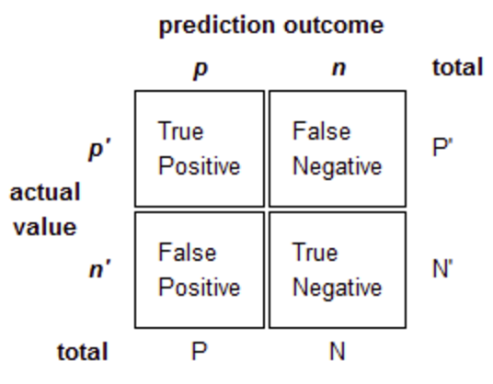
Evaluations
How to evaluate the performances
Regression
Mean square error
Manhattan distance, etc..
Classification
Accuracy/type-I/type-II error
F-measure/precision recall
Clustering
Distance to centroids

Slide 11
Take-Home Messages
What is machine learning?
Three steps in machine learning.
ML can be learned everywhere.

Slide 12
Back to Sentiment Analysis

Slide 13
Questions?

