Slide 1
Understanding Neural Networks
A Visual Guide to AI Components and Architecture
Arshi Khan

Slide 2
Neural Network Layers
What are Layers?
Layers are organized groups of neurons that process information sequentially. Each layer transforms data progressively, building from simple patterns to complex understanding.
Key Types:
• Input Layer: Receives raw data
• Hidden Layers: Process and extract features
• Output Layer: Produces final predictions
Input
Layer
Hidden
Layer
Hidden
Layer
Output
Layer

Slide 3
Neurons: The Building Blocks
What are Neurons?
Neurons are individual computational units that receive inputs, perform calculations, and produce outputs. Each neuron:
1. Receives multiple inputs
2. Multiplies each input by its weight
3. Sums all weighted inputs
4. Applies an activation function
5. Produces an output signal
Millions of neurons working together enable neural networks to learn complex patterns.
w1
Σ
Output
w2
w3

Slide 4
Weights: Connection Strength
What are Weights?
Weights are numerical parameters that determine how much influence each input has on a neuron's output. They represent the strength of connections between neurons.
How Weights Work:
• Each connection has a unique weight
• High weights = strong influence
• Low/negative weights = weak/inhibitory influence
• Adjusted during training to minimize errors
w = 0.85
A
Strong
B
w = 0.12
C
Weak
D

Slide 5
Activation Functions
What are Activation Functions?
ReLU Function
Activation functions determine whether a neuron should 'fire' based on its inputs. They introduce non-linearity, enabling networks to learn complex patterns.
Common Types:
• ReLU (Rectified Linear Unit): Most popular, outputs max(0, x)
• Sigmoid: Outputs between 0 and 1, used for probabilities
• Tanh: Outputs between -1 and
Without activation functions, neural networks would only perform linear transformations.
Output
f(x) = max(0, x)
Input

Slide 6
Loss Functions
What are Loss Functions?
Loss During Training
Loss functions measure how wrong the network's predictions are compared to actual values. They quantify the error the network must minimize.
Common Types:
• Mean Squared Error (MSE): For regression tasks
• Cross-Entropy: For classification tasks
• Binary Cross-Entropy: For binary classification
Goal: Minimize the loss value through training, indicating better predictions.
Loss
Lower loss = Better performance
Epochs

Slide 7
Optimization Algorithms
What are Optimization Algorithms?
Finding the Optimal Solution
Optimization algorithms adjust weights systematically to minimize the loss function. They determine how the network learns from errors.
Common Algorithms:
• Gradient Descent: Basic approach, moves toward lower loss
• Stochastic Gradient Descent (SGD): Faster, uses data batches
• Adam: Adaptive learning, currently most popular
These algorithms adjust weights to improve predictions.
Start
Gradient descent iteratively
adjusts weights to reach
the minimum loss
Optimal
Weights

Slide 8
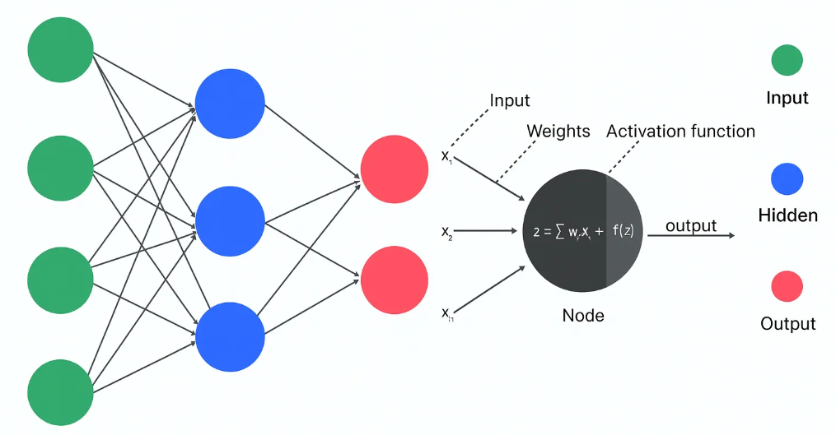
Complete Neural Network Architecture
Data Flow: Input → Processing → Output
Source: upGrad (2024)

Slide 9
Key Insights: Visualizing Neural Networks
Why Visualization Matters
Visual representations transform abstract neural network concepts into comprehensible structures. Through this exploration:
• Layers organize neurons hierarchically for progressive data transformation
• Neurons perform individual computations that collectively enable learning
• Weights determine connection strengths and are adjusted during training
• Activation functions introduce non-linearity for complex pattern recognition
• Loss functions quantify errors to guide optimization
• Optimization algorithms systematically improve network performance
Experimenting with the Neural Network Playground revealed how these components interact dynamically during training. Understanding these fundamentals is essential for developing and optimizing neural network applications

Slide 10
Thank You
Understanding Neural Networks Through Visualization
Arshi Khan

