Slide 1

GIT AND GITHUB
By Arisha and Hina

Slide 2
Contents
Version control system (VCS)
GIT vs GITHUB
Git
Repositories (local and Live)
Commits
Branches and merges
GitHub

Slide 3
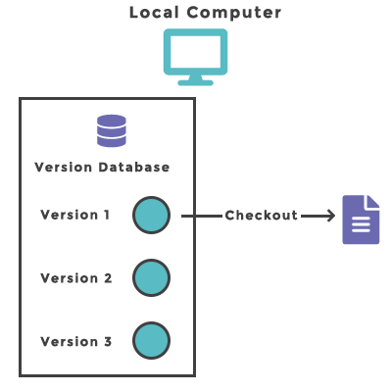
Version control system (VCS)
VCS is the management of changes to documents, computer programs, large web sites, and other collections of information.

Slide 4
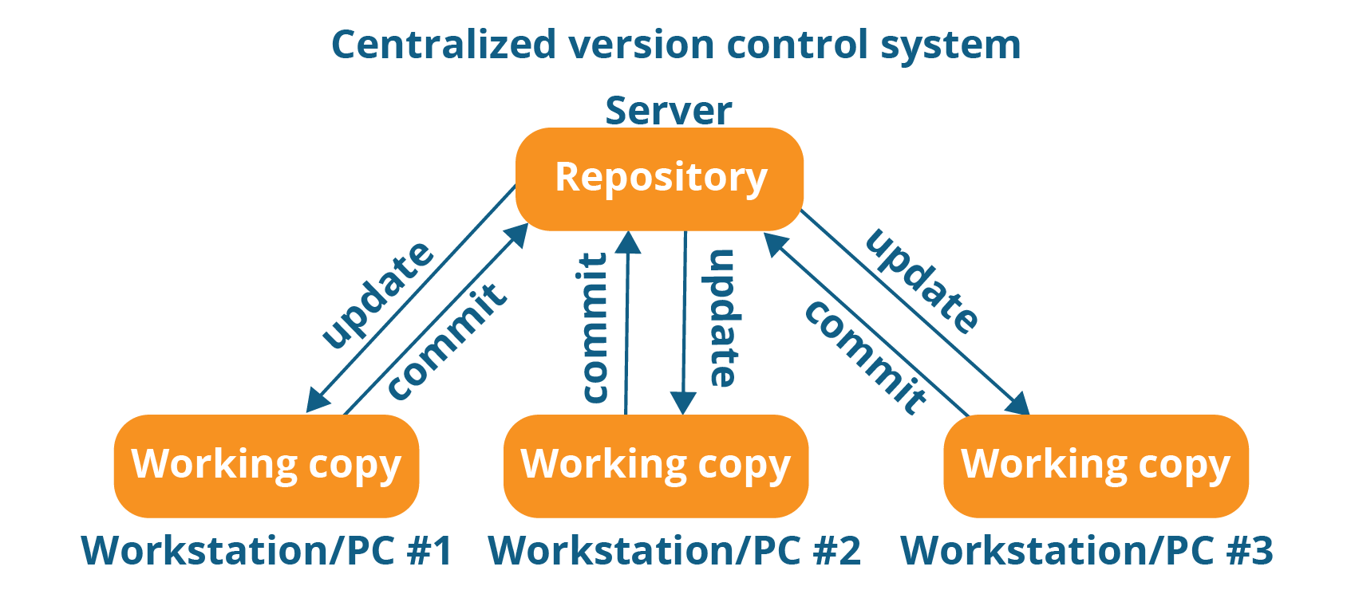

Slide 5

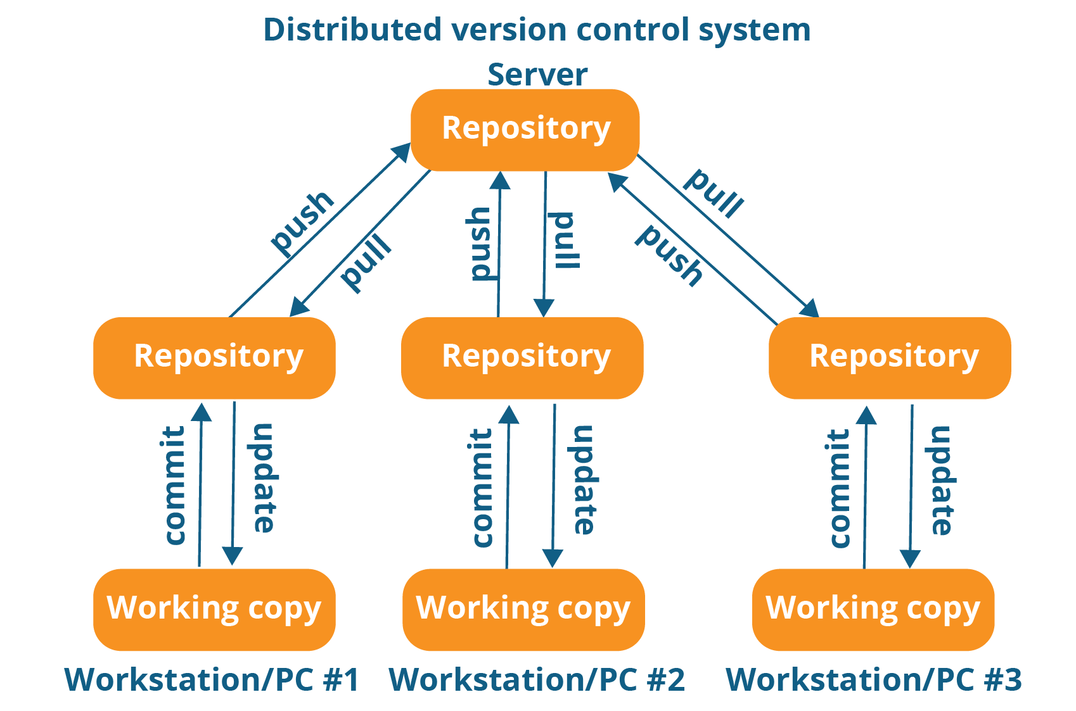

Slide 6
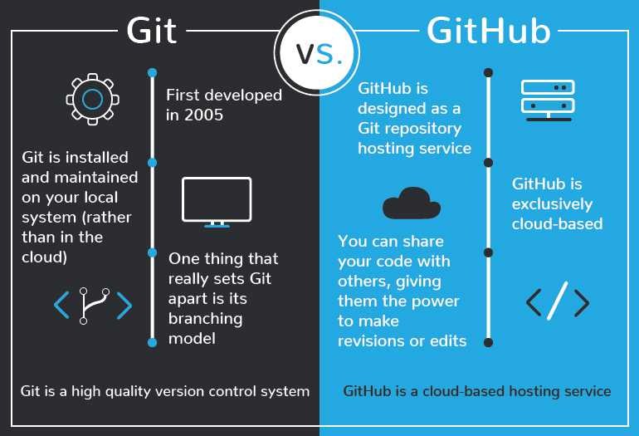

Slide 7
Fundamental Git commands
$ git init //to initialize the repository folder
$ git add <filename> //to add files in repo folder
$ git status //to view files in staging area that are ready for commit.
$ git commit //to make changes in the file.

