Slide 1
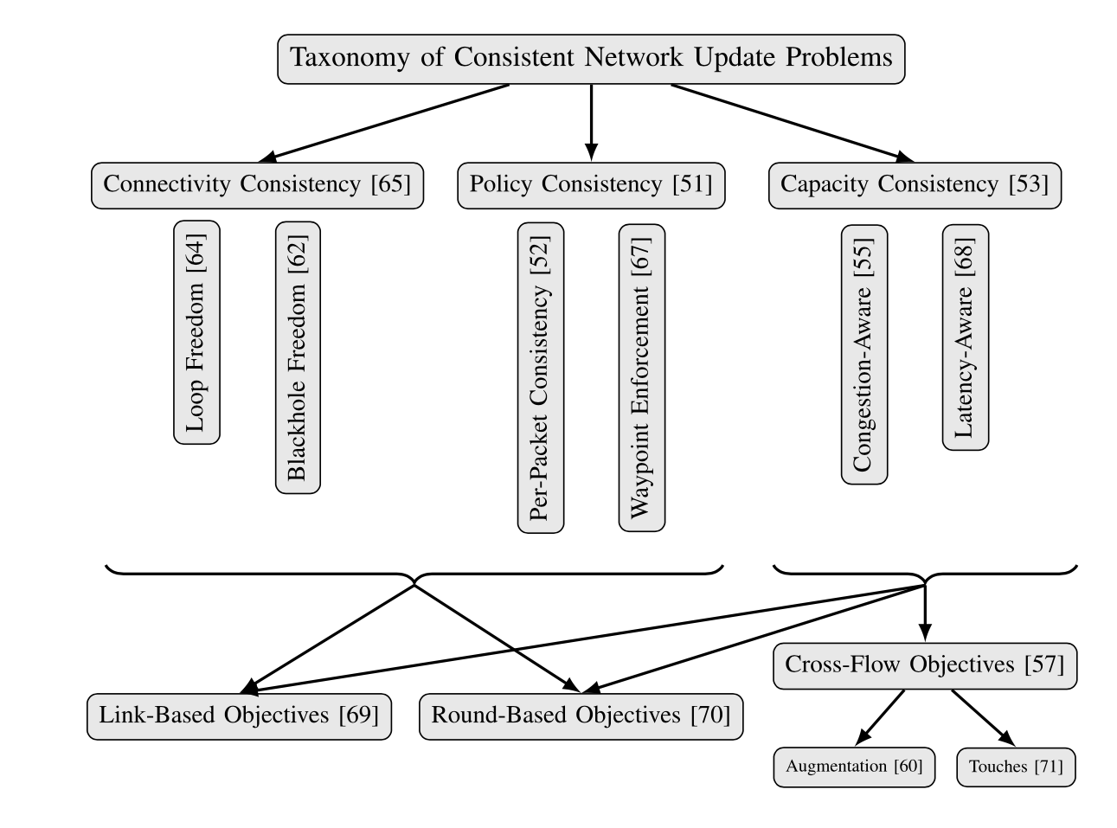
Taxonomy of consistent network update problem
Notes:
CAP theorem
tunnel-based forwarding = no loop

Slide 2
2-phase commit
Advantages
Per-packet consistency guaranteed
No forwarding loop
Very short scheduling time
Simple implementation
Disadvantages
TCAM memory overhead
Tag overhead (negligible)
No additional consistence, e.g. Congestion-freedom cant be guaranteed

Slide 3
SWAN & B4
SWAN suggests to Reserve about 10-30% of link capacity to allow congestion-free updates.
B4 suggests to reduced bandwidth of some or all of the flows during network update which results to fewer packet loss.

Slide 4
time4
Time4 is an update approach that performs multiple changes at different switches at the same time
This paper presents a class of update scenarios in which prior update methods are suboptimal.
PTP(Precision Time Protocol) can synchronize clocks on the order of 1 microseconds .
TIME4 is an update approach that performs multiple changes at different switches at the same time.
Accuracy: scheduling error affected by
Clock accuracy
Execution accuracy

Slide 5
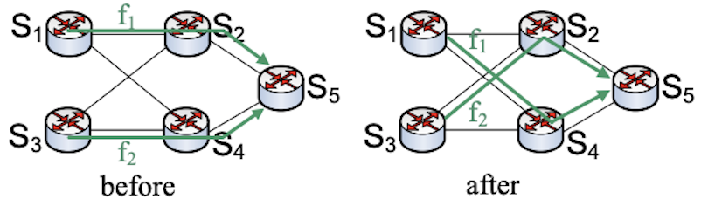
It is assumed that all links in the networks
Have identical capacity .
Required bandwidth of both flows are
Equal
The paper proved that in a dynamic environment flow swaps are inevitable.

Slide 6
Model and Definitions
Traffic generates from source s destination d , in a directed graph
Goal is to maximize traffic rate from s to d.
Problem modeled as a game between source and controller.
Theorem 1: source has a strategy that forces the controller to perform a flow swap.
The controller’s goal is to find a forwarding path for all the flows in the system without exceeding the capacity of any of the edges, i.e., to completely avoid loss of packets from the given flows.
The source’s goal is to progressively add flows, without exceeding the network’s capacity, forcing the controller to perform a flow swap

Slide 7
The network is represented by a directed weighted acyclic graph :G = (V, E, c)
V: set of vertices
E : set of edges
C = set of links capacity
If C=1 of all links : G is referred to as an LFA graph.

Slide 8
Basic Assumptions :
Each flow has a fixed bandwidth.
The controller strives to avoid packet loss
Flows are unsplit table
Notes:
تویی دیتا سنتر ها ممکنه است اسپلیت بخواهیم بکنیم.

Slide 9

EVALUATION
Environment properties
71-node testbed
Each machine is a TIMe4-enabled switch or a host
A separate machine used as a controller
Performance metrics :
∆ : The average time elapsed between two consecutive messages sent by the controller. varies from 1 microseconds to several milliseconds
$I_{R}$: max {installation latency} – min{installation latency}
δ : max {actual update time – scheduled update time}.
No deep buffering
Performance metric : packet loss
Untimed methods are Previous approaches like two-phase and ordered.

Slide 10
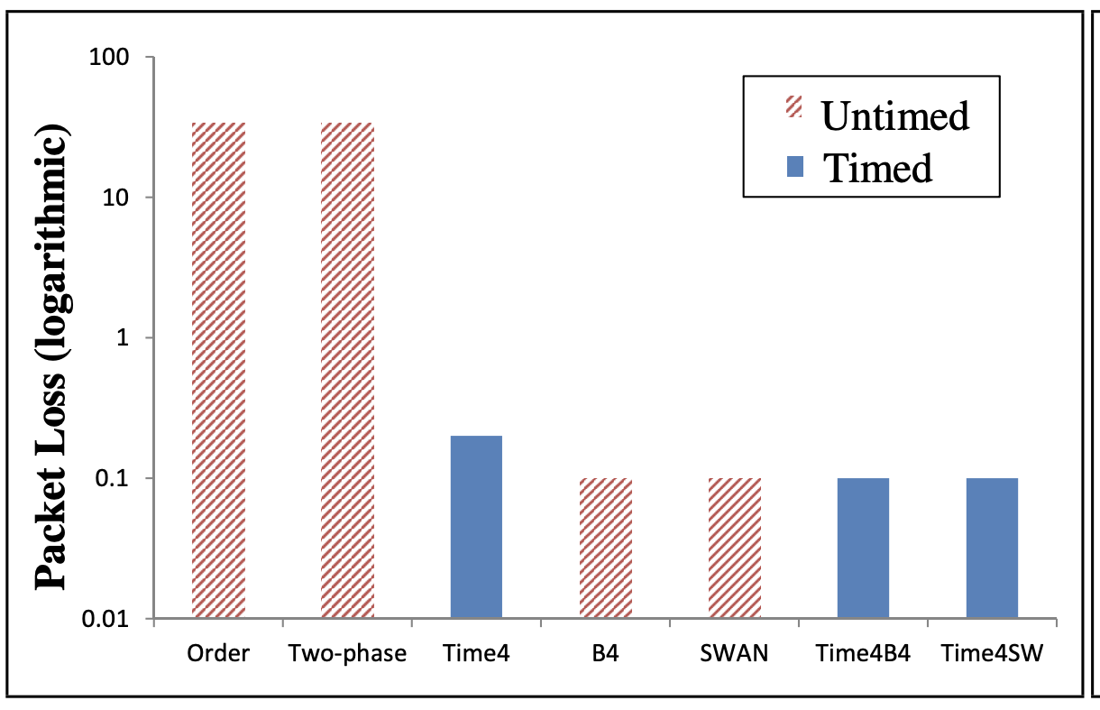
Time4 vs other approaches
Hybrid approaches

Slide 11
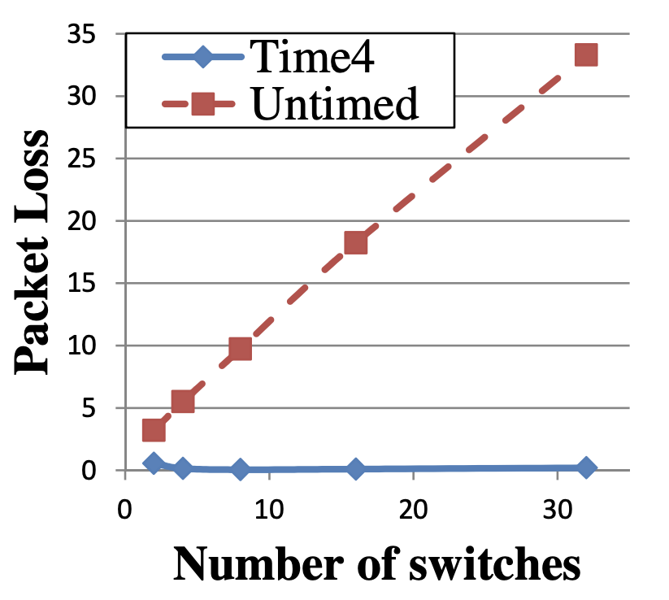
Untimed approaches
Notes:
پکت لاس با افزایش تعداد سوییچ ها زیاد نمیشود.

Slide 12
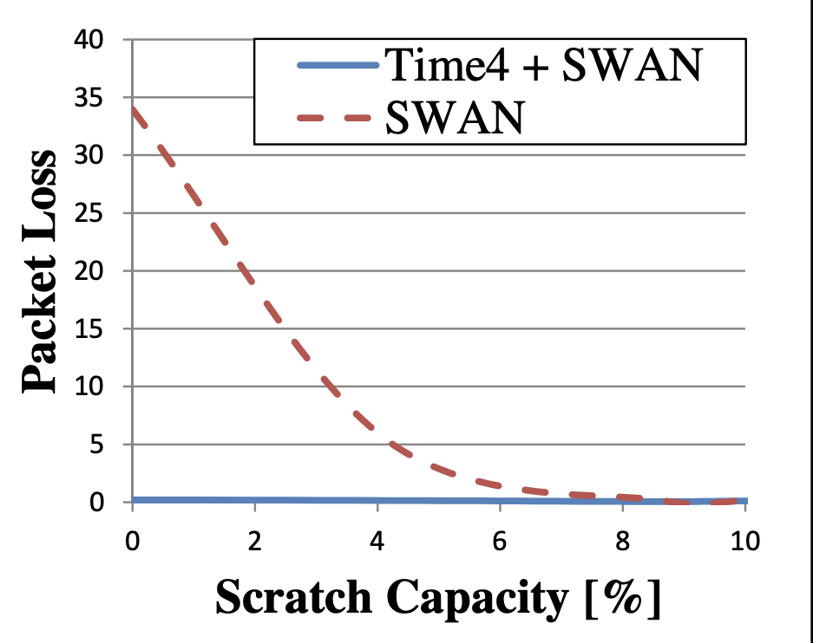
A hybrid approach

Slide 13
conclusion
Hybrid approaches like Time4B4 and Time4SWAN result to fewer packet loss
Ordered approaches like Dionysus works in order of minutes .
It seems a combination of bandwidth reduction and using time is useful.

