Slide 1
ReversePTP A clock synchronization scheme for software‐defined networks

Slide 2
Previous clock synchronization protocols
Precision Time Protocol(PTP)
Defined in IEEE 1588.
Accuracy : order of 1 microsecond
Network Time Protocol(NTP)
Notes:
\

Slide 3
Precision Time Protocol(PTP)
Decentralized Algorithm.
A master clock is elected by BCMA.
Slaves run a servo algorithm which computes accurate time
Direction of protocol messages are from master to slaves.
Idea of PTP and SDN are in contrast

Slide 4
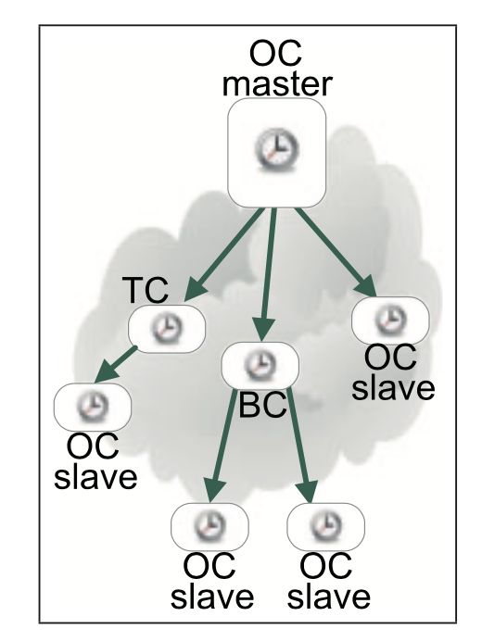
Overview of PTP
Roles
Master
slave
PTP Domain

Slide 5
Overview of PTP(cont.)
Type of nodes
Ordinary Clocks(OCs)
Transparent Clocks(TCs)
Boundary Clocks(BCs)

Slide 6
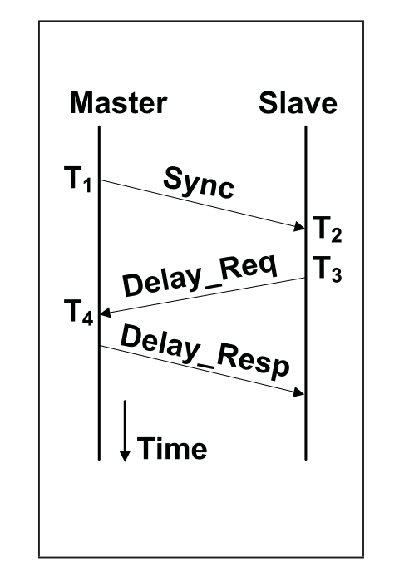

How it works
O $=T_{2} − T_{1 }−d_{Ms}$
$$d_{MS}=\frac{\left(T_{4}−T_{3}\right)+(T_{2}−T_{1})}{2}$$
O : offset
$d_{MS}$ = delay between master and slave
Synch and delay messages are transmitted periodically.

Slide 7
Overview of PTP(Cont.)
Working modes
One-step
twos-step

Slide 8
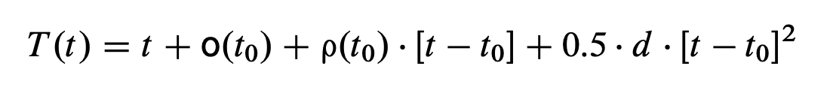
Overview of PTP(Cont.)
Real time values are declared in lowercase .
Clock time values and constants are declare in upper case.

Slide 9
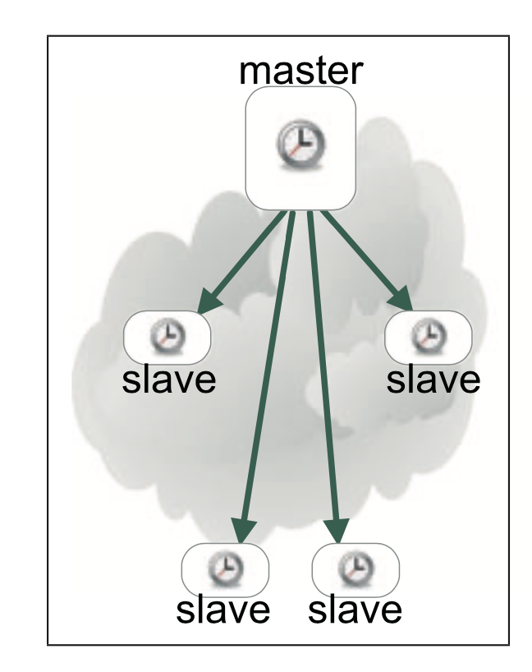
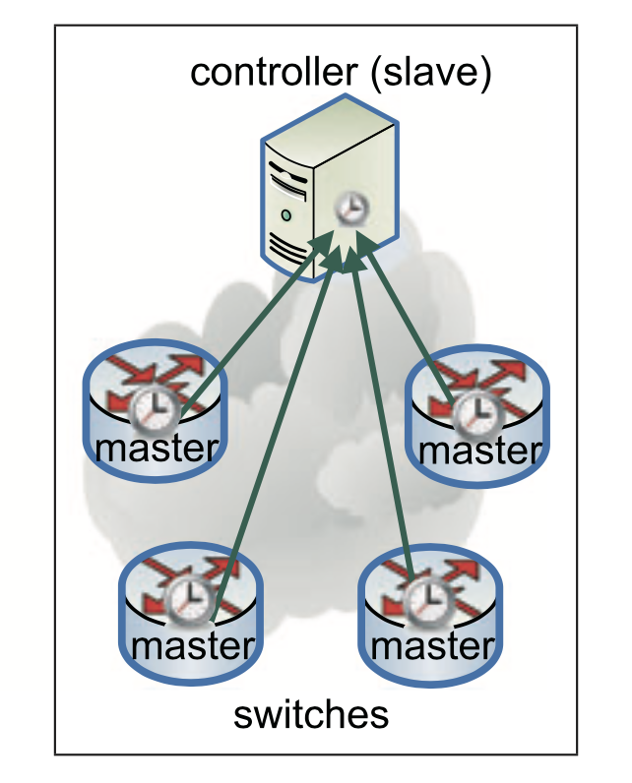
reversePTP in a nutshell
Conventional PTP
REVERSEPTP

Slide 10
ReversePTP: Theory of operation
Tasks of controller
running the PTP protocol as a slave separately with each of the SDN switches.
Time translation between masters’ times and slave's time.
Each REVERSPTP slave is bound to n REVERSEPTP masters.

Slide 11

ReversePTP: Theory of operation(cont.)
REVERSEPTP slave maintains four parameters for each master.
$T_{i_{last}}^{s}$
${\hat{O}}_{i}$
${\hat{ρ}}_{i}$
${\hat{d}}_{i}$

Slide 12

Time translation
$T^{s}$ : timestamp in term of slave’s clock
$T^{i}$: master i’s clock
Timed notification: $T^{i}$($T^{s})$
Timed command: $T^{s}$($T^{i})$

Slide 13
The ReversePtp profile
REVERSPTP is a subset of features in IEEE 1588 standard.
important features of REVERSPTP:
Simple functionality in switches
No messages are exchanged between switches

Slide 14
Evaluation
Goals of experiment
Effectiveness of scheduling simultaneous events by using REVERSPTP.
Evaluate degree of accuracy REVERSEPTP in comparison to conventional PTP.
Analyze scalability of REVERSEPTP.

Slide 15
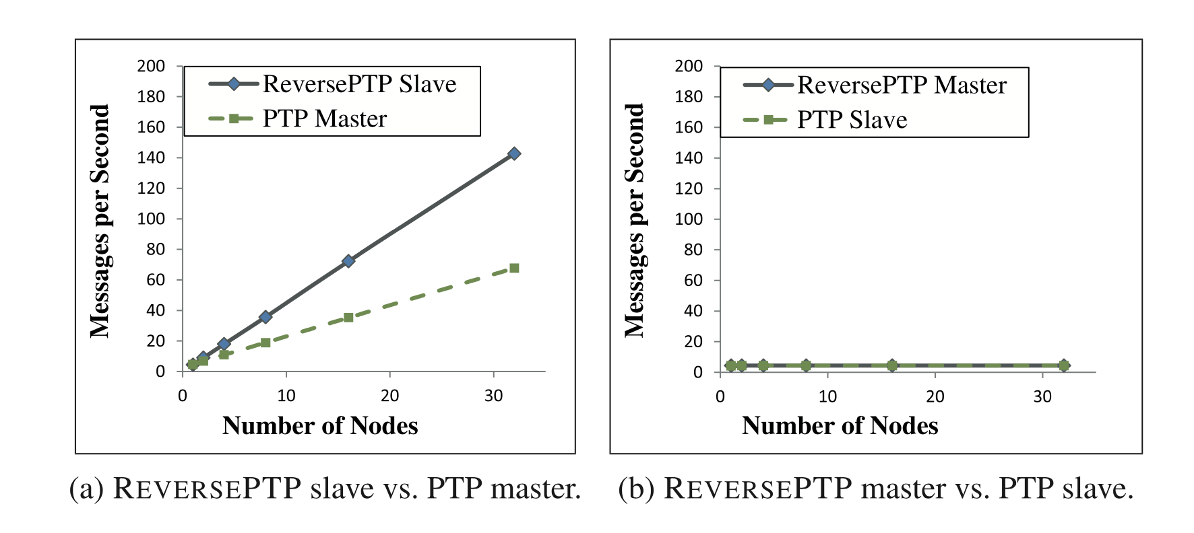
Scalability: Rate of protocol messages
Notes:
Two sptep mode

Slide 16
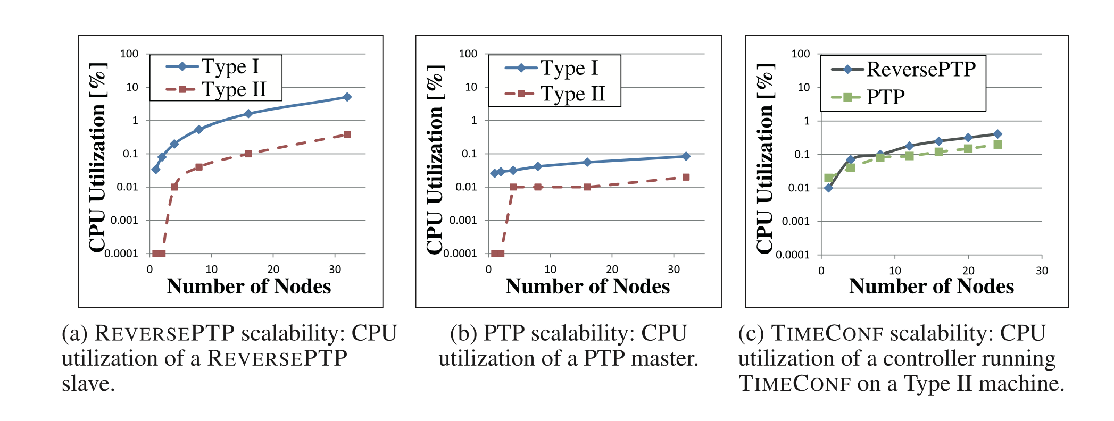
Scalability: Cpu utilization

