Slide 1
Data 2206-02 Capstone Project Update Presentation Water Potability Analysis
Arshiya muslim noor – 100839688
Dimple dinesh Parmar – 100852388
Pradeep rajashekaran - 100848443

Slide 2
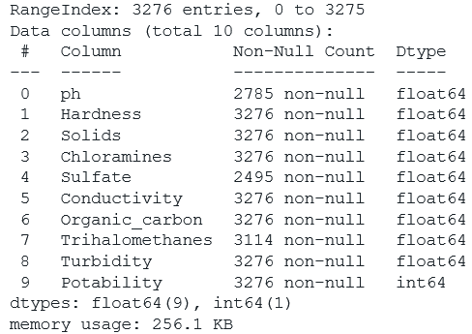
Water Potability
The World Health Organization (WHO) organizes potable water contamination as organic, inorganic, radiological, and microbiological, which includes measures of acceptability of taste, smell, and appearance.
In our project, we will check the potability of the water based on the ph level, hardness level, solids contents, chloramines contents, sulphate contents, its conductivity, organic carbon, trihalomethanes and turbidity.
This analysis will help us determine if the water is fit for human consumption or not.
Dataset Characteristics

Slide 3
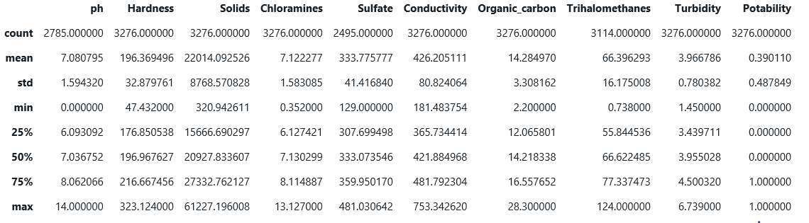
Descriptive Analysis of the dataset
We have analyzed the dataset to understand the different features.
We can see here the range of the datapoints and how the data is spread across.
We can see that most of the feature’s data points are normally distributed.

Slide 4
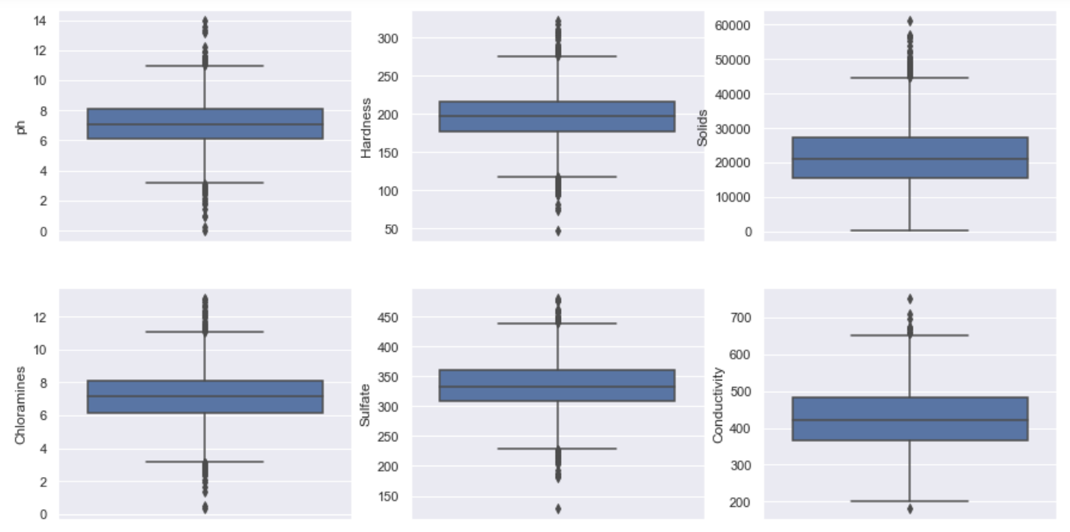
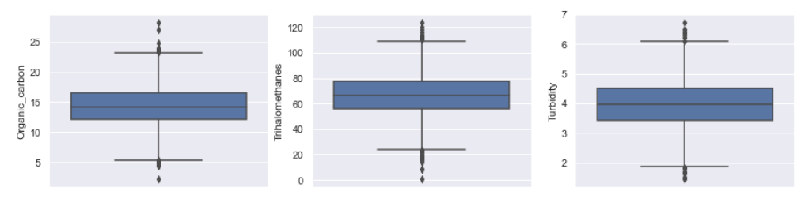
Outliers in the data
From the boxplot, we can see that there are many outliers in the data.
We can delete some outliers of the data while performing data cleansing.
During EDA, We have plotted scatterplot and noticed that we have an imbalance of classes and there is no clear division into clusters.

Slide 5
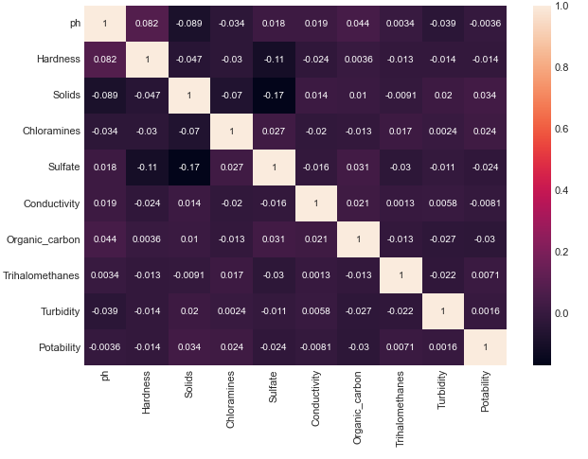
Heat Map & correlation
From the above map, we can clearly see that there is no correlation between any of the features.

Slide 6
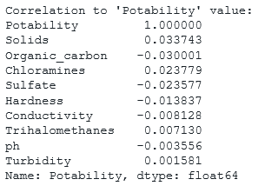
Correlation of features with potability
There is no correlation of the features with portability either.

Slide 7
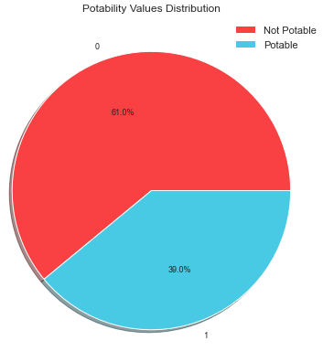
Limitations of the dataset
This dataset is a synthetically generated and not a real dataset and due to this there are some limitations.
By WHO's standard, the TDS should be between 50 to 300 ppm but the dataset contains value that goes unto 50,000 ppm, therefore, we assume the values were generated with incorrect dot placement and will be shifting the fractions to correct it.
Mean value of hardness is around 200, which is extremely Hard.
Chloramines are as high as 13 and mean of 7 whereas should be less than 4 for potability.
Organic carbon values are mostly around 14, whereas should be around 2.5.
Despite all these abnormalities huge chunk of data around 40% is potable.

Slide 8
References https://www.fluencecorp.com/what-is-potable-water/ https://www.kaggle.com/datasets/adityakadiwal/water-potability?resource=download https://www.kent.co.in/blog/what-are-total-dissolved-solids-tds-how-to-reduce-them/ https://www.kent.co.in/blog/what-are-total-dissolved-solids-tds-how-to-reduce-them/
Thank you

