Slide 1

Food Delivery Order and Delivery Performance Analysis
Presented To:
Er. Pawan Sen
HOD, CSE
Presented By:
ARSHI KHAN
RTU Roll No. 24EACCS054
Department of Computer Science & Engineering
Arya College of Engineering, Jaipur

Slide 2






What This Presentation Covers
A quick roadmap of the analysis journey
01
02
Problem Statement
Dataset & Data Cleaning
Why delivery performance and cancellations matter
50,000 orders cleaned and prepared with pandas
03
04
Methodology & Tools
Dashboard Showcase
The workflow from raw data to dashboard
Interactive Power BI dashboard walkthrough
05
06
Key Insights
Conclusion & Recommendations
Orders, revenue, delivery time & cancellations
What the data tells the business to do next
FOOD DELIVERY ORDER & DELIVERY PERFORMANCE ANALYSIS
02

Slide 3



PROBLEM STATEMENT & OBJECTIVES
Every late order chips away at customer trust
Food delivery platforms process thousands of orders every day across multiple cities, restaurant types and traffic conditions. Delays, driver unassignment and order cancellations directly hurt customer satisfaction, driver earnings and platform revenue — yet the reasons behind them are rarely visible at a glance.
Map order & revenue trends
Diagnose delivery delays
Understand cancellations
Build a live dashboard
Across 4 cities, restaurant types and customer segments
Compare estimated vs. actual delivery time and traffic impact
Identify the leading causes behind cancelled orders
Give stakeholders a single view to monitor performance
FOOD DELIVERY ORDER & DELIVERY PERFORMANCE ANALYSIS
03

Slide 4

Dataset Overview & Data Cleaning
cleaned_dataset.csv — one row per food delivery order
50,000
Key Field Groups
Order
Location
ORDERS
order_id, timestamp, hour, day, weekend flag
city, delivery_area, distance_km
37
Money
Delivery
subtotal, discount, fees, tip, order_total
estimated vs. actual time, late_delivery, traffic
DATA FIELDS
People
Outcome
customer_type, restaurant_type, driver rating
order_status, cancellation_reason, ratings
4
CITIES COVERED
Data Cleaning with pandas
Checked and handled missing / duplicate order records
Oct 2025
Converted order_timestamp to datetime; derived order_hour, day_of_week, is_weekend
Fixed data types for monetary and time columns (float/int casting)
ORDER PERIOD
Engineered the late_delivery flag from estimated vs. actual delivery time
Standardized categorical text (city, payment_method, cancellation_reason)
FOOD DELIVERY ORDER & DELIVERY PERFORMANCE ANALYSIS
04

Slide 5
Methodology & Tools
From raw CSV to an interactive, decision-ready dashboard
1. Collect
2. Clean & Prepare
3. Explore
4. Visualize
5. Interpret
Gather raw food delivery order records (50,000 rows, 37 fields)
Use pandas to fix types, handle missing data & engineer features
Analyze trends in orders, revenue, delivery time & cancellations
Design KPI cards & charts on an interactive Power BI dashboard
Translate patterns into insights & recommendations
TOOLS USED
Python • pandas • NumPy • Power BI • Excel • Jupyter Notebook
FOOD DELIVERY ORDER & DELIVERY PERFORMANCE ANALYSIS
05

Slide 6
Key Insights I — Orders, Revenue & Cities
Where the volume and the money are actually coming from
50,000
$1.91M
$38.17
98.3%
TOTAL ORDERS
TOTAL REVENUE
AVG. ORDER VALUE
ORDER COMPLETION RATE
City_A alone drives nearly 40% of all orders and revenue — the clearest market to protect.
Fast Food accounts for 55% of orders — speed and convenience clearly win in this market.
FOOD DELIVERY ORDER & DELIVERY PERFORMANCE ANALYSIS
07

Slide 7
Key Insights II — Delivery & Cancellations
Where delays happen, and why orders get cancelled
35.1 min
35.9%
1.74%
4.7 km
AVG. DELIVERY TIME
LATE DELIVERY RATE
CANCELLATION RATE
AVG. DELIVERY DISTANCE
City_B runs slowest at ~36 min; high-traffic slots see late rates climb to 37.7% vs. 34.3% in low traffic.
FOOD DELIVERY ORDER & DELIVERY PERFORMANCE ANALYSIS
08

Slide 8
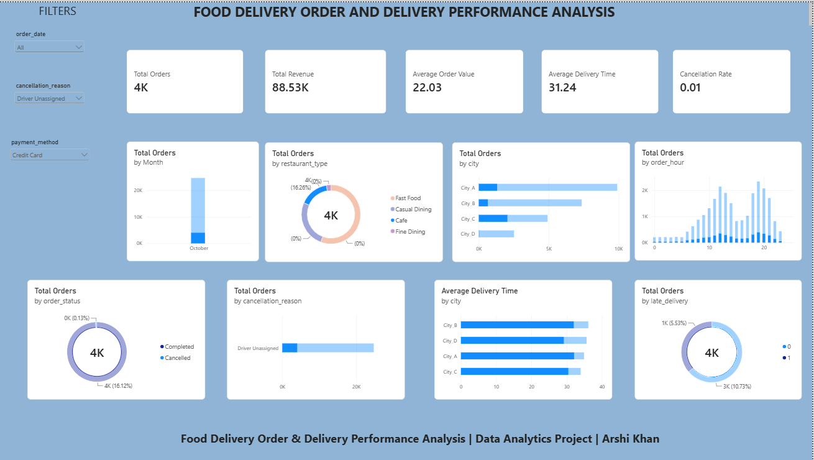

Slide 9
Conclusion & Recommendations
What the data tells us
Recommended next steps
City_A leads in both order volume and revenue, with Fast Food as the dominant restaurant category
Increase driver allocation during high-traffic hours (12–14h & 18–21h) to cut late deliveries
Average delivery takes 35.1 minutes, but over a third (35.9%) of orders arrive late
Fix driver-unassignment gaps first — it drives ~44% of all cancellations
High traffic conditions raise the late-delivery rate from 34.3% to 37.7%
Investigate City_B’s slower delivery times for route or staffing bottlenecks
Cancellations are rare (1.74%) but nearly half trace back to driver unassignment
Promote Digital Wallet payments to reduce cash-handling friction at delivery
Thank You

