Slide 1
Bank Analytics Project
Tools Used: Excel | Power BI | Tableau | MySQL
Presented by:
Arshin Akram

Slide 2
Agenda
Introduction & Objectives
Project Scope
Dataset Description & Preparation
Dashboards & Visualizations
SQL Queries
Findings & Insights
Challenges & Conclusion

Slide 3
Introduction
Project Focus: Bank Analytics – analyzing banking data, customer transactions and financial data.
Why Bank Analytics?
Helps detect fraud and unusual activity
Provides insights into customer spending and saving patterns
Monitoring credit & debit transactions
Supports decision-making at branch and organizational level

Slide 4
Objectives
Project Objective:
To clean and analyze banking data.
To build interactive dashboards for loan analytics and credit–debit trends.
To write SQL queries to extract and analyze key metrics.
To provide meaningful business insights that support better banking decisions.

Slide 5
Project scope
Data Coverage:
Customer details (Client ID, Name, Age, Religion)
Transaction data (Credit, Debit, Balance)
Loan data
Tools Used:
Excel: Pivot tables, charts, dashboards
Power BI & Tableau: DAX measures, Interactive dashboards, advanced visuals
MySQL: Data extraction, queries, aggregation & insights

Slide 6
Project scope
Dashboards Developed:
Bank Analytics Dashboard
Credit & Debit Dashboard
Outcomes:
Clear visualization of loan and transaction patterns.
Actionable insights for customer behavior & financial management.

Slide 7
Data description & Preparation
Datasets Used:
Bank Analytics Dataset – Rich loan-level data with customer demographics, loan amount, funded amount, interest, principal, loan status, categories, repayment details, and branch information.
Credit & Debit Dataset – Customer transaction data including credits, debits, balance, transaction date, method, branch, and bank details.
Cleaning:
Checked for duplicate records and handled missing values.
Standardized formats. (dates, amounts, currency)
Final Output: Two clean, structured datasets ready for analysis & visualization.

Slide 8
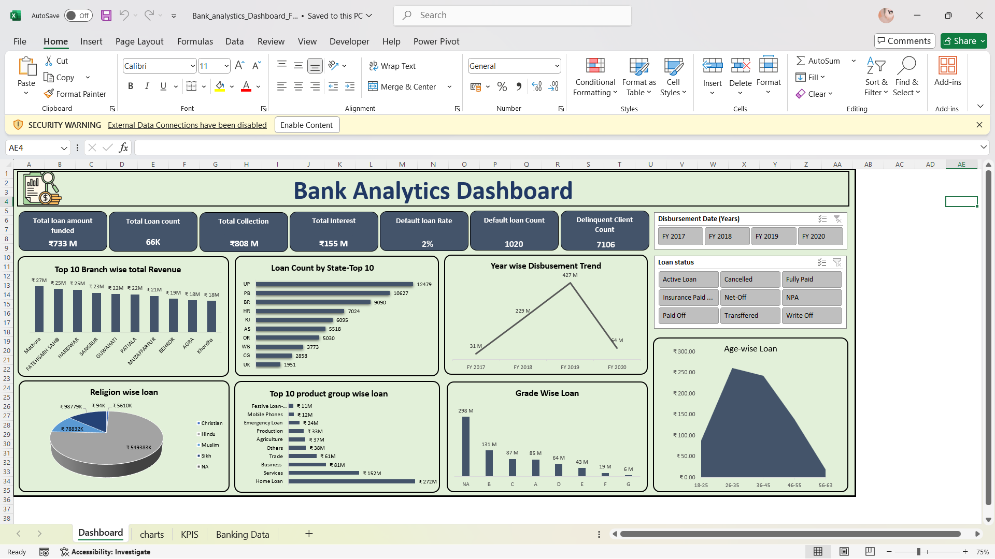
Dashboard - excel

Slide 9
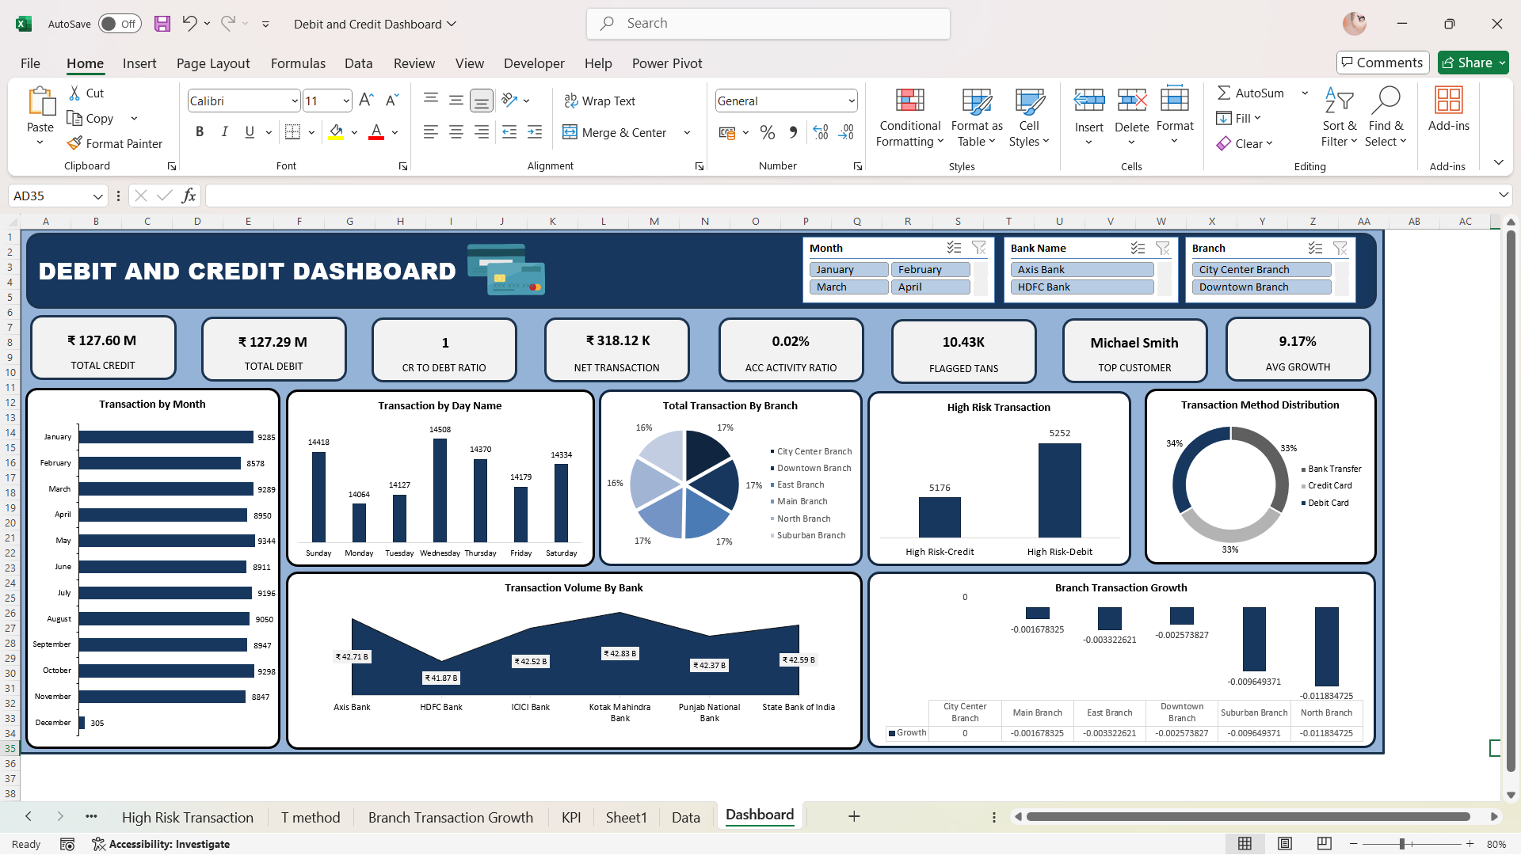
Dashboard - excel

Slide 10
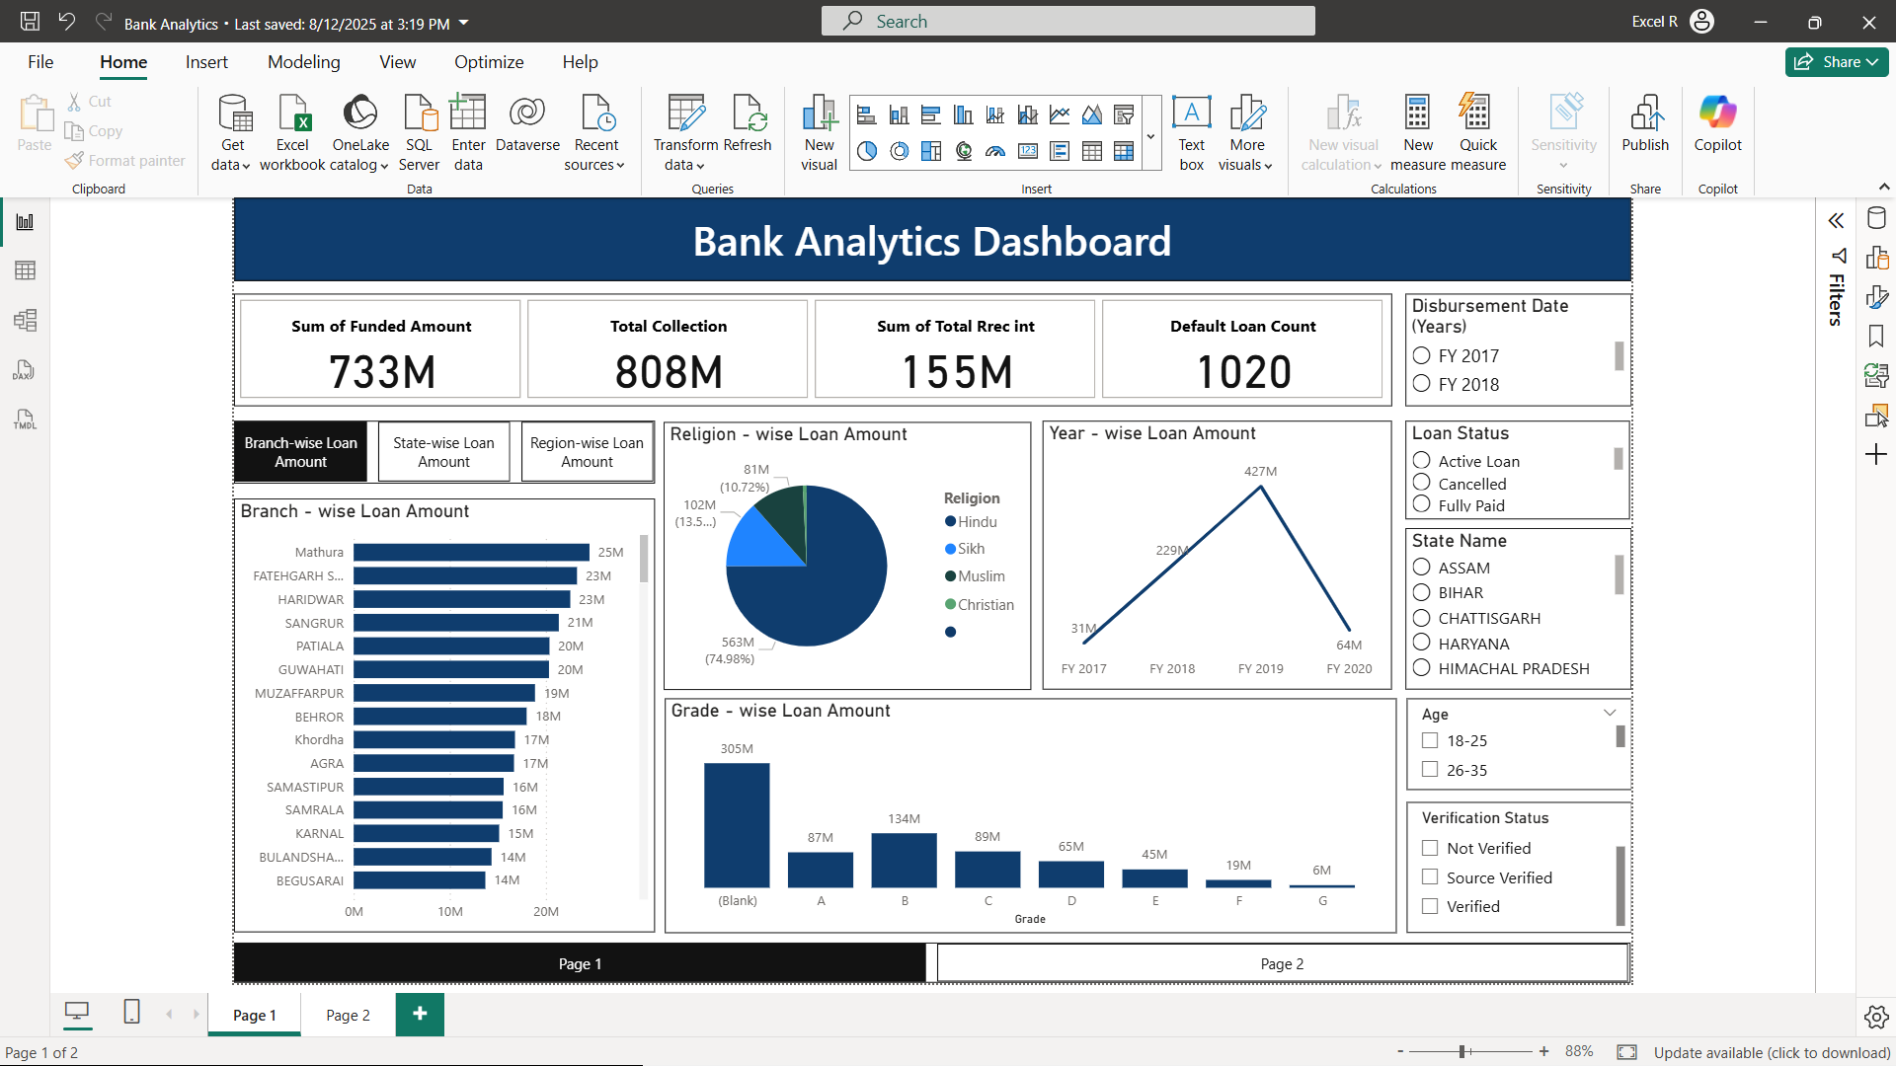
Dashboard – Power bi

Slide 11
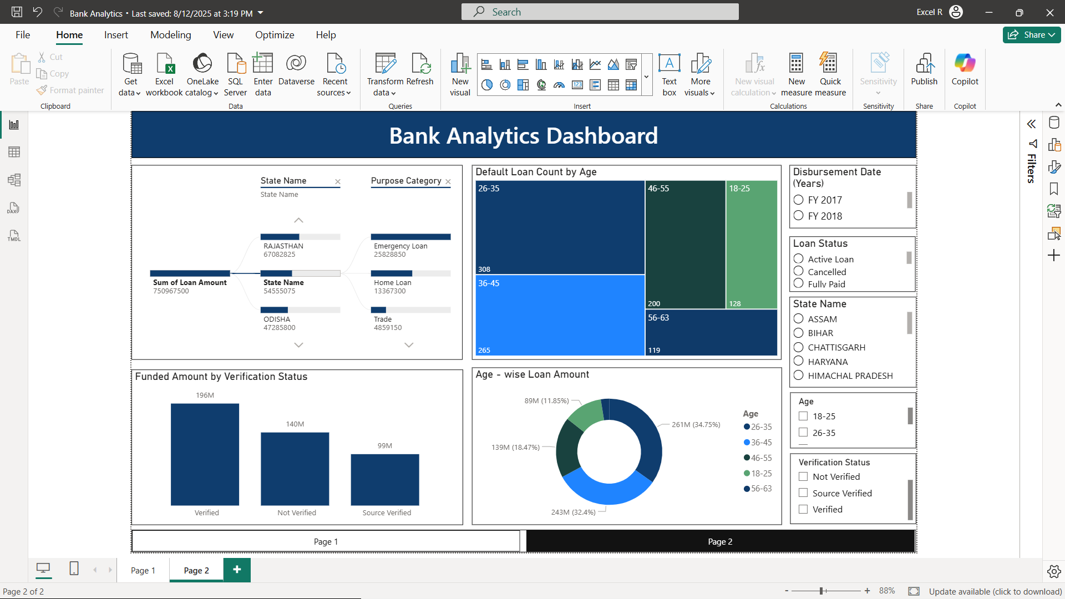
Dashboard – Power bi

Slide 12
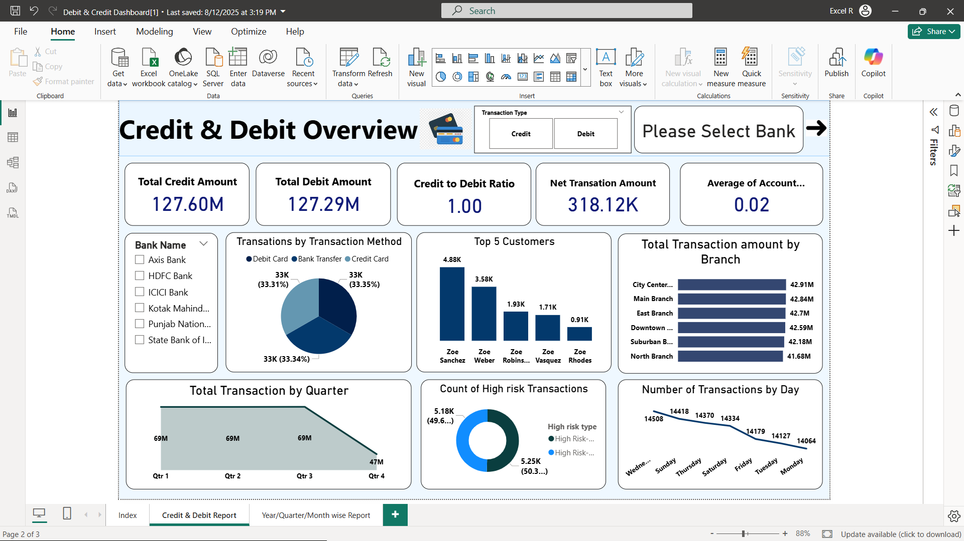
Dashboard – Power bi

Slide 13
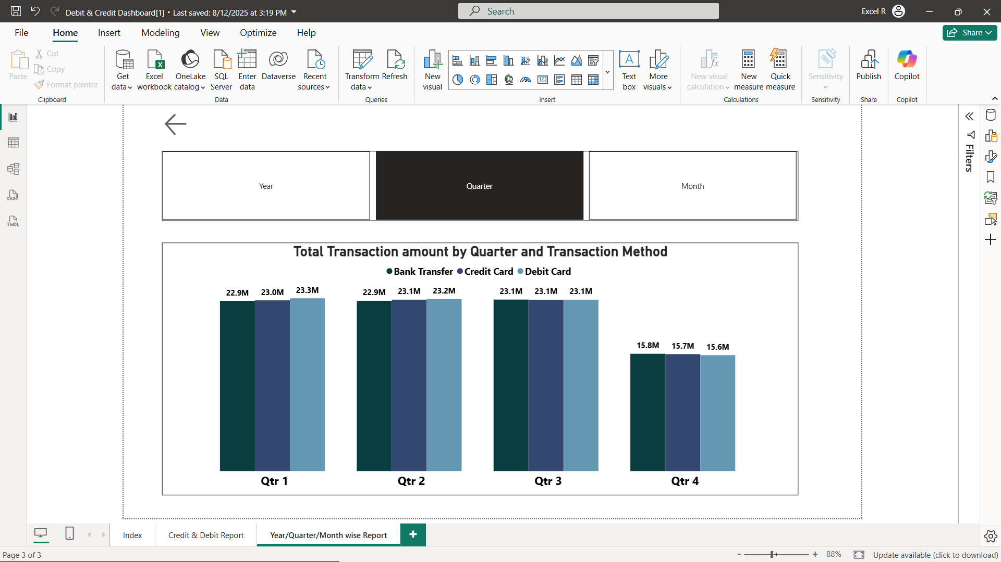
Dashboard – Power bi

Slide 14
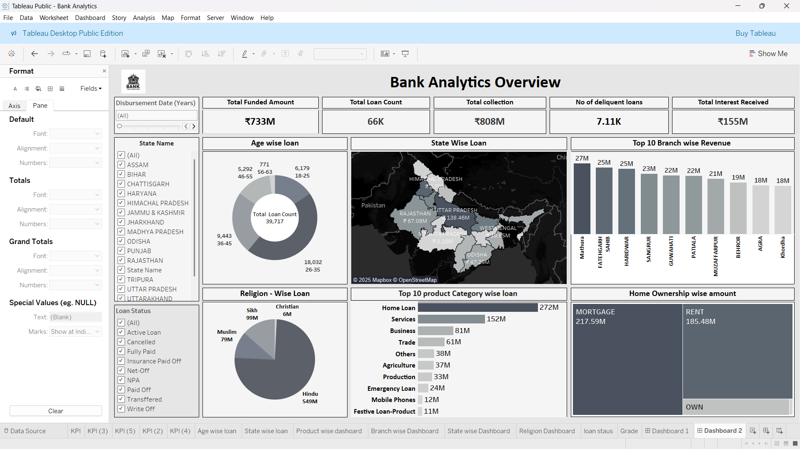
Dashboard – tableau

Slide 15
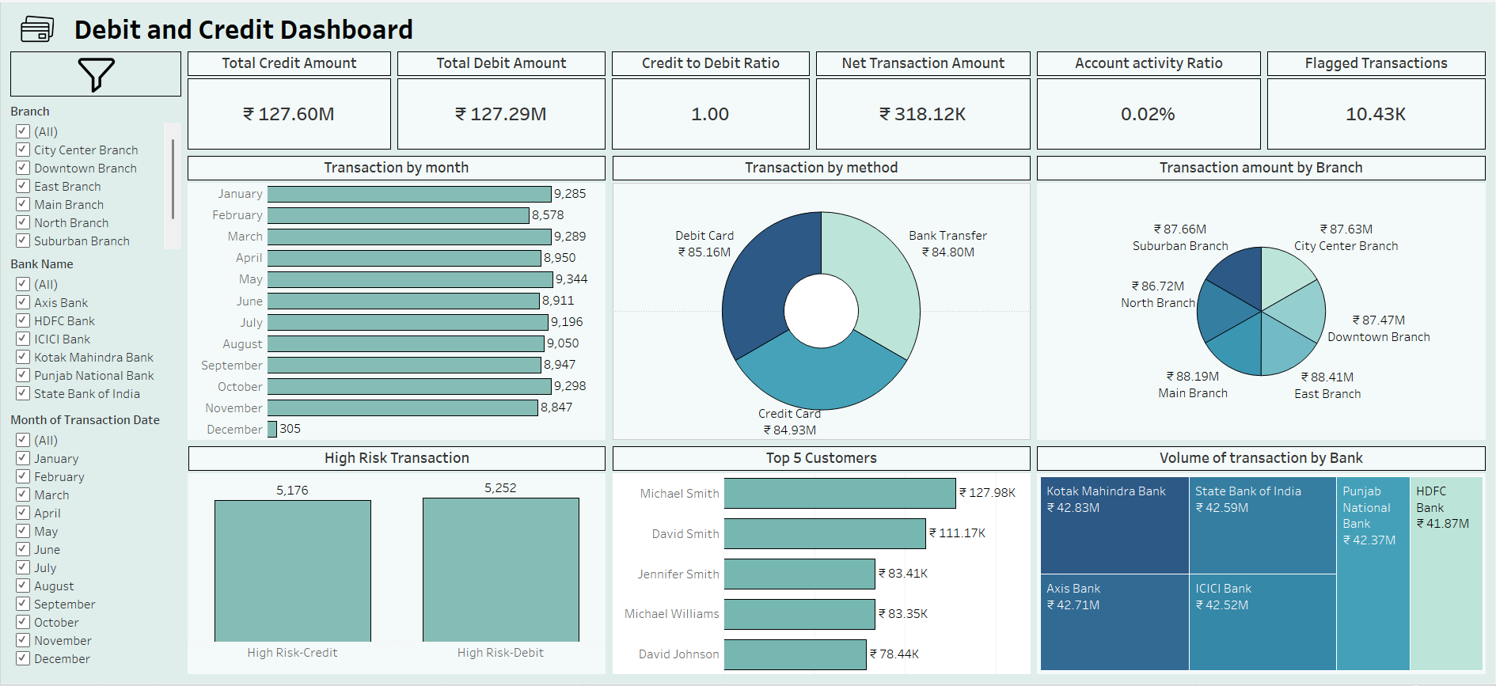
Dashboard – tableau

Slide 16
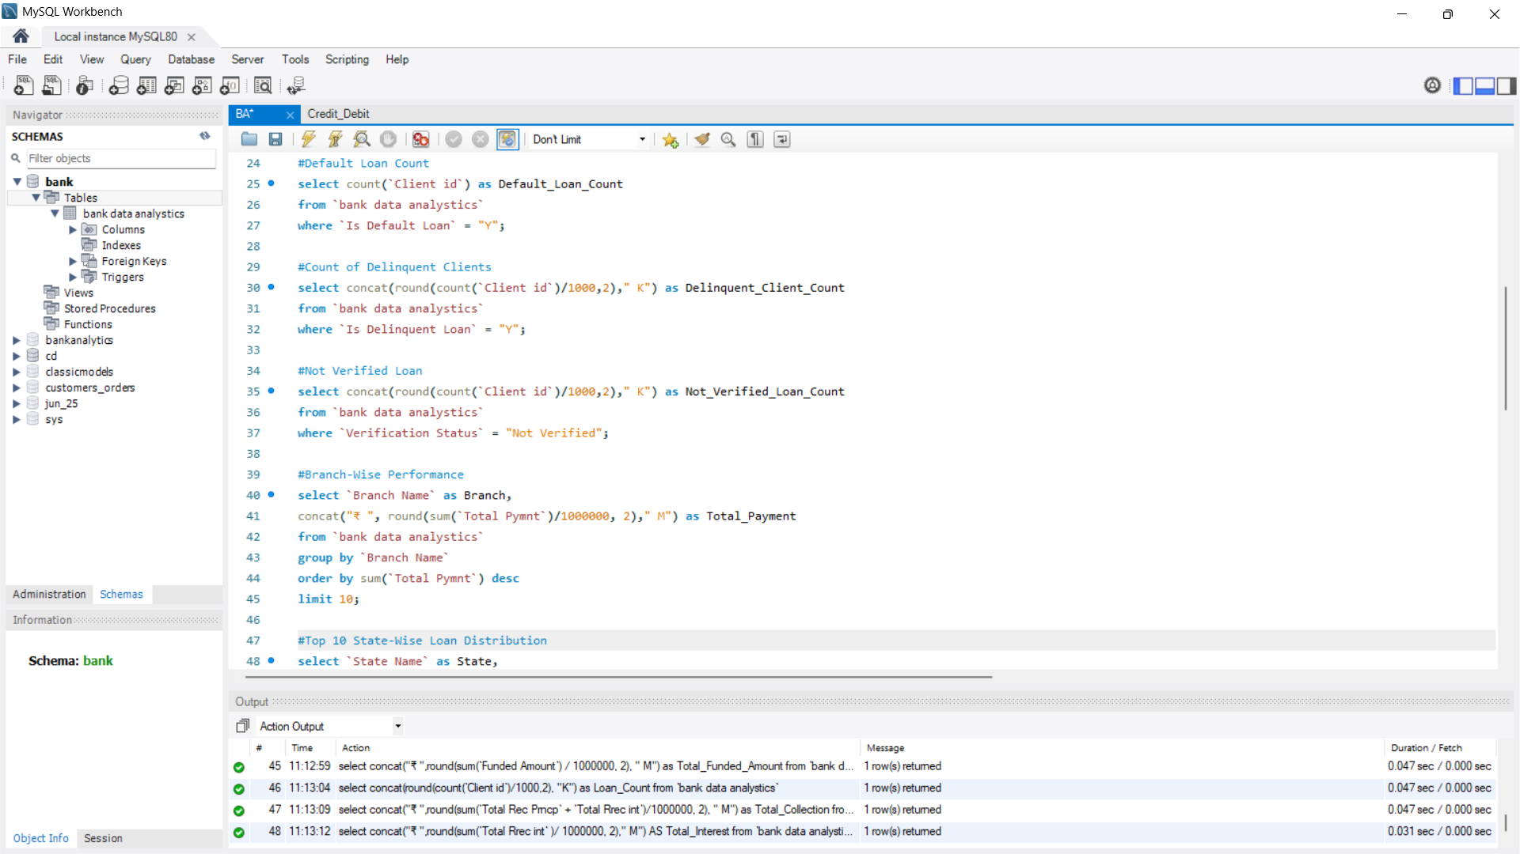
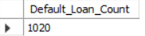
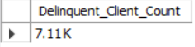
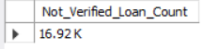
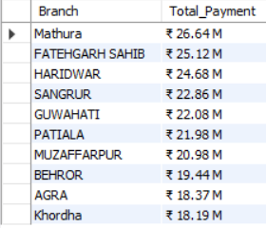
Mysql – Bank Analytics queries

Slide 17
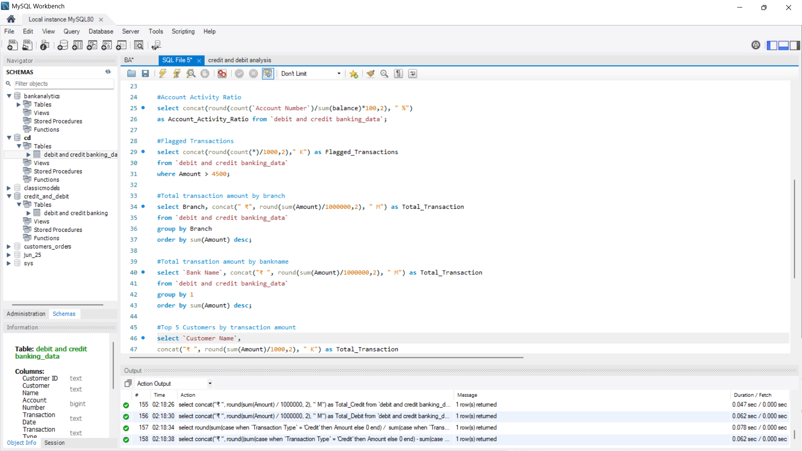
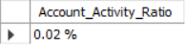
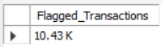
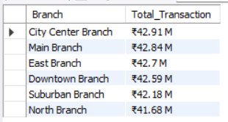
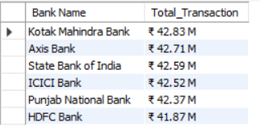
Mysql – Credit and debit queries

Slide 18
Key findings
Bank Analytics Dashboard:
Majority of loans concentrated in specific age groups and regions.
Certain purpose categories (like Home Loan, Services, Business) show higher loan demand.
Noticeable number of delinquent/default loans, highlighting risk areas.
Verification gaps in loan approval process identified.
Credit & Debit Dashboard:
Credit transactions outweigh debit in some branches, indicating surplus cash flow.
Branch-level differences in transaction.
High frequency of Debit Card transactions.

Slide 19
OVERALL Insights
Fraud Monitoring – High-value debit transactions (₹4,500+) can serve as potential fraud flags.
Customer Segmentation – Loan demand is higher among working-age customers, while older customers maintain stronger balances.
Branch-Level Performance – Some branches show stronger credit inflows, while others have higher debit activity.
Transaction Behavior – Debit cards dominate transaction frequency.

Slide 20
Challenges
Data Quality Issues – Duplicates, missing values and inconsistent entries had to be cleaned before analysis.
Complex Dataset Structure – The Bank Analytics dataset had many columns which made selecting relevant fields difficult.
Defining Meaningful KPIs – Translating raw data into metrics (loan default rates, debit vs credit trends, age distribution) required multiple iterations.
Visualization Balance – Ensuring dashboards were not only data-rich but also simple and user-friendly was a constant refinement task.
SQL Data Loading Errors – Initial data load was incomplete, leading to wrong query results. We had to reload both datasets to get accurate insights.

Slide 21
Conclusion
The Bank Analytics and Credit–Debit dashboards provided a clear understanding of customer financial behavior and loan management patterns. Through this analysis, we observed that:
Loan demand is concentrated among working-age customers, primarily for business and personal purposes.
While most loans are successfully disbursed, the presence of delinquent and default cases highlights the need for stricter verification and monitoring mechanisms.
Transaction analysis revealed that debit transactions occur more frequently, but credit transactions hold higher value, reflecting diverse customer spending and saving patterns.

Slide 22
THANK YOU!

