Slide 1
India Personal Loan Landscape: A 21-Year Analysis (2004–2025)
Presented by Arshin Akram
Regional Growth Hubs, ETL Pipeline, and Predictive Forecasting

Slide 2
Agenda
Overview
Bridging the Gap from Raw Data to Analysis
The National Credit Explosion
Regional Hubs & Market Concentration
Future Outlook & Strategic Summary

Slide 3
Overview
The Dataset
This project utilizes 21 years of historical data (2004–2025) sourced from the Reserve Bank of India (RBI). The dataset provides a comprehensive look at scheduled commercial bank credit, specifically focusing on the Personal Loan segment across all Indian States and Union Territories.
The Objective
The goal was to transform fragmented, high-volume government reports into a unified interactive dashboard. By reconciling historical administrative changes and unpivoting complex raw data, this analysis identifies regional credit hubs and the long-term growth trajectories of India's retail lending market.

Slide 4
Bridging the Gap from Raw Data to Analysis
The ETL Challenge (Power Query)
Unpivoting: Transformed the RBI's "Wide" reporting format (where years were columns) into a "Long" time-series format. This was essential for dynamic filtering and trend analysis.
Scaling: Normalized disbursement values to ₹ Crores to ensure consistent financial labeling across the 21-year timeline.
Data Integrity & Mapping
Administrative Reconciliation: Manually resolved geographical shifts, specifically merging Dadra & Nagar Haveli and Daman & Diu to align with the current 36 States/UTs of India.
Cleaning: Handled missing historical entries and standardized state naming conventions to ensure 100% accuracy in the geographic map visuals.

Slide 5
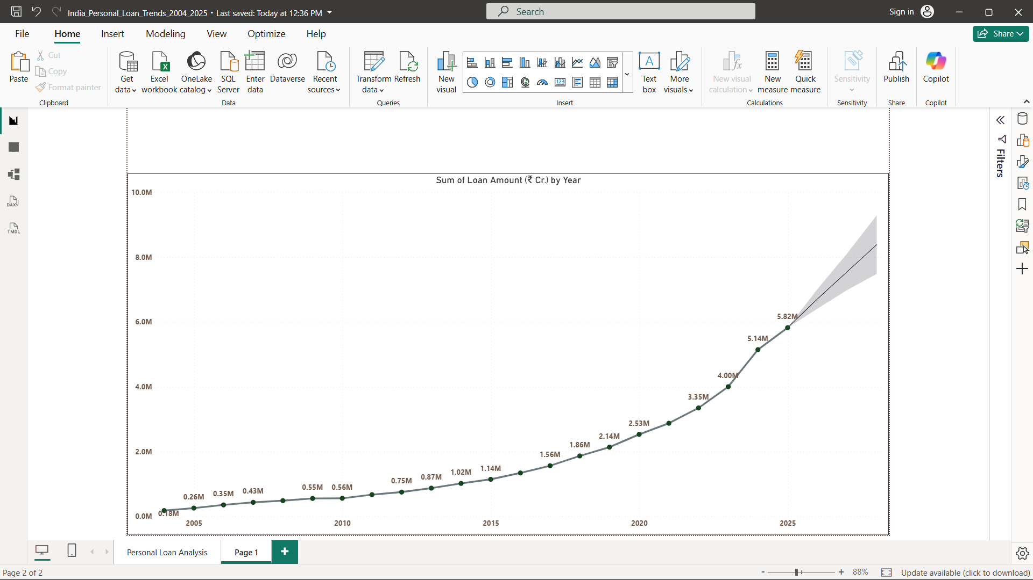
The National Credit Explosion
The "Hockey Stick" Curve: After a decade of steady growth, the market experienced an aggressive surge starting in 2021. This "Hockey Stick" curve reflects the massive adoption of digital lending and fintech platforms across India.
Market Scale: The total analyzed disbursement reached ₹37.89M Cr, with the post-2021 volume representing a significant portion of the 21-year historical total.
Figure 1: 21-Year National Loan Growth (2004–2025) with Predictive Forecasting
(Shaded Area).

Slide 6
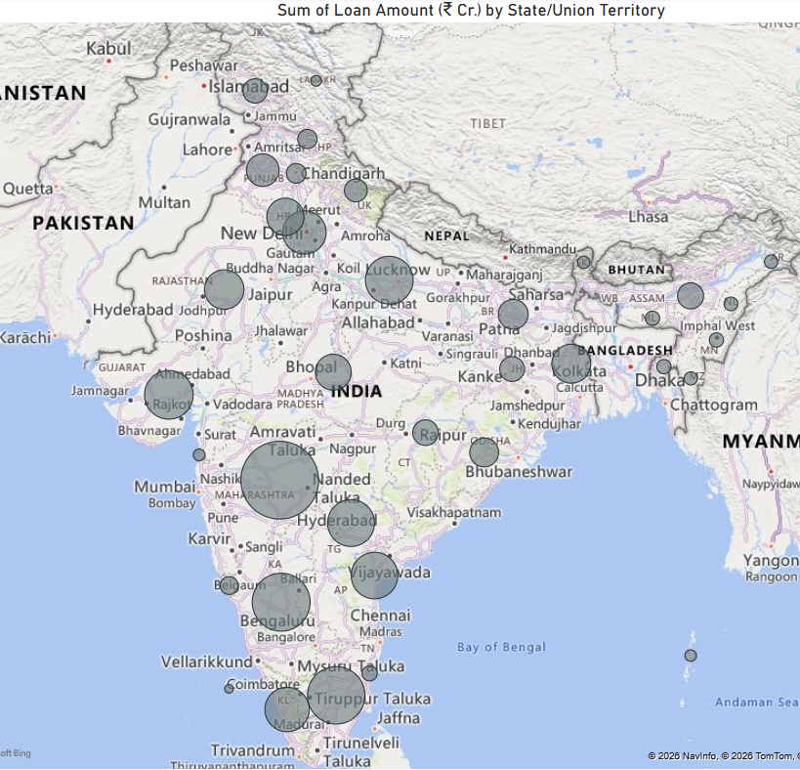
Regional Hubs & Market Concentration
The Big Three: Maharashtra (18.76%), Karnataka (9.64%) and Tamil Nadu (9.43%) consistently emerge as the primary engines of India's personal loan market, collectively commanding a massive portion of the national volume
Geographic Concentration: Analysis shows that high credit velocity is concentrated in industrialized states with established financial hubs, though Tier 2 regions are showing emerging growth.
Dynamic Market Share: Utilizing DAX, I calculated real-time market share percentages for all 36 States/UTs, ensuring that every region—from the largest states to the smallest Union Territories—is accurately represented in the total ₹37.89M Cr volume.
Figure 2: Geographic Credit Distribution & Top-Tier Market Share.

Slide 7
Future Outlook & Strategic Summary
Predictive Insights: Utilizing Exponential Smoothing models, the analysis projects a continued upward trend in domestic credit demand. This suggests that the post-2021 momentum is not a temporary spike but a structural shift in India's borrowing behavior.
National Impact: The transition from traditional banking to a high-velocity, digital-first credit ecosystem is visible nationwide. By reconciling 21 years of fragmented data, this project provides a unified, "bank-grade" view of the factors driving India's ₹37.89M Cr market.
Project Conclusion: This analysis serves as a strategic roadmap for identifying emerging growth "hotspots" and understanding regional credit concentration across all 36 States/UTs.

Slide 8
Thank you
Presented by Arshin Akram

