Slide 1

Analytics
Exploring Restaurant Trends Across Countries and Cities
Presented by:
Arshin Akram

Slide 2
01
02
03
Introduction
Objectives & Dataset Overview
Dashboards
04
Insights Generated
05
06
Conclusion & Outcomes
Recommendations & Drawbacks

Slide 3
Introduction
Zomato Analytics examines key operational and customer-experience patterns within the restaurant listings available on Zomato.
The goal is to convert raw restaurant and location data into actionable insights that help understand market distribution, pricing behavior, customer preferences, and platform performance across different countries and cities.

Slide 4
Objectives
To create a calendar table using Datekey_Opening for year, quarter and month-wise analysis.
To standardize pricing by converting Average Cost for Two into USD and forming pricing buckets.
To analyse restaurant distribution and performance across cities, countries, cuisines and ratings.
To identify trends in restaurant openings across different time periods.
To design visualization-ready KPIs and dashboards that support data-driven decisions.

Slide 5
Dataset Overview
The dataset contains restaurant-level information collected from Zomato across multiple countries and cities.
It provides a detailed view of restaurant operations, pricing and customer feedback.
Key Fields:
Restaurant Metadata: Name, City, Country, Address
Operational Attributes: Has_Table_Booking, Has_Online_Delivery, Price_Range
Cost & Pricing Details: Average Cost for Two (in local currency)
Customer Sentiment: Aggregate Ratings, Votes
Cuisine Information: Primary Cuisine Categories
Time-based Attribute: Datekey_Opening (used for Calendar Table creation)

Slide 6
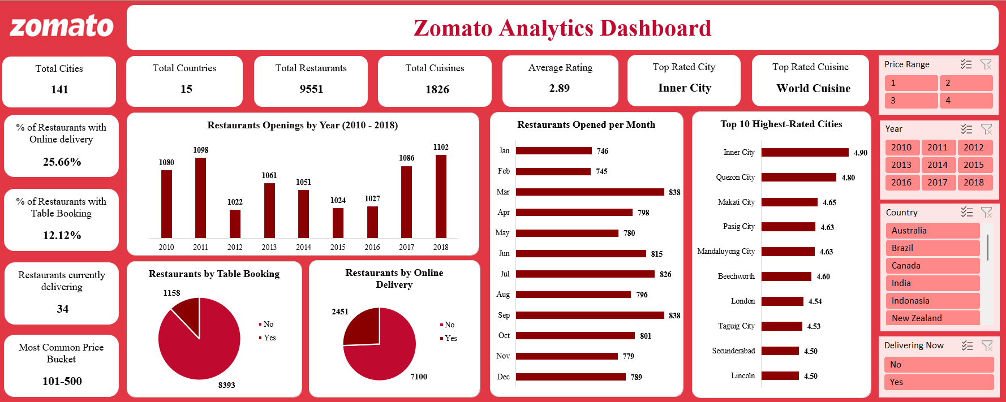
Dashboard – Excel

Slide 7
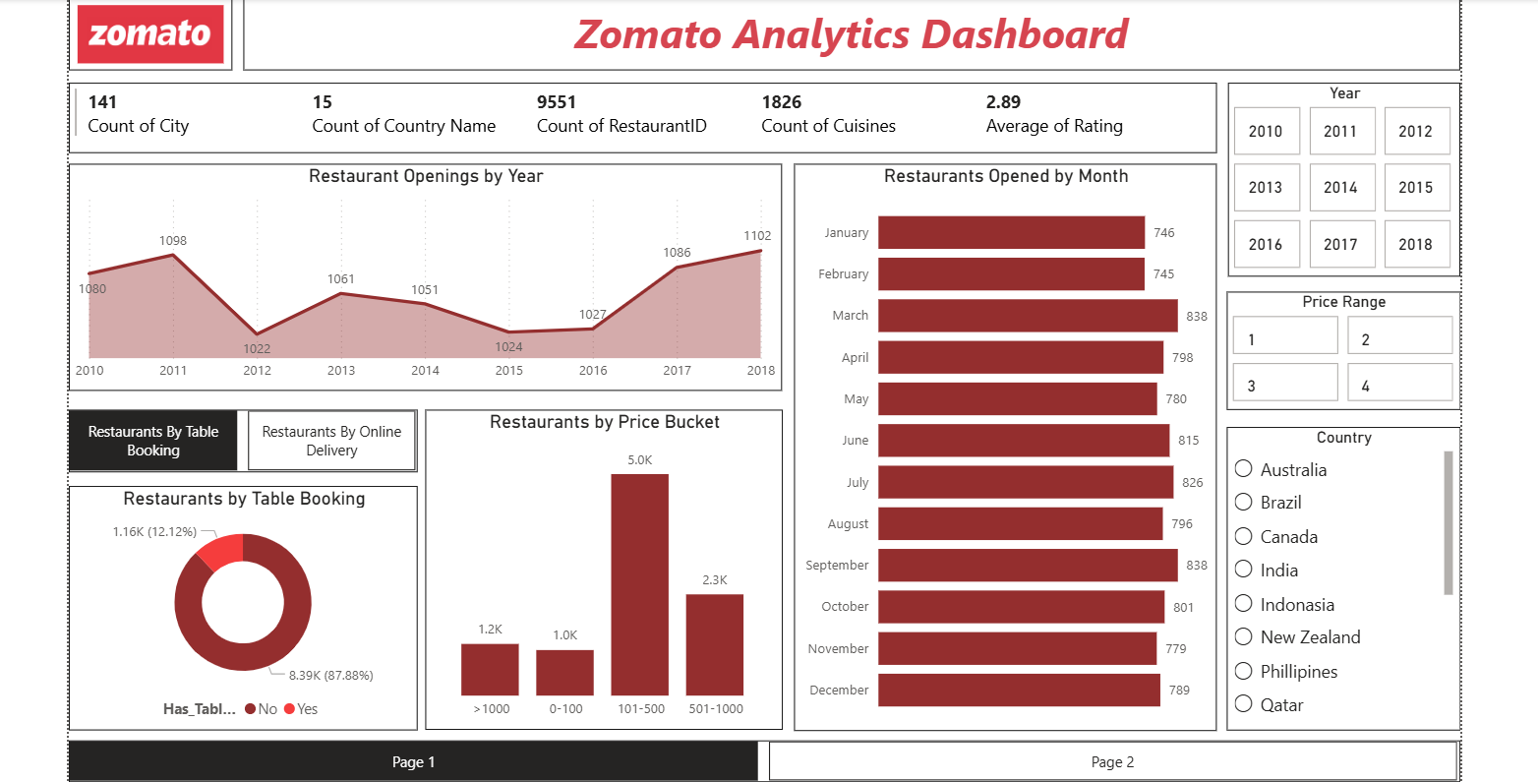
Dashboard – Power BI

Slide 8
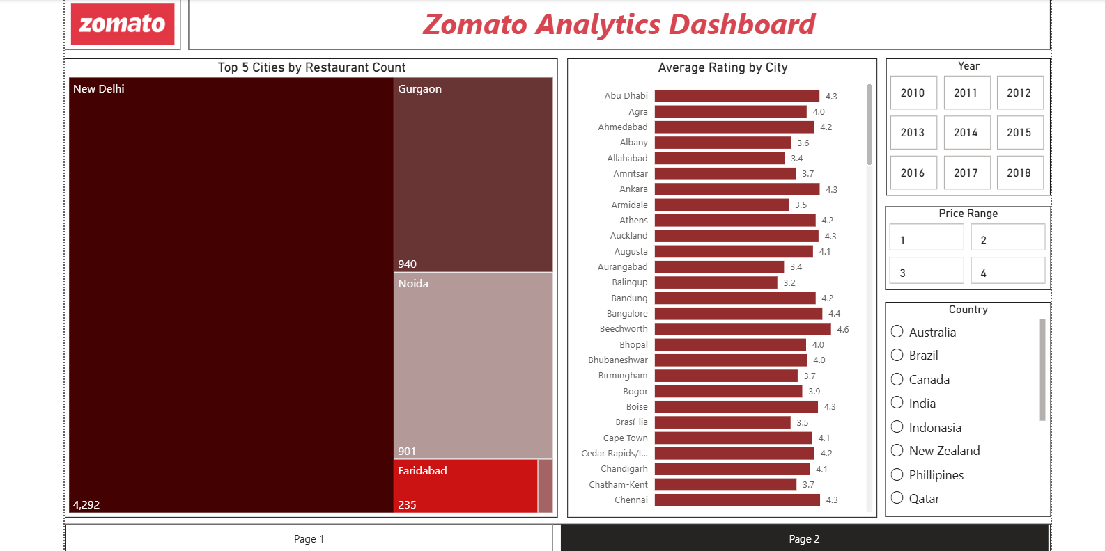
Dashboard – Power BI

Slide 9
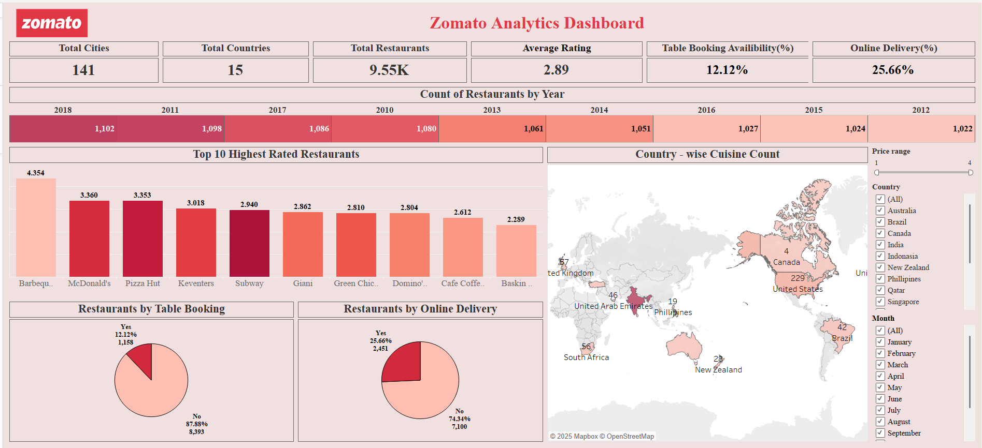
Dashboard – Tableau

Slide 10
📊Insights Generated
🍴Restaurant Distribution
India and the USA have the highest restaurant listings on Zomato.
Within India, New Delhi, Gurgaon and Noida dominate the platform.
Some cities show high restaurant density but lower average ratings, indicating competition.
💰Pricing & Cost Analysis
Average cost for two is highest in Singapore and lowest in India.
Majority of restaurants fall under mid-range (₹101 – ₹500) category.
Fine-dine outlets have fewer listings but higher ratings.

Slide 11
📊Insights Generated
⭐Customer Behaviour & Ratings
Restaurants with online delivery show better ratings and more votes.
Table booking is common among premium restaurants.
Cuisines diversity links to stronger engagement.
📅Time-Based Trends
Noticeable dip during 2012, possibly due to economic or operational factors.
Sharp rise from 2013–2018, showing Zomato’s rapid expansion phase.
March, July, and September recorded the highest restaurant openings across years.

Slide 12
📊Insights Generated
🏆Top Performing Segments
World Cuisine is the top-rated cuisine globally.
Multi-cuisine restaurants attract higher ratings and votes.
Top-rated restaurants maintain ratings between 4.0–4.9, while the global average is 2.89, indicating scope for service improvement.

Slide 13
🏁Conclusion & Final Outcomes
The analysis of Zomato’s dataset revealed key patterns in restaurant growth, pricing, and customer behavior across multiple countries.
World Cuisine emerged as the top-rated, while the average overall rating (2.89) highlights the need for better service quality.
Only 25.66% of restaurants offer online delivery, and 12.12% provide table booking — showing limited-service adoption
India and the USA lead in restaurant listings.
The study demonstrated how data analytics can uncover insights to improve business strategies, enhance customer experience, and drive platform growth.

Slide 14
🏁Conclusion & Final Outcomes
📊Analytical Outcomes
Built a Calendar Table for year, quarter & month-wise analysis.
Standardized pricing by converting Average Cost for Two into USD and creating price segments.
Designed interactive dashboards using Excel, Power BI, Tableau for visual insights.
Wrote SQL queries in MySQL to summarize key data for analysis.
Developed KPI cards and visuals to measure growth, ratings, and service availability.

Slide 15
Recommendations & Drawbacks
💡Recommendations
Encourage restaurants to adopt online delivery and table booking to increase visibility and ratings.
Focus on customer feedback mechanisms and improving customer satisfaction, as the average rating (2.89) indicates room for service enhancement.
Promote World Cuisine and multi-cuisine concepts, as they consistently attract higher ratings and engagement.
Expand operations in underrepresented cities or countries with growing food demand.
Leverage seasonal trends (March, July, September) for marketing and new openings.

Slide 16
Recommendations & Drawbacks
⚠️Drawbacks / Limitations
Currency inconsistency: Average Cost for Two is in different local currencies, making price comparison challenging without conversion.
Missing or incomplete data: Some restaurants have missing cuisine, cost, or rating values, which can affect the accuracy of insights.
Lack of customer demographics: Dataset doesn’t include age, gender, or spending behavior of users – limits customer segmentation analysis.
No time-series continuity: The Datekey_Opening field only shows opening date – no data on closures or ongoing activity.

Slide 17
Recommendations & Drawbacks
⚠️Drawbacks / Limitations
Ratings bias: Ratings may be subjective or outdated, not always reflecting the current quality or service.
Uneven geographic representation: Some countries (like India and USA) dominate the dataset, causing imbalanced insights across regions.
Limited business metrics: No fields for revenue, profit, or sales volume, restricting financial performance analysis.
Static dataset: Represents a snapshot in time, not live or regularly updated — trends may not represent current Zomato data.

Slide 18
Thank you!
Tools Used: Excel | Power BI | Tableau | MySQL
Turning data into decisions, and insights into impact.

