Slide 1
HAPPIEST HEALTH DIGITAL TWIN CHALLENGE 2026
HyperTwin
From isolated home blood-pressure readings to a continuously updated, patient-specific state
Research prototype | synthetic data only | not a diagnostic or treatment tool
Arshin Kazi (arshin.kazi20) | Mody University of Science and Technology
Notes:
Open with the problem, not the tool. HyperTwin is a research prototype on synthetic data.

Slide 2
One home reading is one noisy number
Home BP is guideline-endorsed
Out-of-office BP is recommended in major hypertension guidance.
Thresholds are for averages
Guidelines cite 135/85 mmHg for home BP averaged over several days.
The trend is what a clinician needs
Single readings scatter. A state estimate shows where the patient is heading.
Synthetic patient P090, 41 valid morning readings
Sources: ESH Working Group home BP position paper 2021 (PMC9904446); AAFP summary of ISH guidelines 2021
Notes:
Guidelines endorse home BP and cite 135/85 for multi-day averages. The chart is a synthetic patient, not real data.

Slide 3
The insight
Read history and today's data together, as one evolving state.
Historical EHR
New observations
Patient state
age, BMI, medications, family history, last clinic BP
+
home BP, sleep, steps, one day at a time
=
a level and its uncertainty, updated every day
Notes:
A static dashboard shows readings. A twin keeps a state that changes when new data arrives.

Slide 4
HyperTwin
HyperTwin is a research prototype that updates a patient-specific blood-pressure state from historical health information and home readings to forecast next-morning systolic BP risk.
Inputs
State
Outputs
Synthetic EHR, home SBP/DBP, sleep, steps
Kalman level and variance per patient
Next-morning SBP, P(SBP at or above target), contributions
Notes:
Read the sentence slowly. Everything on this slide exists in the code.

Slide 5
How it works: data flow
1 Synthetic EHR
EHR prior
5 Forecast
age, BMI, antihypertensive count, family history, last clinic SBP
OLS fit on training patients gives the starting level
next-morning SBP, P(at or above target), contributions
4 Patient state
Kalman level and variance, plus sleep/steps effect
2 Home observations
3 Quality gate
6 Dashboard
timestamped SBP, DBP, sleep, steps; missing days and implausible values
SBP 70 to 250, DBP below SBP, else the reading is skipped
replay, add reading, what-if
Matches src/twin.py. Parameters fit on 90 training patients only; each forecast uses data before that day.
Notes:
Walk left to right. Missing and implausible readings do not move the state; uncertainty grows instead.

Slide 6
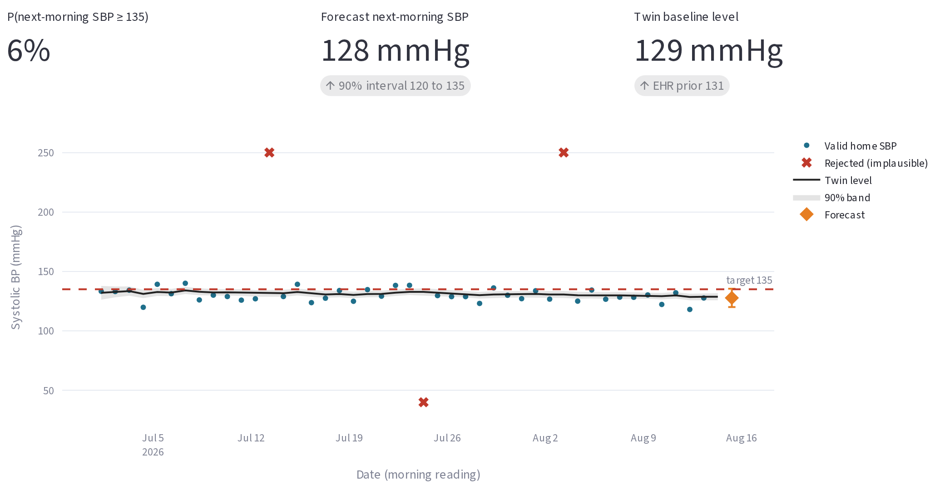
The clinician view
Forecast and risk
Next-morning SBP, 90% interval, P(at or above 135)
State over time
Twin level with 90% band against valid readings
Data quality
Rejected implausible readings shown as red crosses
Actual dashboard screenshot. Synthetic patient P090, replay day 45.
Notes:
This is the real Streamlit app. Controls: patient, replay slider, target, add observation.

Slide 7
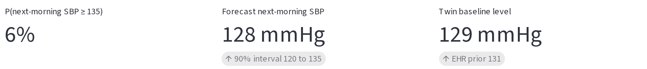
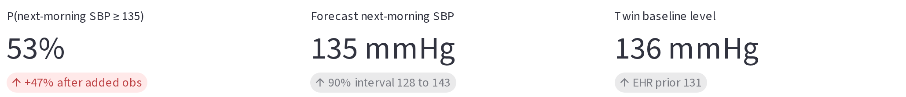
A new reading changes the state
Before
6%
to
53%
After adding 175/95 mmHg
risk of next-morning SBP at or above 135 mmHg
A default 150/90 reading gives 6% to 20%.
Illustrative synthetic demonstration, patient P090 at replay day 45. Not a clinical outcome, and not what any real patient would see.
Notes:
Verified in the app: 175/95 gives 6% to 53%. The added reading moves forecast and risk; it is not drawn as a point on the chart.

Slide 8
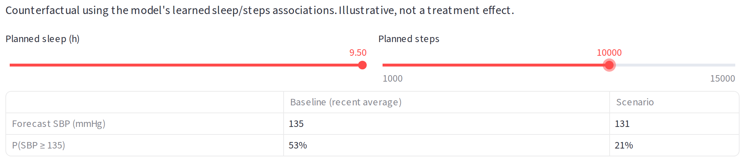
What if sleep and activity change?
How to read it
Uses the sleep and steps associations the model learned. In this prototype those effects are assumptions built into the synthetic data.
53% to 21%
An illustration, not a treatment effect.
forecast 135 to 131 mmHg, with 9.5 h sleep and 10,000 steps planned, after the 175/95 reading
Actual dashboard screenshot, What-if scenario tab. Extreme settings chosen to make the effect visible.
Notes:
The sliders are planned sleep and planned steps for the next day.

Slide 9
Does the state beat simple baselines?
MAE (mmHg)
AUROC
Brier score
Lower is better
Higher is better (axis starts at 0.85)
Lower is better
Clear gain over the last reading. Small gain over the 7-day mean, not shown to be statistically significant.
Synthetic data. 4,024 predictions, 60 held-out test patients (90 training), one seed, no confidence intervals. Twin uses past data only.
Notes:
Be honest: the 7-day mean is nearly as good. Results show agreement with our own generator, not clinical validity.

Slide 10
What the prototype demonstrates
1
2
3
4
5
Patient-specific state
Bad data handled
Short-horizon forecast
Interpretable output
What-if simulation
Starts from each patient's EHR, then learns from readings
Missing and implausible readings do not move the state
Next-morning SBP with a 90% interval and risk
Forecast split into EHR prior, recent level, sleep, steps
Compare planned sleep and steps on the same patient
No first-of-its-kind claim. Many challenge entries build twins for other conditions.
Notes:
Only what is implemented and tested is listed here.

Slide 11
Safety and limitations
Synthetic data only
Not clinically validated
No real patient information.
Results show agreement with our own generator.
Not a diagnosis or treatment tool
Proxy target
Research prototype.
Guidelines use multi-day averages. We predict a single morning.
Small edge over a 7-day mean
Assumed effects
Not shown to be significant. One seed.
Sleep and steps effects are set in the generator.
Notes:
State all of this out loud in the video.

Slide 12
From readings to a state
A reading says what happened. A patient-specific state says where things are heading.
Validation roadmap
Team
1
Test on licensed real home-BP data
arshin.kazi20
Arshin Kazi
Mody University of Science and Technology
https://github.com/arshinkazi/HyperTwin
2
Add confidence intervals and calibration checks
3
Forecast sleep and steps instead of assuming them
4
Review usefulness with clinicians

