Slide 1
Daisy intelligence 2020 hackathon: digital flyer processing
Team Name:
Milk Before Cereal
- Haoran (Jayce) Wang
- Arsh Kadakia

Slide 2

High-Level Pipeline
Bounding Box Detection
Parsing Algorithm to Output csv
Text-Recognition
Each recognized bounding box of each flyer is passed in for text-recognition
Words outputted via text-recognition is parsed and analyzed via patterns and logic statements to check for output categories

Slide 3
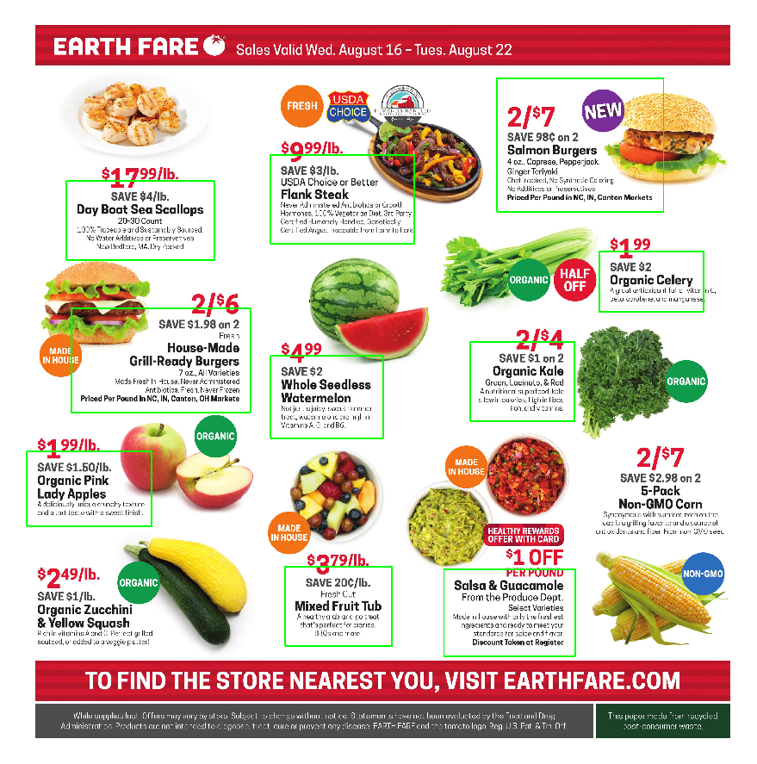
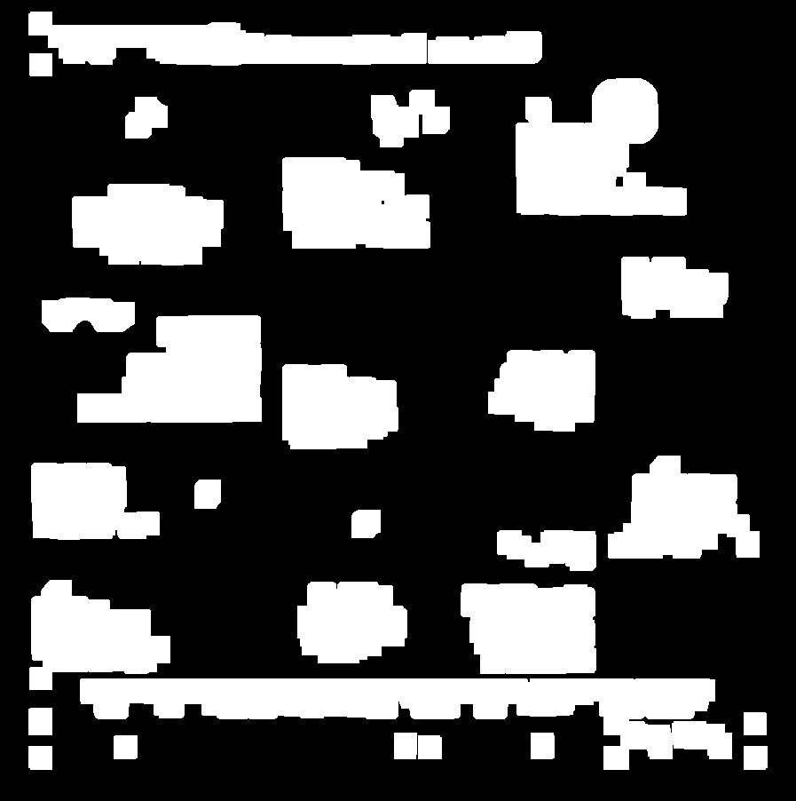
Bounding Box Detection
Employed method is to detect the contours of densely packed words as rectangles once they are blurred and dilated using computer vision algorithms
Alternate solution was to apply employed algorithm to collect training data for a MASK-RCNN network in hope of consistently detecting every entry on a flyer but failed due to lack of data
Algorithm is biased toward rectangularly packed entries on the flyer
Better results can be achieved through further tuning of parameters

Slide 4
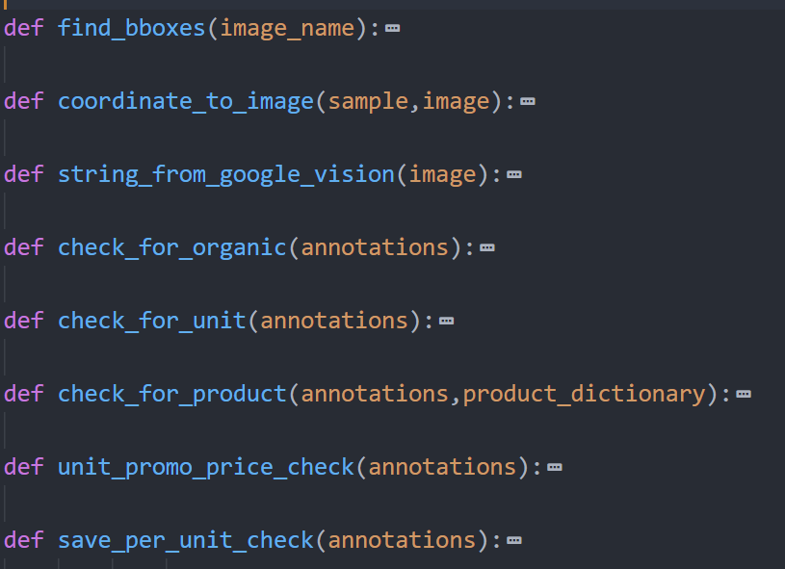
Text-Recognition
Detected entries are passed into Google Cloud Vision API for text-recognition
JSON output for each entry is sorted using a library of functions each responsible for existence of a output criteria
Function library is used in a main pipeline file that completes the writing of the output csv file if an output criteria has been successfully detected

Slide 5
Challenges We Faced
Attempting to use deep learning for entry detection, we spent a lot of time developing the code and preprocessing required for transfer learning of the Mask-RCNN algorithm until it was not worth the investment due to the lack of data
Having trouble deciding parameter configuration for computer vision algorithm as certain setups worked well for some photos but not others
Bounding boxes sometimes did not cover all of the text, therefore text recognition api struggled to provide accurate results at times

