Slide 1

KisanSetu AI
Smart Markets. Better Prices. Stronger Farmers.
IBM University Engagement Project · Agriculture Domain · Agentic AI with IBM Granite & LangFlow

Slide 2
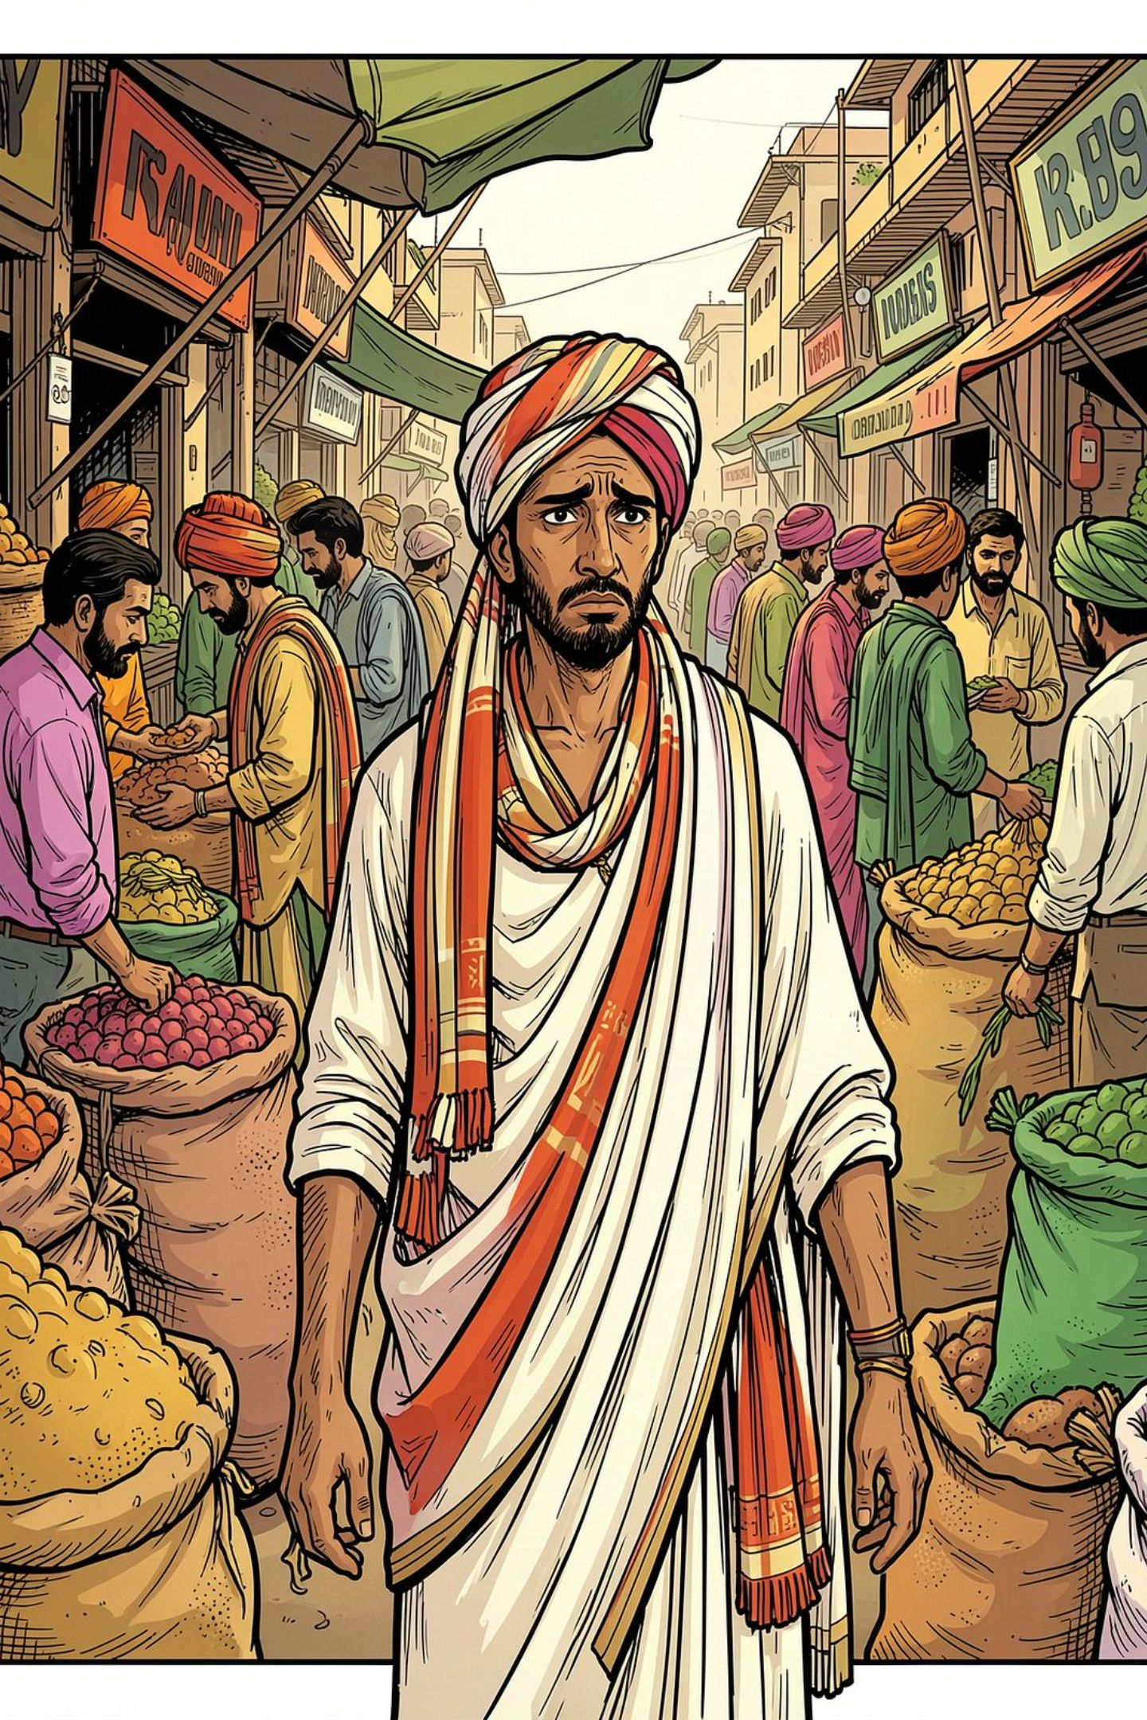
The Problem Farmers Face
No Price Transparency
Mandi prices are difficult to track in real time.
Middleman Dependence
Farmers rely on intermediaries, often receiving lower prices.
Limited Buyer Access
Hard to find trustworthy buyers for cotton & groundnut.
Poor Selling Decisions
Without data, decisions on selling, storage, and quality reduce income.

Slide 3
Introducing KisanSetu AI
An Agentic AI-powered market linkage platform connecting farmers directly with buyers — providing price intelligence, forecasting, and actionable recommendations.
Mandi Price Agent
Price Forecasting Agent
Real-time price intelligence across mandis.
Predicts price trends using IBM Granite.
Buyer Matching Agent
Sell/Store Advisor
Finds suitable buyers for farmer produce.
Recommends when to sell or store produce.
Quality Grading Agent
Income Dashboard Agent
Assists in produce quality assessment.
Tracks revenue and selling performance.

Slide 4

Technology Stack
IBM Granite
AI reasoning, forecasting, and recommendations.
IBM watsonx.ai
AI model deployment and governance.
IBM Cloud
Scalable backend and deployment infrastructure.
LangFlow
Multi-agent workflow orchestration.
RAG + Vector DB
Retrieves reliable market data before generating responses.
HTML · CSS · JS
Simple, mobile-first user interface prototype.

Slide 5

LangFlow Components & Workflow
LangFlow orchestrates the multi-agent pipeline — from farmer input to AI-generated recommendation.
Farmer Input
AI Agent Processing
RAG Retrieval
Output Recommendation
Example: "Should I sell my cotton today?" → Retrieve mandi prices → Analyze trend → Granite reasoning → Sell / Wait / Store recommendation

Slide 6
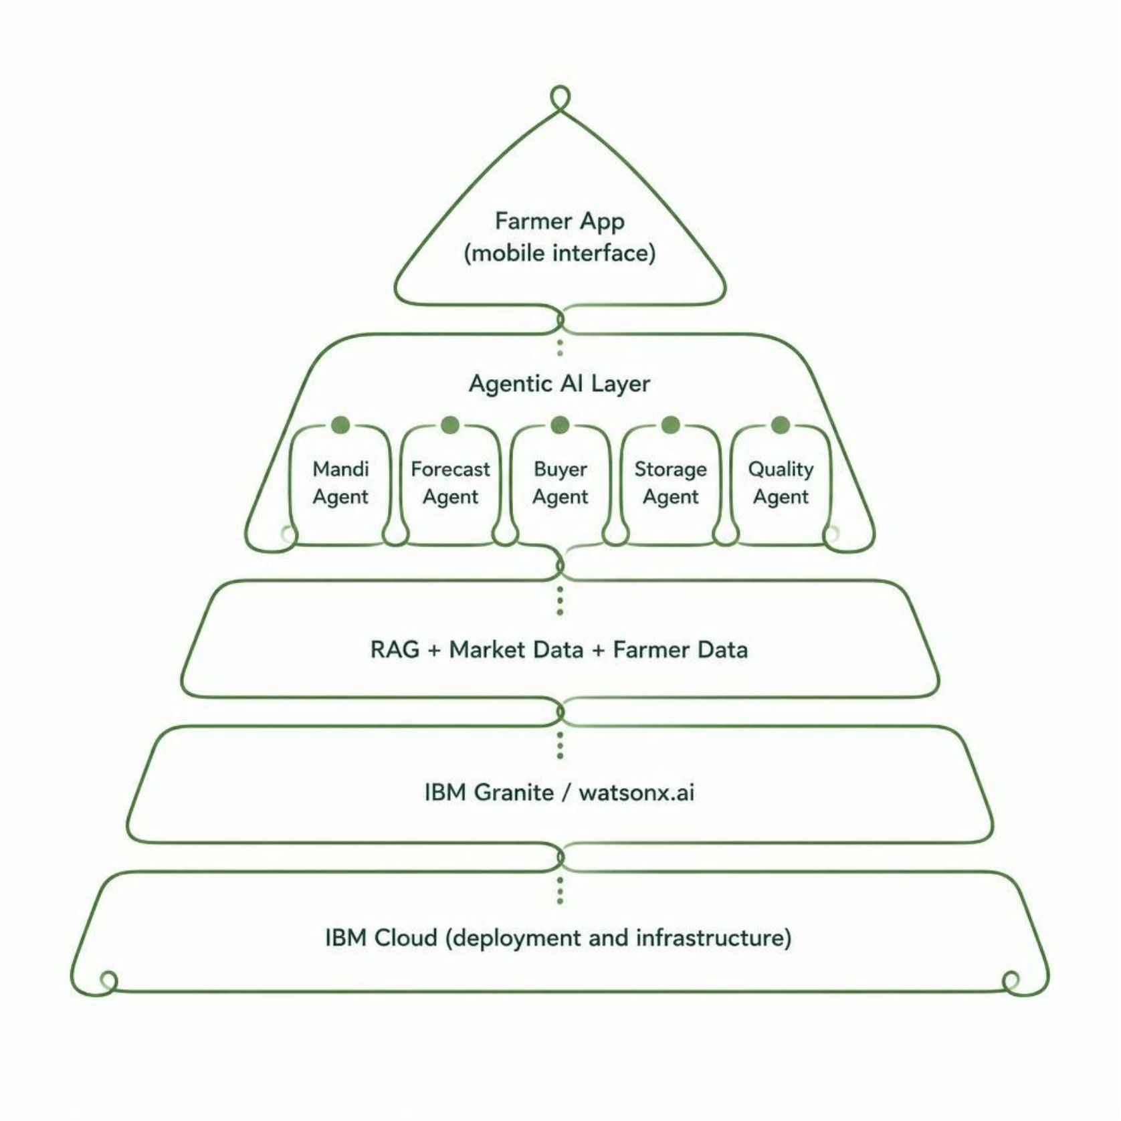

Architecture Blueprint
How It Works
Farmers interact through a simple mobile app. The Agentic AI Layer coordinates specialized agents that query real-time market data via RAG. IBM Granite processes insights and delivers personalized recommendations — all hosted on scalable IBM Cloud infrastructure.
Each agent has a focused role, but they coordinate to solve complex selling decisions together.

Slide 7

The Power of Agentic AI
KisanSetu AI is a decision-support system — not a simple chatbot. Multiple specialized agents work together to deliver personalized, actionable insights.
Specialized Agents
Each agent handles a distinct farming decision — pricing, forecasting, buyer matching, quality, storage.
Coordinated Reasoning
Agents analyze market and farmer data together to solve complex selling decisions.
Simple Language Output
Farmers receive clear, actionable recommendations in Gujarati, Hindi, or English.

Slide 8
Novelty & Uniqueness
Multi-Agent AI
Real-Time Intelligence
Six specialized agents for different farming decisions.
Live mandi price data with trend analysis.
AI Price Forecasting
Direct Buyer Matching
IBM Granite predicts short-term price movements.
Eliminates middlemen with direct farmer-buyer links.
Sell vs. Store
Multilingual Support
Data-driven recommendations on optimal selling timing.
Gujarati, Hindi, and English with voice-friendly input.

Slide 9
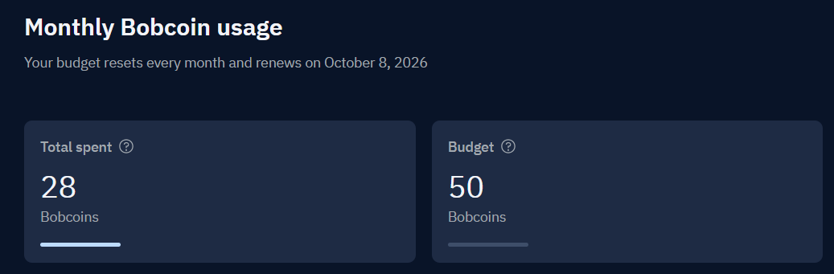
Token Usage & Screenshots
Token Count
50
Before Prompt
50
After Prompt
28

Slide 10

Impact & Conclusion
KisanSetu AI empowers farmers to make smarter, data-driven decisions — increasing income, reducing dependence on middlemen, and improving market access.
Higher Income
Direct Market Access
Real-time prices and forecasting help farmers sell at the right time.
Buyer matching eliminates intermediaries and improves bargaining power.
Scalable Future
Expandable to more crops, regions, and languages across India.
"KisanSetu AI — Smart Markets. Better Prices. Stronger Farmers."

Slide 11
Git hub repository link
Repository link
https://arshitrivedi31-afk.github.io/

Slide 12
Thank you

