Slide 1
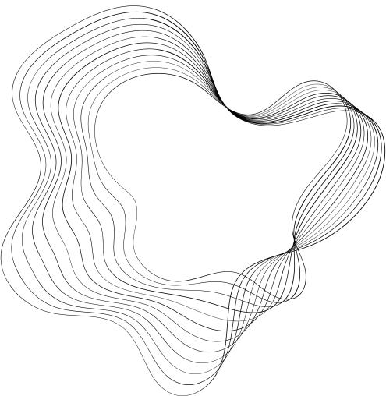


Major Project
SYSTEMATIC COMPARISON OF SEMI-SUPERVISED AND SELF-SUPERVISED LEARNING FOR MEDICAL IMAGE CLASSIFICATION
Guided by:
Dr. Sonali Agarwal
By:
Preeti (IIB2021042)
Girisha Vashisht (IIT2021183)
Arshiya Chutke (IIT2021270)

Slide 2
INTRODUCTION
In this project, we systematically benchmark Self-Supervised Learning (Self-SL) and Semi-Supervised Learning (SSL) for medical image classification to determine the most effective approach for handling limited labeled data.
Semi-Supervised Learning : trains a classifier using a small labeled dataset while leveraging a large unlabelled dataset to improve learning.
Self-Supervised Learning : earns useful representations from the unlabelled data first, then fine-tunes a classifier using the labeled data.
Evaluating these methods on medical datasets using ResNet-50, Vision Transformers (ViT, Swin-ViT).comparing performance based on Accuracy, AUC-ROC, and Precision to find the most efficient model for medical AI applications.

Slide 3
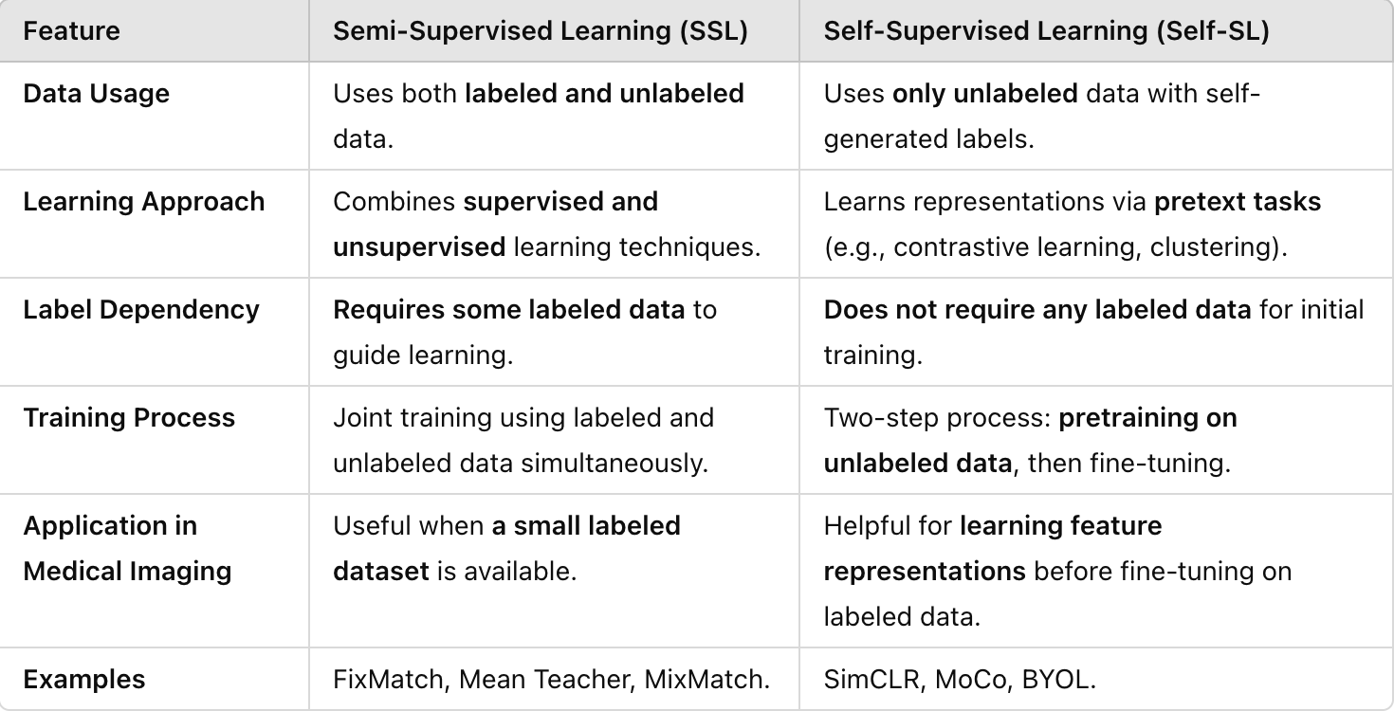
SSL AND SELF-SL

Slide 4
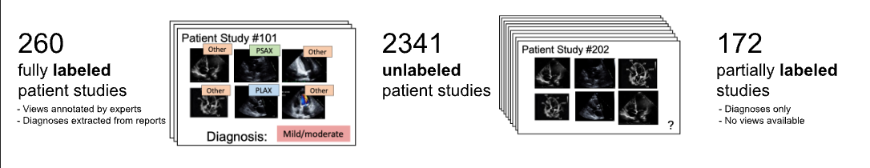
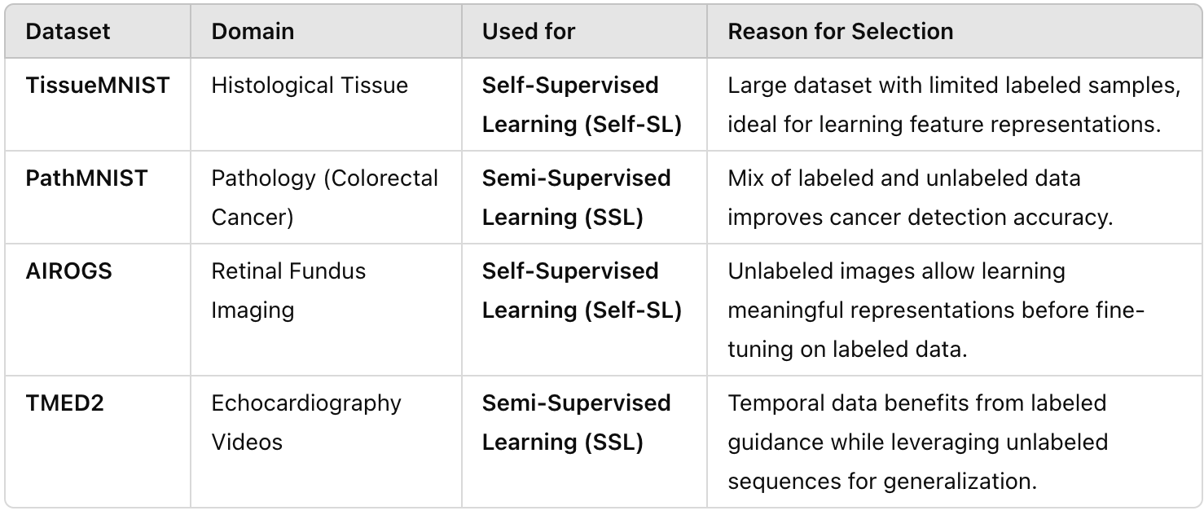

DATASET DESCRIPTION

Slide 5
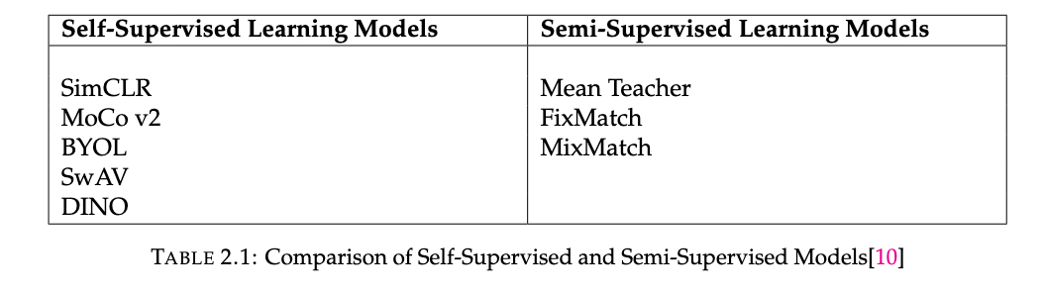
LITERATURE REVIEW
Focus: Comparative review of Self-Supervised Learning (SSL) and Semi-Supervised Learning (Semi-SL) in medical image classification.
Motivation: Addresses challenges like scarcity of labeled data and complexity of medical images.
SSL: Learns from unlabeled data using pretext tasks.
Semi-SL: Combines limited labeled data with large unlabeled data using consistency or pseudo-labeling.

Slide 6
LITERATURE REVIEW
Semi-Supervised Learning (SSL) Approaches
Combines few labeled with many unlabeled images Uses techniques like:
Consistency Regularization Pseudo-labeling:
Useful in low-label medical scenarios
Learns generalizable features from unlabeled data.
Particularly helpful in healthcare where labeled data is scarce and sensitive.
Model Evaluation (Kakarla et al., 2023)
Models: Mean Teacher, FixMatch, MixMatch, SimMatchV2 FixMatch SimMatchV2 outperformed Mean Teacher on TissueMNIST

Slide 7
RESEARCH GAP
Limited Comparative Studies
Lack of systematic comparisons between self-supervised and semi-supervised approaches
Few studies directly comparing performance across multiple medical imaging domains
Insufficient benchmarking under consistent evaluation protocols
Architectural Adaptation Challenges
Most existing models are optimized for natural images rather than medical data
Limited understanding of how to adapt model architectures for medical-specific features
Need for guidelines on modifying mainstream architectures for medical imaging tasks

Slide 8
RESEARCH GAP
Data Efficiency and Scalability
Unclear effectiveness of different approaches in extremely low-label regimes
Limited research on model performance with varying amounts of labeled data
Need for better understanding of scaling behaviors in medical contexts

Slide 9
METHODLOGY AND MODELS

Slide 10
DINO
MAIN PRINCIPLE: STUDENT TEACHER MODEL
How it Works:
• Two identical networks with different roles:
Student: Actively learns and updates
Teacher: Guides learning process
Key Mechanism:
Knowledge Transfer:
Teacher provides stable training targets
Student learns to match teacher's predictions
No manual labels needed
Update Process:
Student: Updated through backpropagation
Teacher: Updated through momentum averaging
Formula: θt ← mθt + (1-m)θs [m = 0.996]

Slide 11
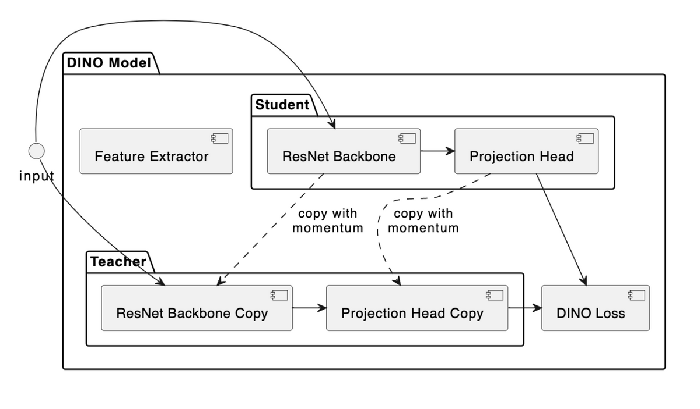
DINO ARCHITECTURE

Slide 12
WORKING
Step 1: Initial Setup •
Input medical image (96×96 grayscale)
Two networks: Student & Teacher (identical architecture)
Prototypes: Learned cluster centers in feature space
Step 2: Data Processing
• Generate multiple views of same image:
Global views (full image)
Local views (cropped portions)
Apply augmentations
Step 3: Feature Extraction
• ResNet-18 backbone processes views
• Student network: Direct gradient updates
• Teacher network: Momentum updates • Output: 512-dimensional features

Slide 13
Step 4: Prototype Learning
• Features mapped to prototype space • Prototypes act as cluster centers • Helps organize similar medical patterns • Enables better feature discrimination
Step 5: Few-Shot Integration
• Phase 1: Self-supervised pretraining
Uses only unlabeled data
Learns general medical patterns
Guided by prototypes
• Phase 2: Fine-tuning
Uses minimal labeled data (1%, 10%, 25%)
Adapts prototypes to specific classes
Maintains learned representations
Step 6: Training Process
Student processes image views
Teacher provides target representations
Compare outputs using cross-entropy loss
Update student through backpropagation
Update teacher through momentum averaging
Refine prototypes based on assignments

Slide 14
SWAV
What it does ?
Step 1: Multi-View Clustering Setup
Generate multiple augmented views of the same image using random crops, flips, and color transformations. Each view is treated as a separate input to the network
Step 2: Shared Feature Extractor
All views are passed through the same encoder network (e.g., ResNet-18 or ResNet-50), producing high-dimensional feature vectors for each augmented view.
Step 3: Projection into Clustering Space
Each feature vector is fed into a projection head that maps it into a lower-dimensional embedding space suitable for clustering.
Step 4: Soft Clustering via Prototypes
Embeddings are assigned to a set of learnable prototype vectors using soft assignments computed via the Sinkhorn-Knopp algorithm. These prototypes act as cluster centroids.

Slide 15
Step 5: Swapped Clustering Prediction
SwAV introduces a swapped prediction task: for a pair of views , the model predicts the cluster assignment of view 2 from view 1’s features, and vice versa. Cross-entropy loss is used for training.
Step 6: Joint Optimization
The encoder, projection head, and prototypes are trained together using standard backpropagation. No contrastive negatives or teacher networks are needed.
Step 7: Linear Evaluation
After pretraining, the encoder is frozen, and a linear classifier is trained on top using a small amount of labeled data. This step evaluates the quality of the learned features for downstream tasks.

Slide 16
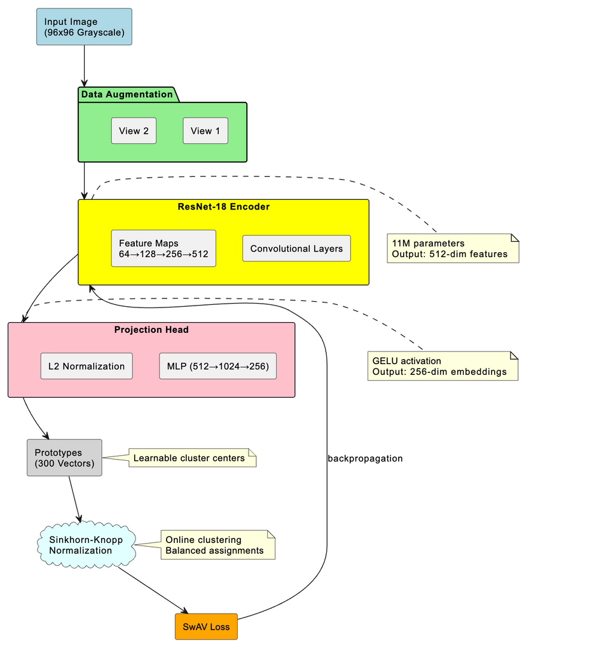

Slide 17
SwAV (Swapping Assignments between Views) is a self-supervised learning method that avoids contrastive pairs or teacher networks. Instead, it performs clustering-based learning by assigning image representations to prototypes (clusters) and enforcing consistency across multiple augmented views of the same image.
Rather than pulling views closer or pushing apart samples, SwAV swaps cluster assignments between views, encouraging the model to learn discriminative and invariant features.
It achieves strong performance using only unlabeled data and can be evaluated via a simple linear classifier on top of the frozen encoder.

Slide 18
SIM MATCH

Slide 19
WORKING METHODOLOGY
1. Core Framework Components
Data Processing Pipeline
Takes both labeled and unlabeled medical images as input
Uses two types of augmentations:
Weak Augmentation: Subtle changes like minor crops and flips
Strong Augmentation: More aggressive transformations including RandAugment
Maintains parallel processing streams for labeled and unlabeled data
Network Architecture
Backbone Network: Usually ResNet-50 or Vision Transformer
Dual Head Design:
Classification Head: For main classification task
Projection Head: For similarity learning in feature space

Slide 20
2. Training Process
Phase 1: Labeled Data Processing
Apply weak augmentation to labeled images
Pass through backbone network
Generate classification predictions and feature embeddings
Compute supervised loss using ground truth labels
Phase 2: Unlabeled Data Processing
Generate two views of each unlabeled image:
Weak augmentation view
Strong augmentation view
Process weak augmentation through model to create pseudo-labels
Use strong augmentation view for consistency training
Extract feature embeddings for similarity matching
Phase 3: Loss Computation
Combines three distinct loss components:
Supervised Loss
Traditional cross-entropy loss on labeled data
Ensures basic classification capability
Weighted based on labeled data proportion
Consistency Loss
Enforces prediction consistency between weak and strong views
Uses confidence thresholding to filter reliable pseudo-labels
Helps model learn from unlabeled data
Similarity Matching Loss
Aligns feature representations of similar images
Creates compact clusters in feature space
Improves model's discriminative ability

Slide 21
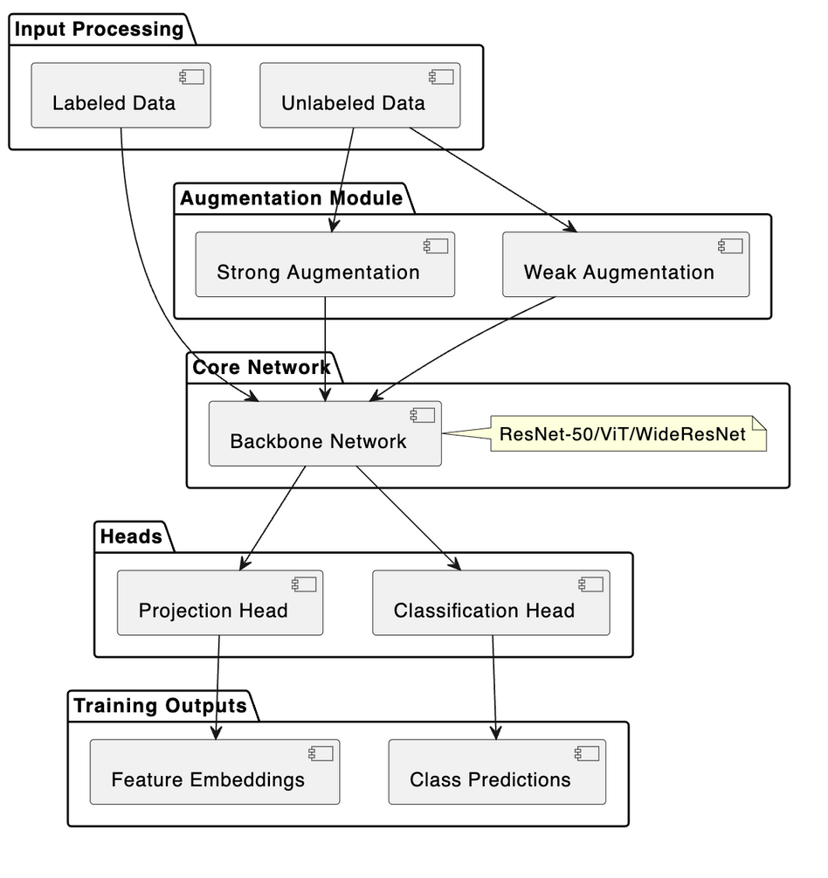
SIM MATCH ARCHITECTURE

Slide 22
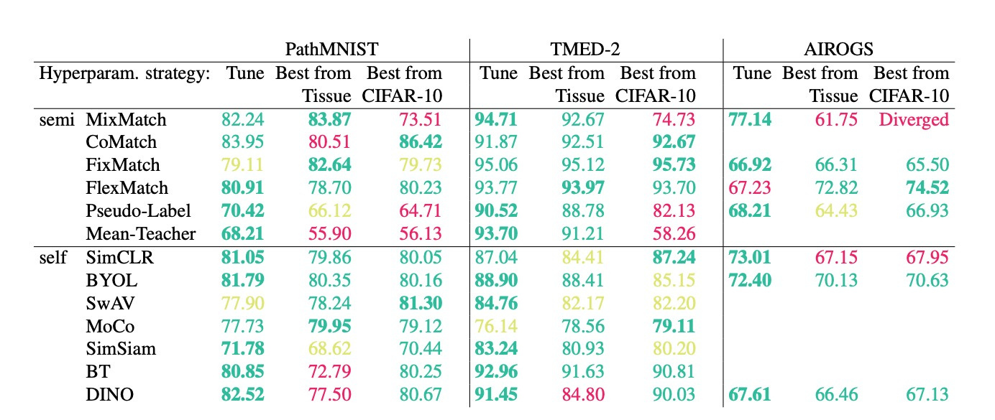
Resutls for existing research work

Slide 23
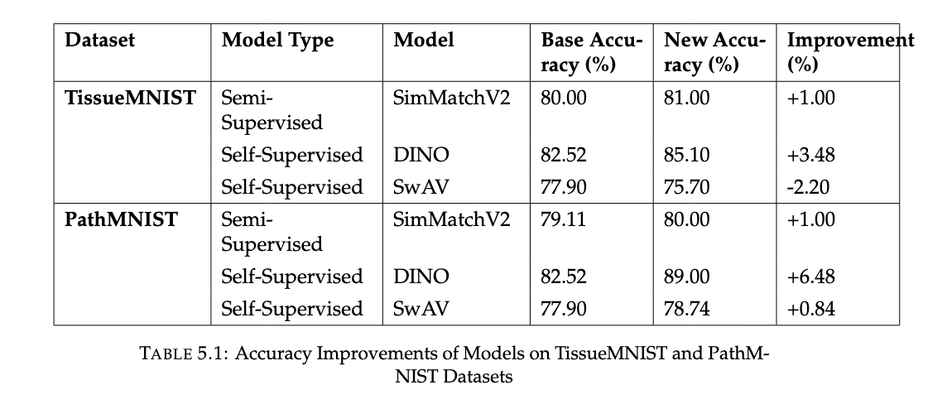
Experimental Results

Slide 24
FUTURE WORK
Improving Robustness with Domain Adaptation Models can be trained to adapt to domain shifts—such as changes in imaging equipment, protocols, or patient populations—by incorporating domain adaptation techniques, making them more resilient across real-world settings.
Multimodal Learning Integration Future research can explore combining medical imaging data with other clinical information sources like electronic health records (EHRs), pathology reports, or genomic data. This fusion of modalities can provide richer context and lead to more accurate diagnostic outcomes.
Application to 3D Imaging ModalitiesThe current work can be extended to 3D medical imaging such as MRI and CT scans. These data types introduce greater complexity due to their high dimensionality and spatial variability.

Slide 25
APPLICATIONS
Real-World Use Cases of SSL & Self-SL in Medical Imaging:
Disease Detection: Early cancer detection from histopathology slides.
Radiology Automation: Chest X-ray abnormality classification.
Medical Image Segmentation: Brain tumor segmentation using SSL models.
Rare Disease Prediction: Using self-supervised learning for low-data diseases.

Slide 26
REFERENCES
1. Kakarla, A., Lau, A., Jordon, J., Akhavan, A., Shah, P., & Raskar, R. "Systematic Comparison of Semi-Supervised and Self-Supervised Learning for Medical Image Classification.
2. Chen, T., Kornblith, S., Swersky, K., Norouzi, M., & Hinton, G. "Big Self-Supervised Models are Strong Semi-Supervised Learners." Advances in Neural Information Processing Systems (NeurIPS), 2020.
3. Chen, Y., Mancini, M., Zhu, X., & Akata, Z. "Semi-Supervised and Unsupervised Deep Visual Learning: A Survey." IEEE Transactions on Pattern Analysis and Machine Intelligence, 2022.
4. Chen, Y., Lu, M. T., & Raghu, V. K. "A Comparison of Self- and Semi-Supervised Pretraining Approaches for Risk Prediction from Chest Radiograph Images." Proceedings of Machine Learning Research, 2023
5. Assran, M., Misra, I., Minsky, M., Mustikovela, S. K., Sridhar, V., Joulin, A., & Shlens, J. "Semi-Supervised Learning of Visual Features by Non-Parametrically Predicting View Assignments with Support Samples." Proceedings of the IEEE/CVF Conference on Computer Vision and Pattern Recognition (CVPR), 2021.
6.Chen, X., & He, K. "Exploring Simple Siamese Representation Learning." Proceedings of the IEEE/CVF Conference on Computer Vision and Pattern Recognition (CVPR), 2021.

Slide 27
THANK YOU

