Slide 1
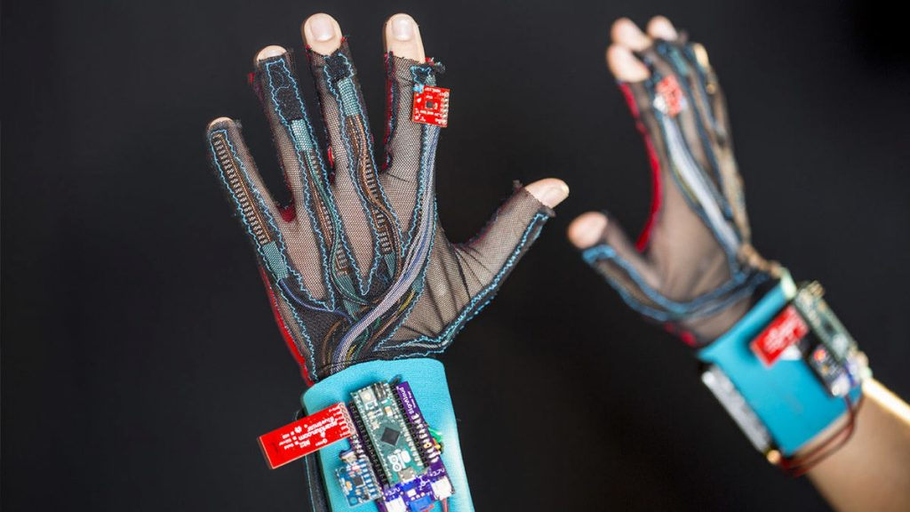
SAMVAAD SAARTHI
A Project Presentation by
Sezalpreet Kaur 102103531
Yatharth Gautam 102103550
Mannat Sadana 102103561
Arshiya Kishore 102103565
Aakarsh Walia 102153005
Under the mentorship of
Dr. Vaibhav Pandey
Assistant Professor

Slide 2
01 | Addressing Communication Challenges
02 | Challenges of Conventional Techniques
03 | Complexities of ISL
04 | Advancing Inclusivity
05 | Advancing Equality and Respect
PROJECT OVERVIEW
WHY DO WE NEED SAMVAAD SAARTHI?

Slide 3
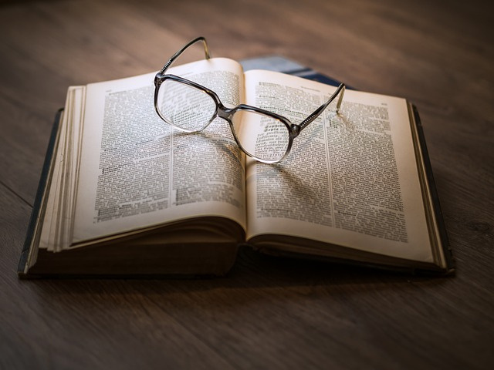
LITERATURE SURVEY
AHMED J ABOUGARAIR
(AMERICAN SIGN LANGUAGE INTO SPEECH AND TEXT)
JASON PARRY
(AMERICAN SIGN LANGUAGE INTO SPEECH AND TEXT)
WOEI SHENG WONG
(TRANSLATING MALAYSIAN SIGN LANGUAGE)
AMAL DWEIK
(TRANSLATE THE ARABIC SIGN LANGUAGE )
A.HARITHA
(INDIAN SIGN LANGUAGE INTO SPEECH AND TEXT)
DIVYA P S
(AMERICAN SIGN LANGUAGE INTO SPEECH AND TEXT)

Slide 4
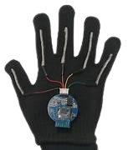
OBJECTIVES
WHAT PROBLEM DOES SAMVAAD SAARTHI solve?
Communication barriers between deaf and hearing individuals, including mute individuals, hinder social interaction and inclusivity.
Existing solutions like interpreters can be costly and limited, while current technology might be complex or inaccessible.
The initiative develops a smart glove translator that converts Indian Sign Language (ISL) into spoken words or text, assisting deaf and mute individuals in communicating independently and promoting social inclusion.

Slide 5
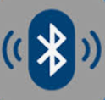
Data Collection
Data Interpretation
Data Transmission
WORK MECHANICS
DATA PRE-PROCESSING WITH DATABASE
Collecting data from a 3-way accelerometer and gyroscope (MPU6050) and flex sensors.
The data is then interpreted to determine hand position and gestures, transmitted from the left-hand glove to the right-hand glove via Bluetooth.
The received data is compared with a pre-defined database of alphabets.
Data-to-Speech Conversion
Final Output

Slide 6
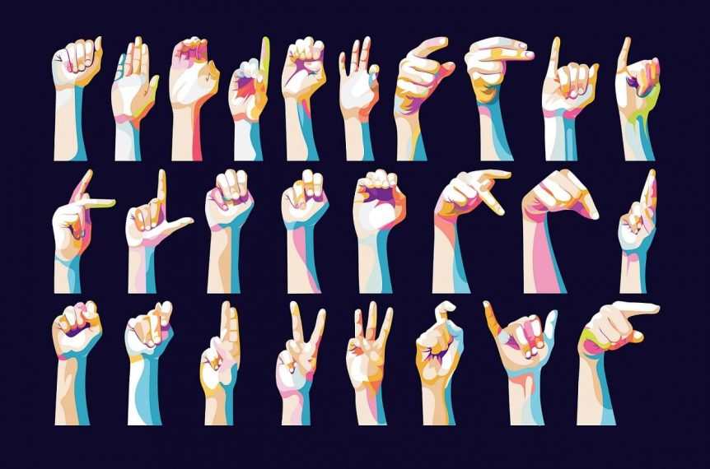
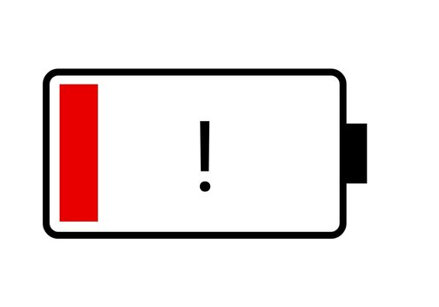
ASSUMPTIONS
CONSTRAINTS
Users are familiar with basic sign language gestures.
Sign language used is consistent and widely recognized.
Reliable internet connection available for speech synthesis.
Limited storage capacity on SD card/memory.
Accuracy of sign language detection may vary.
Battery life limitations.

Slide 7
REQUIREMENTS
HARDWARE FLex sensors Arduino board for data processing Accelerometer Bluetooth module for speaker connection | SOFTWARE Arduino IDE for coding Sign language recognition library (potentially)
SOFTWARE TEXT-TO-SPEECH LIBRARY | HARDWARE SD card/memory Speaker Wifi Module Gyro sensor

Slide 8
PROJECT OUTCOMES
IMPROVED ACCESSIBILITY | EFFICIENT COMMUNICATION | TECHNOLOGICAL INNOVATION | CUSTOMIZABILITY AND ADAPTABILITY | ENGAGEMENT AND COLLABORATION
Real-time ISL translation, Empowering the deaf community | Automated gesture-to-speech conversion, Boosting productivity and clarity | Pioneering breakthrough solutions, Showcasing innovation in disability support | Personalized statement storage, Improved usability and adaptability | Collaborative development approach, Incorporating user feedback

Slide 9
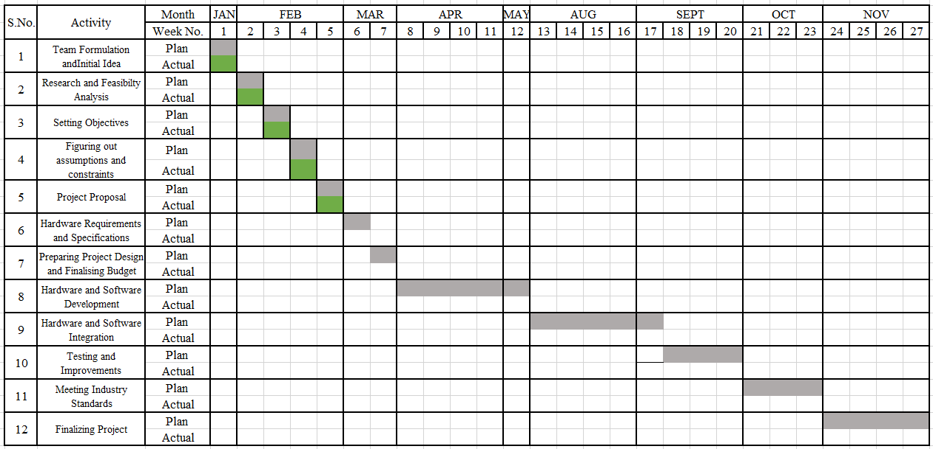
WORKPLAN

Slide 10
Sezalpreet Kaur
OUR ROLES
Idea finalization, Documentation, Hardware Implementation
Yatharth Gautam
Idea finalization, Documentation, Integration of hardware and software
Mannat Sadana
Idea finalization, Documentation, Hardware Implementation
Arshiya Kishore
Idea finalization, Documentation, Hardware Implementation
Aakarsh Walia
Idea finalization, Documentation, Integration of hardware and software

Slide 11
THANK
YOU

