Slide 1
Data Structures & Programming
Complexity Analysis More Examples
Golnar Sheikhshab

Slide 2
Updating a sorted array
void update(int* sorted_array, int & n, int x )
{
// finding the rightful place of x
int x_index = right_place(sorted_array, n, x);
n++;
// shift everything starting from x_index to the right to open a space for x
for (int i= n-2; i>= x_index; i--)
sorted_array[i+1] = sorted_array[i];
sorted_array[x_index] = x;
}

Slide 3
Updating a sorted array (contintue)
int right_place(int* sorted_array, int & n, int x){
int x_index = n;
for (int i = 0; i<n; i++){
if (sorted_array[i] >= x){
x_index = i;
break;
}
}
return x_index;
}

Slide 4
Updating a sorted array (Worst case analysis)
Getting the right place : O(n)
Incrementing n : O(1)
Shifting right: O(n)
Assignment statement : O(1)
Overall: O(n)

Slide 5
Binary Search
bool binarySearch(const E& elem, int start_index, int end_index){
if (start_index > end_index)
return false;
int middle_index = (start_index + end_index)/2;
if (this->listArray_[middle_index]>elem)
return binarySearch(elem, start_index, middle_index-1);
else if (this->listArray_[middle_index]<elem)
return binarySearch(elem, middle_index+1, end_index);
else if( this->listArray_[middle_index]==elem)
return true;
else
return false;
}

Slide 6
Binary Search (Worst case analysis)
f(n) is cost function
f(n) = f(n/2)+ c1 n>1
f(1) = c2
pattern:
f(1) = c2
f(2) = c2 + c1
f(4) = c2+ 2*c1
f(8) = c2 + 3* c1
f(n) is O(log n)

Slide 7
Tic-Tac-Toe (check for winner)
bool isWin(int mark) { // is mark the winner?
int win = 3*mark; // +3 for X and -3 for O
return ((board[0][0] + board[0][1] + board[0][2] == win) // row 0
|| (board[1][0] + board[1][1] + board[1][2] == win) // row 1
|| (board[2][0] + board[2][1] + board[2][2] == win) // row 2
|| (board[0][0] + board[1][0] + board[2][0] == win) // column 0
|| (board[0][1] + board[1][1] + board[2][1] == win) // column 1
|| (board[0][2] + board[1][2] + board[2][2] == win) // column 2
|| (board[0][0] + board[1][1] + board[2][2] == win) // diagonal
|| (board[2][0] + board[1][1] + board[0][2] == win)); // diagonal
}
IsWin is O(1) : only constant number of statements

Slide 8
Tic-Tac-Toe (print the board)
void printBoard() { // print the board
for (int i = 0; i < 3; i++) {
for (int j = 0; j < 3; j++) {
switch (board[i][j]) {
case X: cout << "X"; break;
case O: cout << "O"; break;
case EMPTY: cout << " "; break;
}
if (j < 2) cout << "|"; // column boundary
}
if (i < 2) cout << "\n-+-+-\n"; // row boundary
}
}
PrintBoard is O(1) : 3*3 = 9 which is a constant

Slide 9
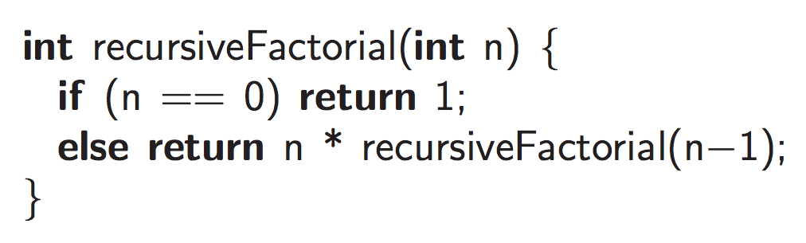
Factorial
f(n) = c1 + f(n-1) if n>1
f(1) = c2
f(n) = c2 + (n-1)*c1
recursiveFactorial is O(n)

Slide 10
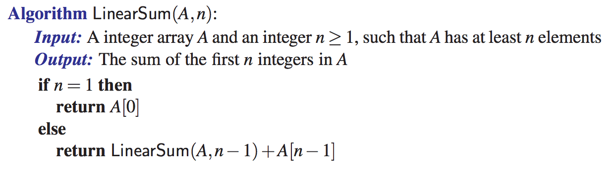
Linear Sum
f(n) = c1 + f(n-1) if n>1
f(1) = c2
f(n) = c2 + (n-1)*c1
recursiveFactorial is O(n)

Slide 11
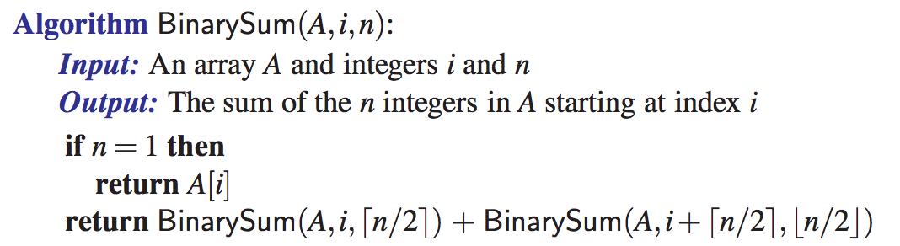
Binary Sum

Slide 12
Binary Sum Analysis
f(2^k) = c1 + 2* f(2^(k-1))
f(1) = c2
f(0) = c2
f(2) = c1 + 2*c2
f(4) = c1 + 2*c1 + 4*c2 = 3*c1+4*c2
f(8) = c1 + 6*c1 + 8* c2
f(n) = (n-1)* c1 + n* c2 prove by induction
Binary Sum is O(n)

Slide 13
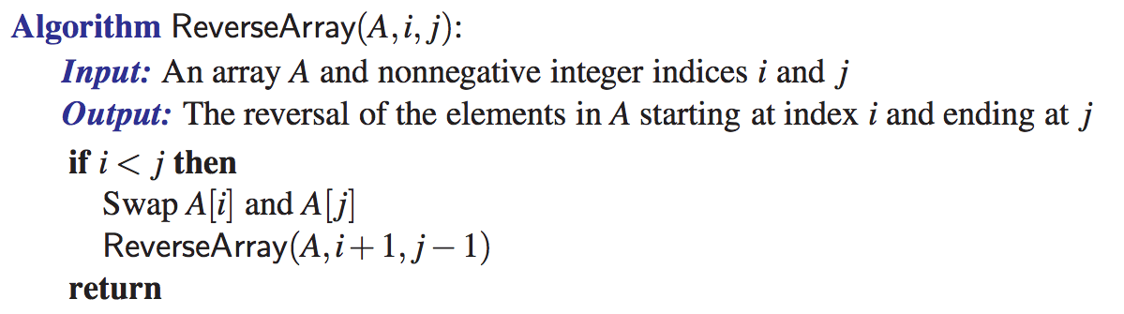
Reverse Array
f(n) = c2 + (n/2)*c1
ReverseArray is O(n)
f(n) = c1 + f(n-2) if n>1
f(1) = c2
f(0) = c2
f(2) = c2 + c1
f(3) = c2 + c1
f(4) = c2 + 2*c1
f(5) = c2 + 2*c1
f(6) = c2 + 3*c1
f(7) = c2 + 3*c1

Slide 14
Getting all subsets of {1...n}
vector<set<int>> getSubsetsOfOneToN(int n){
vector<set<int>> v; set<int> s;
if (n<=0){
v.push_back(s);
return v;
}
else{
v = getSubsetsOfOneToN(n-1); // all subsets without n
int freezed_size = v.size();
for (int i=0; i<freezed_size; i++){
s = v[i]; s.insert(n); v.push_back(s); }
return v;
}
}

Slide 15
Getting all subsets of {1...n} Analysis
f(n) = f(n-1) + c1* freezed_size + c2
freezed_size itself is 2^(n-1) because it is the number of subsets in {1...n-1}
f(n) = f(n-1) + c1*2^(n-1) + c2 if n > 1
f(1) = c3
f(2) = c3 + c2 + c1*2
f(3) = c3 + 2* c2 + c1* (2+4) = c3 + 2*c2 + c1* 6
f(4) = c3 + 3* c2 + c1* (6 + 8) = c3 + 3*c2 + c1 * 14
f(5) = c3 + 4* c2 + c1* (16 + 14) = c3 + 4*c2 + c1*30
f(n) = c3 + n* c2 + c1* (2^n - 2) prove by induction
f(n) is O(2^n)

Slide 16
What about n queens problem?
bool solutionExists(int i){ // there is a solution that is consistent with the board so far
if (i >=n ) // base case
return true; // the board is a complete solution.
for (int j=0; j<n; j++){
if (valid(i,j)){
board[i]=j;
print_until(i);
if (solutionExists(i+1))
return true;
}
}
return false;
}

Slide 17
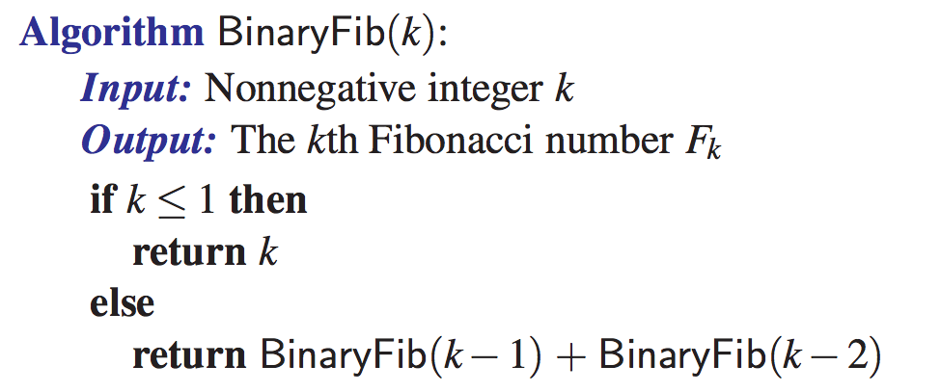
How about Fibonacci?

