Slide 1
Data Structures & Programming
Justification Techniques
Golnar Sheikhshab

Slide 2
Simple Justification Techniques
Counterexample
Proof by contradiction (contra attack)
Induction
Loop Invariant

Slide 3
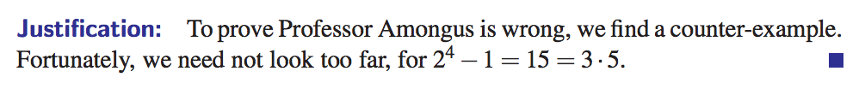
Counterexample
To show some predicate is not correct

Slide 4


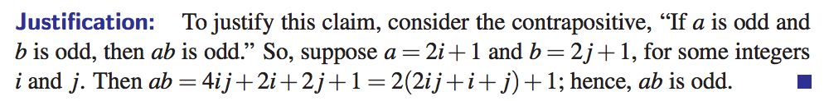
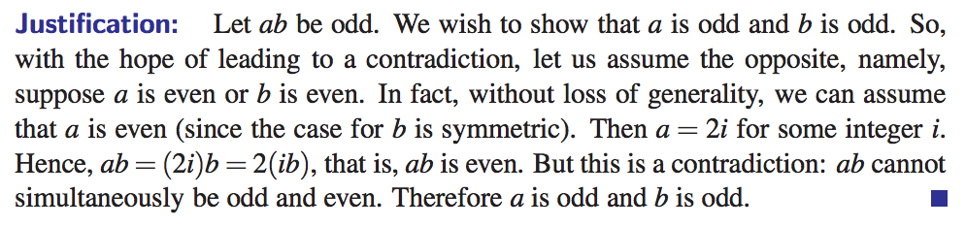
Contra Attack

Slide 5
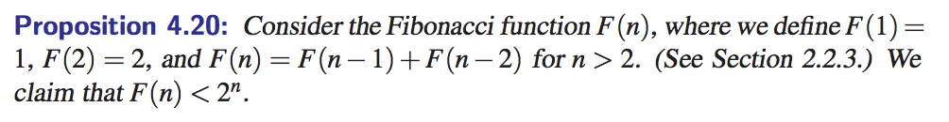
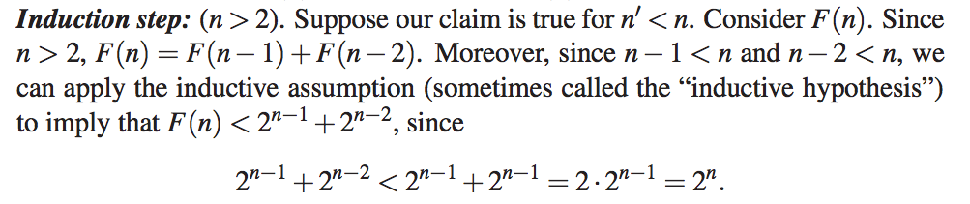
Induction
A very important tool for proving many complexities.
Also, the main tool for showing the correctness of recursive algorithms.

Slide 6
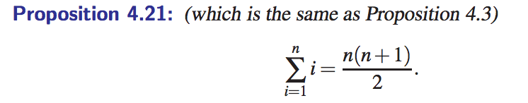

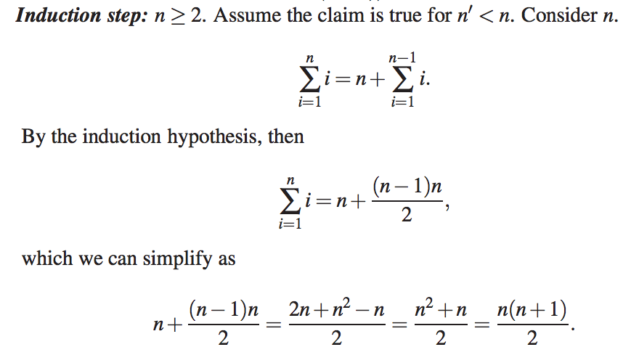

Slide 7
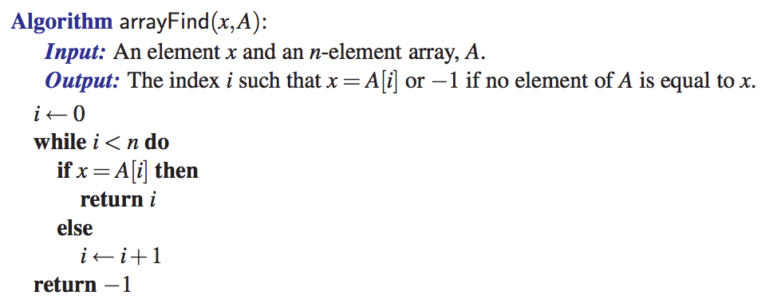
Loop invariant
Great tool for proving correctness of iterative or even recursive algorithms.
loop invariant: x is not equal to any of the first elements of A.

Slide 8
Loop invariant (2)
bool solutionExists(int i){ // there is a solution that is consistent with the board so far
if (i >=n ) // base case
return true; // the board is a complete solution.
for (int j=0; j<n; j++){
if (valid(i,j)){
board[i]=j;
print_until(i);
if (solutionExists(i+1))
return true;
}
}
return false;
}
Loop invariant: queens in board[0]....board[i] don't threaten each other.

Slide 9
Reading material
Section 4.3 of your textbook

