Slide 1
Data Structures & Programming
Double-Ended Queue
Golnar Sheikhshab

Slide 2
Double-Ended Queue (dequeue) ADT
insertFront(e): | Insert a new element e at the beginning
insertBack(e): | Insert a new element e at the end
eraseFront(): | Remove the first element; throws error if dequeue is empty
eraseBack(): | Remove the last element; throws error if dequeue is empty
front(): | Return the first element; throws error if dequeue is empty
back(): | Return the last element; throws error if dequeue is empty
size(): | Return the number of elements
empty(): | Return true if the deque is empty and false otherwise

Slide 3
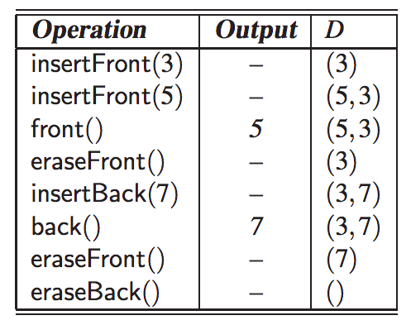
Example of Operations

Slide 4
STL dequeu
#include <dequeue>
using std::deque; // make deque accessible
deque<string> myDeque; // a deque of strings
insertFront and insertBack are called push_front and push_back
eraseFront and eraseBack are called pop_front ant pop_back
No method throws exception but they can make the program crash.

Slide 5
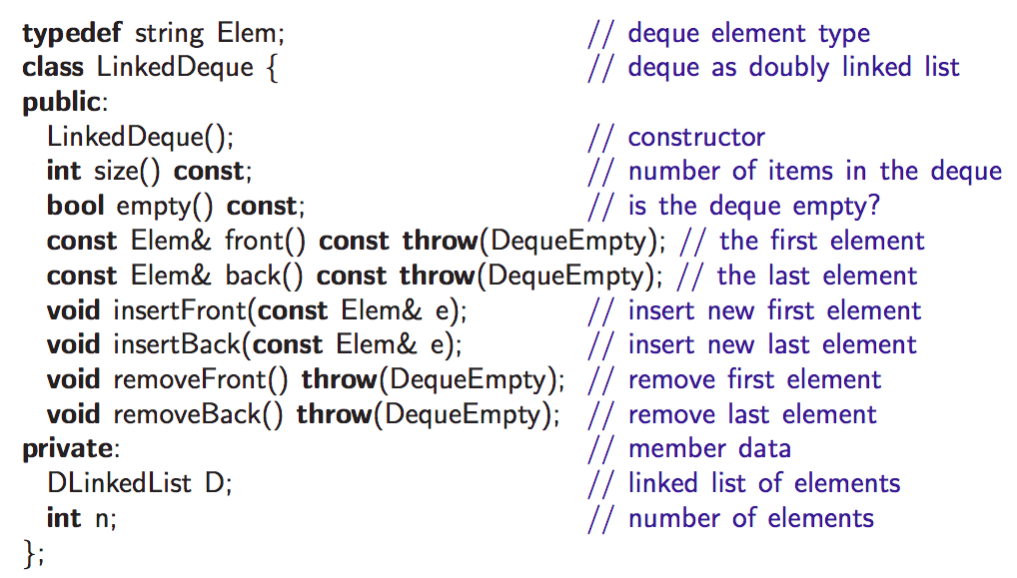
Implementing a Deque with a Doubly Linked List

Slide 6
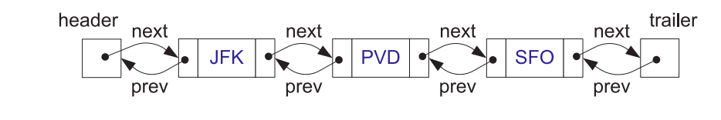
Doubly Linked List ADT (reminder)
bool empty() const; | // is list empty?
const Elem& front() const; | // get front element
const Elem& back() const; | // get back element
void addFront(const Elem& e); | // add to front of list
void addBack(const Elem& e); | // add to back of list
void removeFront(); | // remove from front
void removeBack(); | // remove from back

Slide 7
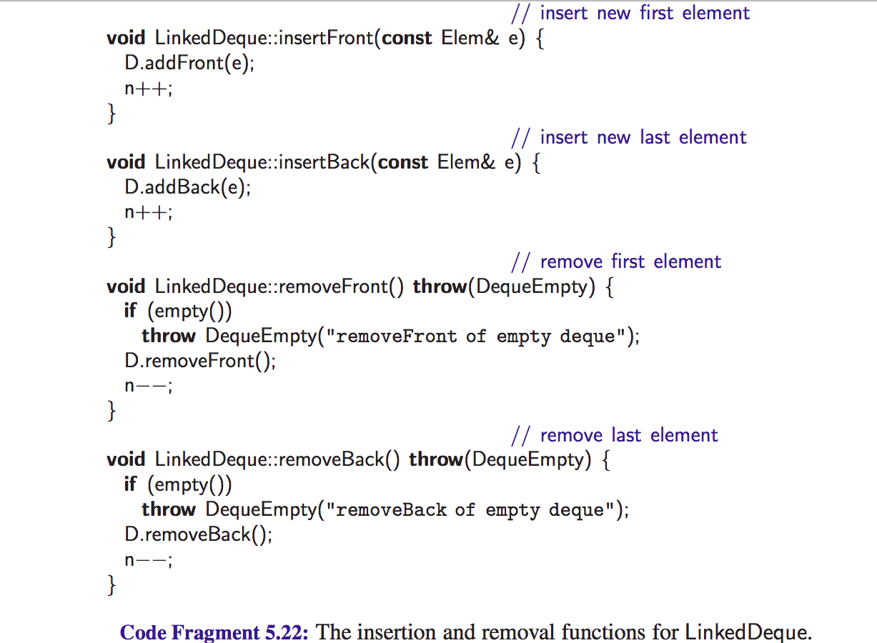

Slide 8
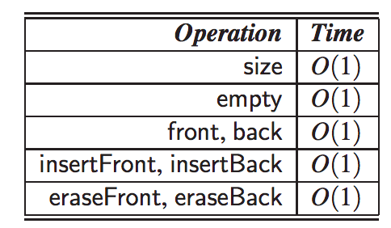
Time Complexities

Slide 9
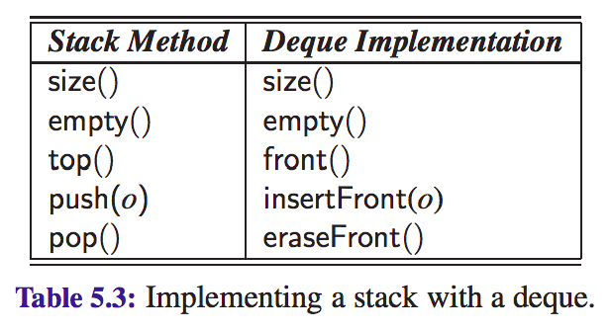
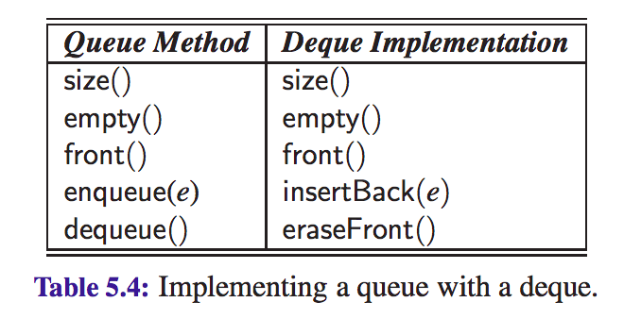
Adapter (Wrapper) Design Pattern
An adapter (also called a wrapper) is a data structure, for example, a class in C++, that translates one interface to another.

Slide 10
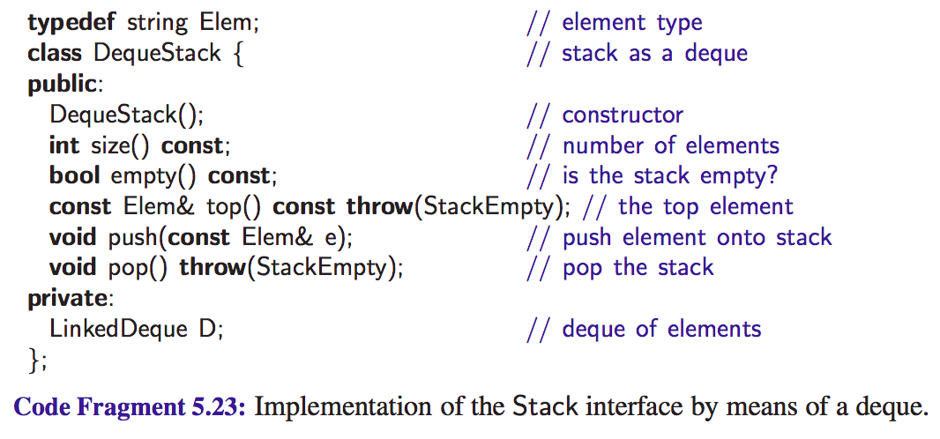

Slide 11
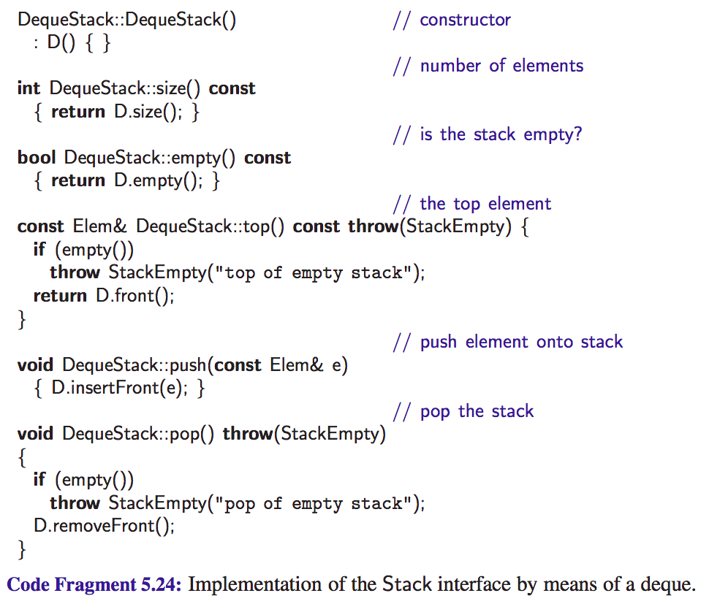

Slide 12
Reading material
Section 5.3 of the textbook

