Slide 1
Data Structures & Programming
Vector, Iterator, and List
Golnar Sheikhshab

Slide 2
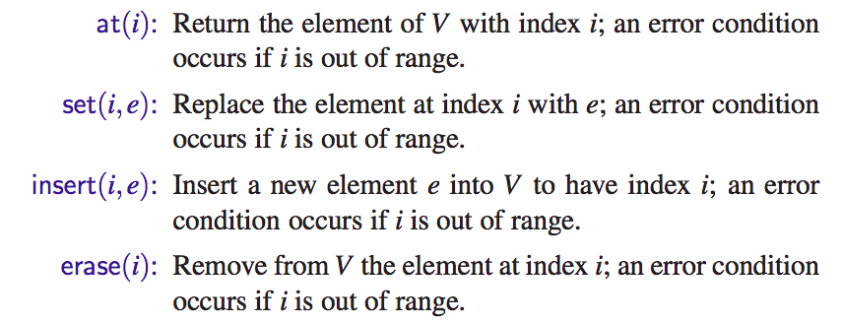
Vector ADT

Slide 3
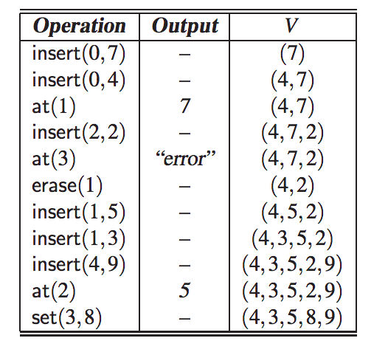

Slide 4


A Simple Array Based Implementation

Slide 5


A Simple Array Based Implementation (2)

Slide 6
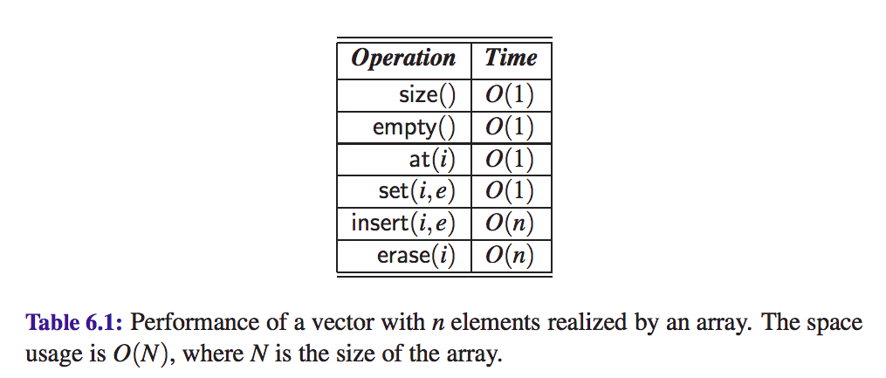
Complexity Analysis of Array Based Implementation

Slide 7

An Extendable Array Implementation
When an overflow occurs
Allocate a new array B of capacity N
Copy A[i] to B[i], for i = 0,...,N −1
Deallocate A and reassign A to point to the new array B

Slide 8
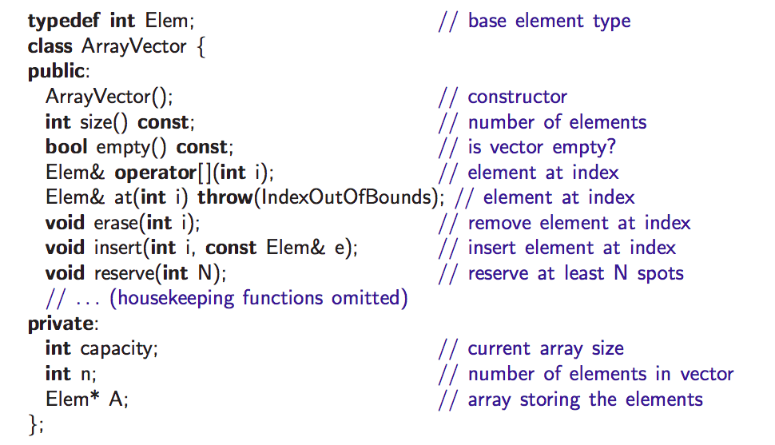
A C++ Implementation Based on Extendable Array

Slide 9
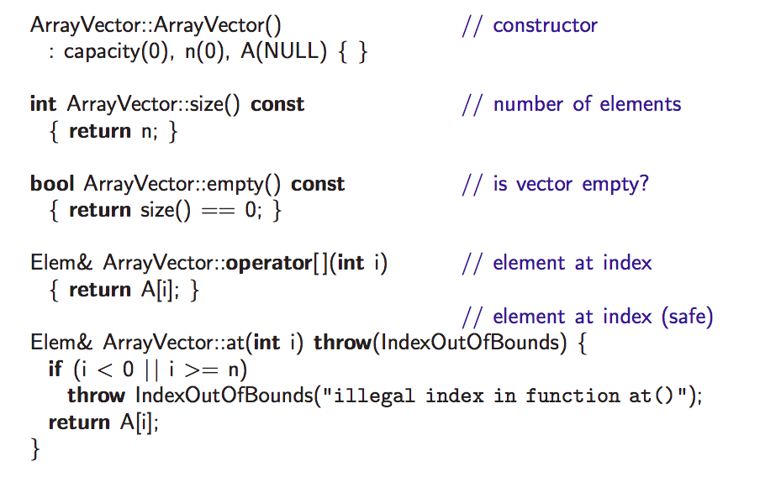

A C++ Implementation Based on Extendable Array (2)

Slide 10
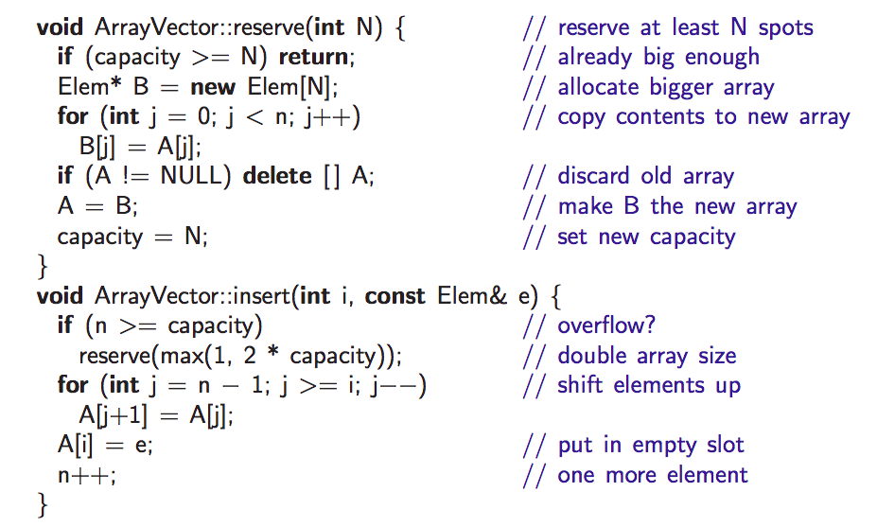
A C++ Implementation Based on Extendable Array (3)

Slide 11


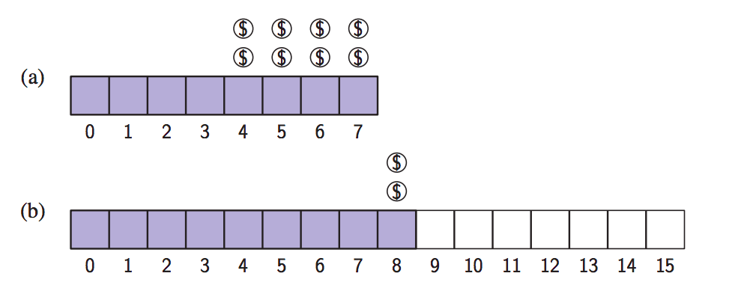
Complexity Analysis of Insert (with amortization)
We overcharge the pushes that don't lead to overflow to pay for ones that do.

Slide 12
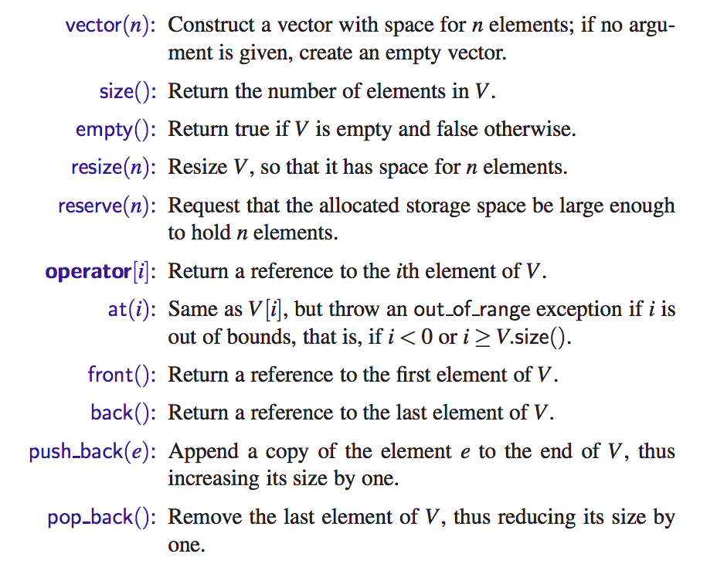
STL Vectors

Slide 13


Iterator

Slide 14


List ADT

Slide 15
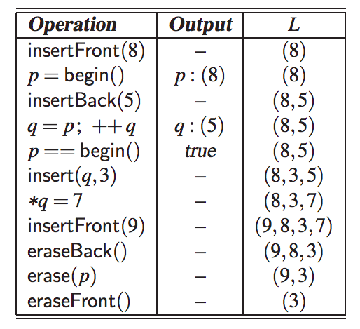

Slide 16
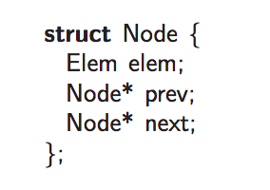
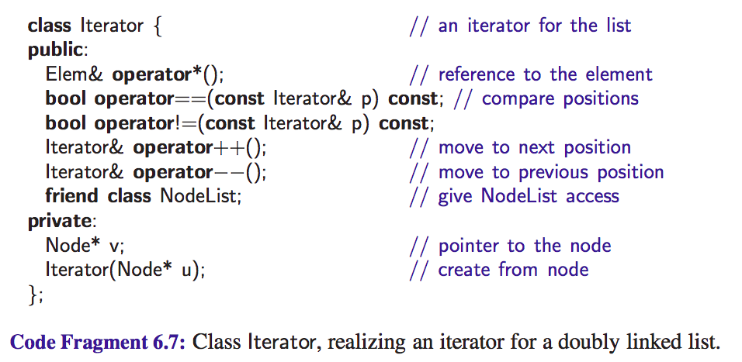

Slide 17
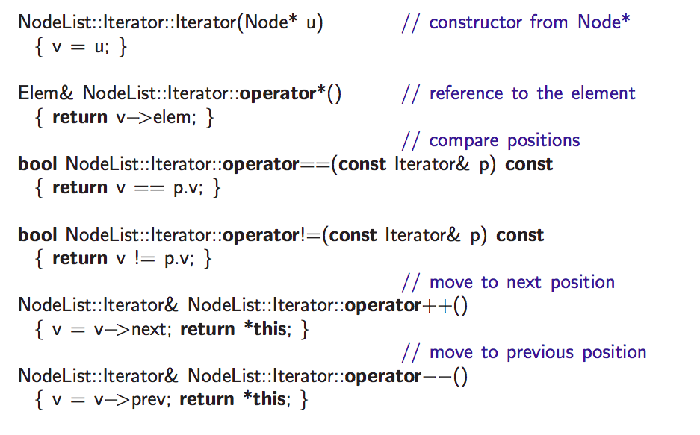

Slide 18
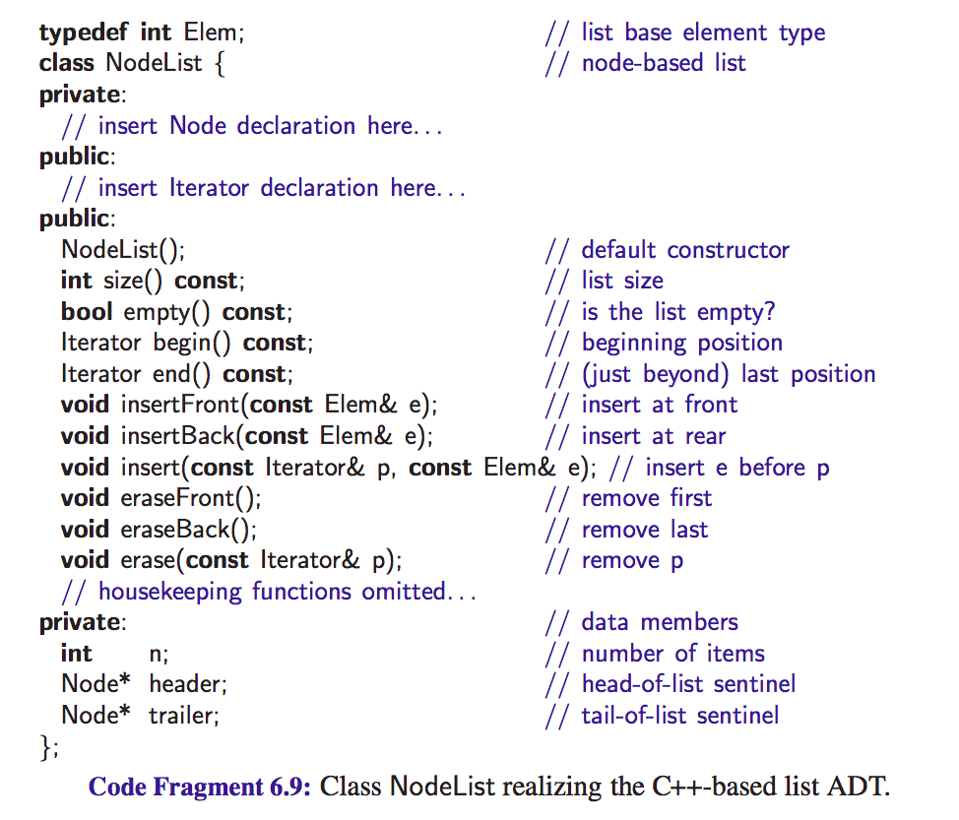

Slide 19
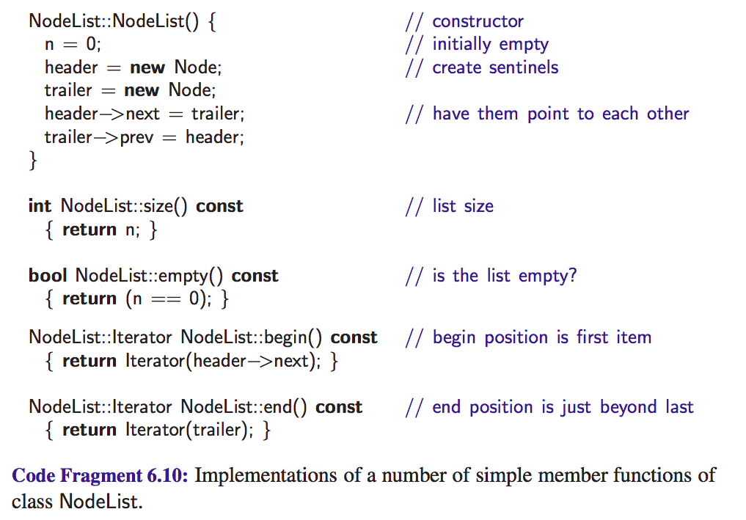

Slide 20
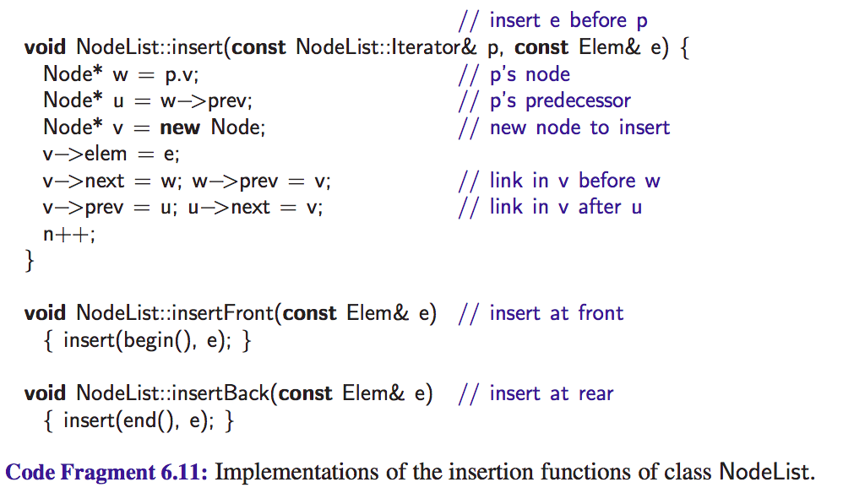

Slide 21
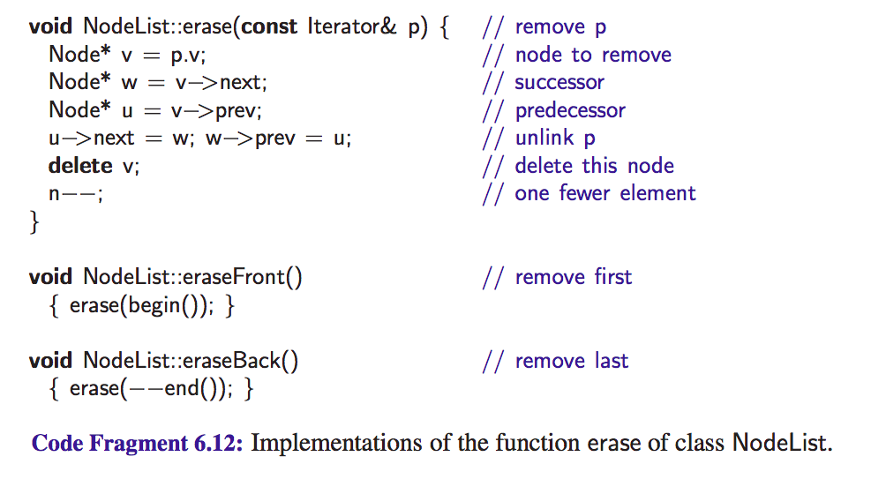

Slide 22

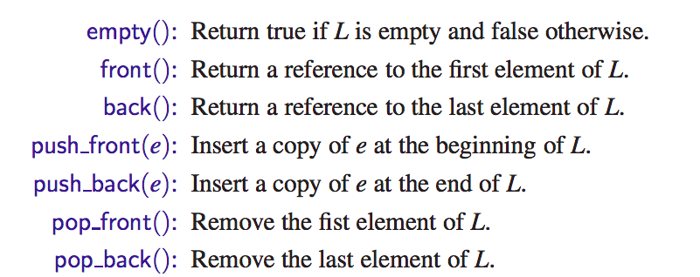
STL List

Slide 23
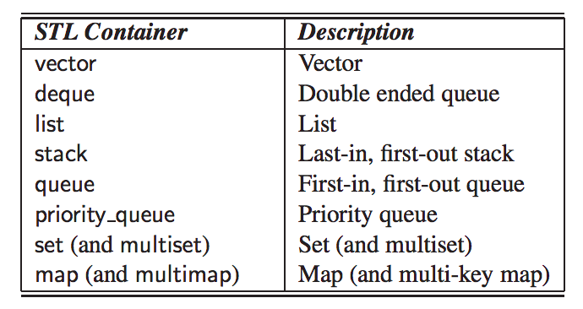
Some STL Containers

Slide 24



Slide 25

Constant Iterators

Slide 26
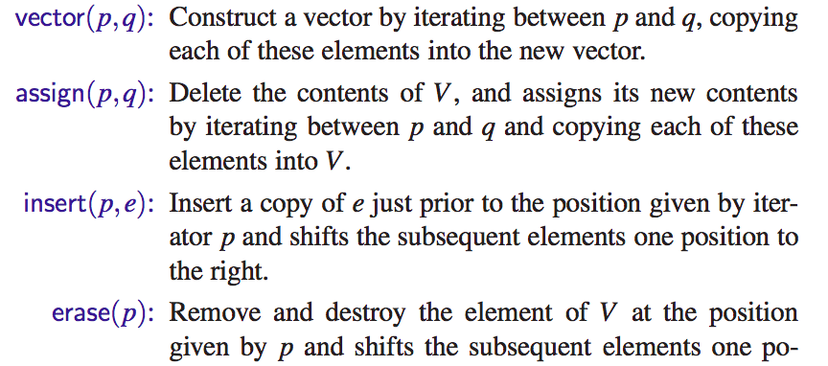

STL Iterator-Based Container Functions

Slide 27
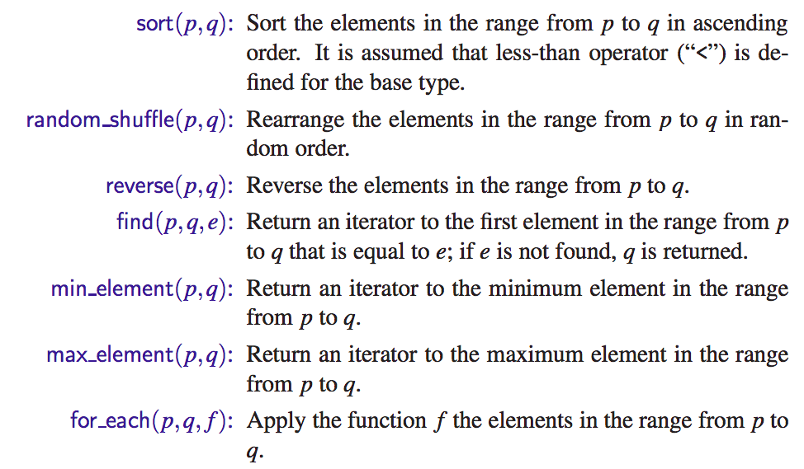
STL Algorithms

Slide 28
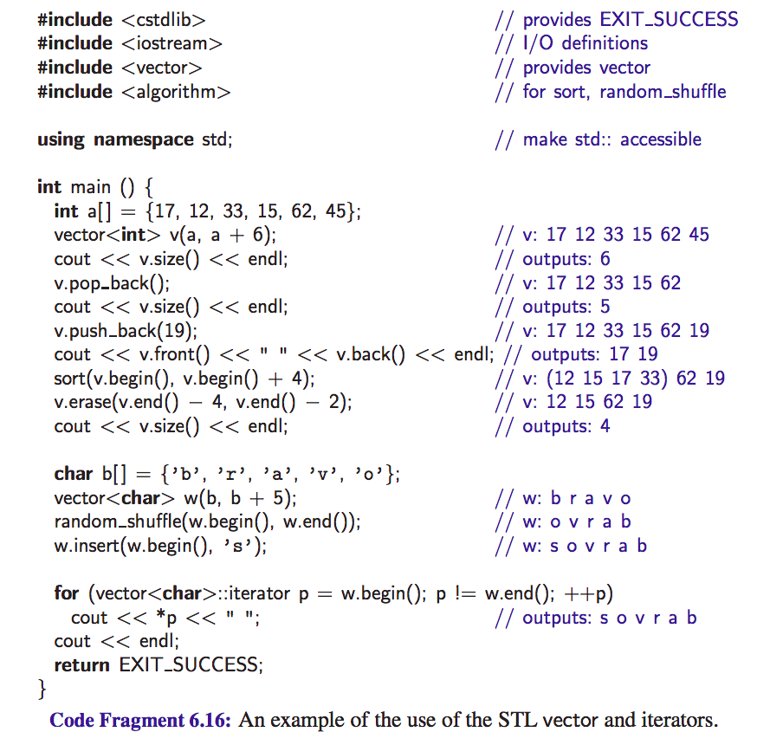

Slide 29
Reading material
Sections 6.1 and 6.2 from the textbook

