Slide 1
Data Structures & Programming
Multiple Recursion &
Brute Force Search
Golnar Sheikhshab

Slide 2
Multiple Recursion
So far, we have only seen linear and binary recursions
Number of sub-problems were one or two
We can have arbitrarily many sub-problems in recursion
For example, in brute force search, where we check for all possible configurations, there could be many sub-problems.

Slide 3









Four Queens Problem

Slide 4
Checking all possible value combinations
Four Variables: The row for the queen in each column: int row_index[4]
Possible values for variables? 0 ... 3
How to check validity?
no threat in the same row : row_index values are all unique
no threat in diagonal 1: i+ row_index[i] values are unique
no threat in diagonal 2: i- row_index[i] values are unique

Slide 5
Four Queens Problem

Slide 6
Queens.cpp
#include <iostream>
using namespace std;
int* board;
int n;
// print the board until column i inclusive
void print_until(int i){
for (int col = 0; col <=i; col++)
cout << board[col] << " ";
for (int col = i+1; col < n; col++)
cout << "-1 ";
cout << endl;
}

Slide 7
Queens.cpp (2)
void initialize(){
board = new int(n);
for (int i=0; i<n; i++)
board[i]=-1;
print_until(n-1);
}

Slide 8
Queens.cpp (3)
bool valid(int i, int j){
cout << "checking validtity for (" << i << ", " << j << ")\n";
for (int col=0; col< i; col++){
if (board[col]==j)
return false; // same row
if (col + board[col] == i+j)
return false; // diagonal 1
if (col - board[col] == i - j)
return false; // diagonal 2
}
return true;
}

Slide 9
Queens.cpp (4)
bool solutionExists(int i){ // there is a solution that is consistent with the board so far
if (i >=n ) // base case
return true; // the board is a complete solution.
for (int j=0; j<n; j++){
if (valid(i,j)){
board[i]=j;
print_until(i);
if (solutionExists(i+1))
return true;
}
}
return false;
}

Slide 10
Queens.cpp (5)
int main(int argc, char** argv){
if (argc!=2){
cout << "Usage: executable.o n" << endl;
return 1;
}
n = atoi(argv[1]);
initialize();
solutionExists(0);
cout << "The final board is :"; print_until(n-1);
delete [] board;
return 0;
}

Slide 11
Summation Puzzles
Each letter takes a unique value from {0 ... 9}
Constraints are represented as equations:
pot + pan = bib
dog + cat = pig
boy + girl = baby
Let's trace a simplified version : values < 4 and
ab + bc = ac

Slide 12
Summation Puzzles - brute force solution
We check all possible configurations, but systematically:
Variables are letters in an assumed order :
example a,b,c
Then a sequence of values is one possible configuration:
example 0, 2, 1 means a=0, b=2, c=1
By enumerating all such configurations and testing if they solve the problem we can find a solution or report that no solution exists.

Slide 13
Solving the simplified puzzle
ab + bc = ac , a, b, c < 4 a!= b!= c
enumerating abc configurations:
0, 1, 2 => 01+12 != 02
0, 1, 3 => 01+13 != 03
0, 2, 1 => 02+21 != 01
0, 2, 3 => 02+23 != 03
1, 0, 2 => 10+02 = 12 we found a solution

Slide 14
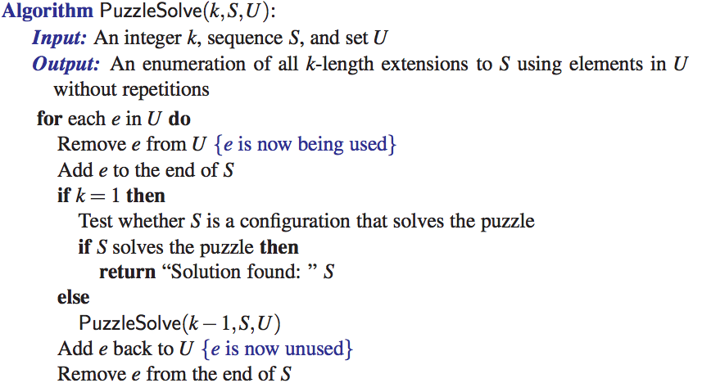

Slide 15
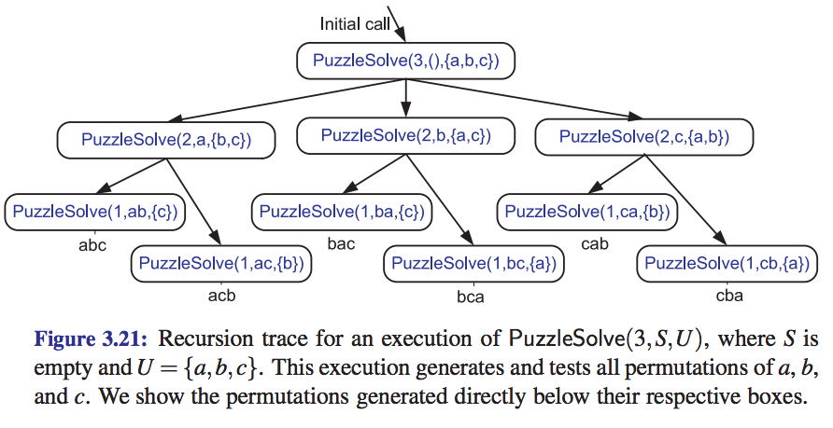

Slide 16
Reading material
Chapter 3 - Multiple recursion

