Slide 1
Data Structures & Programming
Complexity Analysis
Golnar Sheikhshab

Slide 2
Seven most important functions
The Constant Function
The Logarithm Function
The Linear Function
The N-Log-N Function
The Quadratic Function
The Cubic Function and Other Polynomials
The Exponential Function

Slide 3
The Constant Function
f(n)=c
n is the size of the problem/input
The time/space the algorithm takes, doesn't grow with the size of the problem
We say f(n) belongs to O(1)
Doesn't matter how big c is. c= 1, c=10, or c=3489849588274, all O(1)
Some data-structure operations like add_front in a list are of O(1)

Slide 4
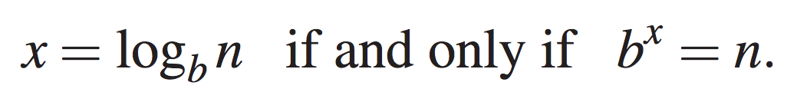
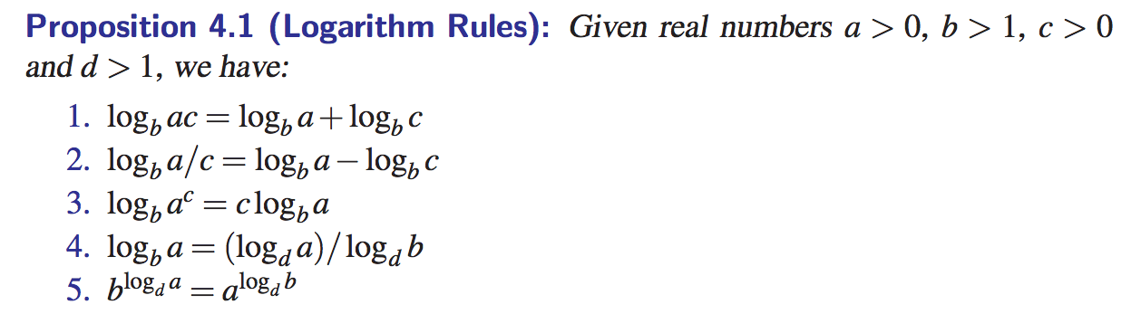
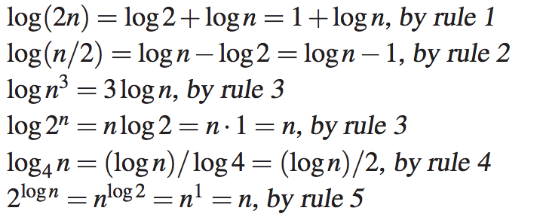
The Logarithm function
We don't care about the base because base conversion is just a constant multiplication
Binary Search is of O(log n)

Slide 5
The Linear Function
f(n) = n
The complexity grows linearly with the size of the problem
Best we can hope for running an algorithm whose input is not already in memory
Reading the input will require n operations
Printing an array is of O(n)

Slide 6
The N-Log-N Function
f(n) = n.log(n)
grows a little faster than linear
grows much slower than quadratic
improving the complexity from quadratic to n.log(n) makes it much faster for bigger problems
Fastest general sorting algorithms are O(n log n)

Slide 7
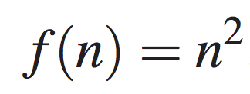
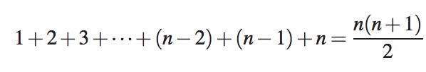
The Quadratic Function
Most inefficient sorts are quadratic
Nested loops are sometimes quadratic
for (int i=0; i<n; i++)
for (int j=0; j<n; j++)
cout << i << "," << j <<endl;
for (int i=0; i<n; i++)
for (int j=0; j<i+1; j++)
cout << i << "," << j <<endl;
for (int i=0; i<n; i++)
for (int j=0; j<10; j++)
cout << i << "," << j <<endl;

Slide 8


The Cubic Function and Other Polynomials
We care about the degree of polynomial (d)
The larger the d, the less efficient the algorithm
Technically, constant, linear, and quadratic functions are also polynomials. But they are so important that we consider them separately.
A naive implementation of matrix multiplication is of O(n^3)

Slide 9
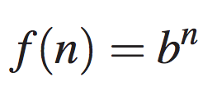
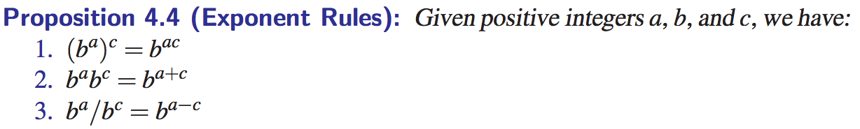
The Exponential Function
b is the base (often 2)
n is the exponent
brute force search is exponential in time complexity

Slide 10
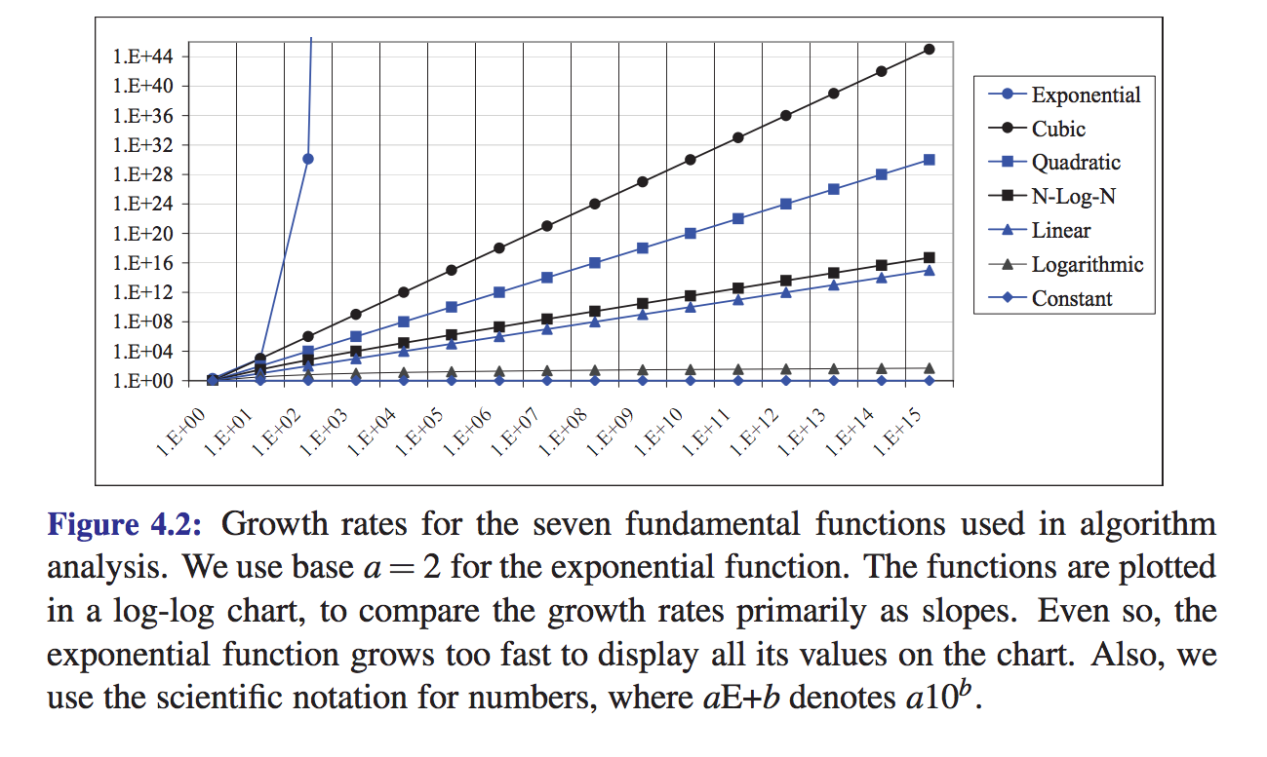
Comparing growth rates

Slide 11
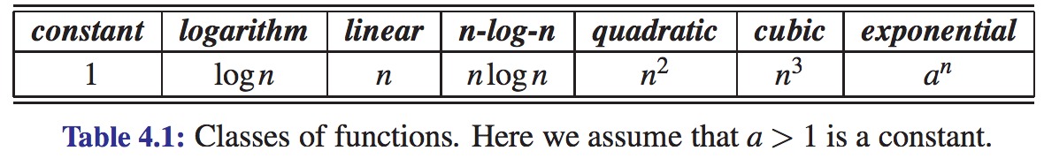
Comparing growth rates (2)

Slide 12
Reading material
Section 4.1 of the textbook

