Slide 1
Data Structures & Programming
Queue
Golnar Sheikhshab

Slide 2
Queue Abstract Data Type
First in First out (FIFO) container of objects
Elements enter the queue at the rear and are removed from front
Some applications:
Simulating real-world queues
Multi-tasking in operating systems

Slide 3
Queue ADT
Supported functions:
enqueue(e): Insert element e at the rear of the queue.
dequeue(): Remove element at the front of the queue; an error occurs if the queue is empty.
front(): Return, but do not remove, a reference to the front element in the queue; an error occurs if the queue is empty.
size(): Return the number of elements in the queue.
empty(): Return true if the queue is empty and false otherwise.

Slide 4
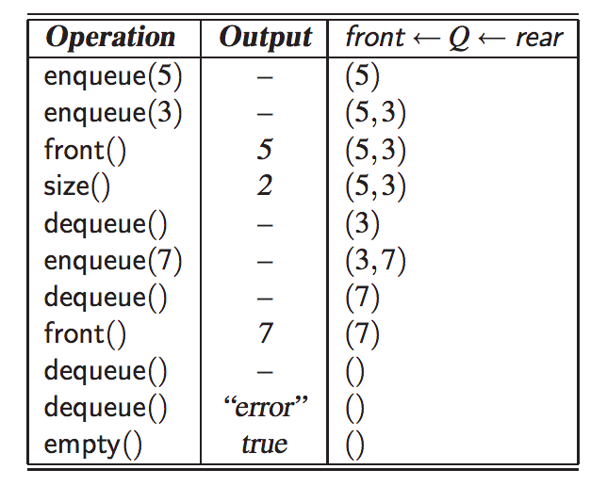

Slide 5
STL Queue
#include <queue>
using std::queue; // make queue accessible
queue myQueue; // a queue of floats
Similar to other STL containers, queue doesn't throw exceptions. It may very well cause the program to crash though.
STL queue has a back() method too and calls enqueue and dequeue, push and pop respectively.

Slide 6
An informal interface for queue
template class Queue { // an interface for a queue
public:
int size() const; // number of items in queue
bool empty() const; // is the queue empty?
const E& front() const throw(QueueEmpty); // the front element
void enqueue (const E& e); // enqueue element at rear
void dequeue() throw(QueueEmpty); // dequeue element at front
};

Slide 7
Make it a formal interface (an abstract class)
template class Queue { // an interface for a queue
public:
virtual int size() const = 0; // number of items in queue
bool empty() const; // is the queue empty?
const E& front() const throw(QueueEmpty); // the front element
void enqueue (const E& e); // enqueue element at rear
void dequeue() throw(QueueEmpty); // dequeue element at front
};

Slide 8
An array based implementation
What is the time complexity of functions if
the front of the queue is index 0 of the array?
the rear of the queue is index 0 of the array?
Can we have an array based implementation where all operations are of O(1)?

Slide 9
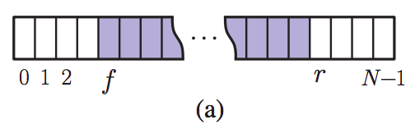
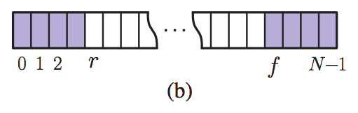
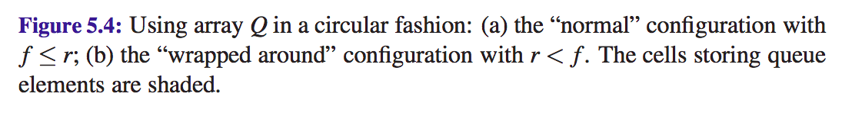
Using an Array in a Circular Way
We keep three variables f, r, and n for front, rear and size
We use modulo operation to wrap around the array

Slide 10
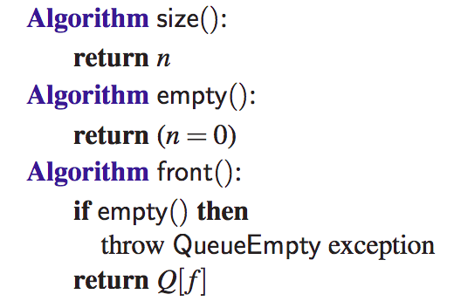
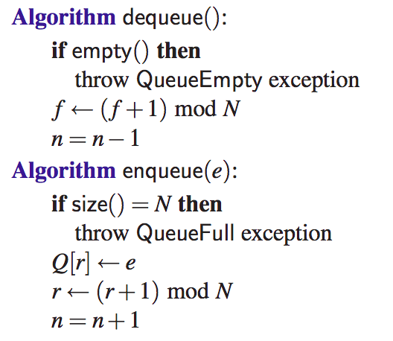
Implementation of queue using circular array

Slide 11
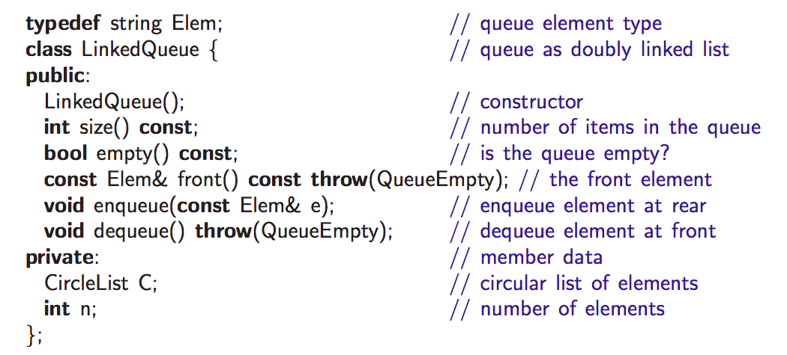
Implementing a Queue with a Circularly Linked List

Slide 12
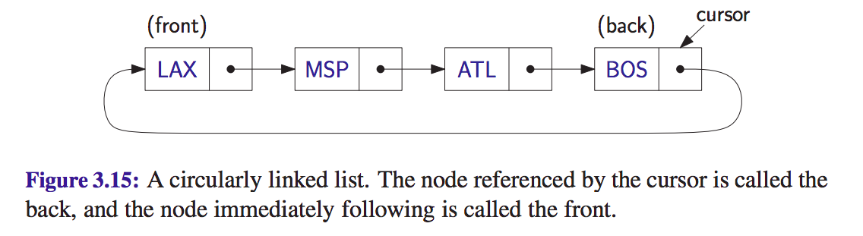
Circular Linked List ADT (reminder)
front() and back() return the data in front and back nodes
add(e) adds e right after the cursor
remove() removes the element right after the cursor
advance() moves the cursor forward

Slide 13
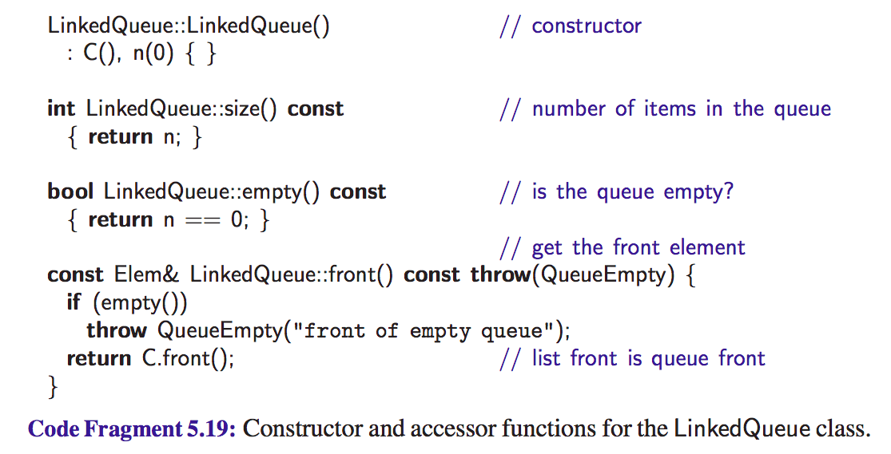

Slide 14
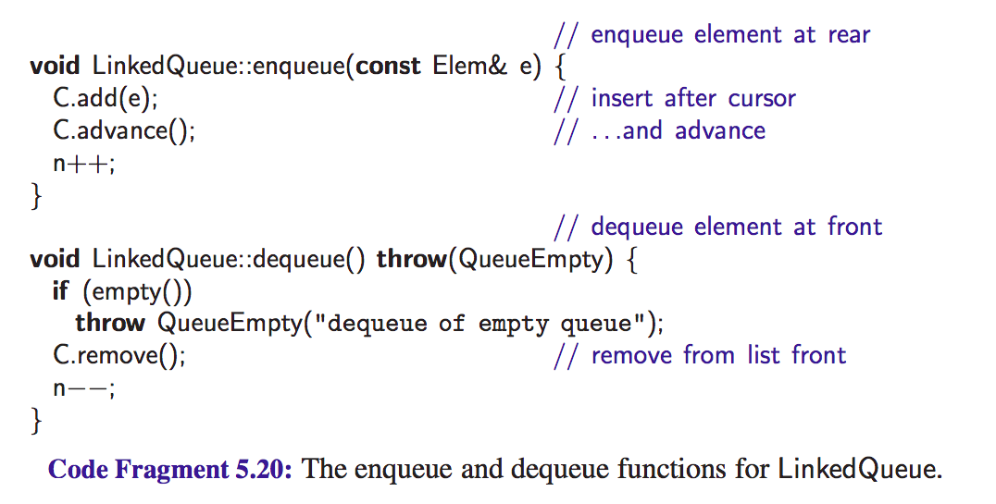

Slide 15
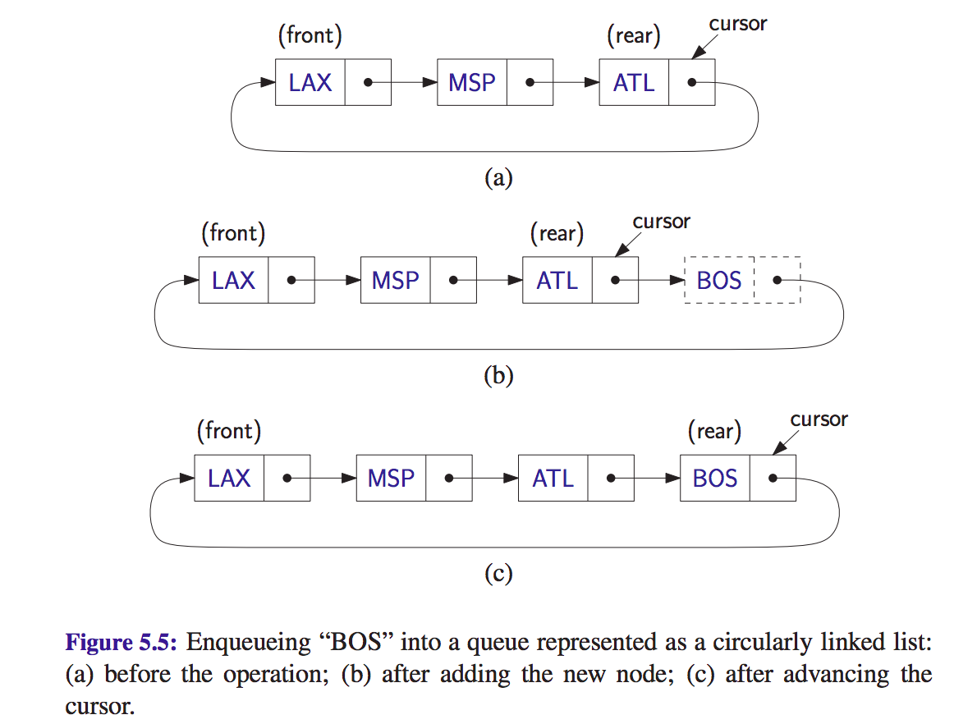

Slide 16
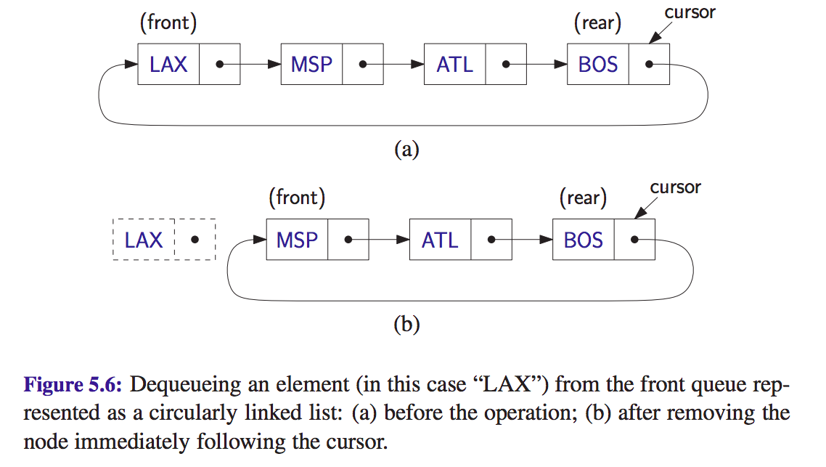

Slide 17
Reading material
Section 5.2 of the textbook

