Slide 1
Disease Detection in Chest X-Ray Images
Adithya Chenthilkannan
Arsh Modak
Omkar Waghmare

Slide 2
Agenda
Introduction
Dataset
Pre-processing
The Flow
Model Configurations
Model Performance Comparison
AUC of the best model
Future Works

Slide 3
Introduction
Problem Statement
Chest X-ray exams are one of the most frequent and cost-effective medical imaging examinations available.
However, clinical diagnosis of a chest X-ray can be challenging and sometimes more difficult than diagnosis via chest CT imaging.
By using machine learning and deep learning techniques, we aim to ease the detection and classification of pneumonia and its types.

Slide 4
The Dataset
Provided by NIH (National Institutes of Health)
Contains 112k+ images of 30k+ unique patients
All images are 1024x1024 single band images
14 distinct diseases
Each image can have multiple labels

Slide 5
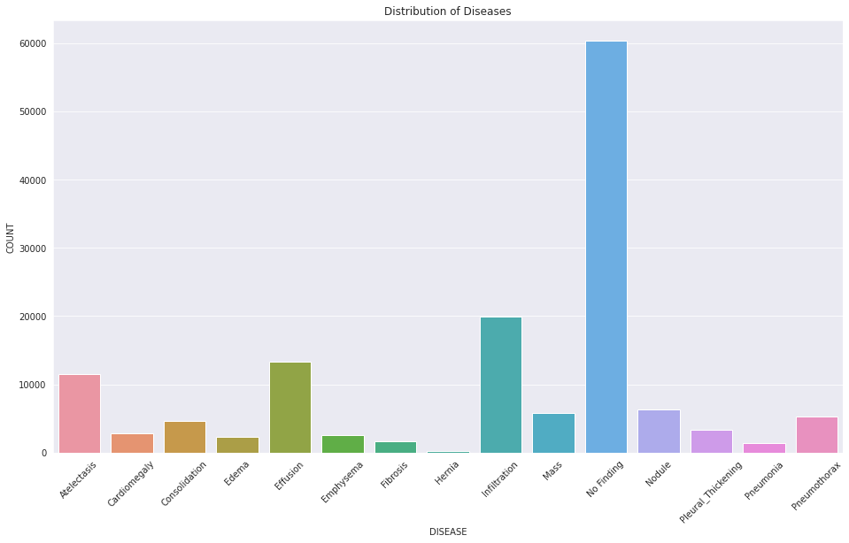

Slide 6
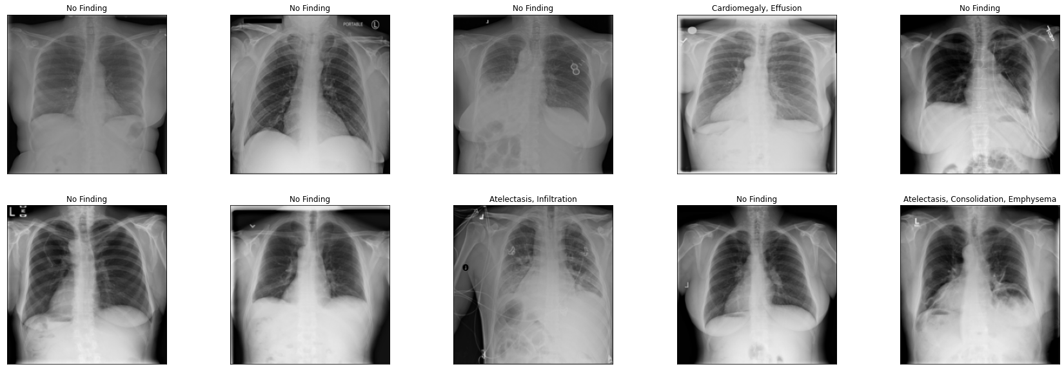
Sample of Raw Images
Notes:
Talk about images having multiple labels

Slide 7
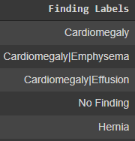
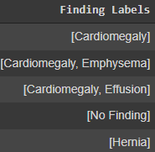
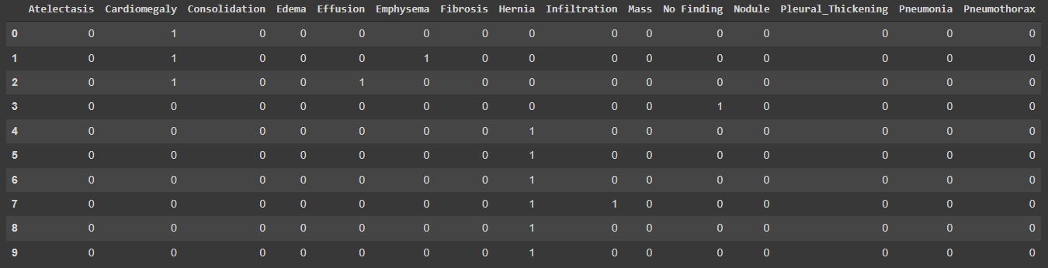
Pre-processing: Metadata
Notes:
Talk about how we manipulated No Findings and came to a conclusion that keeping the images but dropping the label yields best results.

Slide 8
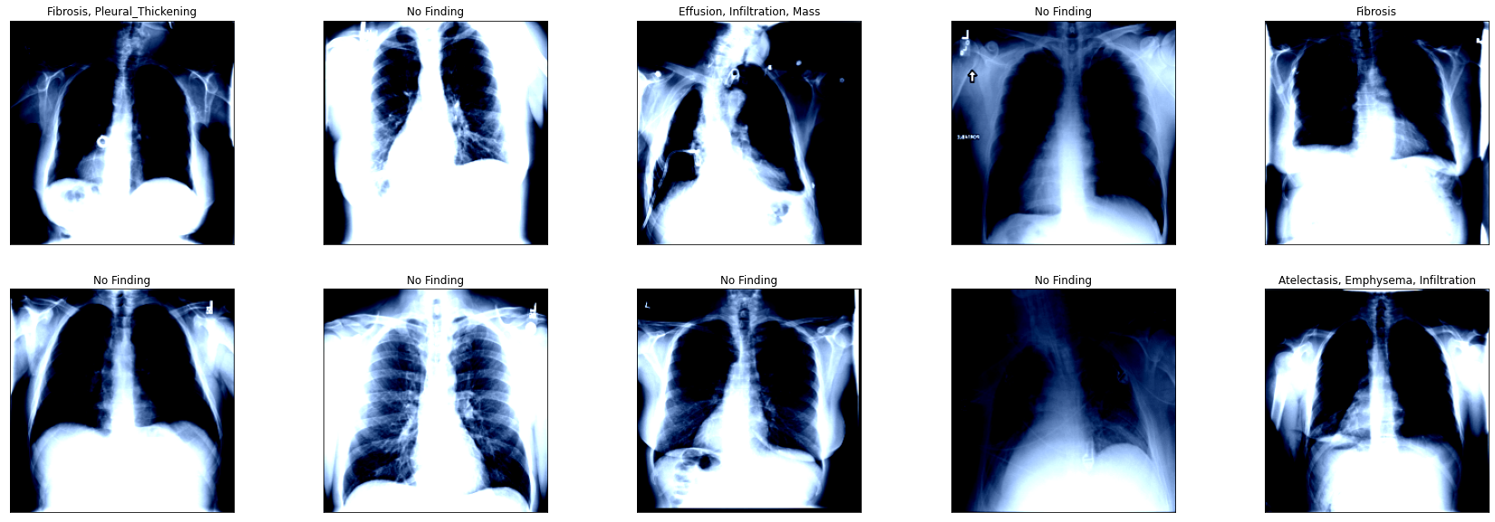
Pre-processing: Images
Resized Images to 224x224
Converted to RGB
Random Horizontal Flip
Normalization

Slide 9
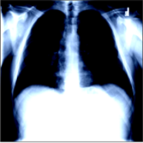
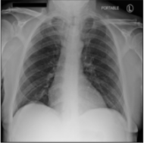
The Flow: CNN
Probability of
Atelectasis
Cardiomegaly
Consolidation
Edema
Neural Network Architecture
Effusion
Emphysema
Fibrosis
Hernia
Infiltration
Mass
Raw Image
Pre-processed Image
Nodule
Pleural Thickening
Pneumonia
Pneumothorax

Slide 10
The Flow: Traditional ML Models
(CNN Feature Extraction)
Probability of
Atelectasis
Cardiomegaly
Consolidation
Edema
Neural Network Architecture as a Feature Extractor
ML Model
Effusion
Emphysema
Fibrosis
Hernia
Infiltration
Pre-processed Image
No Training.
Features are extracted from the last layer of the CNN architecture
2048 Features Extracted from ResNet-152
Mass
Nodule
Pleural Thickening
Pneumonia
Pneumothorax

Slide 11
The Flow: Traditional ML Models
(Manual Feature Extraction)
Probability of
Atelectasis
Cardiomegaly
Consolidation
Edema
Image Feature Extractor
Effusion
ML Model
Emphysema
Fibrosis
Hernia
Infiltration
Pre-processed Image
Gray Level Co-Occurrence Matrix + Local Binary Pattern + Wavelet transform
Pre-processed Image
Mass
Nodule
Pleural Thickening
Pneumonia
Pneumothorax

Slide 12
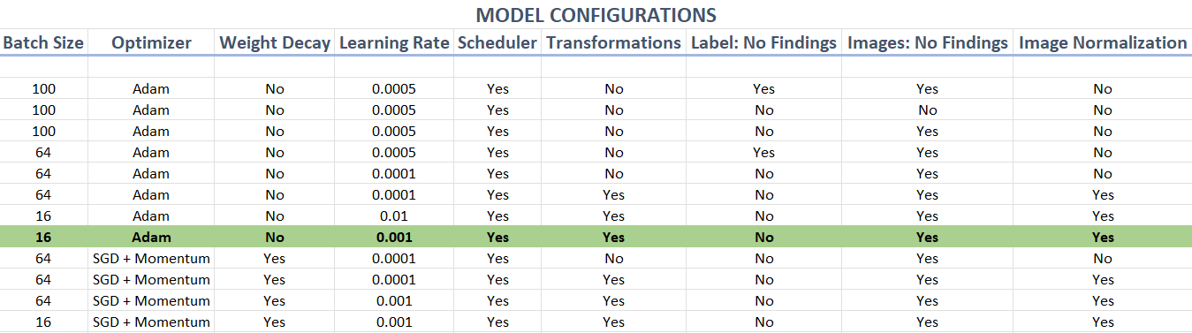
CNN Hyperparameter Configurations
Loss Function: Binary Cross Entropy Loss
Image Size: 512x512 and 224x224 (works best)
Number of Epochs: 35
GPU: NVIDIA Tesla P100-PCIE 16GB
Training Time: 9 to 10 hours per model per config

Slide 13
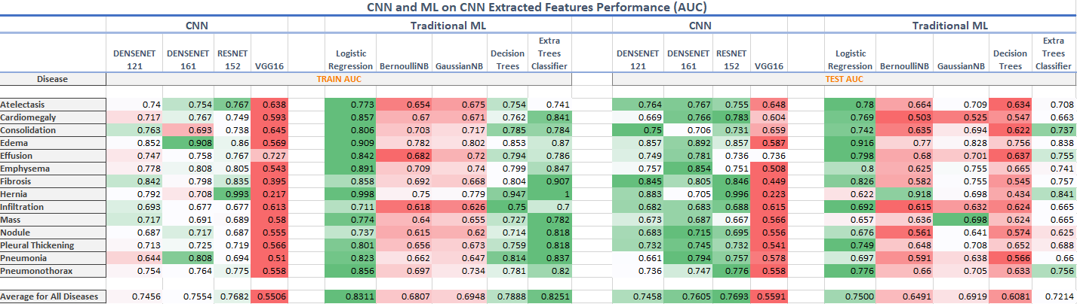
Logistic Regression and Tree Based Models seem to overfit quite a bit even after some Hyperparameter Tuning
VGG16 is the worst performing model
DenseNet-161 and ResNet-152 are the better performing models with ResNet-152 performing the best

Slide 14
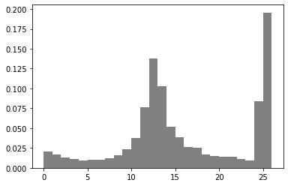
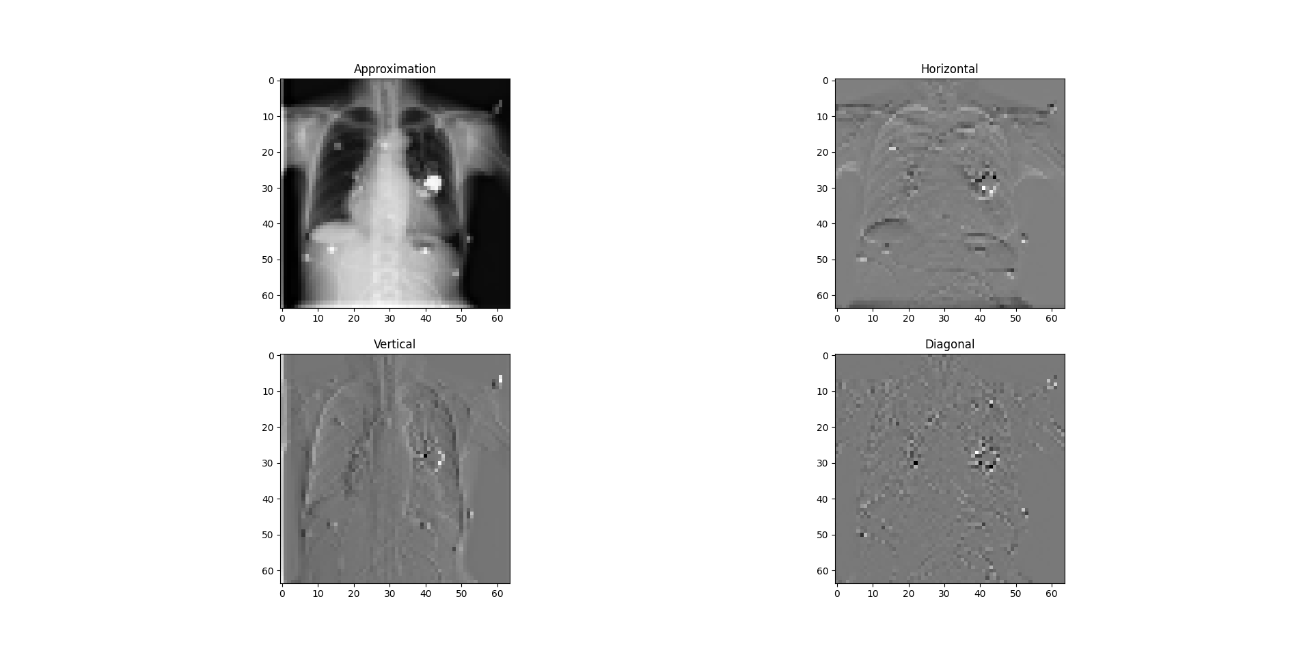
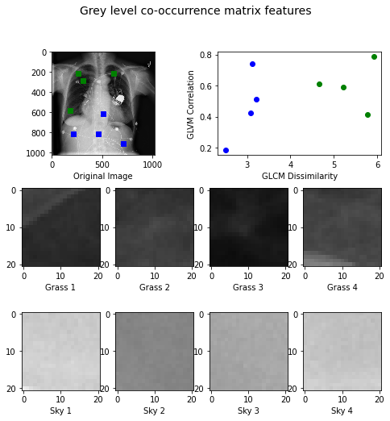
MANUAL FEATURE EXTRACTION TECHNIQUES
Local Binary Pattern
Wavelet Transform
Gray Level Co-Occurrence Matrix

Slide 15
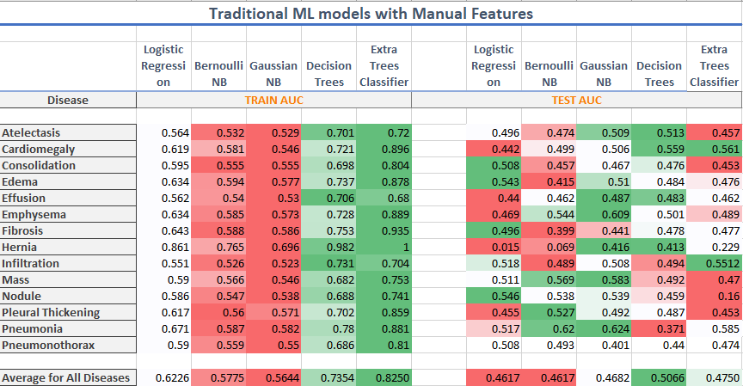
We see similar results of the ML models that were trained on manually extracted features
The performance is worse than the performance with CNN extracted Features
The best performing model is still ResNet-152

Slide 16
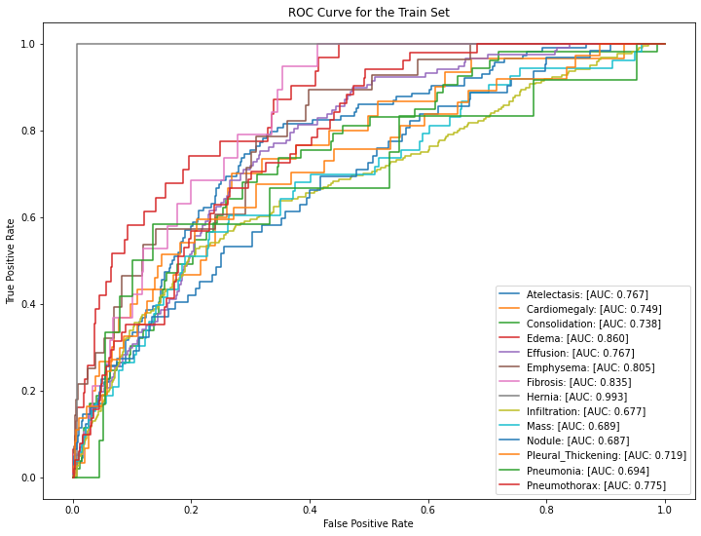
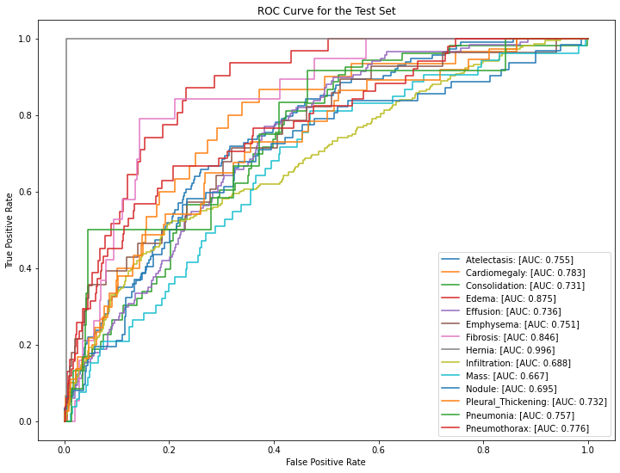
Best Performing Model Results: ResNet-152

Slide 17
References
https://nihcc.app.box.com/v/ChestXray-NIHCC/folder/36938765345
https://www.nih.gov/news-events/news-releases/nih-clinical-center-provides-one-largest-publicly-available-chest-x-ray-datasets-scientific-community
https://arxiv.org/abs/1711.05225

Slide 18
Thank You

