Slide 1

Introduction to Cloud Computing
09/27/2023
Ahmedur Rahman Shovon
PhD student
Department of Computer Science
Email: ashov@uic.edu
Website: arshovon.com

Slide 2
Table of contents
What is cloud computing?
Everyday applications of cloud computing
Exploring cloud service models
Summary
Quick quiz

Slide 3
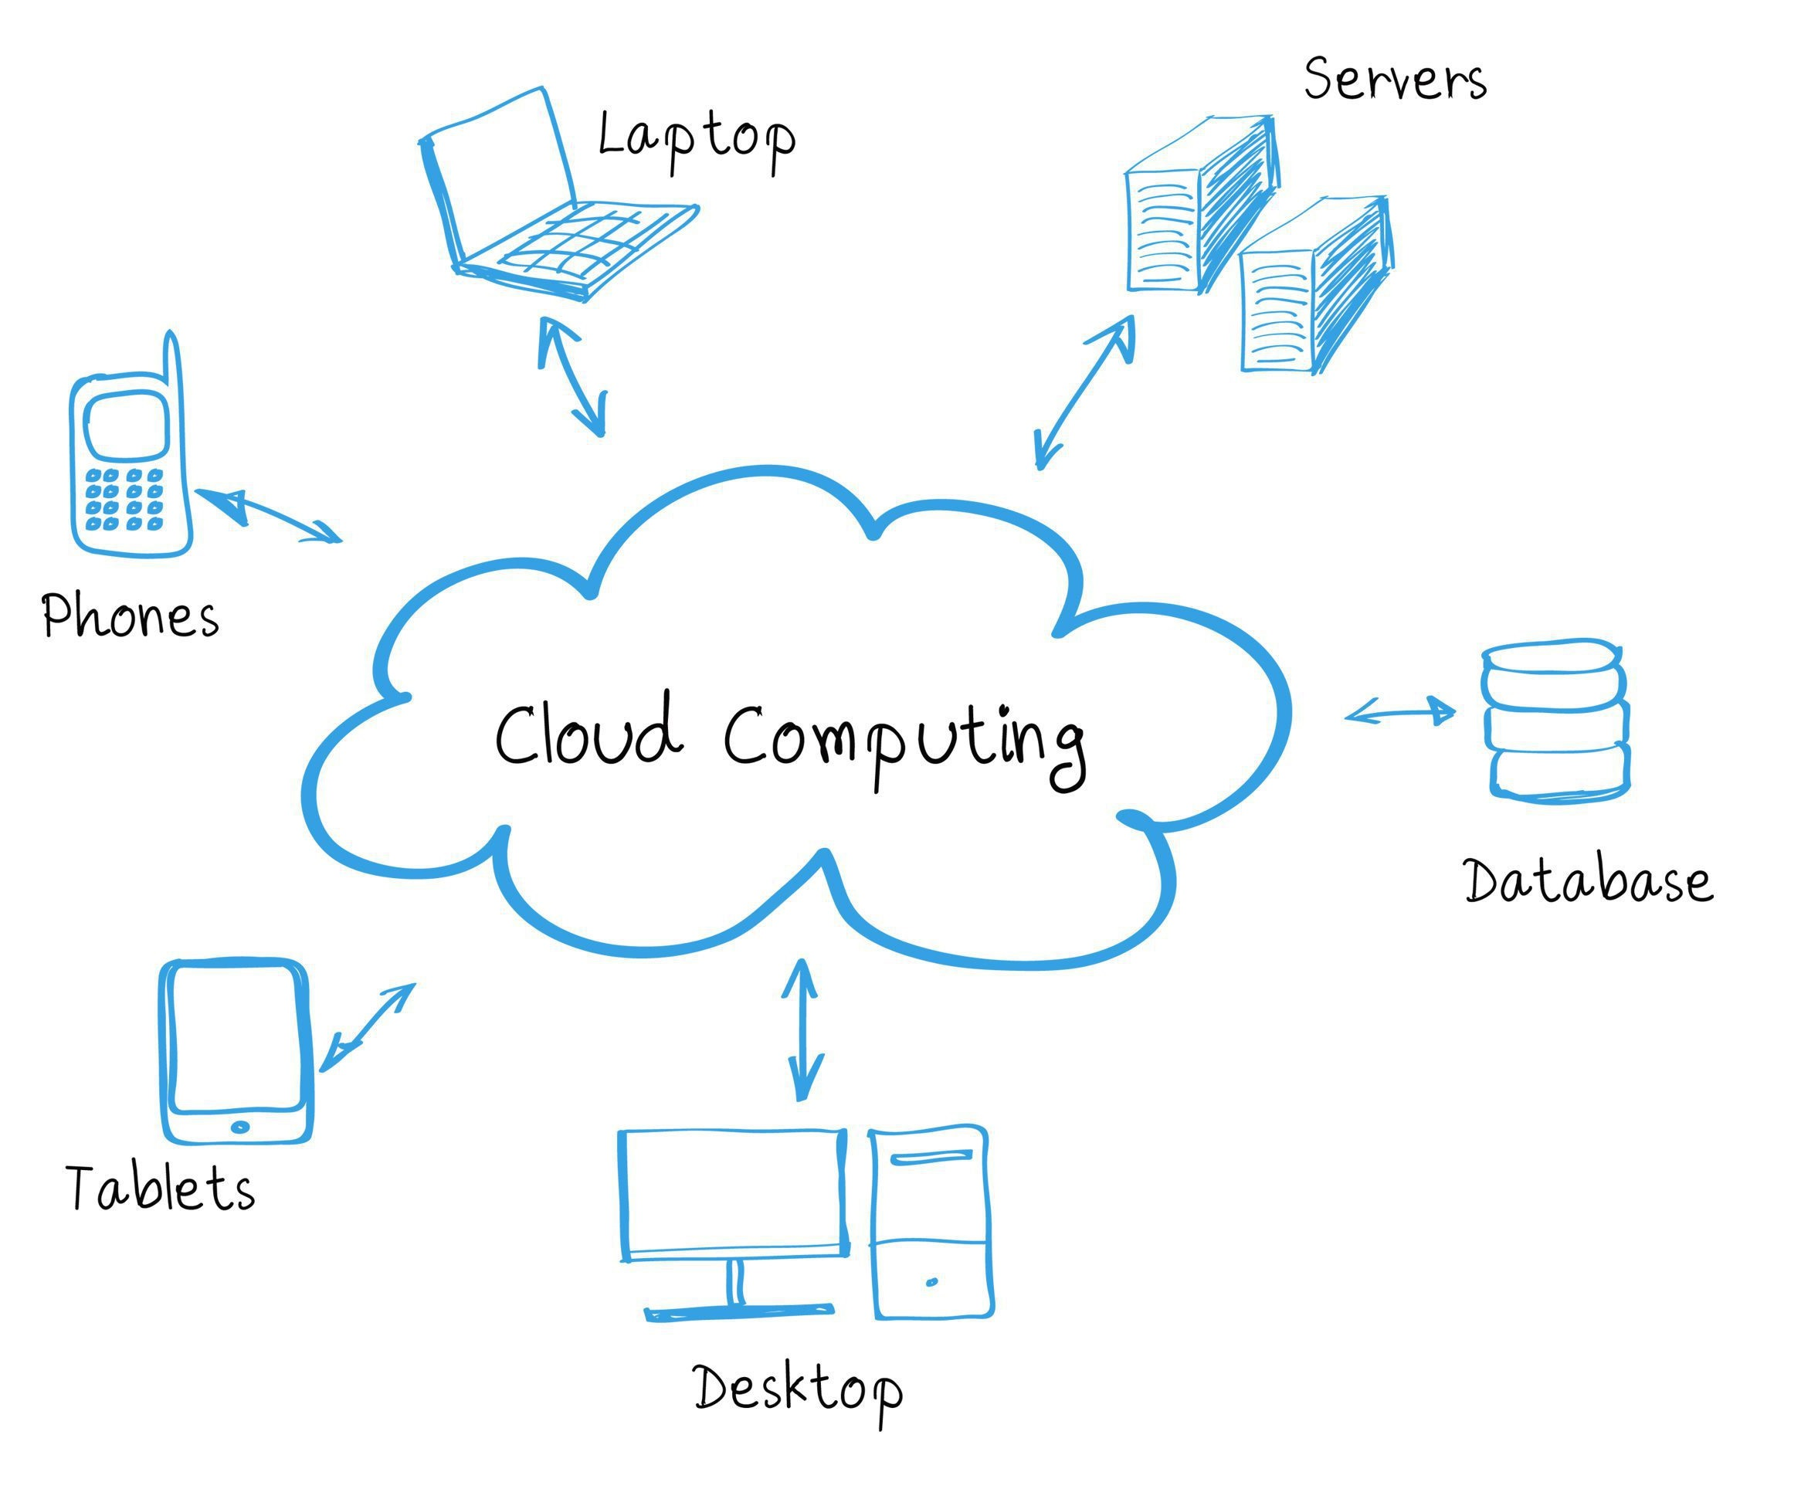
What is Cloud Computing?
Computation over the internet
Internet is represented by cloud shaped symbol
Coined in August of 2006 at a conference in San Jose, California
Notes:
Cloud Computing is a paradigm in which computing resources and software, are delivered over the internet
Allows users to utilize these services without buying or managing the physical infrastructures

Slide 4
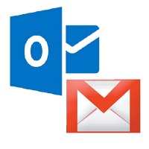
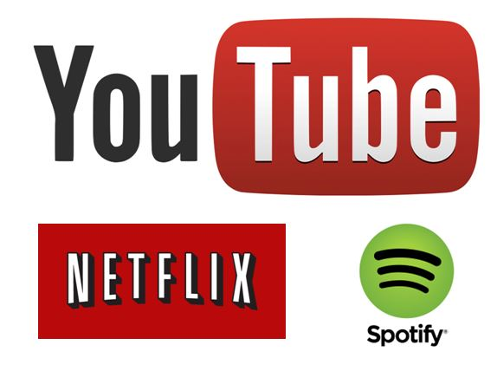
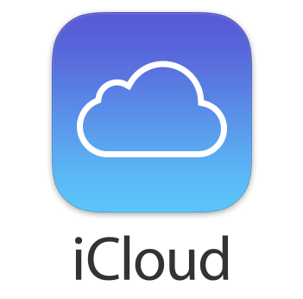
Everyday Applications of Cloud Computing
Email
Streaming
Storage
Outlook
Gmail
Yahoo
YouTube
Netflix
Spotify
iCloud
Google Drive
OneDrive
Notes:
Every time we check our email on Outlook, stream music on Spotify, collaborate documents on Box, or store photos in Google Photos, we're using cloud computing.
It's become an integral part of our daily lives.

Slide 5
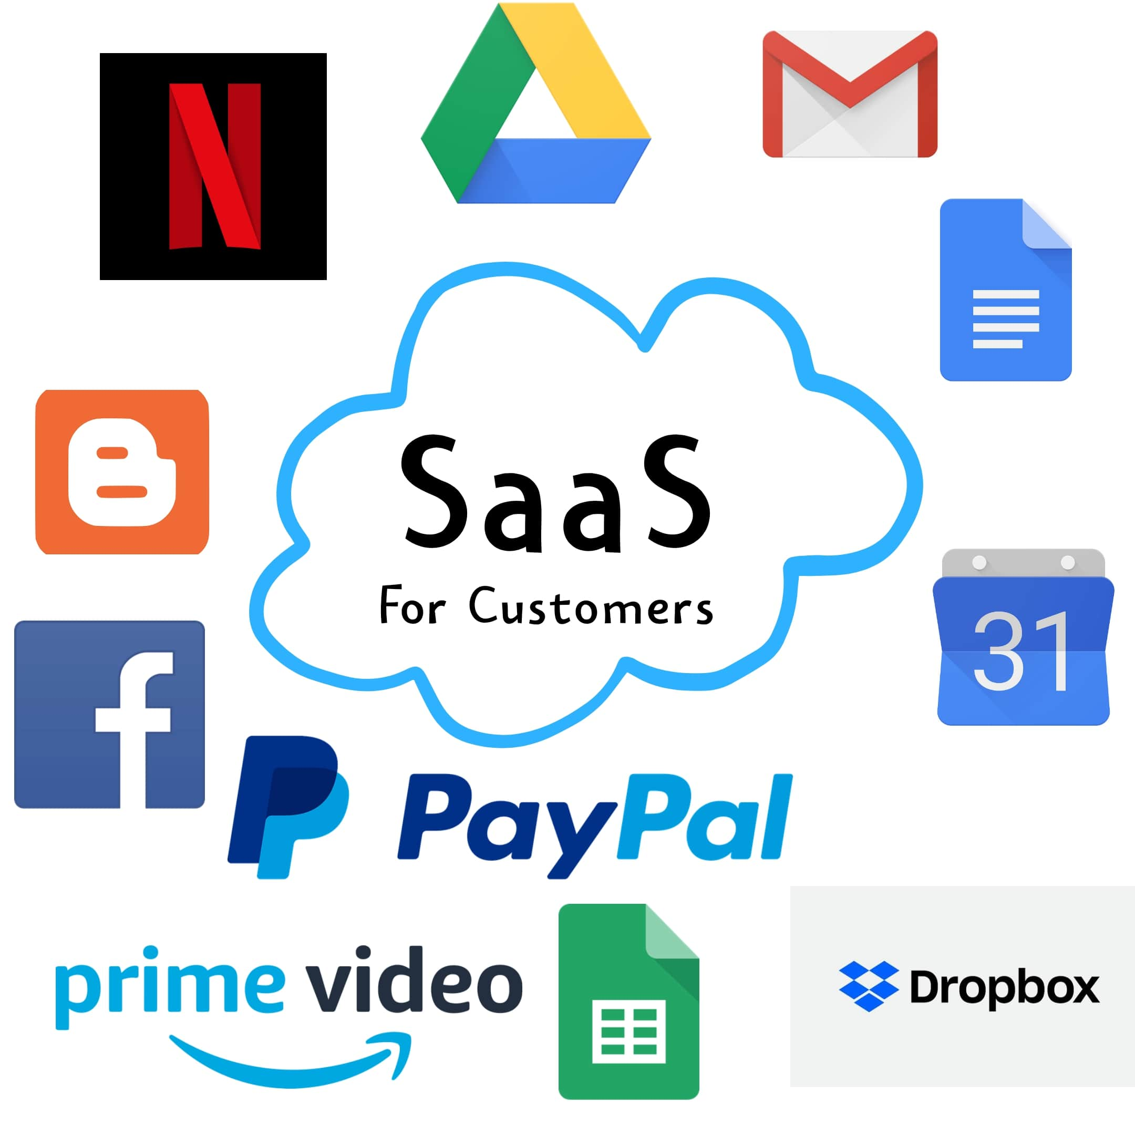
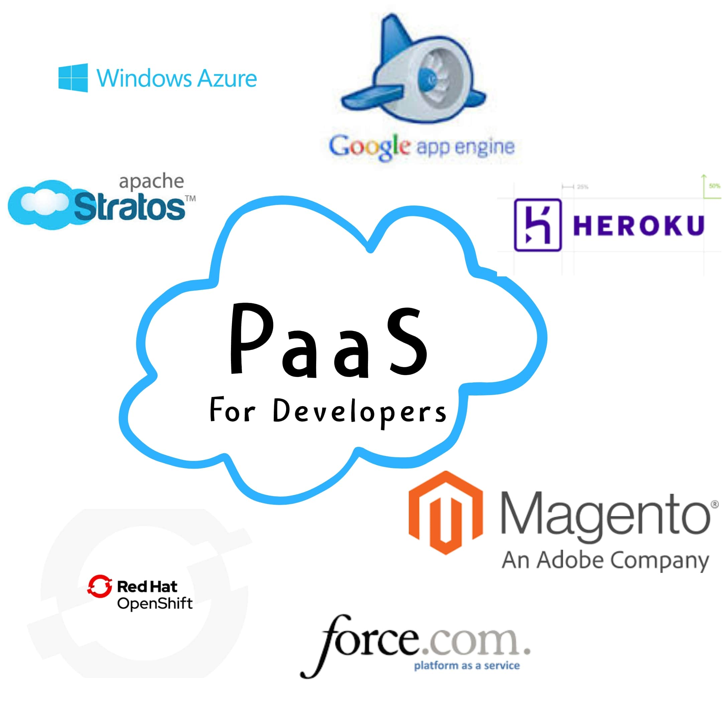
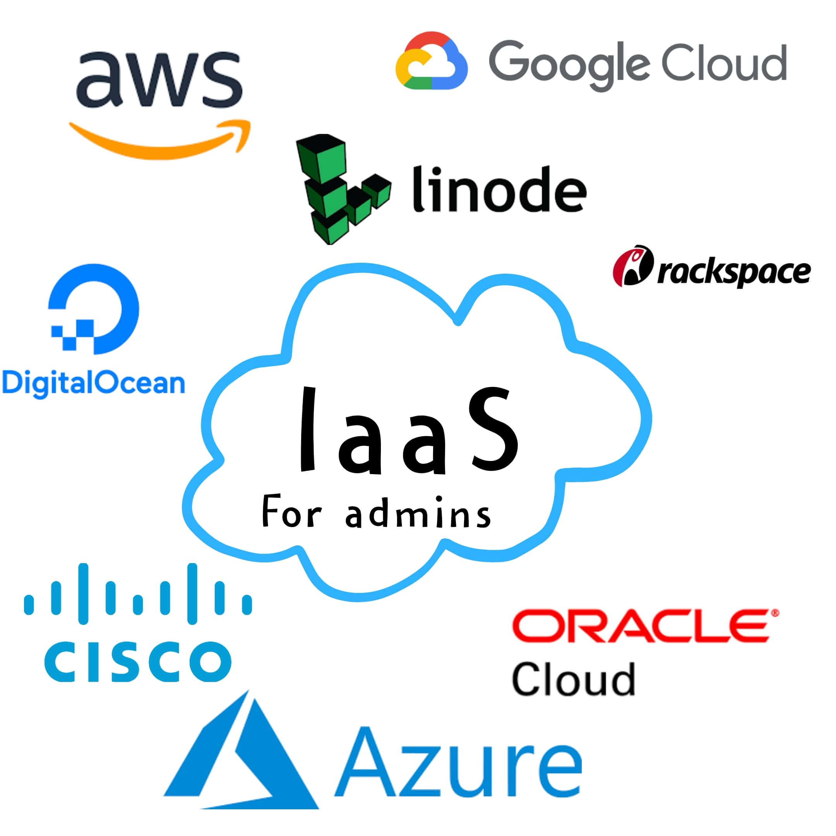
Cloud Computing Service Models
Ready-to-use software applications
SaaS
Software as a Service
Platform as a Service
Software development platforms
PaaS
Configurable computing resources
Infrastructure as a Service
IaaS

Slide 6

Summary
Cloud Computing empowers computation over internet
Integral to our daily routines
SaaS for software, PaaS for platforms, IaaS for infrastructure

Slide 7
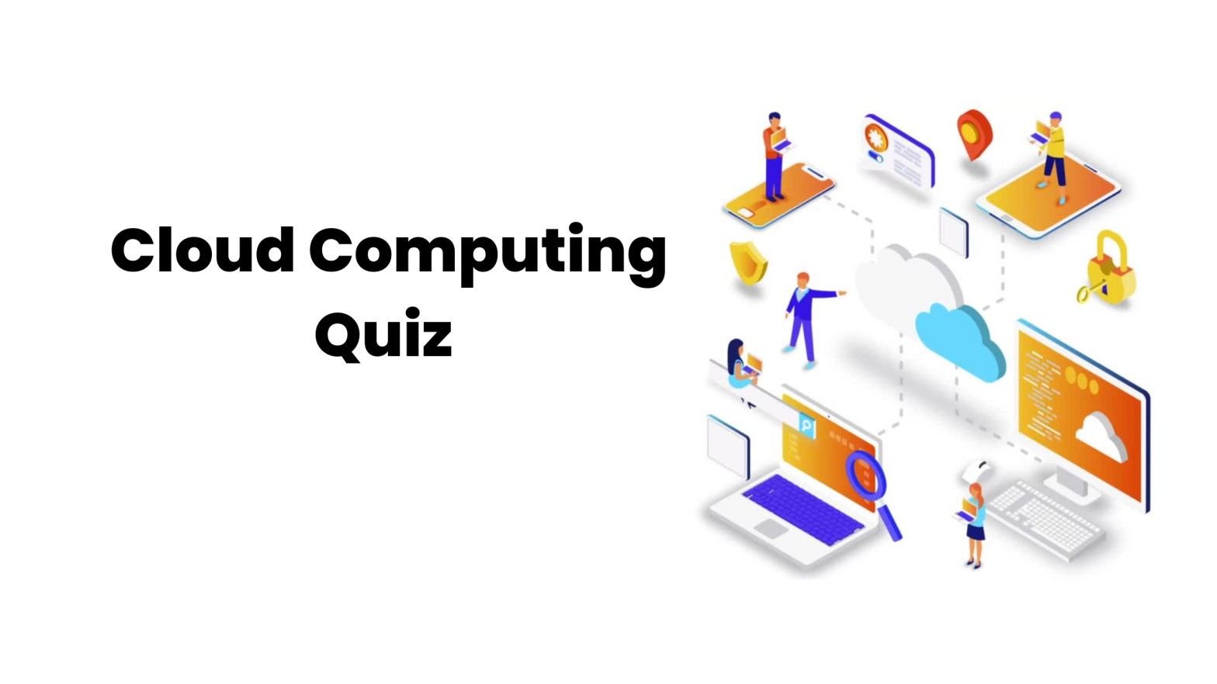
Quiz Time!

Slide 8
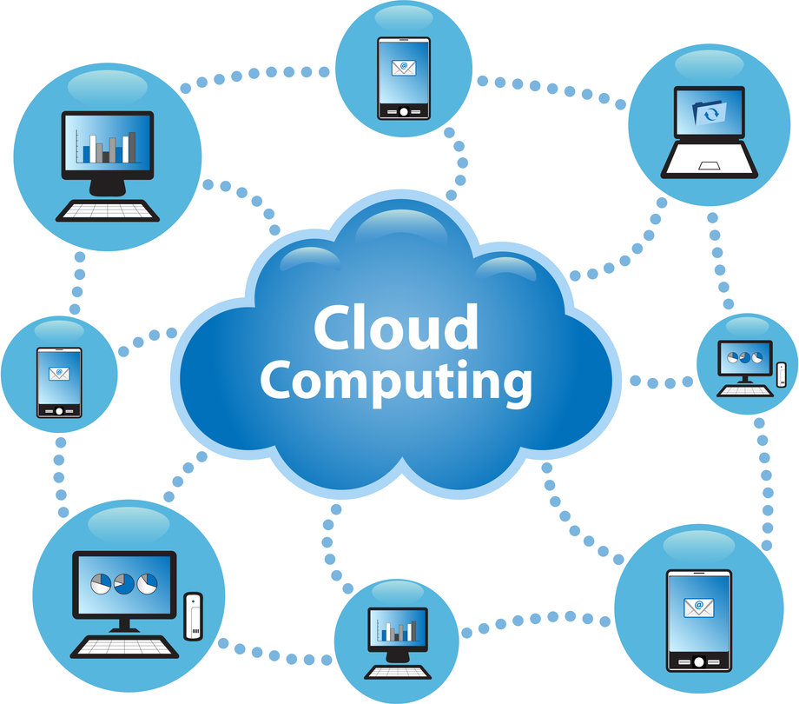
Quiz 1: Why is it called "cloud" in cloud computing?
Metaphor as internet symbol
Because cloud is vast and large
To make alliteration with "Computing"

Slide 9
Quiz 1: Why is it called "cloud" in cloud computing?
Metaphor as internet symbol
Because cloud is vast and large
To make alliteration with "Computing"

Slide 10
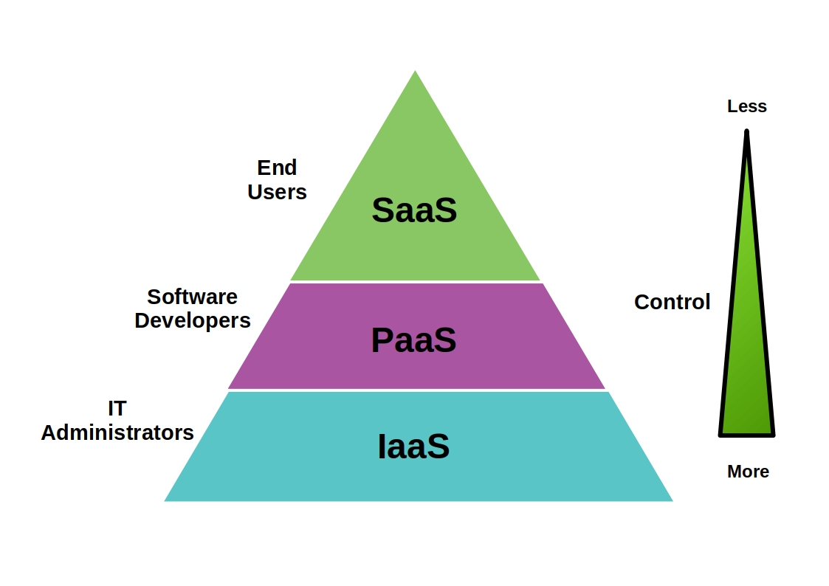
Quiz 2: What is the main difference between PaaS and IaaS?
PaaS provides product while IaaS provides information
PaaS provides platform while IaaS provides infrastructure
PaaS provides programming while IaaS provides instance

Slide 11
Quiz 2: What is the main difference between PaaS and IaaS?
PaaS provides product while IaaS provides information
PaaS provides platform while IaaS provides infrastructure
PaaS provides programming while IaaS provides instance

Slide 12
Thank You
ashov@uic.edu

