Slide 1


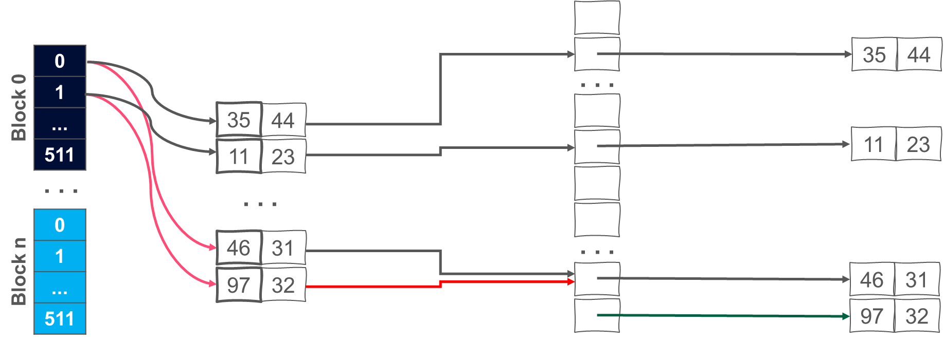


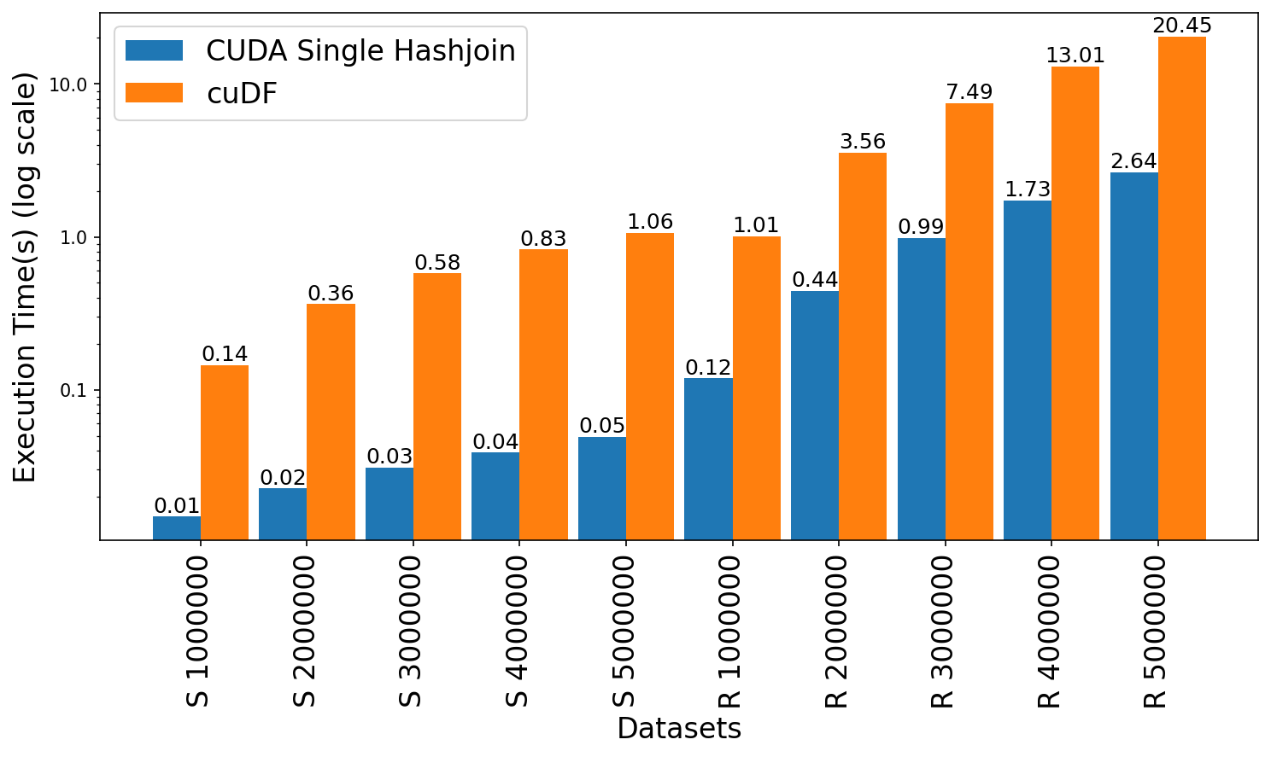
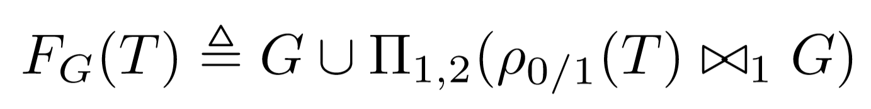
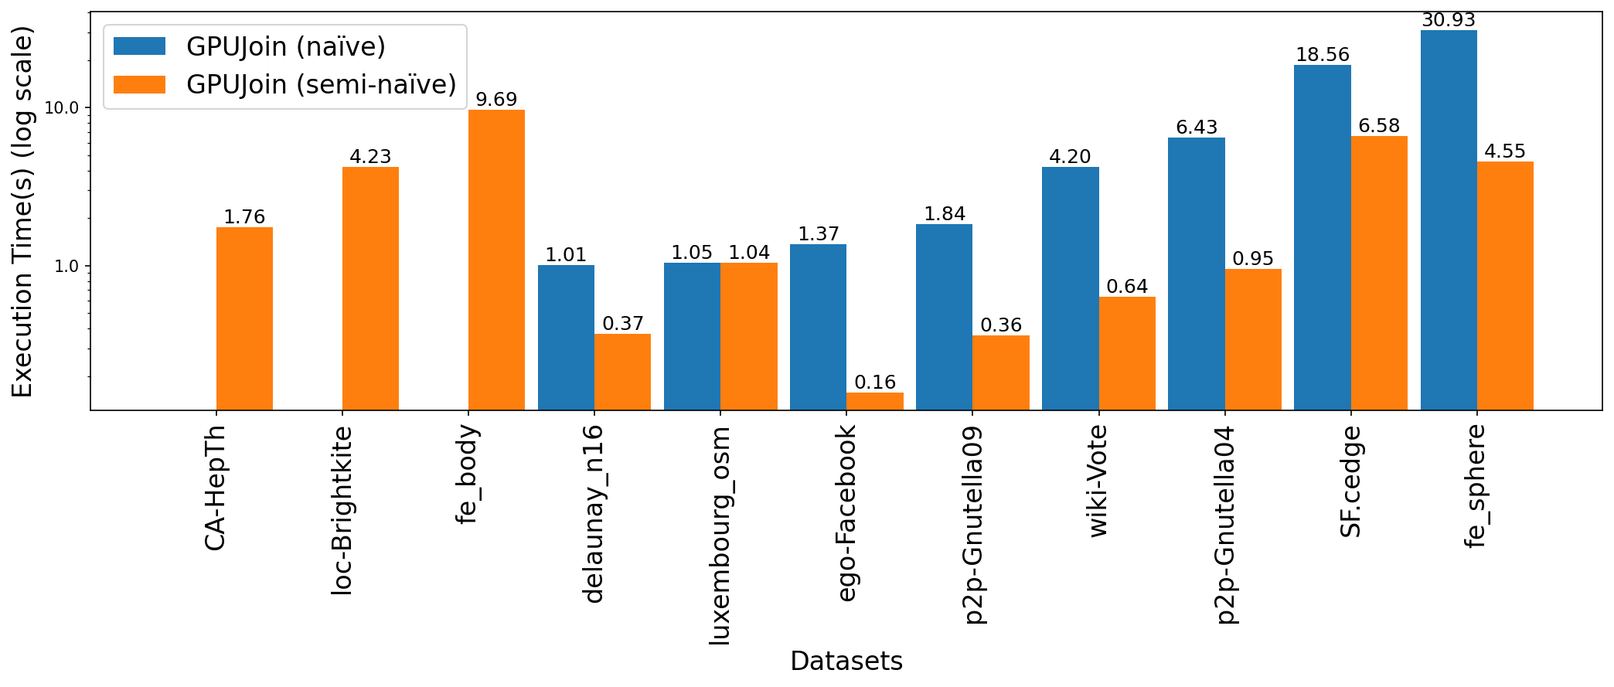
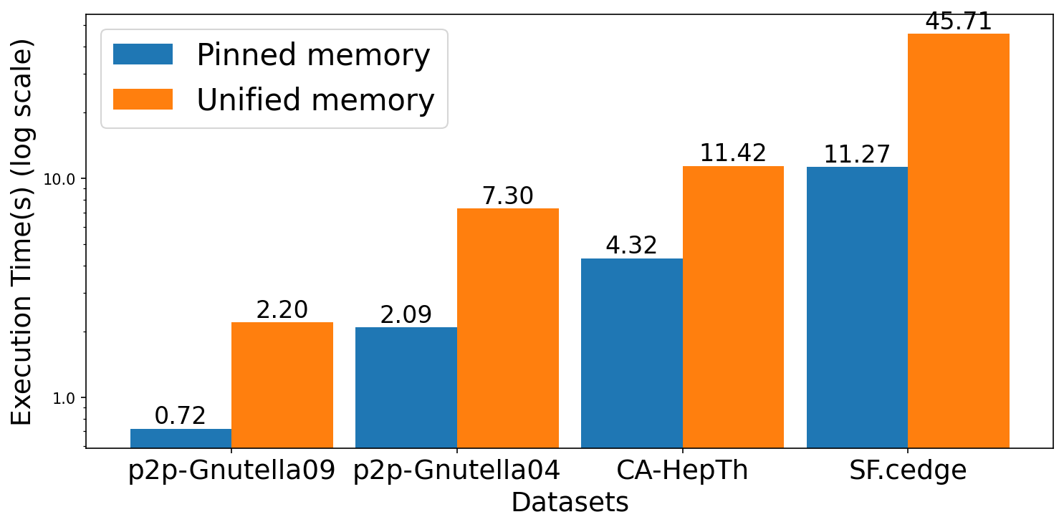
GPUJoin sets the journey toward a modern Datalog backend on GPU
Accelerating Iterative Joins Toward a Modern Datalog Backend on GPU
Ahmedur Rahman Shovon (ashov@uic.edu), Sidharth Kumar (sidharth@uic.edu)
University of Illinois Chicago
Background
Accelerating Iterative Joins with GPUJoin
Experiments
Experiments (Continue)
Declarative programming focuses on “WHAT” to achieve rather than “HOW”.
We introduce a GPU-optimized open addressing hash table tailored for relational data to perform binary hash joins.
GPUJoin lays the groundwork for a modern Datalog backend on GPU, specifically tailored to iterative relational algebra.
We evaluated GPUJoin on large datasets with state-of-the-art CPU Datalog solver (Soufflé) and GPU library (cuDF).
Users
Hash Join Relation
With
Duplicate records
Transitive closure performance comparison (GPUJoin vs Soufflé vs cuDF)
UserID | UserName | UserEmail | Country
101 | Alice | alice@example.com | USA
102 | Bob | bob@example.com | USA
103 | Eve | eve@example.com | Canada
GPU Hash Table (Open addressing, linear probing)
Thread Parallel
(Soufflé)
Dataset | Type | Rows | TC size | Iterations | GPUJoin(s) | Soufflé(s) | cuDF(s)
fe_ocean | U | 409,593 | 1,669,750,513 | 247 | 138.237 | 536.233 | Out of Memory
p2p-Gnutella31 | D | 147,892 | 884,179,859 | 31 | Out of Memory | 128.917 | Out of memory
usroads | U | 165,435 | 871,365,688 | 606 | 364.554 | 222.761 | Out of Memory
fe_body | U | 163,734 | 156,120,489 | 188 | 47.758 | 29.07 | Out of Memory
loc-Brightkite | U | 214,078 | 138,269,412 | 24 | 15.88 | 29.184 | Out of Memory
SF.cedge | U | 223,001 | 80,498,014 | 287 | 11.274 | 17.073 | 64.417
fe_sphere | U | 49,152 | 78,557,912 | 188 | 13.159 | 20.008 | 80.077
CA-HepTh | D | 51,971 | 74,619,885 | 18 | 4.318 | 15.206 | 26.115
p2p-Gnutella04 | D | 39,994 | 47,059,527 | 26 | 2.092 | 7.537 | 14.005
p2p-Gnutella09 | D | 26,013 | 21,402,960 | 20 | 0.72 | 3.094 | 3.906
wiki-Vote | D | 103,689 | 11,947,132 | 10 | 1.137 | 3.172 | 6.841
cti | U | 48,232 | 6,859,653 | 53 | 0.295 | 1.496 | 3.181
delaunay_n16 | U | 196,575 | 6,137,959 | 101 | 1.137 | 1.612 | 5.596
luxembourg_osm | U | 119,666 | 5,022,084 | 426 | 1.322 | 2.548 | 8.194
ego-Facebook | U | 88,234 | 2,508,102 | 17 | 0.544 | 0.606 | 3.719
cal.cedge | U | 21,693 | 501,755 | 195 | 0.489 | 0.455 | 2.756
TG.cedge | U | 23,874 | 481,121 | 58 | 0.198 | 0.219 | 0.857
wing | U | 121,544 | 329,438 | 11 | 0.085 | 0.193 | 0.905
OL.cedge | U | 7,035 | 146,120 | 64 | 0.148 | 0.181 | 0.523
Grid Stride Loop
Murmur 3 hashing
Datalog
Iterative
Relational
Algebra
Node Parallel
(DPRA)
WHAT
HOW
SELECT UserID FROM Users WHERE Country=‘USA’;
AtomicCAS
GPU Parallel
(GPUJoin)
Advanced approach: Logic programming (Datalog)
Off-the-shelf DataFrame data structure for Iterative Relational Algebra
Datalog rules to compute Transitive Closure (TC) of a relation
Collision resolution: Linear probing
TC(x, y) :- Edge(x, y).
TC(x, z) :- TC(x, y), Edge(y, z).
CUDA
Threads
Input Relation
Hash Table
Key - value
Dataframe: 2D labeled tabular data structure
Single join performance comparison (GPUJoin vs cuDF)
Operationalized as a fixed-point iteration using F_{G}
CPU
GPU
(cuDF)
Performing Hash Join on GPU
DataFrame based Datalog applications
Hash Table
Inner Relation
Calculate join size
Advantages
Limitations
Datalog rules compiled down to relational algebra operators
(Union, Projection, Rename, Join)
Key | Value
⨝
Key | Value
First pass
Prefix sum
Join Result
Abstract memory management
Abstract thread block configuration
Same API signatures for CPU, GPU
Easy-to-code interface
No fusing
Memory + computation overhead
No consecutive operation
Memory limitation
Accelerating the iterative joins is crucial
as it is the most expensive operation in Datalog rule evaluation
Second pass
(fused projection)
Join Key | Key | Value
Challenges
Sort and Unique
Efficiently mapping iterative join operations to GPUs poses unique challenges:
Deduplicated Join Result
Pinned memory, clear buffers
Key | Value
CUDA advantages over DataFrame
Iterations in Transitive Closure (TC) Computation
2
Fuse operations
Thread-block configuration
Memory management
Optimize data structure
Naïve vs semi-naïve evaluation of TC computation in GPUJoin
Fused join and projection
1
1
1
1
3
T
T
T
Transitive closure computation (naïve vs semi-naïve evaluation)
0
3
4
0
3
4
0
3
4
0
3
4
T=∅
Loop
T_{new}=E_{(x,y)}∪Π_{x,y}(E_{(x,z)}⋈T_{(z,y)})
If T_{new}=T:
then break
EndIf
T=T_{new}
EndLoop
T=∅, ΔT=E
Loop
ΔT_{(x,y)}=Π_{x,y}(E_{(x,z)}⋈ΔT_{(z,y)})
If ΔT=∅:
then break
EndIf
T=T∪ΔT
EndLoop
Experiment platform and datasets
2
2
2
2
ThetaGPU supercomputer from Argonne National Lab
Input relation
Iteration 1
Iteration 2
Iteration 3
CPU: AMD EPYC 7742 processors with 3.31GHz clock speed, 128 cores
Relational operations in a fixed-point setting (Iteration 1)
GPU: NVIDIA A100 Tensor Core GPU with 40GB GPU memory, 108 SM
ρ_{0/1}(T)
G
ρ_{0/1}(T) ⨝ G
Π_{1, 2}(ρ_{0/1}(T) ⨝ G)
Environment: CUDA (11.4, 3456x512), Soufflé (2.3, 128 threads), cuDF (22.06)
1 | 0
2 | 0
3 | 1
3 | 2
4 | 3
⨝
0 | 1
0 | 2
1 | 3
2 | 3
3 | 4
1 | 0 | 3
2 | 0 | 3
3 | 1 | 4
3 | 2 | 4
0 | 3
1 | 4
2 | 4
Datasets: Stanford large network, SuiteSparse, Road network datasets
Empty bars in naïve evaluation presents out of memory error
Our GPU Hash Table performance
Conclusion
Transitive closure computation single iteration (semi-naïve evaluation)
Build rate:
Random synthetic graph: 400 million keys/second
String graph: 4 billion keys/second
Our contributions:
High performance GPU hash table for iterative RA
Operations optimization (fuse join and projection)
Overcome deduplication challenge
Efficient GPU memory management (pinned memory and buffer clearance)
Semi-naïve evaluation for avoiding redundant computation
Open-sourced code, data, documentation: https://github.com/harp-lab/usenixATC23 (Published in USENIX ATC 2023, IA^3 2022)
Duplicates on join results
Storing intermediate results
Hash Table
ΔT
T_{new}=T∪ΔT
ΔT
1
2
Key | Value
⨝
Key | Value
Key | Value
Key | Value
Pinned vs unified memory performance comparison for iterative joins (TC)
Fusing multiple operations
Redundant computations
3
4
Hash Join
Set
Union
Set
Difference
We present a single GPU-based open addressing hash join (GPUJoin) designed to accelerate iterative joins for Datalog evaluation:
Static
Hash Table
⨝
Inner
Relation
Hash Join results
with
duplicates
Deduplicated records
Acknowledgement
Continue until ΔT≠∅
This work was funded in part by NSF RII Track-4 award 2132013, NSF collaborative research award 2217036, and NSF collaborative research award 2221811. We are thankful to the ALCF’s Director’s Discretionary (DD) program for providing us with compute hours to run our experiments on the ThetaGPU supercomputer located at the Argonne National Laboratory.
Efficient deduplication
Fuse operations
Deduplication
1
Avoid redundant computations
4

