Slide 1
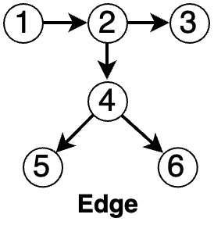
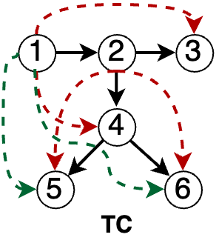

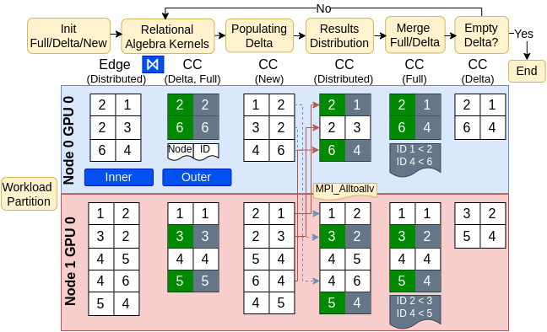
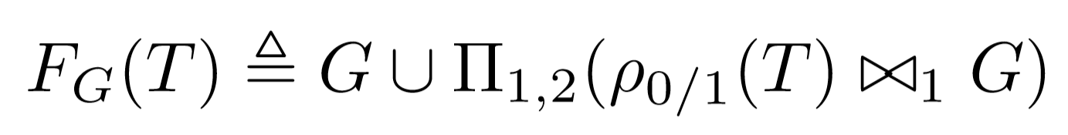


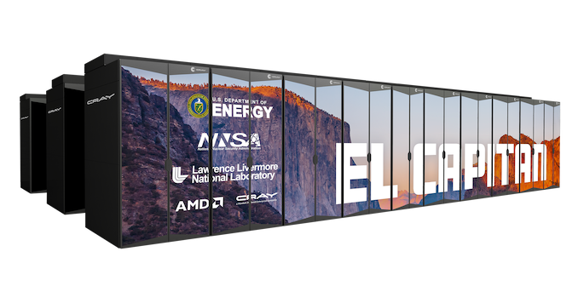
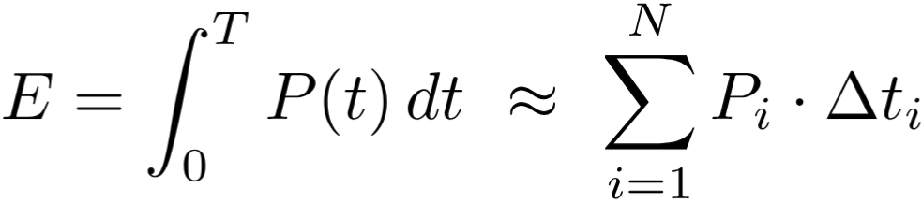
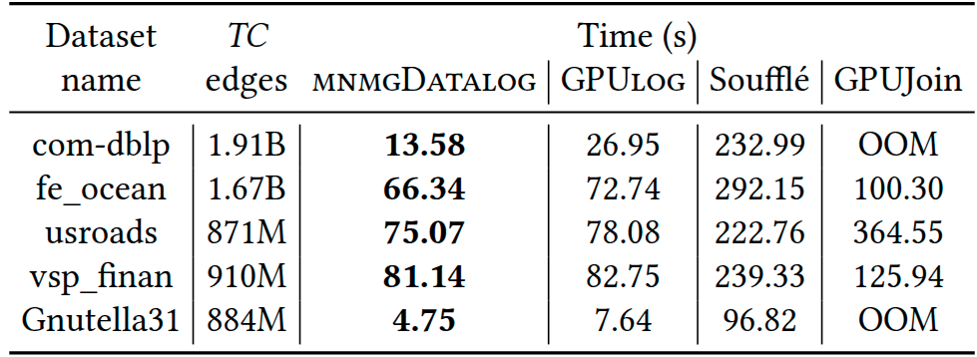
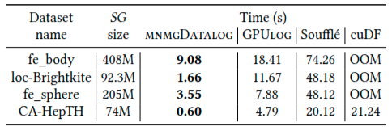
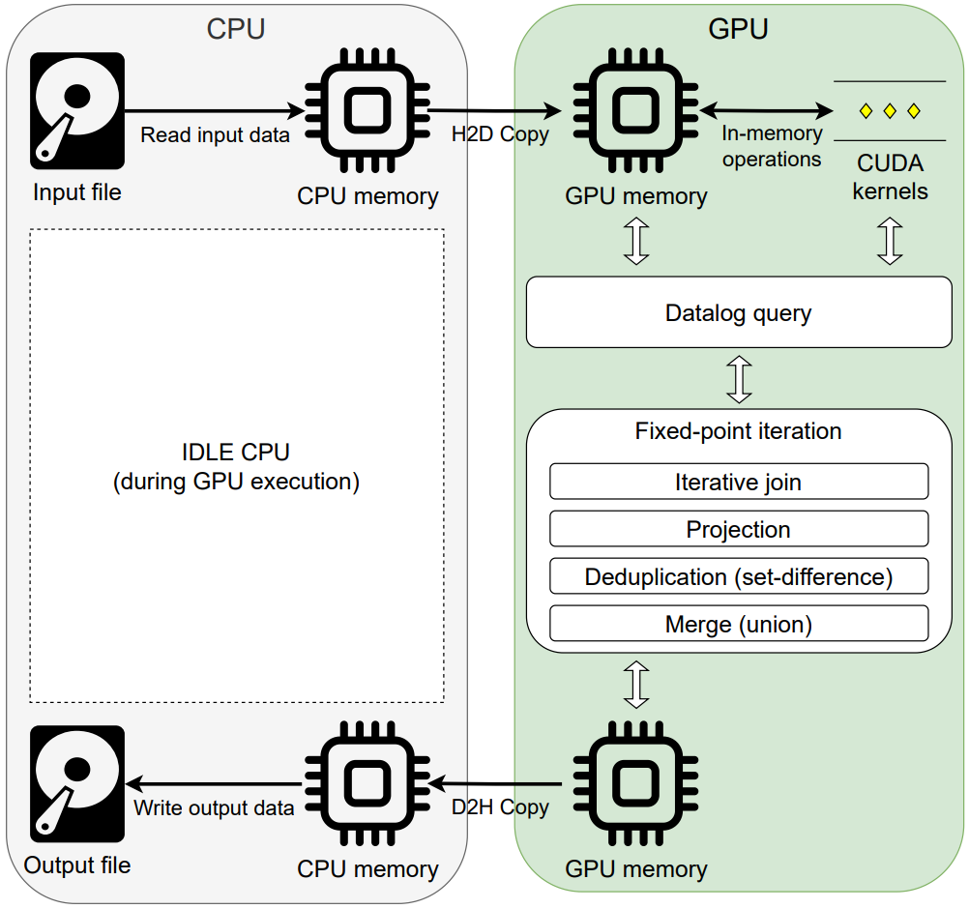
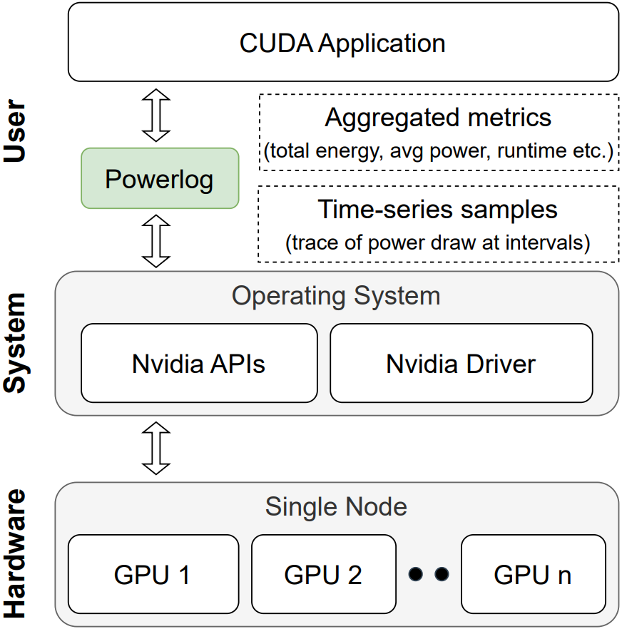
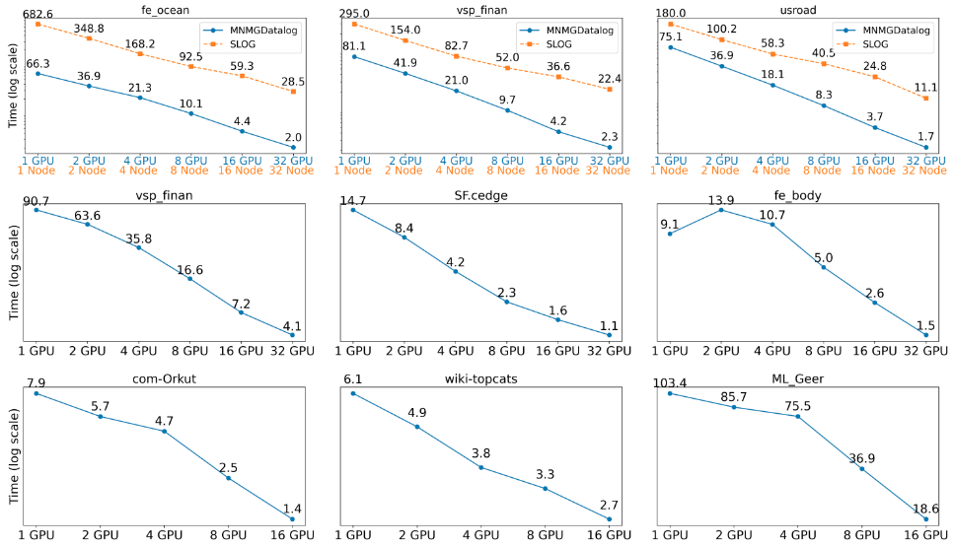
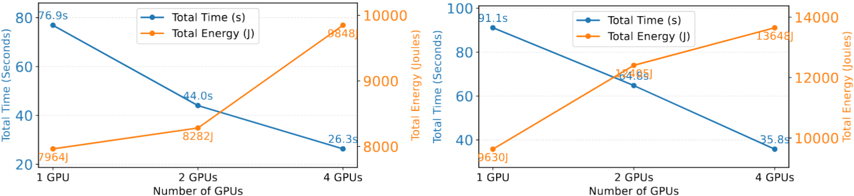
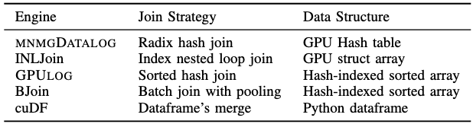
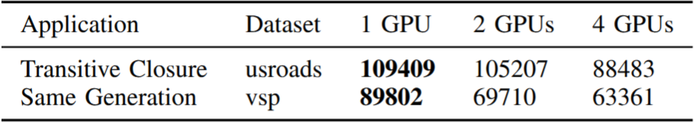







Scalable Multi-Node Multi-GPU Datalog Engine with Energy-Aware Profiling
Accelerating declarative analytics on HPC systems
Ahmedur Rahman Shovon, Mathematics and Computer Science Division, Argonne National Laboratory
Sidharth Kumar, University of Illinois Chicago
Datalog simplifies large-scale analytics by expressing recursive logic with concise, declarative rules
The rules are compiled down to iterative relational algebra
Datalog executes queries iteratively until a fixed point is reached, making it well-suited for graph mining, deductive databases, and symbolic AI
Parallelizing these iterative relational operations on modern accelerators can greatly improve the performance of declarative analytics
MNMGDatalog is the first multi-node, multi-GPU Datalog engine built on CUDA-Aware MPI
Achieves up to 32× speedup over distributed CPU-based engines on Polaris
Powerlog enables GPU-level energy profiling for declarative workloads
Motivation
MNMGDatalog uses radix-hash partitioning and non-uniform all-to-all communication with GPU-aware hash tables for efficient tuple materialization
ABSTRACT
Limitations of current Datalog Engines
Methods
TC(x, y) :- Edge(x, y).
TC(x, z) :- TC(x, y), Edge(y, z).
Multi-threaded
Distributed
(Apache Spark)
Multi-node
Multi-threaded
Single-GPU
Multi-node Multi-GPUs (MNMG)
Soufflé
RDFox
SLOG
GPUJoin
Materialization in fixed point iteration
Datalog rules to compute Transitive Closure (TC) of a relation
LogicBlox
Radlog
PRAM
GPULog
Scalability
Overhead
CPU-Only
VRAM
Datalog on multi-node multi-GPU systems
High performance implementation for highly expressive language
Requirements for MNMG Engine
Experiment environment
Workload partitioning
Data representation
HW: AMD EPYC 7543P CPU, NVIDIA A100 GPUs with NVLink
1
2
Apps: Transitive Closure (TC), Same Generation (SG), Connected Component (CC)
Efficient communication
Tuple materialization
3
4
Datasets: Stanford large network, SuiteSparse, Road network
We evaluate MNMGDatalog against state-of-the-art single-GPU, shared-memory, and distributed multi-node Datalog engines up to 32 NVIDIA A100 GPUs
MNMGDatalog performance evaluation
Evaluates energy-efficiency of SOTA GPU-powered engines on Polaris
where, E=total energy, N=# of samples, P_{i}=power draw at i, Δt_{i}=time between i, i+1
Powerlog for energy profiling
Single-GPU evaluation for TC
Single-GPU evaluation for SG
Workflow for energy profiling
Powerlog architecture
Multi-node evaluation for TC, SG, and CC
Energy efficiency metric: Tuples/Joule
MNMGDatalog multi-GPU power analysis
Total number of tuples produced
Total energy consumed (Joules)
Comparison of GPU Datalog engines
Energy efficiency using Tuples/Joule
Introduces novel GPU-Aware communication for scalable recursive query evaluation
Supports recursive aggregation for Datalog rules using high-throughput GPU kernels
Power profiling of GPU-based Datalog engines
Conclusion
Add spatial and temporal load balancing
Develop GPU-Aware HIP and OneAPI implementations
Benchmark on Neurosymbolic programming applications
Extend Powerlog to multi-node environment
Augment Tuples/Joule metric with Datalog-level counters (work/iteration, duplicate ratio, tuples materialized) and system-level metrics (HBM/DRAM bandwidth, cache hits/misses)
Future plan
Gilray, T., Sahebolamri, A., Sun, Y., Kunapaneni, S., Kumar, S., & Micinski, K. (2024). Datalog with First-Class Facts. VLDB, 18(3), 651-665.
Jordan, H., Scholz, B., & Subotić, P. (2016, July). Soufflé: On synthesis of program analyzers. In International Conference on Computer Aided Verification (pp. 422-430).
First multi-node multi-GPU Datalog engine
Single-GPU: Up to 7× speedup over GPULog
Multi-threaded: Up to 32× over Soufflé
Distributed: Up to 31.9× speedup over SLOG
references
MNMGDatalog evolution
Accelerating Datalog applications with cuDF
Towards iterative relational algebra on the {GPU}
Optimizing Datalog for the GPU
Multi-node multi-GPU Datalog

