Slide 1



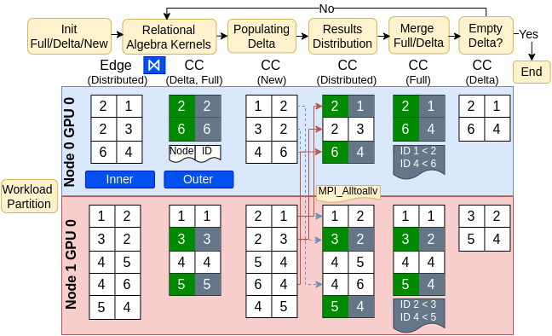
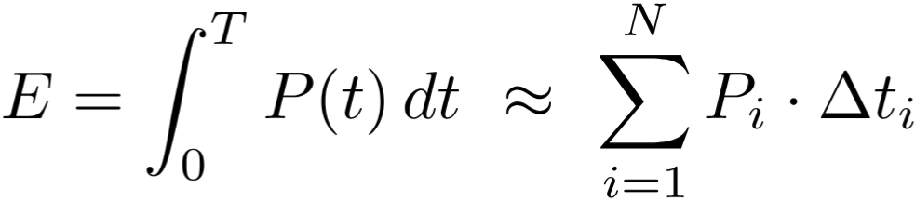
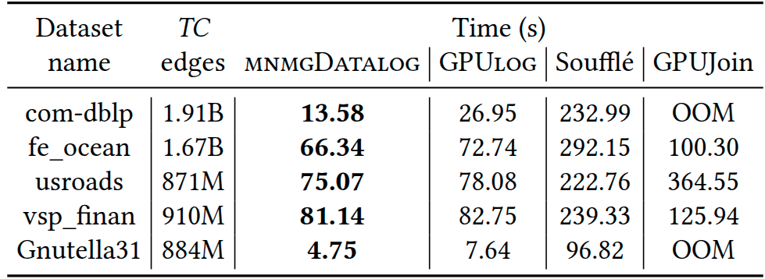
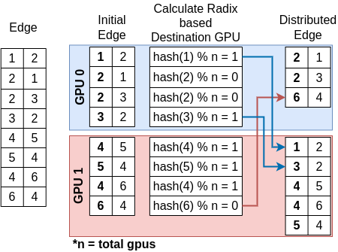
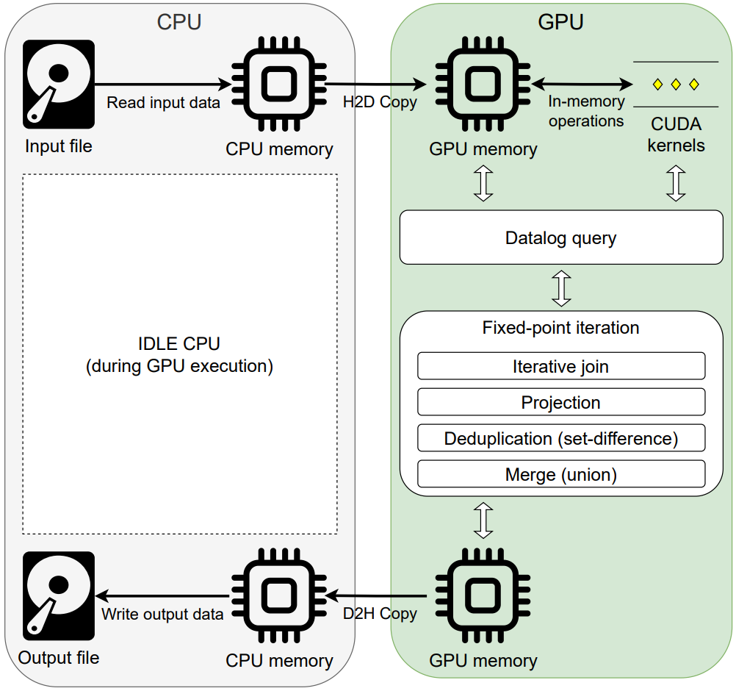
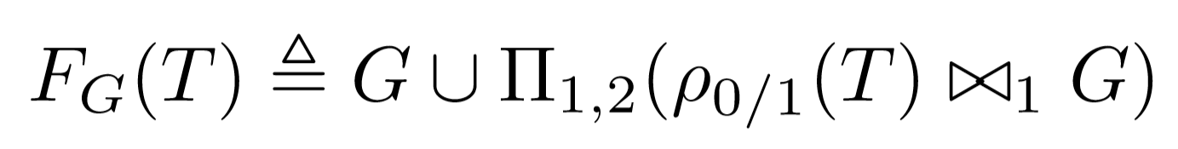
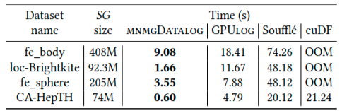
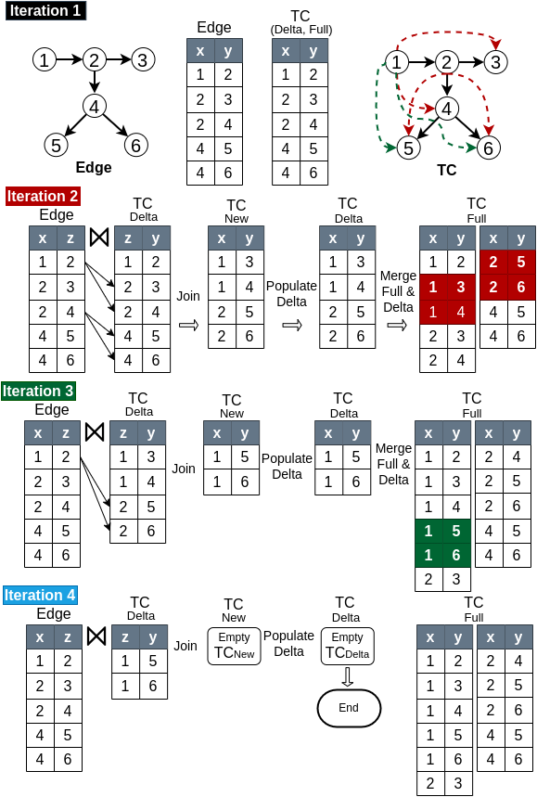
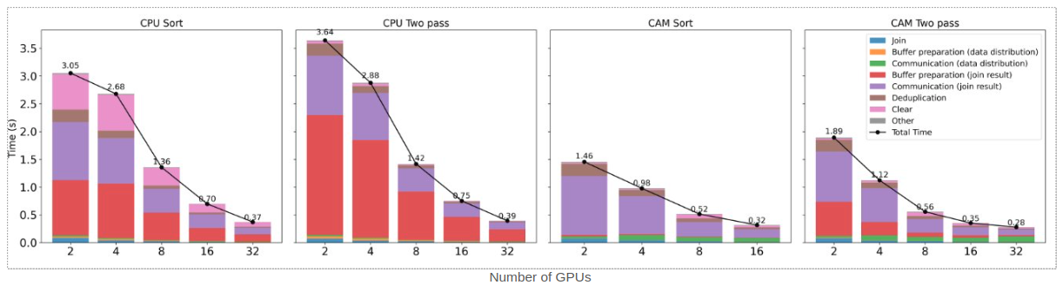
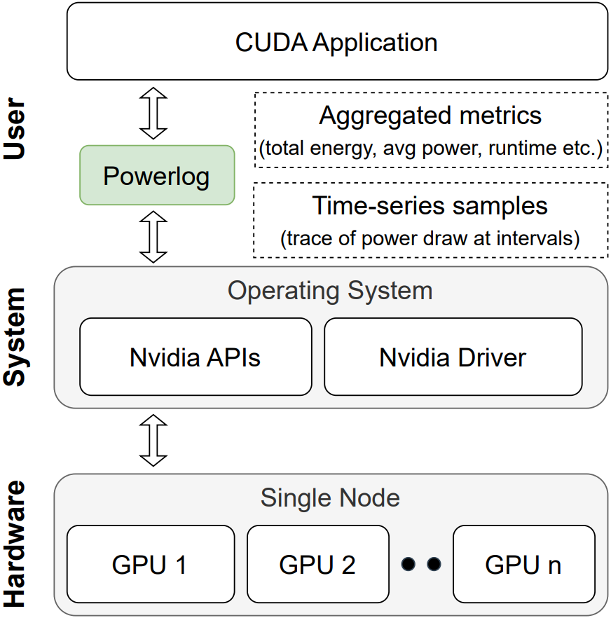
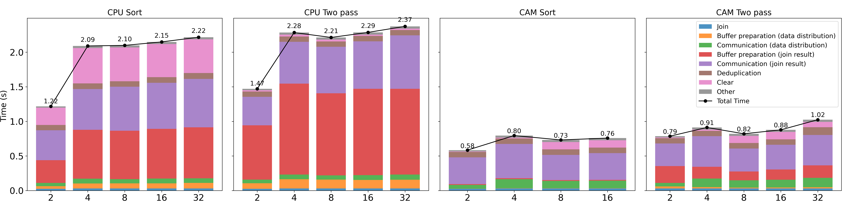
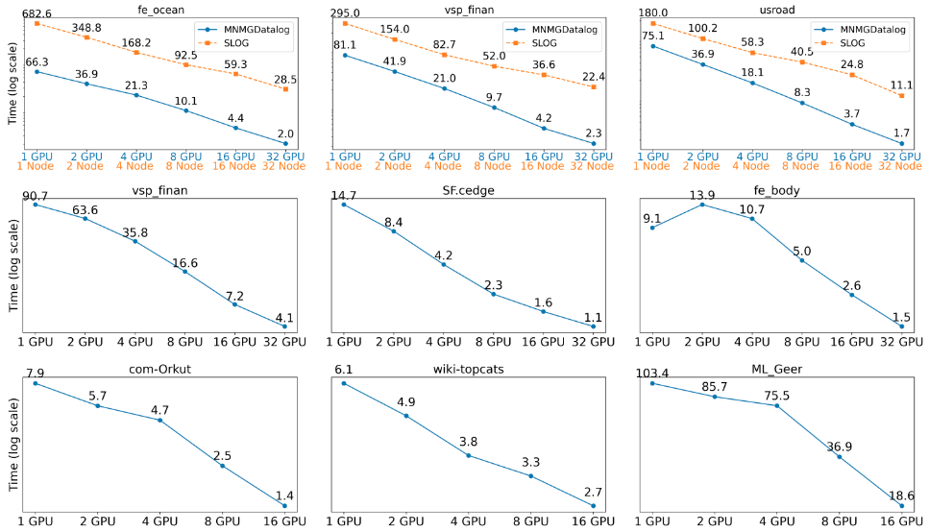
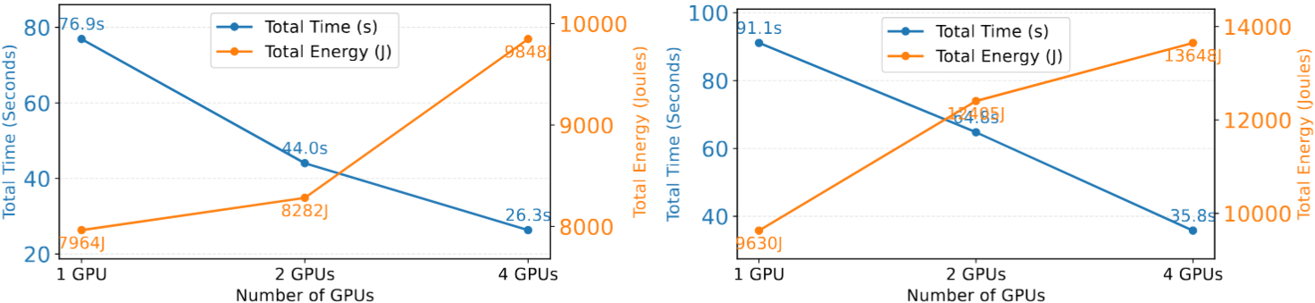
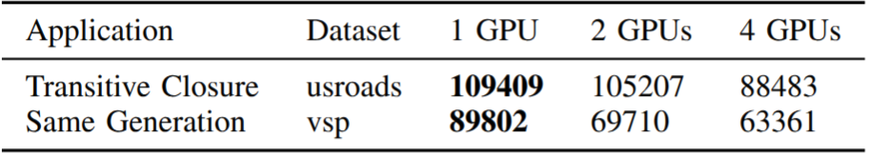








Scalable Multi-Node Multi-GPU Datalog Engine with Energy-Aware Profiling
Ahmedur Rahman Shovon (ashovon@anl.gov)
Sidharth Kumar (sidharth@uic.edu)
MNMGDatalog
Powerlog
Introduction
MNMGDatalog Implementation
Performance Experiments
Powerlog for Energy Profiling
Declarative programming focuses on “WHAT” not on “HOW”
MNMGDatalog uses radix-hash partitioning and non-uniform all-to-all communication with GPU-aware hash tables for efficient tuple materialization
We evaluate MNMGDatalog against state-of-the-art single-GPU, shared-memory, and distributed multi-node Datalog engines up to 32 NVIDIA A100 GPUs
Powerlog: the first GPU energy profiler for Datalog engines, enabling energy-efficiency evaluation of SOTA GPU-powered engines on Polaris
Users
UserID | UserName | UserEmail | Country
101 | Alice | alice@example.com | USA
102 | Bob | bob@example.com | USA
103 | Eve | eve@example.com | Canada
Materialization in fixed point iteration
Experiment platform, application, and datasets
Power consumption measurement
Polaris supercomputer from Argonne National Lab
HW: AMD EPYC 7543P CPU, NVIDIA A100 GPUs with NVLink
Apps: Transitive Closure, Same Generation, Connected Component
where, E = total energy, N = # of samples, P_{i} = power draw at i, Δt_{i} = elapsed time between i,i+1
WHAT
HOW
Datasets: Stanford large network, SuiteSparse, Road network
SELECT UserID FROM Users WHERE Country=‘USA’;
Single-GPU evaluation for Transitive Closure (TC)
Energy efficiency metric: Tuples/Joule
Advanced approach: Logic programming (Datalog)
Tuples per Joule =
Total number of tuples produced
Total energy consumed (Joules)
Datalog rules to compute Transitive Closure (TC) of a relation
Radix-hash-based data partitioning
Workflow for energy profiling Datalog engines
TC(x, y) :- Edge(x, y).
TC(x, z) :- TC(x, y), Edge(y, z).
Operationalized as a fixed-point iteration using F_{G}
Single-GPU evaluation for Same Generation (SG)
Datalog rules compiled down to iterative relational algebra
Iterations in Transitive Closure (TC) Computation
Strong scaling for iterative join (total 10M tuples)
Powerlog architecture
Weak scaling for iterative join (10M tuples/GPU)
Challenges
Multi-node evaluation for TC, SG, and CC
MNMGDatalog multi-GPU power analysis
Iterative relational algebra on MNMG systems is challenging due to high communication overhead, synchronization cost, and repeated materialization.
Datalog Engine Categories
Energy efficiency evaluation using Tuples/Joule
Multi-threaded
Distributed
(Apache Spark)
Multi-node
Multi-threaded
Single-GPU
Multi-node Multi-GPUs (MNMG)
Soufflé
RDFox
SLOG
GPUJoin
Conclusion
LogicBlox
Radlog
PRAM
GPULog
First ever Datalog engine designed for multi-node multi-GPU HPC systems outperforming state-of-the-art engines
Introduces novel GPU-Aware communication for scalable recursive query evaluation
Supports recursive aggregation for Datalog rules using high-throughput GPU kernels
Power profiling of GPU-based Datalog engines
Requirements for MNMG Datalog Engine
Workload partitioning
Data representation
1
2
Efficient communication
Tuple materialization
3
4
MNMGDatalog is the first MNMG Datalog engine
Engine evolution
Acknowledgement
Future plan
First multi-node multi-GPU Datalog engine
Single-GPU: Up to 7× speedup over GPULog
Multi-threaded: Up to 33× over Soufflé
Distributed: Up to 31.9× speedup over SLOG
Accelerating Datalog applications with cuDF
Towards iterative relational algebra on the {GPU}
Optimizing Datalog for the GPU
Multi-node multi-GPU Datalog
Spatial and temporal load balancing
GPU-Aware HIP and OneAPI implementations
Application to Neurosymbolic programming
Extend Powerlog to multi-node environment

