Slide 1

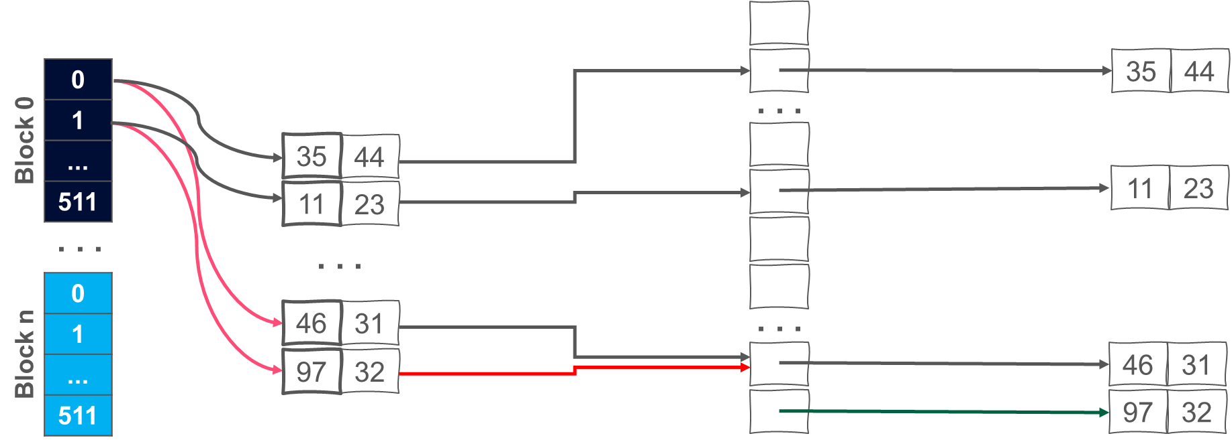
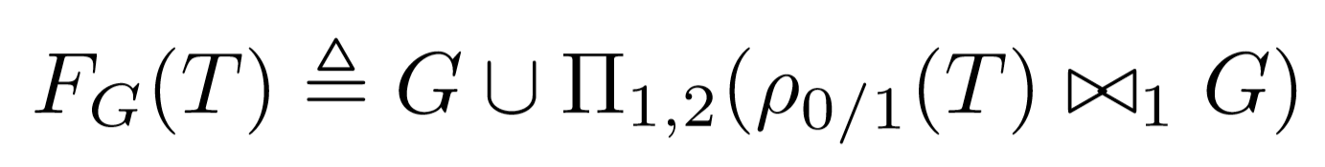
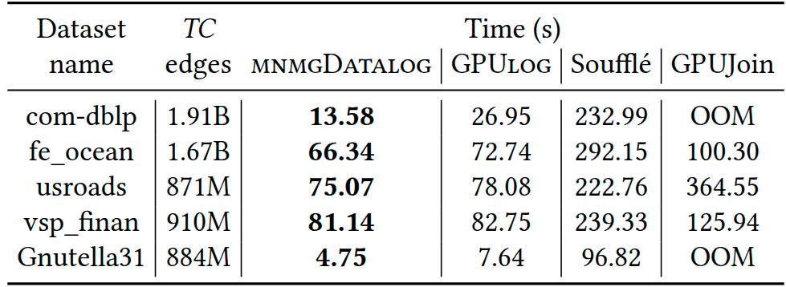
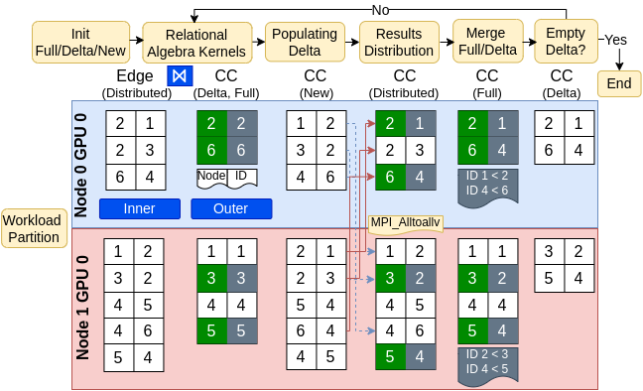
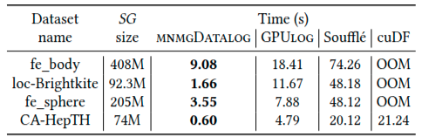
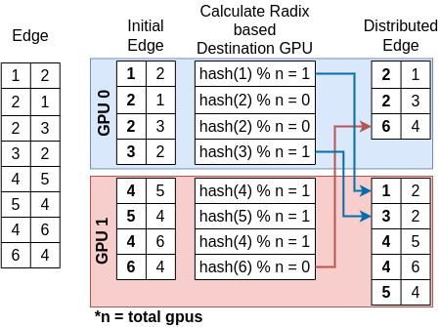
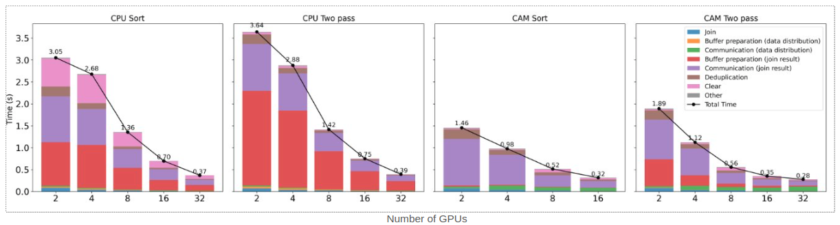
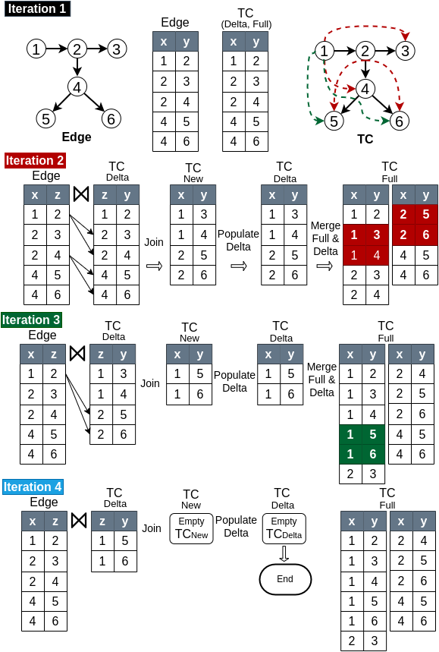
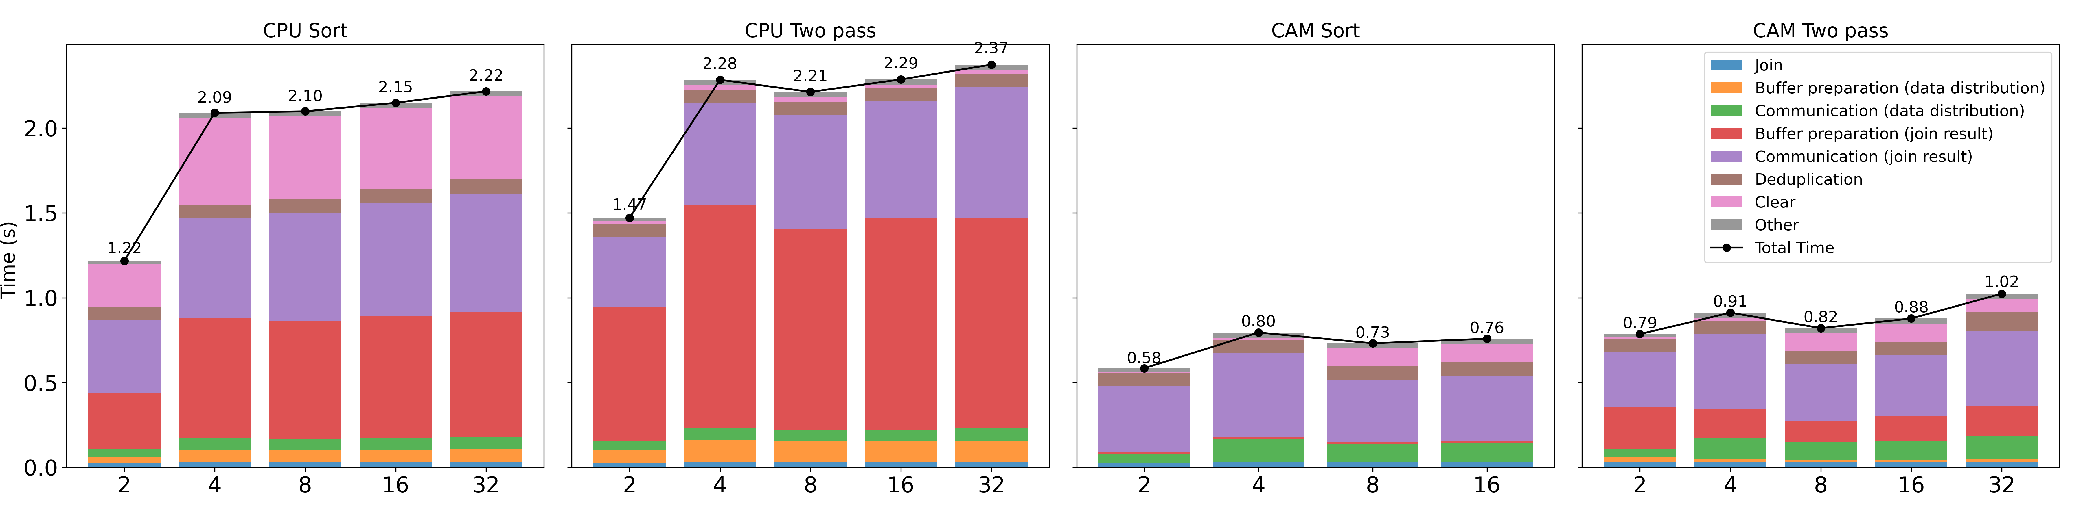
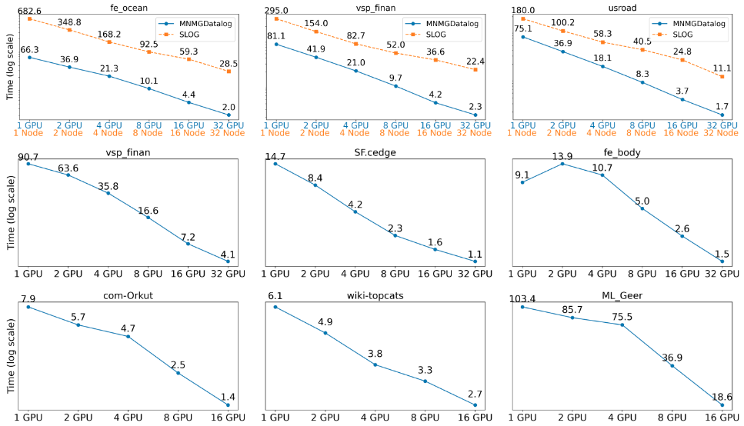
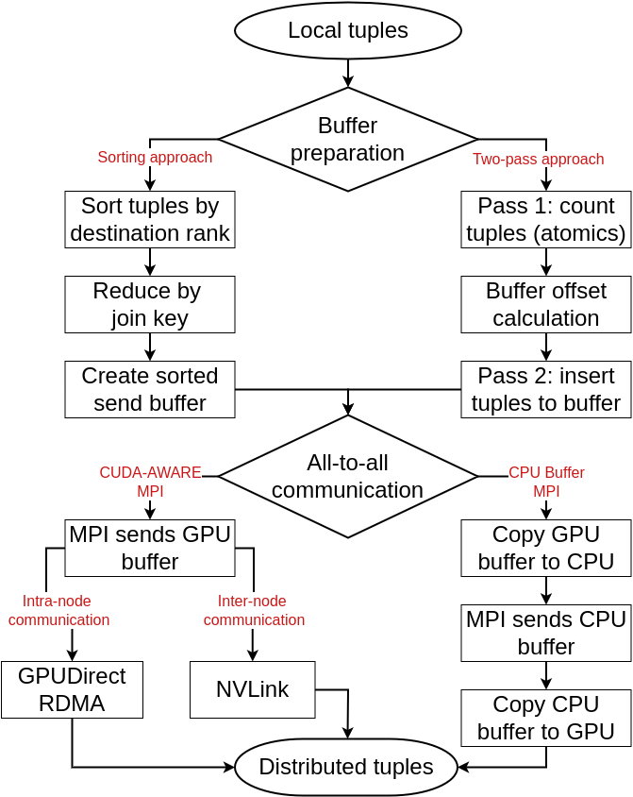
MNMGDatalog: A Scalable Multi-Node Multi-GPU Datalog Engine
Ahmedur Rahman Shovon (ashov@uic.edu), Sidharth Kumar (sidharth@uic.edu)
University of Illinois Chicago
Introduction
Implementation of MNMGDatalog Engine
Experiments
Declarative programming focuses on “WHAT” to achieve rather than “HOW”
MNMGDatalog uses radix-hash partitioning and non-uniform all-to-all communication with GPU-aware hash tables for efficient tuple materialization
We evaluate MNMGDatalog against state-of-the-art single-GPU, shared-memory, and distributed multi-node Datalog engines up to 32 A100 GPUs
Users
Hash Join Relation
With
Duplicate records
Experiment platform and datasets
UserID | UserName | UserEmail | Country
101 | Alice | alice@example.com | USA
102 | Bob | bob@example.com | USA
103 | Eve | eve@example.com | Canada
GPU Hash Table (Open addressing, linear probing)
Grid Stride Loop
Murmur 3 hashing
2
Polaris supercomputer from Argonne National Lab
CPU: AMD EPYC 7543P processors with 32 cores
GPU: 4 NVIDIA A100 GPUs per node interconnected by NVLink
WHAT
HOW
Environment: CUDA (12), SLOG(32 threads), Soufflé (128 threads)
SELECT UserID FROM Users WHERE Country=‘USA’;
AtomicCAS
Benchmark: Transitive Closure, Same Generation, Connected Component
Advanced approach: Logic programming (Datalog)
Datasets: Stanford large network, SuiteSparse, Road network datasets
Buffer preparation and communication
MPI CPU Sort
MPI CPU Two pass
Datalog rules to compute Transitive Closure (TC) of a relation
Collision resolution: Linear probing
1
2
CUDA-Aware-MPI Sorting
CUDA-Aware-MPI Two pass
TC(x, y) :- Edge(x, y).
TC(x, z) :- TC(x, y), Edge(y, z).
CUDA
Threads
Input Relation
Hash Table
Key - value
3
4
Operationalized as a fixed-point iteration using F_{G}
Local aggregation and tuple materialization in fixed point iteration
Single-GPU evaluation for Transitive Closure (TC)
4
Datalog rules compiled down to iterative relational algebra operators
HPC paved the way for parallelizing iterative relational algebra where current Datalog engines target only multi-core CPUs and single-GPU systems
Multi-threaded
Distributed
(Apache Spark)
Multi-node
Multi-threaded
Single-GPU
Multi-node
Multi-GPUs
Single-GPU evaluation for Same Generation (SG)
Soufflé
RDFox
SLOG
GPUJoin
LogicBlox
Radlog
PRAM
GPULog
Nemo
BigDatalog
GPUDatalog
MNMGDatalog is the first multi-node, multi-GPU (MNMG) Datalog engine
Highest performant Datalog engine
Single-GPU: Up to 7× speedup over GPULog
Multi-threaded: Up to 33× over Soufflé
Distributed: Up to 31.9× speedup over SLOG spanning 32 GPUs
Radix-hash-based data partitioning
1
Strong scaling for single iterative join up to 32 GPUs – total 10M tuples)
Challenges
Iterative relational algebra on MNMG systems is challenging due to high communication overhead, synchronization cost, and repeated materialization.
Iterations in Transitive Closure (TC) Computation
Weak scaling for single iterative join up to 32 GPUs – 10M tuples per GPU)
Multi-node evaluation for TC, SG, and CC up to 32 GPUs
Configurable buffer preparation and all-to-all communication strategy
3
Conclusion
Our contributions:
First ever Datalog engine designed for multi-node multi-GPU HPC systems, outperforming state-of-the-art shared-memory, distributed-memory, and GPU-based engines
Introduces novel GPU-Aware communication and buffer preparation strategies for scalable recursive query evaluation
Supports recursive aggregation for Datalog rules using high-throughput GPU kernels (Accepted for publication at ICS 2025)
Acknowledgement
Requirements for MNMGDatalog Engine
This work was funded in part by NSF RII Track-4 award 2132013, NSF collaborative research award 2217036, and NSF collaborative research award 2221811. We are thankful to the ALCF’s Director’s Discretionary (DD) program for providing us with compute hours to run our experiments on the Polaris supercomputer located at the Argonne National Laboratory.
Workload partitioning
Data representation
1
2
Efficient communication
Tuple materialization
3
4

