Slide 1

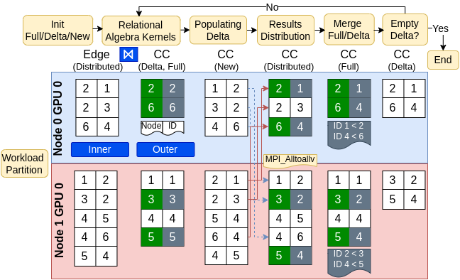
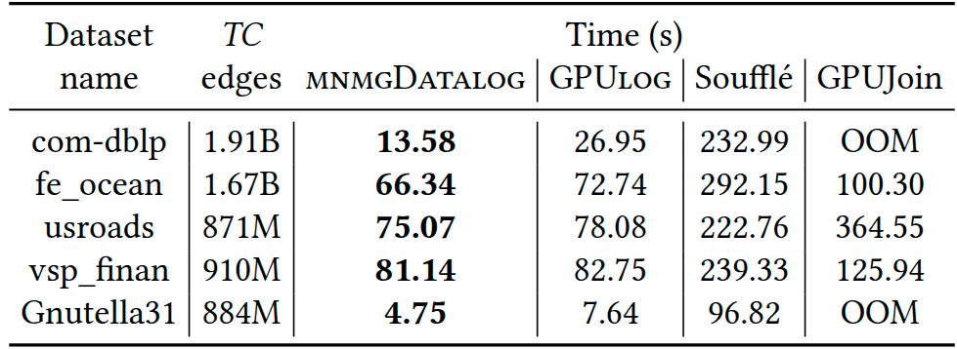
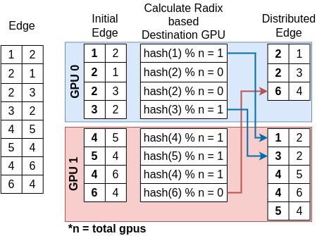
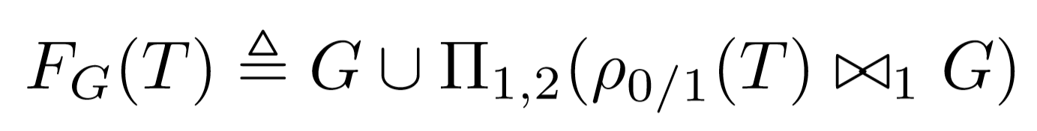
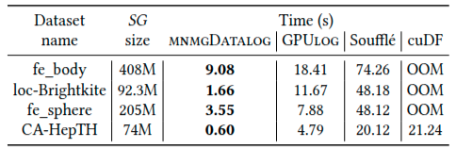
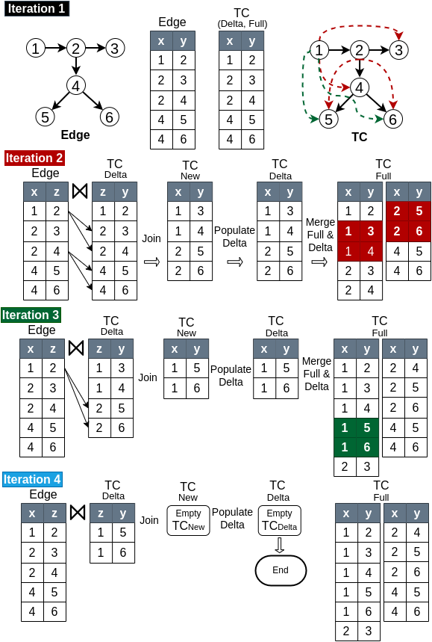
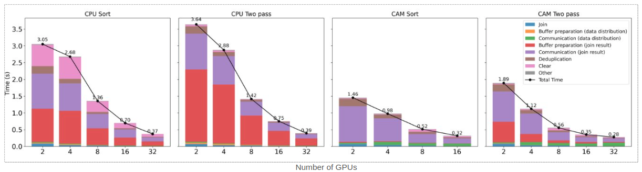
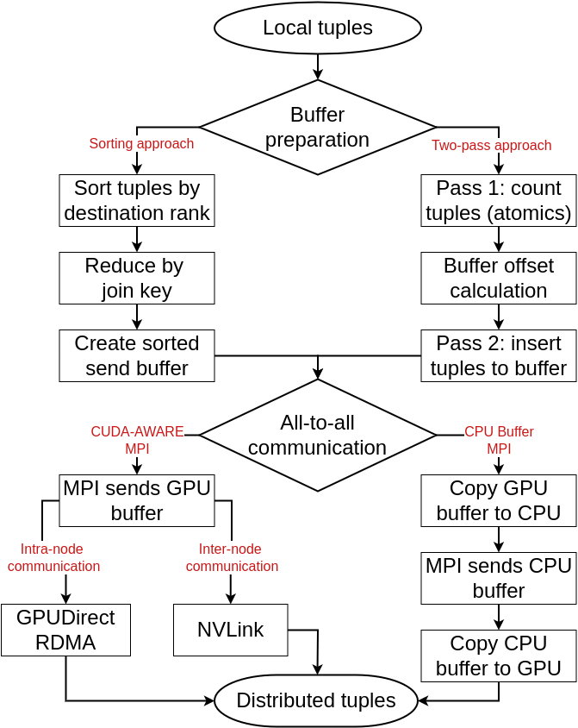
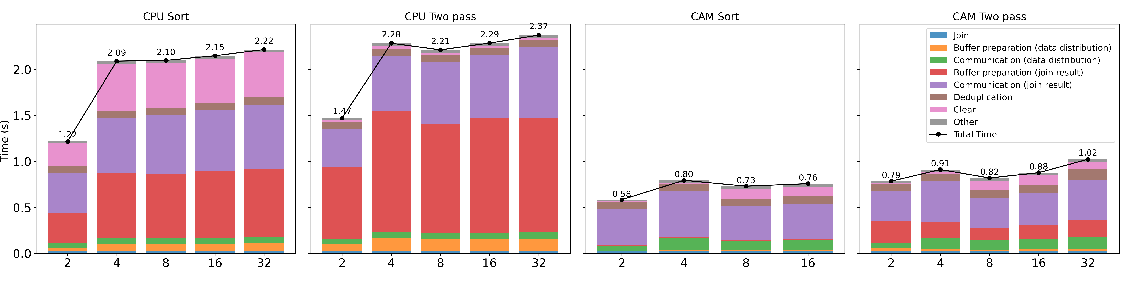
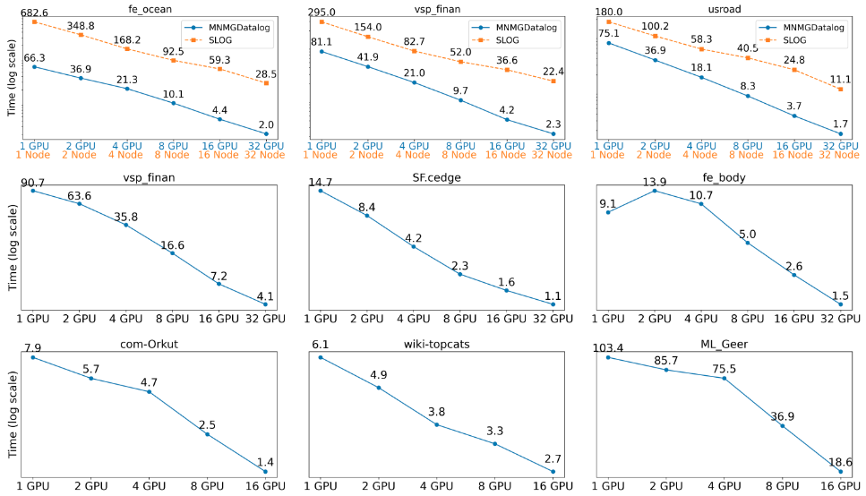








MNMGDatalog: A Scalable Multi-Node Multi-GPU Datalog Engine
Ahmedur Rahman Shovon (ashov@uic.edu)
Sidharth Kumar (sidharth@uic.edu)
University of Illinois Chicago
Introduction
MNMGDatalog Implementation
Experiments
Declarative programming focuses on “WHAT” not on “HOW”
MNMGDatalog uses radix-hash partitioning and non-uniform all-to-all communication with GPU-aware hash tables for efficient tuple materialization
We evaluate MNMGDatalog against state-of-the-art single-GPU, shared-memory, and distributed multi-node Datalog engines up to 32 NVIDIA A100 GPUs
Users
Hash Join Relation
With
Duplicate records
UserID | UserName | UserEmail | Country
101 | Alice | alice@example.com | USA
102 | Bob | bob@example.com | USA
103 | Eve | eve@example.com | Canada
Tuple materialization in fixed point iteration
Experiment platform, application, and datasets
2
4
Polaris supercomputer from Argonne National Lab
CPU: AMD EPYC 7543P processors with 32 cores
WHAT
HOW
GPU: 4 NVIDIA A100 GPUs per node interconnected by NVLink
SELECT UserID FROM Users WHERE Country=‘USA’;
Environment: CUDA (12), SLOG(32 threads), Soufflé (128 threads)
Advanced approach: Logic programming (Datalog)
Apps: Transitive Closure, Same Generation, Connected Component
Datasets: Stanford large network, SuiteSparse, Road network
Datalog rules to compute Transitive Closure (TC) of a relation
Single-GPU evaluation for Transitive Closure (TC)
TC(x, y) :- Edge(x, y).
TC(x, z) :- TC(x, y), Edge(y, z).
1
Radix-hash-based data partitioning
Operationalized as a fixed-point iteration using F_{G}
Single-GPU evaluation for Same Generation (SG)
Datalog rules compiled down to iterative relational algebra
Iterations in Transitive Closure (TC) Computation
Strong scaling for iterative join (total 10M tuples)
Configurable all-to-all communication strategy
3
Weak scaling for iterative join (10M tuples/GPU)
Multi-node evaluation for TC, SG, and CC
Challenges
Iterative relational algebra on MNMG systems is challenging due to high communication overhead, synchronization cost, and repeated materialization.
Datalog Engine Categories
Conclusion
Multi-threaded
Distributed
(Apache Spark)
Multi-node
Multi-threaded
Single-GPU
Multi-node Multi-GPUs (MNMG)
Evolution from single-GPU to multi-node multi-GPU
Our contributions:
First ever Datalog engine designed for multi-node multi-GPU HPC systems, outperforming state-of-the-art shared-memory, distributed-memory, and GPU-based engines
Introduces novel GPU-Aware communication and buffer preparation strategies for scalable recursive query evaluation
Supports recursive aggregation for Datalog rules using high-throughput GPU kernels (Accepted at ICS 2025)
Soufflé
RDFox
SLOG
GPUJoin
Accelerating Datalog applications with cuDF
Towards iterative relational algebra on the {GPU}
Optimizing Datalog for the GPU
Multi-node multi-GPU Datalog
LogicBlox
Radlog
PRAM
GPULog
Requirements for MNMG Datalog Engine
Workload partitioning
Data representation
1
2
Efficient communication
Tuple materialization
3
4
MNMGDatalog is the first MNMG Datalog engine
Acknowledgement
Future plan
Highest performant Datalog engine
Single-GPU: Up to 7× speedup over GPULog
Multi-threaded: Up to 33× over Soufflé
Distributed: Up to 31.9× speedup over SLOG
We are working on:
Spatial and temporal load balancing
GPU-Aware HIP and OneAPI implementations
Application to Neurosymbolic programming

