Slide 1




Multi-Node Multi-GPU Datalog
Ahmedur Rahman Shovon, Yihao Sun, Thomas Gilray, Kristopher Micinski, Sidharth Kumar

Slide 2





Slide 3
Introduction and motivation

Slide 4
Declarative Programming Paradigm
Users expresses what to achieve with the data rather than how to accomplish it
User
UserID | UserName | UserEmail | Country
101 | Alice | alice@example.com | USA
102 | Bob | bob@example.com | USA
103 | Eve | eve@example.com | Australia
WHAT
HOW
SELECT UserID FROM User WHERE Country = 'USA';
Another approach: Datalog (suitable for recursive queries)
Makrynioti, N., & Vassalos, V. (2019). Declarative data analytics: A survey. IEEE Transactions on Knowledge and Data Engineering, 33(6), 2392-2411.
Salesforce. (2024). Click, Not Code: The Benefits of Declarative Programming vs. Imperative Programming retrieved from https://www.salesforce.com/products/platform/best-practices/declarative-programming-vs-imperative-programming/ on 01/24/2026
Notes:
Declarative analytics enables users to focus on what they want to achieve with the data, rather than worrying about how it is computed

Slide 5
Datalog on Recursive Queries (Example: Transitive Closure)
1
G
1
T
0
3
4
0
3
4
Paths can be discovered multiple times
Finds all reachable paths
2
2
Transitive Closure using Recursive SQL
Transitive Closure using Datalog
-- Recursive CTE for Transitive Closure
WITH RECURSIVE TransitiveClosure AS ( -- Base case: start with the initial edges SELECT source, target FROM edges UNION -- Recursive case: find new edges by joining with previous results SELECT tc.source, e.target FROM TransitiveClosure tc JOIN edges e ON tc.target = e.source )
SELECT DISTINCT source, target FROM TransitiveClosure;
Datalog simplifies recursive queries
// Base case: Direct edges
tc(X, Y) :- edges(X, Y).
// Recursive case: Indirect connections
tc(X, Z) :- tc(X, Y), edges(Y, Z).
Shovon, A. R. (2024, April 23). Recursive queries in SQL and Datalog. Ahmedur Rahman Shovon. Retrieved June 22, 2024, from https://arshovon.com/blog/recursive-queries/

Slide 6
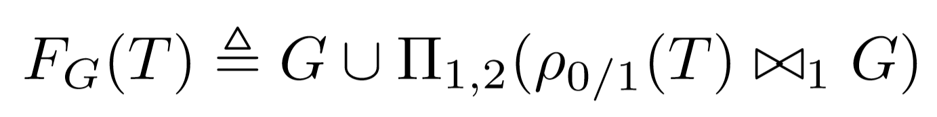
Datalog Rules to Iterative Relational Algebra
Datalog Rules
tc(X, Y) :- edges(X, Y).
tc(X, Z) :- tc(X, Y), edges(Y, Z).
Iterative
Relational Algebra
Relational algebra:
Union
Projection
Join
Gilray, T., & Kumar, S. (2019, December). Distributed relational algebra at scale. In 2019 IEEE 26th International Conference on High Performance Computing, Data, and Analytics (HiPC) (pp. 12-22). IEEE.

Slide 7
Transitive Closure with Datalog
1
G
1
T
tc(X, Y) :- edges(X, Y).
tc(X, Z) :- tc(X, Y), edges(Y, Z).
0
3
4
0
3
4
2
2
0​ | 1​
0 | 2​
1​ | 3​
2​ | 3​
3 | 4
0​ | 1​
0​ | 2​
1​ | 3​
2​ | 3​
3​ | 4​
0​ | 3​
1​ | 4​
2​ | 4​
0​ | 4​

Slide 8
Transitive Closure: Iterations 1
1
T
0
3
4
2
0​ | 1​
0​ | 2​
1​ | 3​
2​ | 3​
3​ | 4​

Slide 9
Transitive Closure: Iterations 1
ρ_{0/1}(T)
G
1 | 0
2​ | 0
3 | 1
3 | 2
4​ | 3
⨝
0​ | 1​
0​ | 2​
1​ | 3​
2​ | 3​
3​ | 4​

Slide 10
Transitive Closure: Iterations 1
ρ_{0/1}(T)
G
ρ_{0/1}(T) ⨝ G
1 | 0
2​ | 0
3 | 1
3 | 2
4​ | 3
⨝
0​ | 1​
0​ | 2​
1​ | 3​
2​ | 3​
3​ | 4​
1 | 0 | 3

Slide 11
Transitive Closure: Iterations 1
ρ_{0/1}(T)
G
ρ_{0/1}(T) ⨝ G
1 | 0
2​ | 0
3 | 1
3 | 2
4​ | 3
⨝
0​ | 1​
0​ | 2​
1​ | 3​
2​ | 3​
3​ | 4​
1 | 0 | 3
2 | 0 | 3

Slide 12
Transitive Closure: Iterations 1
ρ_{0/1}(T)
G
ρ_{0/1}(T) ⨝ G
1 | 0
2​ | 0
3 | 1
3 | 2
4​ | 3
⨝
0​ | 1​
0​ | 2​
1​ | 3​
2​ | 3​
3​ | 4​
1 | 0 | 3
2 | 0 | 3
3 | 1 | 4

Slide 13
Transitive Closure: Iterations 1
ρ_{0/1}(T)
G
ρ_{0/1}(T) ⨝ G
1 | 0
2​ | 0
3 | 1
3 | 2
4​ | 3
⨝
0​ | 1​
0​ | 2​
1​ | 3​
2​ | 3​
3​ | 4​
1 | 0 | 3
2 | 0 | 3
3 | 1 | 4
3 | 2 | 4

Slide 14
Transitive Closure: Iterations 1
ρ_{0/1}(T)
G
ρ_{0/1}(T) ⨝ G
Π_{1, 2}(ρ_{0/1}(T) ⨝ G)
1 | 0
2​ | 0
3 | 1
3 | 2
4​ | 3
⨝
0​ | 1​
0​ | 2​
1​ | 3​
2​ | 3​
3​ | 4​
1 | 0 | 3
2 | 0 | 3
3 | 1 | 4
3 | 2 | 4
0 | 3
1 | 4
2 | 4

Slide 15
Transitive Closure: Iterations 1
1
1
T
0
3
4
0
3
4
2
2
0​ | 1​
0​ | 2​
1​ | 3​
2​ | 3​
3​ | 4​
0​ | 1​
0​ | 2​
1​ | 3​
2​ | 3​
3​ | 4​
0​ | 3​
1​ | 4​
2​ | 4​

Slide 16
Transitive Closure: Iterations 2
1
1
1
T
0
3
4
0
3
4
0
3
4
2
2
2
0​ | 1​
0​ | 2​
1​ | 3​
2​ | 3​
3​ | 4​
0​ | 1​
0​ | 2​
1​ | 3​
2​ | 3​
3​ | 4​
0​ | 3​
1​ | 4​
2​ | 4​
0​ | 1​
0​ | 2​
1​ | 3​
2​ | 3​
3​ | 4​
0​ | 3​
1​ | 4​
2​ | 4​
0​ | 4​

Slide 17
Transitive Closure: Iterations 3
Fixed-point reached
1
1
1
1
T
0
3
4
0
3
4
0
3
4
0
3
4
2
2
2
2
0​ | 1​
0​ | 2​
1​ | 3​
2​ | 3​
3​ | 4​
0​ | 1​
0​ | 2​
1​ | 3​
2​ | 3​
3​ | 4​
0​ | 3​
1​ | 4​
2​ | 4​
0​ | 1​
0​ | 2​
1​ | 3​
2​ | 3​
3​ | 4​
0​ | 3​
1​ | 4​
2​ | 4​
0​ | 4​
0​ | 1​
0​ | 2​
1​ | 3​
2​ | 3​
3​ | 4​
0​ | 3​
1​ | 4​
2​ | 4​
0​ | 4​

Slide 18
Traditional Graph Mining Applications
Applications
Transitive closure
Connected components
Same generation
Triangle counting
tc(X, Y) :- edges(X, Y).
tc(X, Z) :- tc(X, Y), edges(Y, Z).
2cl(X, Y) :- edges(X, Y), X < Y.
2cl(X, Y) :- edges(Y, X), X < Y.
triangles(X, Y, Z) :- 2cl(X, Y), 2cl(Y, Z), 2cl(X, Z).
cc(X, X) :- edges(X, _).
cc(Y, $MIN(Z)) :- cc(Y, Z), edges(X, Y).
sg(x, y) :- edges(p, x), edges(p, y), x ≠ y.
sg(x, y) :- edges(a, x), sg(a, b), edges(b, y), x ≠ y.
De Moor, O., Gottlob, G., Furche, T., & Sellers, A. (Eds.). (2012). Datalog Reloaded: First International Workshop, Datalog 2010, Oxford, UK, March 16-19, 2010. Revised Selected Papers (Vol. 6702). Springer.
Huang, S. S., Green, T. J., & Loo, B. T. (2011, June). Datalog and emerging applications: an interactive tutorial. In Proceedings of the 2011 ACM SIGMOD International Conference on Management of data (pp. 1213-1216).
Gilray, T., & Kumar, S. (2017). Toward parallel cfa with datalog, mpi, and cuda. In Scheme and Functional Programming Workshop.
Zomorodian, A. (2012). Topological data analysis. Advances in applied and computational topology, 70, 1-39.

Slide 19
Datalog Applications
Graph
mining
Static
analysis
Deductive database
Machine
learning
Datalog
Notes:
Graph Mining for community detection
Static Analysis analyzing program behavior, such as identifying bugs, verifying security properties, or performing dependency analysis
Deductive Databases for complex recursive queries
Machine Learning for explainable AI
Its declarative nature makes it ideal for scaling these tasks on heterogeneous exascale systems

Slide 20
Datalog Implementations
Multi-threaded
Distributed
(Apache Spark)
Multi-node
Multi-threaded
Single-GPU
Multi-node
Multi-GPU
Soufflé
RDFox
SLOG
GPUJoin
LogicBlox
Radlog
PRAM
GPULog
Nemo
BigDatalog
GPUDatalog
Herbert Jordan, Bernhard Scholz, and Pavle Subotić. 2016. Soufflé: On synthesis of program analyzers. In Computer Aided Verification: 28th International Conference, CAV 2016, Toronto, ON, Canada, July 17-23, 2016, Proceedings, Part II 28, Swarat Chaudhuri and Azadeh Farzan (Eds.). Springer, Springer International Publishing, Cham, 422–430.
Boris Motik, Yavor Nenov, Robert Piro, Ian Horrocks, and Dan Olteanu. 2014. Parallel materialisation of datalog programs in centralised, main-memory RDF systems. In Proceedings of the AAAI Conference on Artificial Intelligence, Vol. 28.
Shkapsky, A., Yang, M., Interlandi, M., Chiu, H., Condie, T., & Zaniolo, C. (2016, June). Big data analytics with datalog queries on spark. In Proceedings of the 2016 International Conference on Management of Data (pp. 1135-1149).
Yavor Nenov, Robert Piro, Boris Motik, Ian Horrocks, Zhe Wu, and Jay Banerjee. 2015. RDFox: A Highly-Scalable RDF Store. In The Semantic Web - ISWC 2015, Marcelo Arenas, Oscar Corcho, Elen Simperl, Markus Strohmaier, Mathieu d’Aquin, Kavitha Srinivas, Paul Groth, Michel Dumontier, Jeff Heflin, Krishnaprasad Thirunarayan, and Steffen Staab (Eds.). Springer International Publishing, Cham, 3–20.
Gilray, T., Sahebolamri, A., Sun, Y., Kunapaneni, S., Kumar, S., & Micinski, K. (2024). Datalog with First-Class Facts. arXiv preprint arXiv:2411.14330.
Notes:
Multi-threaded: Limited scalability
Distributed: High overhead for introduced by Spark framework recursive queries
Multi-node Multi-threaded: Lacks GPU acceleration
Single-GPU: Bound by single GPU limitations

Slide 21



Motivation: Datalog on Multi-Node Multi-GPU Systems
Datalog
Relational algebra
Multi-node multi-GPU systems
Node 0
Node 1
Node n
High performance implementation for highly expressive language
High Bandwidth Network
Notes:
Write queries on a very high level language that runs on a supercomputer

Slide 22
Contributions
Radix-hash-based data partitioning strategy for iterative computation
CUDA-Aware non-uniform all-to-all communication targeting iterative relational algebra
Scalable recursive aggregation on GPUs
Introduced MNMGDatalog the first multi-node multi-GPU Datalog engine​
Single-GPU: Up to 7× speedup over GPULog​
Multi-threaded: Up to 33× over Soufflé​
Multi-node multi-threaded: Up to 32× speedup over SLOG​

Slide 23
MNMGDatalog Implementation

Slide 24
Requirements for Multi-node Multi-GPU Datalog
1
G
1
T
tc(X, Y) :- edges(X, Y).
tc(X, Z) :- tc(X, Y), edges(Y, Z).
0
3
4
0
3
4
Data representation
2
2
2
0​ | 1​
0 | 2​
1​ | 3​
2​ | 3​
3 | 4
0​ | 1​
0​ | 2​
1​ | 3​
2​ | 3​
3​ | 4​
0​ | 3​
1​ | 4​
2​ | 4​
0​ | 4​
Communication
Workload partitioning
3
1

Slide 25
MNMGDatalog Implementation
Hash-based data distribution
GPU-optimized data representation
GPU-Aware all-to-all communication
Workload partitioning
Data representation
Communication
1
2
3

Slide 26
MNMGDatalog: Radix-hash-based partitioning
Hash-based data distribution
GPU-optimized data representation
GPU-Aware all-to-all communication
Workload partitioning
Data representation
Communication
1
2
3

Slide 27
(k)
The join column decides the GPU (bucket-id)
0 | 1
0 | 2
0 | 3
1 | 2
1 | 3
1 | 4
2 | 4
3 | 4
3 | 6
4 | 5
4 | 6
5 | 7
5 | 9
7 | 6
7 | 8
8 | 9
5
2
0
1
4
7
8
9
3
6
Hash-partitioning based on the
Join Column
Kumar, S., & Gilray, T. (2020). Load-balancing parallel relational algebra. In High Performance Computing: 35th International Conference, ISC High Performance 2020, Frankfurt/Main, Germany, June 22–25, 2020, Proceedings 35 (pp. 288-308). Springer International Publishing.
Notes:
In a join, it is necessary to iterate over all tuples where particular columns match a value or values taken from the ﬁrst operand of join—in which case the variable being matched should come ﬁrst and be a key in the outermost B-tree. The relation is thus explicitly indexed on this column.

Slide 28
(k)
0 | 1
0 | 2
0 | 3
0
1
2
The join column decides the GPU (bucket-id)
0 | 1
0 | 2
0 | 3
1 | 2
1 | 3
1 | 4
2 | 4
3 | 4
3 | 6
4 | 5
4 | 6
5 | 7
5 | 9
7 | 6
7 | 8
8 | 9
0 | 1
0 | 2
0 | 3
1 | 2
1 | 3
1 | 4
2 | 4
3 | 4
3 | 6
4 | 5
4 | 6
5 | 7
5 | 9
7 | 6
7 | 8
8 | 9
3 | 4
3 | 6
7 | 6
7 | 8
5
2
5 | 7
5 | 9
8 | 9
Hash(k) % 3
0
1
4
7
8
9
3
1 | 2
1 | 3
1 | 4
6
GPU (ID)
2 | 4
4 | 5
4 | 6
Kumar, S., & Gilray, T. (2020). Load-balancing parallel relational algebra. In High Performance Computing: 35th International Conference, ISC High Performance 2020, Frankfurt/Main, Germany, June 22–25, 2020, Proceedings 35 (pp. 288-308). Springer International Publishing.
Notes:
In a join, it is necessary to iterate over all tuples where particular columns match a value or values taken from the ﬁrst operand of join—in which case the variable being matched should come ﬁrst and be a key in the outermost B-tree. The relation is thus explicitly indexed on this column.

Slide 29
MNMGDatalog: Data representation
Hash-based data distribution
GPU-optimized data representation
GPU-Aware all-to-all communication
Workload partitioning
Data representation
Communication
1
2
3

Slide 30
GPU Hash Table (Open Addressing, Linear Probing)
Grid Stride Loop
Murmur 3 hashing
0
1
...
511
35
44
. . .
Block 0
35
44
11
23
11
23
. . .
. . .
0
1
...
511
AtomicCAS
46
31
. . .
Block n
46
31
97
32
Collision -> Linear probing (Position + 1) & hash table size
97
32
CUDA Threads
Key - Value
Hash Table
Key-Value Pair
Shovon, A. R., Gilray, T., Micinski, K., & Kumar, S. (2023). Towards iterative relational algebra on the {GPU}. In 2023 USENIX Annual Technical Conference (USENIX ATC 23) (pp. 1009-1016).

Slide 31
Performing Hash Join on GPU
Static Hash Table
Inner Relation
Key | Value
Key | Value
Calculate join size
⨝
First pass

Slide 32
Performing Hash Join on GPU
Static Hash Table
Inner Relation
Key | Value
Key | Value
Calculate join size
⨝
First pass
Prefix sum
Join Result
Second pass
(fused projection)
Join Key | Value 1 | Value 2

Slide 33
Performing Hash Join on GPU
Static Hash Table
Inner Relation
Key | Value
Key | Value
Calculate join size
⨝
First pass
Prefix sum
Join Result
Second pass
(fused projection)
Join Key | Value 1 | Value 2
Sort and Unique
Deduplicated Join Result
Key | Value

Slide 34
MNMGDatalog: Communication for Iterative RA
Hash-based data distribution
GPU-optimized data representation
GPU-Aware all-to-all communication
Workload partitioning
Data representation
Communication
1
2
3

Slide 35
Relational Algebra Kernel
All to all comm
Join Project Hash
GPU 0
GPU 1
GPU 2
GPU 3
GPU 4
Kumar, S., & Gilray, T. (2020). Load-balancing parallel relational algebra. In High Performance Computing: 35th International Conference, ISC High Performance 2020, Frankfurt/Main, Germany, June 22–25, 2020, Proceedings 35 (pp. 288-308). Springer International Publishing.

Slide 36
Relational Algebra Kernel
All to all comm
Local inserts
Join Project Hash
GPU 0
GPU 1
GPU 2
GPU 3
GPU 4

Slide 37
Fixed point?
Relational Algebra Kernel
All to all comm
Local inserts
Join Project Hash
GPU 0
GPU 1
GPU 2
GPU 3
GPU 4

Slide 38
NO
Fixed point?
Relational Algebra Kernel
All to all comm
Local inserts
Join Project Hash
GPU 0
GPU 1
GPU 2
GPU 3
GPU 4

Slide 39
NO
Fixed point?
YES
Relational Algebra Kernel
All to all comm
Local inserts
STOP
Join Project Hash
GPU 0
GPU 1
GPU 2
GPU 3
GPU 4

Slide 40
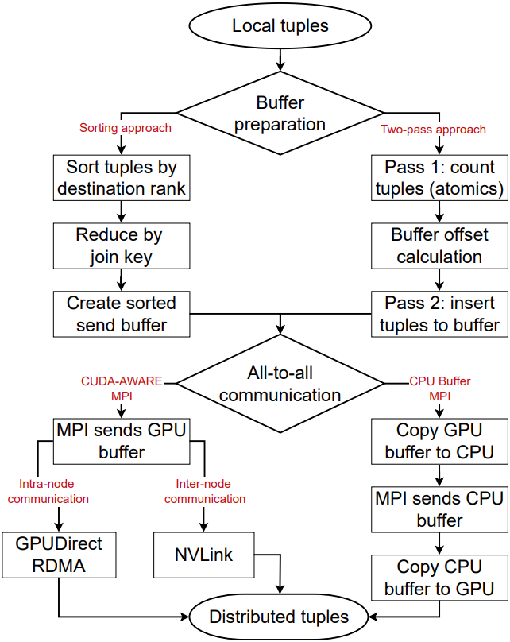
All-to-all communication phases in MNMGDatalog

Slide 41
Evaluation

Slide 42
Evaluation environment, applications, datasets
Polaris supercomputer from Argonne National Lab
CPU: AMD EPYC 7543P processors with 32 cores
GPU: 4 NVIDIA A100 GPUs per node interconnected by NVLink
Software: CUDA (12), SLOG (32 threads), Soufflé (128 threads)
Apps: Transitive Closure, Same Generation, Weakly Connected Component
Datasets: Stanford large network, SuiteSparse, Road network
Baseline Datalog Engines:
Multi-node multi-threaded: SLOG
Multi-threaded: Soufflé
Single-GPU: GPULog, GPUJoin, cuDF
Argonne Leadership Computing Facility. 2022. Polaris. https://www.alcf.anl.gov/polaris
Jure Leskovec and Andrej Krevl. 2014. SNAP Datasets: Stanford Large Network Dataset Collection. http://snap.stanford.edu/data
Timothy A. Davis and Yifan Hu. 2011. The University of Florida Sparse Matrix Collection. ACM Trans. Math. Softw. 38, 1, Article 1 (dec 2011), 25 pages. doi:10.1145/2049662.2049663

Slide 43
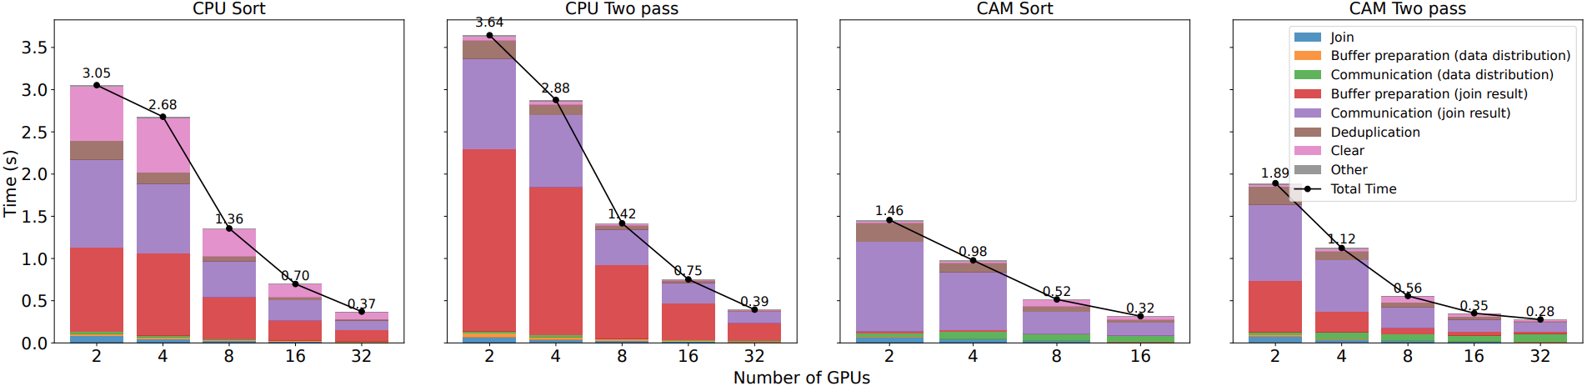
Single iteration of fixed-point benchmark
Single iteration of fixed-point iteration benchmark with 10M tuples

Slide 44
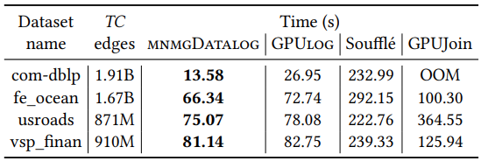
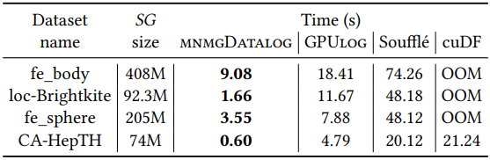
Single GPU benchmark
Transitive closure benchmark on single-GPU
Same generation benchmark on single-GPU

Slide 45
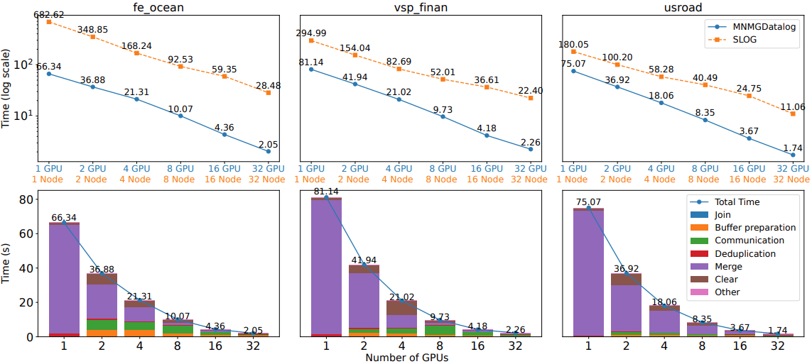
Multi-node multi-GPU benchmark
Transitive closure benchmark and breakdown up to 32 GPUs

Slide 46
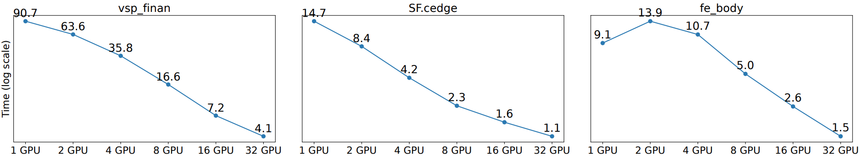
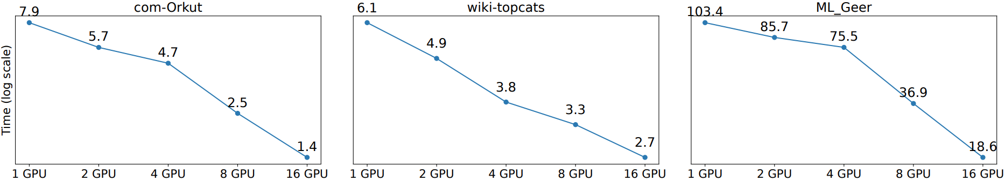
Multi-node multi-GPU benchmark (Continue)
Same generation benchmark up to 32 GPUs
Weakly connected component benchmark (scalable recursive aggregation) up to 16 GPUs

Slide 47
Conclusion

Slide 48
Conclusion and future work
Presented MNMGDatalog the first multi-node, multi-GPU Datalog engine
Designed for efficient execution of recursive queries over internet-scale datasets in scale
The highest-performant Datalog engine outperforming state-of-the-art
GPU-based engine (GPULog) by 7x
CPU-based engine (Soufflé) by 33x
Distributed engine (SLOG) by 32x
Improve robustness and portability
Add per-iteration checkpoint/restart capability
More versions targeting different GPUs and HPC systems

Slide 49

Thank You
ashov@uic.edu
https://github.com/harp-lab/MNMGDatalog

