Slide 1
Message Broker System
Ahmedur Rahman Shovon
Codalo
shovon.sylhet@gmail.com

Slide 2


But I’ll actually talk about RabbitMQ

Slide 3
“Message broker translates a message from the formal messaging protocol of the sender to the formal messaging protocol of the receiver.”
From Wikipedia, the free encyclopedia

Slide 4
RabbitMQ is open source message broker software that implements the Advanced Message Queuing Protocol (AMQP).

Slide 5
The principal idea is pretty simple: it accepts and forwards messages. You can think about it as a post office: when you send mail to the post box you're pretty sure that Mr. Postman will eventually deliver the mail to your recipient. Using this metaphor RabbitMQ is a post box, a post office and a postman!

Slide 6
What can RabbitMQ do for you?
Messaging enables software applications to connect and scale. Applications can connect to each other. Messaging is asynchronous, decoupling applications by separating sending and receiving data.
Data delivery, non-blocking operations or push notifications, publish / subscribe, asynchronous processing, or work queues.
RabbitMQ is a messaging broker - an intermediary for messaging. It gives your applications a common platform to send and receive messages, and your messages a safe place to live until received.

Slide 7
Feature Highlights
Reliability
Flexible Routing
Clustering and Federation
Highly Available Queues
Multi-protocol with Many Clients
Plugin System

Slide 8
PRODUCER, QUEUE, CONSUMER
Remember these things please A producer is a user application that sends messages. A queue is a buffer that stores messages. A consumer is a user application that receives messages.

Slide 9

Now let’s see messaging in action!

Slide 10
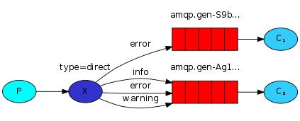

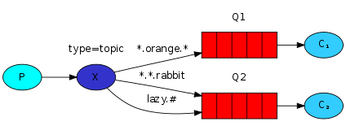
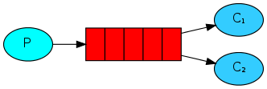
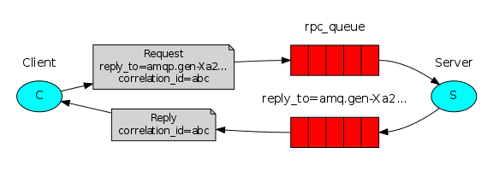
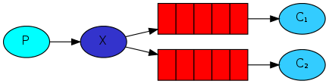
1 "Hello World!"
The simplest thing that does something
4 Routing
Receiving messages selectively
2 Work queues
Distributing tasks among workers
5 Topics
Receiving messages based on a pattern
3 Publish/Subscribe
Sending messages to many consumers at once
6 RPC
Remote procedure call implementation

Slide 11
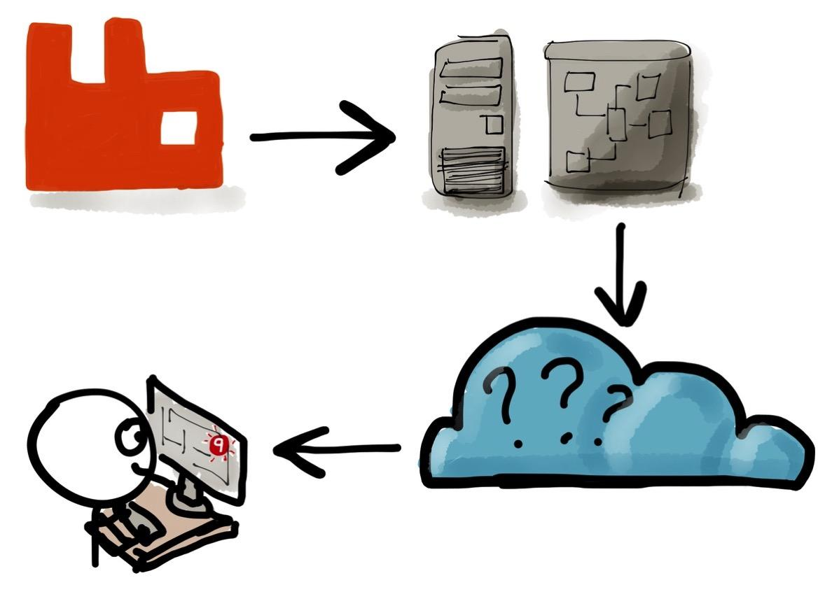
What should I do to play with Rabbits?

Slide 12
Have a Windows machine? Start installing!
ERLANG 64 bit exe: otp_win64_19.1.exe
MS Visual C++ redistributable 2013 64 bit
RabbitMQ Server: rabbitmq-server-3.6.5.exe
RabbitMQ libraries based on the language
Python client recommended by the RabbitMQ team: Pika
Pika Installation: pip install pika

Slide 13
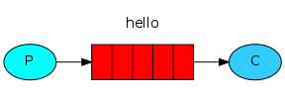
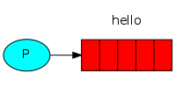
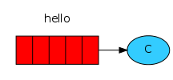
1 “Hello World!” - The simplest thing that does something
Our "Hello world" won't be too complex ‒ let's send a message, receive it and print it on the screen. To do so we need two programs: one that sends a message and one that receives and prints it.
Sending message to queue
Receiving message from queue

Slide 14
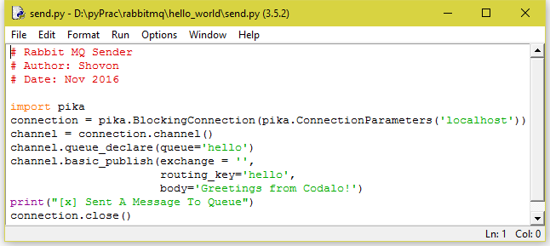
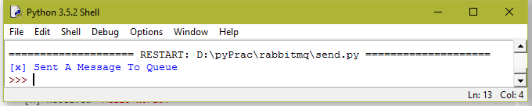
Sending message...
Producer Script
Message is sent to the queue

Slide 15
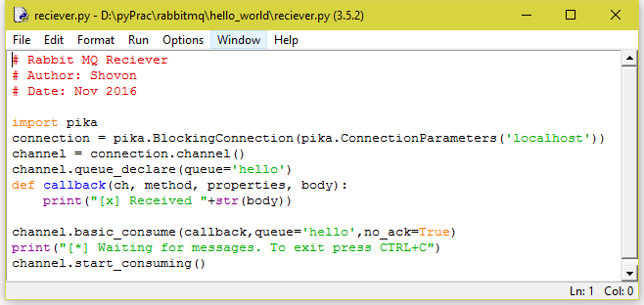
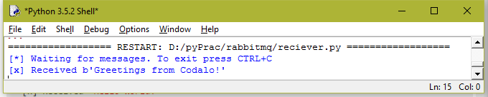
Receiving message...
Consumer Script
Message is received from the queue

Slide 16
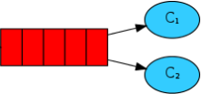
2 Work queues - Distributing tasks among workers
The main idea behind Work Queues (aka: Task Queues) is to avoid doing a resource-intensive task immediately and having to wait for it to complete. Instead we schedule the task to be done later.
Sending message to queue
Multiple consumers receiving message

Slide 17
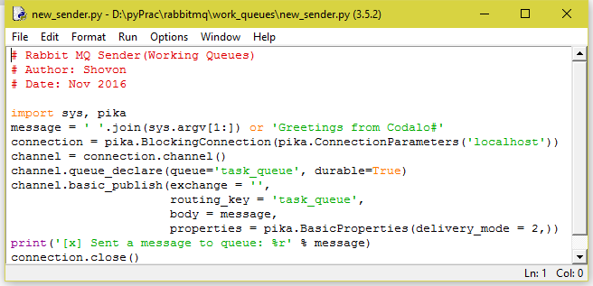
Producer’s script (new_sender.py)
Producer Script is now updated to allow run time argument which contains messages

Slide 18
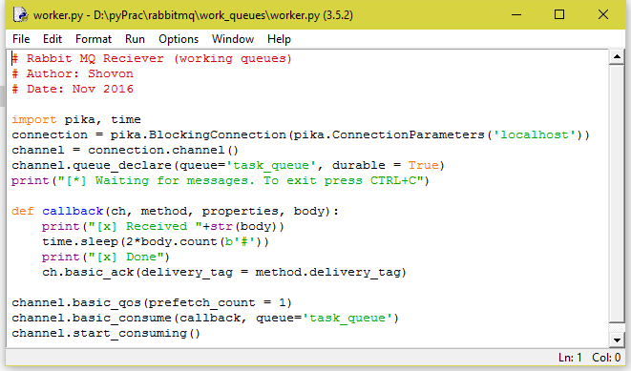
Consumer’s / Worker’s script (worker.py)
Receiver Script is now updated to allow pause to process the queue element. Lets think each consumer as a worker. We ensure the fair dispatch of queues using prefetch_count=1. Each “#” in message takes 2 seconds to process.

Slide 19
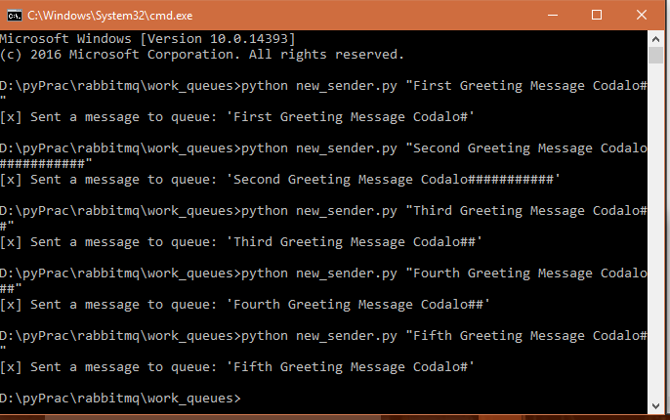
Sending messages...
Open two cmd and run worker.py in both prompt.
Open another cmd and run new_sender.py.
The messages with lot of # will take much time to process in worker

Slide 20
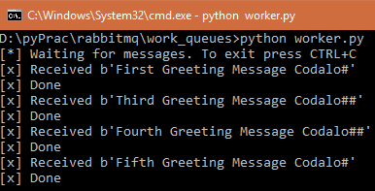
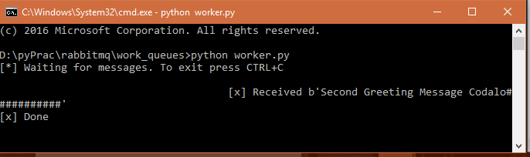
Receiving messages...
First worker received and processed messages faster because the fifth worker takes a lot of time to process only one message which takes time to process.

Slide 21
Real World Uses
Fast logging solution
Sending emails
Sending SMSs
Background processing (data analysis)

Slide 22
Want to learn more?
Go to the official site of RabbitMQ: https://www.rabbitmq.com/
How about Wiki? : https://en.wikipedia.org/wiki/RabbitMQ

Slide 23
And pass the messages… :D

Slide 24
Thank you.

