Slide 1
WebSockets && SockJS
Ahmedur Rahman Shovon
Codalo
shovon.sylhet@gmail.com

Slide 2
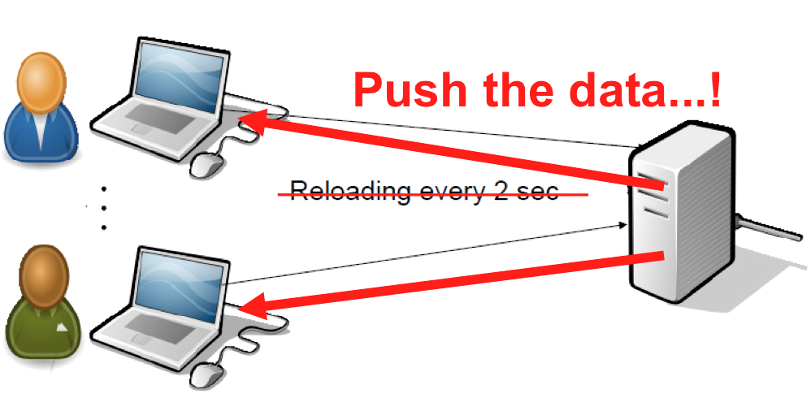
Different Communication Techniques in Web
AJAX: request → response. Creates connection to server, sends request headers with optional data, gets response from server, closes connection.
Long poll: request → wait → response. Creates connection to server like AJAX does, but keep-alive connection open for some time (not long though).
WebSockets: client ↔ server. Create TCP connection to server, and keep it as long as needed. Server or client can easily close it.

Slide 3

What is WebSockets?

Slide 4
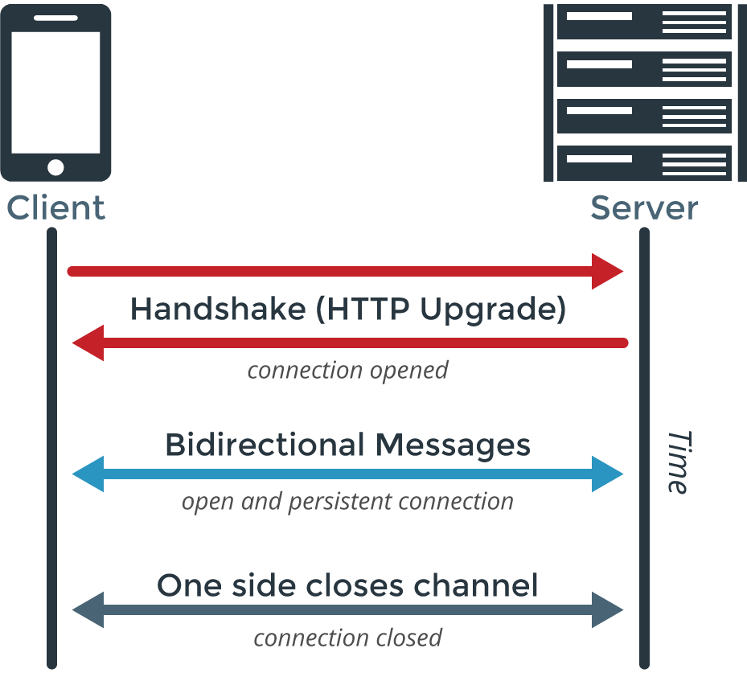
“WebSockets is a technology for bidirectional communication over single (TCP) socket, a type of PUSH technology.”
From code.tutsplus.com

Slide 5
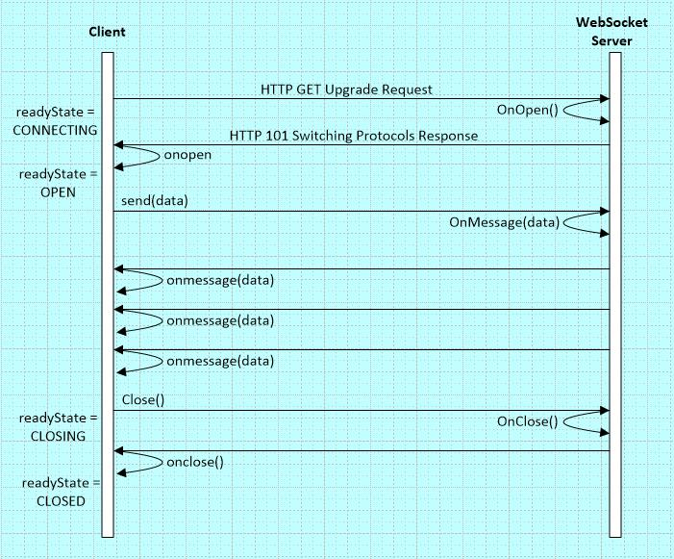
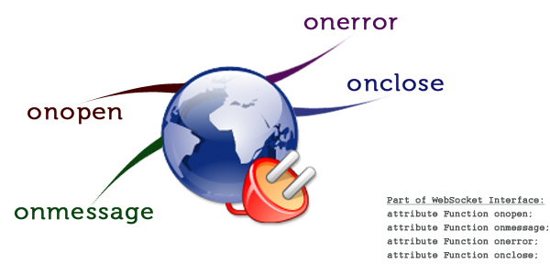
Client-Server Communication
Events

Slide 6
Advantages
Disadvantages
Cross origin communication (however this poses security risks)
Cross platform compatibility (web, desktop, mobile)
No HTTP overhead
Replace long-polling
WebSockets are data typed but AJAX calls can only send String datatypes
WebSockets are faster than AJAX
WebSockets has no success functions like AJAX
WebSockets needs server support. Though any server will support WebSockets. Using hosting service, one may not be able to use them, specially Heroku.
Load testing
Scaling, redundancy, load balancing, replication

Slide 7
Use Cases of WebSockets
Multiplayer online games
Chat applications
Live sports ticker
Real time updating social streams

Slide 8
What is SockJS?
SockJS is a browser JavaScript library that provides a WebSocket-like object.
It gives a coherent, cross-browser, Javascript API which creates a low latency, full duplex, cross-domain communication channel between the browser and the web server.
Under the hood SockJS tries to use native WebSockets first.
SockJS is intended to work for all modern browsers and in environments which don't support the WebSocket protocol.

Slide 9
SockJS-client, SockJS-server
SockJS-client JavaScript client library SockJS-node Node.js server SockJS-erlang Erlang server SockJS-cyclone Python/Cyclone/Twisted server SockJS-tornado Python/Tornado server SockJS-twisted Python/Twisted server Spring Framework Java client & server vert.x Java/vert.x server Xitrum Scala server Atmosphere Framework JavaEE Server, Play Framework, Netty, Vert.x
Remember these things please

Slide 10

What should I do to play with SockJS?

Slide 11
Required Setup to Wear Socks!
SockJS client side library: sockjs-1.1.1.min.js
Node.js (for running SockJS server, you can choose others too)
SockJS libraries based on the SockJS server
Node.js server library recommended by the SockJS: SockJS-node
SockJS-node is a Node.js server side counterpart of SockJS-client browser library written in CoffeeScript.
SockJS-node Installation: npm install sockjs

Slide 12

Now let’s see socketing in action!

Slide 13
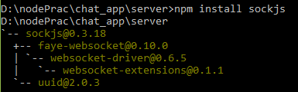
Installing SockJS Server
At first we need to install SockJS-node as we are using Node.js as SockJS server.
First install the Node.js installer.
Then using Node Package Manager(NPM) install SockJS-node.
Installing SockJS-node using npm

Slide 14
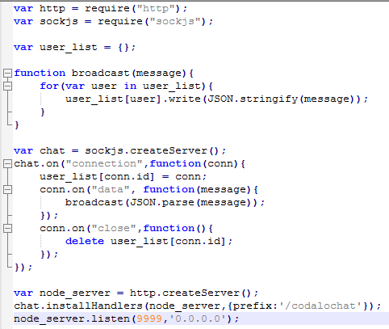
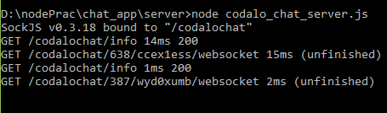
SockJS Server
Server Script
Running the server

Slide 15
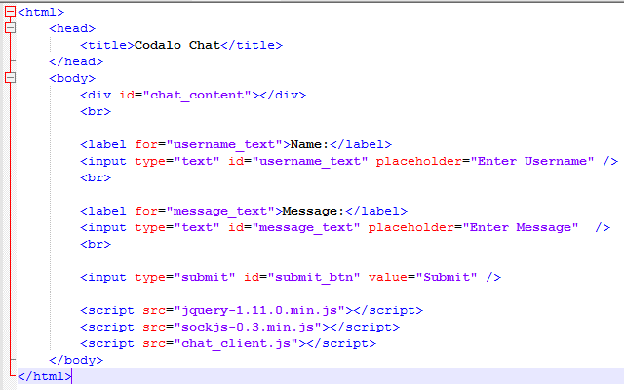
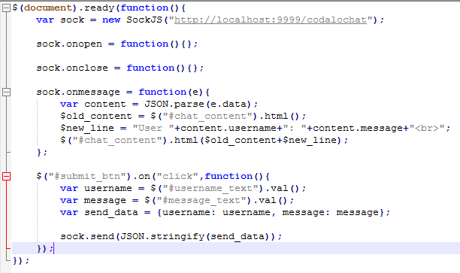
SockJS Client Application
chat_client.js
Client Side Application

Slide 16
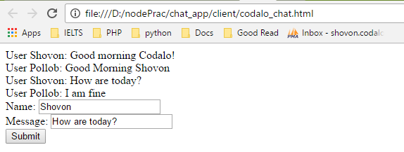
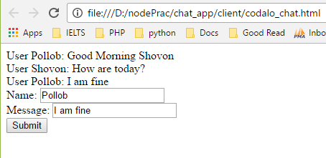
SockJS Client Demo
User 1
User 2

Slide 17
And it’s open source!
SockJS-Client: https://github.com/sockjs/sockjs-client
SockJS-Node: https://github.com/sockjs/sockjs-node
Did not like the demo interface? Have a look at updated code here: https://github.com/arsho/real_time_chatting_wearing_socks

Slide 18
Note Behind This interface does not allow for raw access to the underlying network. For example, this interface could not be used to implement an IRC client without proxying messages through a custom server.

Slide 19
Browser Quirks
Pressing ESC in Firefox, before Firefox 20, closes the SockJS connection.
jsonp-polling transport will show a "spinning wheel" (aka. "busy indicator") when sending data.
Can't open more than one SockJS connection to one domain at the same time.
From SockJS' point of view there is nothing special about SSL/HTTPS.
Trying to connect from secure "https://" to insecure "http://" is not a good idea.

Slide 20
Thank you.

