Slide 1
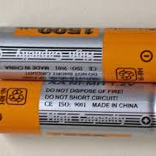
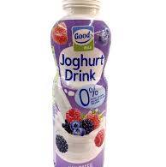

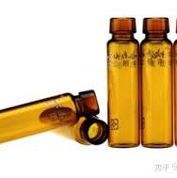
DEEP LEARNING PROJECT
Garbage
Classification
Image classification with MobileNetV2, TensorFlow, Flask, and Render
12 waste classes / 15,515 images / 94.68% validation accuracy
Notes:
Source: project dataset samples and models/metadata.json.

Slide 2
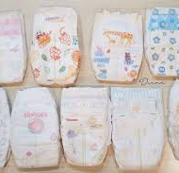
Project objective
Convert a trained waste-classification model into a usable browser experience
The project takes a user-uploaded image and identifies the most likely waste category.
01
Classify waste
Recognize 12 categories, including plastic, glass, paper, metal, shoes, and clothes.
02
Show confidence
Return the top five predicted labels so users can judge the model's certainty.
03
Make it accessible
Serve saved Keras models through a Flask web application that accepts common image files.
Dataset example: trash
02
Notes:
Source: app.py and templates/index.html. Image source: project dataset.

Slide 3
Training dataset
15,515 labelled images stored in one folder per waste class
The classes are imbalanced. Class weights were used during training to reduce the influence of overrepresented categories.
Dataset highlights
Largest class
Clothes 5,325
Smallest class
Brown-glass 607
20% of the dataset is reserved for validation.
03
Notes:
Source: models/metadata.json and garbage_classification_model.ipynb.

Slide 4
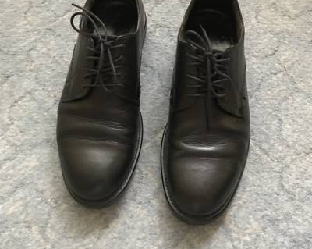
Model training pipeline
MobileNetV2 transfer learning with augmentation, class weighting, and fine-tuning
Dataset folders
Augmentation
MobileNetV2
Fine-tuning
Keras models
12 labelled classes
Flip, rotation, zoom
ImageNet base model
Last layers trainable
Saved .keras artifacts
224 x 224
32
12 + 5
20%
RGB input size
Batch size
Training and fine-tune epochs
Validation split
Example input
04
Notes:
Source: garbage_classification_model.ipynb. The notebook uses MobileNetV2, data augmentation, class weights, EarlyStopping, and ReduceLROnPlateau.

Slide 5

Validation results
The best saved model reaches 94.68% validation accuracy with a 0.172 validation loss
94.68%
validation accuracy
0.172
validation loss
3,103 validation images
Training history includes 16 recorded epochs.
05
Notes:
Source: models/metadata.json and models/training_history.png. Validation dataset count comes from garbage_classification_model.ipynb.

Slide 6
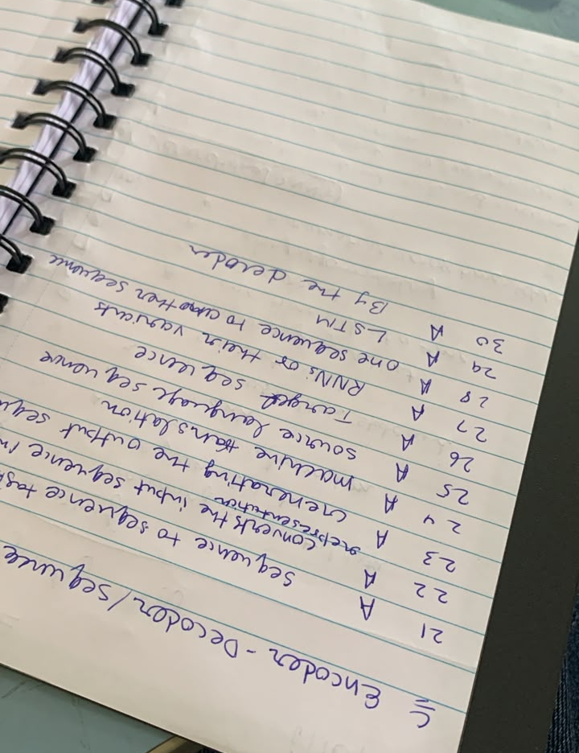
Web application integration
Flask loads the saved model once and returns ranked probabilities for every valid upload
Upload
Validate
Preprocess
Predict
Display
User chooses an image
Extension and size checks
RGB resize to 224 x 224
Keras model returns probabilities
Top five labels and confidence
The app defaults to best_garbage_classifier.keras and lets the user select either saved model.
Example upload
JPG, PNG, BMP, or WEBP
Maximum file size: 8 MB
Core stack: Flask | TensorFlow / Keras | Pillow | NumPy
06
Notes:
Source: app.py and templates/index.html. Example image source: garbage_classification/testing/paper.jpg.

Slide 7
Live deployment on Render
The repository contains the service definition and start command for a public Python web service
GitHub repository
Render build
Gunicorn service
Public web app
Source code, models, and configuration
pip install -r requirements.txt
gunicorn --bind 0.0.0.0:$PORT app:app
Browser uploads an image for classification
Deployment files
render.yaml
Defines build command, Gunicorn start command, and Python environment variable
runtime.txt
Records Python 3.11.9 for compatible deployment tooling
.python-version
Pins the project runtime to Python 3.11.9
Procfile
Provides a process command for compatible hosts
07
Notes:
Source: render.yaml, runtime.txt, .python-version, Procfile, requirements.txt, and README.md.

Slide 8
Render deployment issue and fix
Pin Python 3.11.9 because the default Python 3.14.3 build cannot install the requested TensorFlow package
Why the build failed
Configured solution
Render selected Python 3.14.3 by default. The package installer then reported that no compatible tensorflow>=2.15 distribution was available.
1. Set the Render environment variable PYTHON_VERSION to 3.11.9.
2. Keep runtime.txt and .python-version set to 3.11.9.
3. Clear the build cache, then deploy again.
Observed build error:
No matching distribution found for tensorflow>=2.15
Expected result after redeploy: Render installs TensorFlow on Python 3.11.9 and starts the Flask app with Gunicorn.
08
Notes:
Source: Render build log supplied for this project, render.yaml, runtime.txt, .python-version, and README.md.

