Slide 1
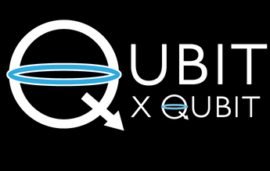

INTRO TO QUANTUM COMPUTING
Week 14 Lab
THE BLOCH SPHERE
Aman Bansal
13th February 2021
© 2021 The Coding School

Slide 2
PROGRAM FOR TODAY
Logistics
Canvas attendance quiz
Pre-lab zoom feedback
Questions from last week
Lab content
Post-lab zoom feedback

Slide 3

logistics
Student assistant office hours
Every Friday 8 am-2 pm EST, and Sunday 10 am-12 pm EST (UTC-5)
Student Assistants are available to review lab and lecture materials, walk through homework problems, or answer any other content-related questions you might have at the end of each week
Zoom link available on Canvas
Friday homework review sessions
Every Friday 4-5 p.m. EST (UTC-5)
Review, ask questions, work through weekly homework problems with an instructor
Zoom links available on Canvas
Recordings will be made available if you cannot attend live
Create your IBM Quantum Experience accounts (instructions on Canvas)
We will be using QE in lab next week!

Slide 4
Canvas attendance quiz
Please log into Canvas and answer your lab section’s quiz (using the password posted below and in the chat).
This is lab number: 12A
Passcode: 4973
Before this course, did you know about the IBM Quantum Experience?
This quiz not graded, but counts for your lab attendance!

Slide 5
PRE-LAB Zoom FEEDBACK
On a scale of 1 to 5, how would you rate your understanding of this week’s content?
1 –Did not understand anything
2 – Understood some parts
3 – Understood most of the content
4 – Understood all of the content
5 – The content was easy for me/I already knew all of the content

Slide 6

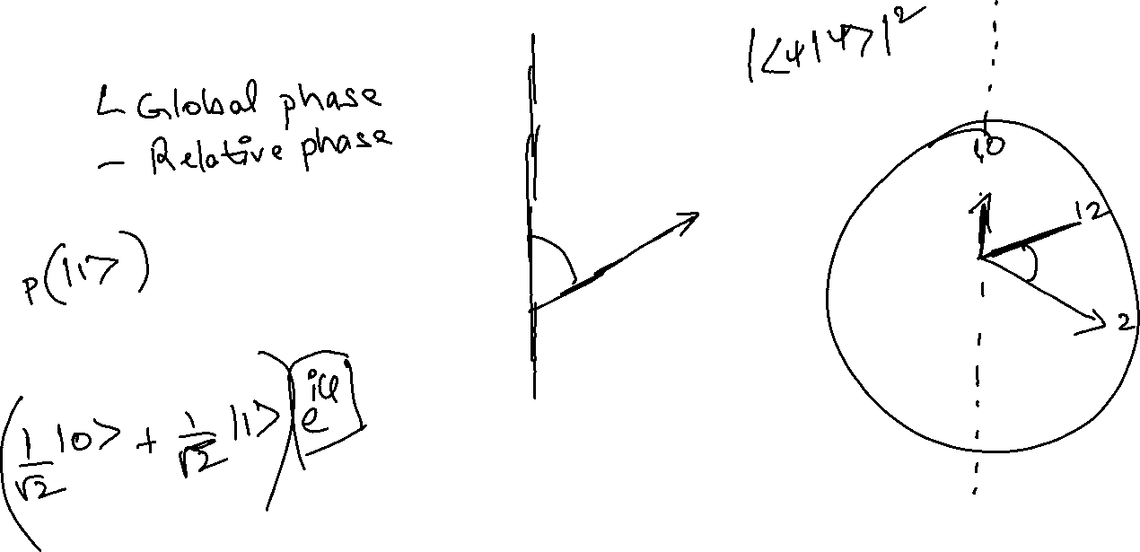
Questions from past week
What is phase?
Notes:
Phase corresponds to the position of each of the hands of the clock.

Slide 7
Learning objectives FOR LAB 14
Locating states on the Bloch sphere
Latitude and longitude
Bloch sphere and Stern Gerlach experiment
Visualizing the application of gates on states
Rotation operators
Rotating qubit states on the Bloch sphere
Comparing modes on a piano and a violin*
*Optional content

Slide 8
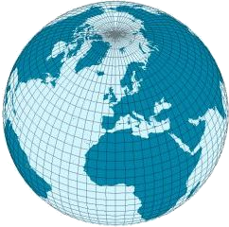
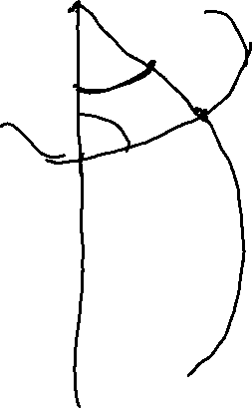
Locating a place on earth
How would you tell me where your hometown is?
Latitude and longitude! Two angles
Notes:
Open chat. Ask students- how would you locate a place on the surface of the earth? How would you tell someone where your hometown is? Hopefully, some of them say latitude and longitude. Point out how these are two angles – one to locate a place along one circle, and another to locate it along another, perpendicular circle. The place that you want to locate is at the intersection of the two circles. Annotate with the two circles (can draw separately or on the globe)

Slide 9
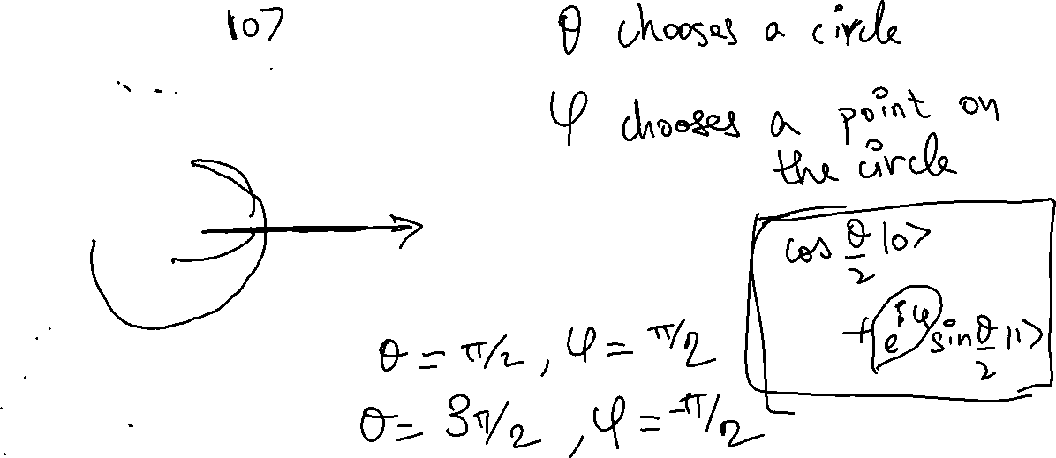

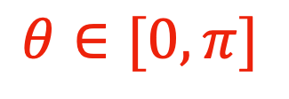
Locating points on a sphere
$$θ∈[0,π]$$
$$φ∈[0,2π]$$
Notes:
Here are the limits! There are what we need to capture every possible point. What are theta and phi for the points marked by the two empty circles? What about the point along the y axis (annotate with pen)?
Connecting dots to what phase means in this context.

Slide 10
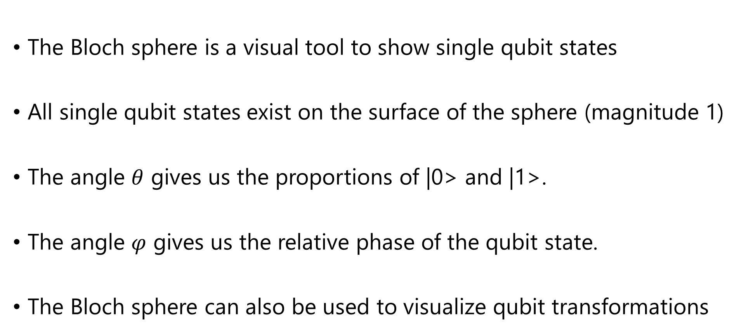
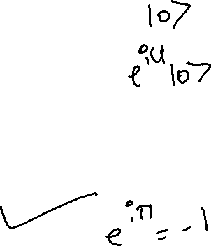
Characteristics of Bloch sphere
The Bloch sphere is a visual tool to show single qubit states
All single qubit states exist on the surface of the sphere (magnitude 1)
The angle $θ$ gives us the proportions of |0> and |1>.
The angle $φ$ gives us the relative phase of the qubit state.
The Bloch sphere can also be used to visualize qubit transformations

Slide 11
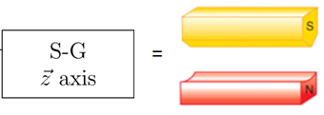
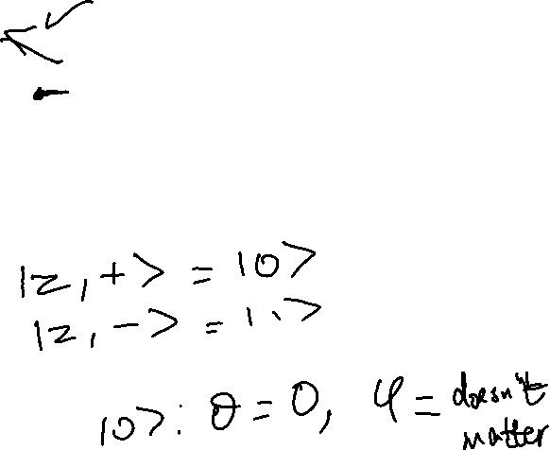
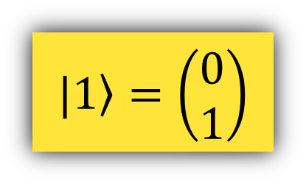
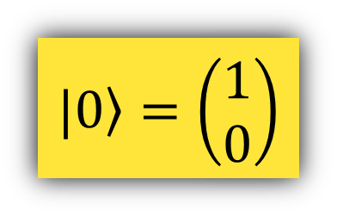
Locating points on a sphere
$$|\left.0\right\rangle =\left(\begin{aligned}1 \\ 0\end{aligned}\right)$$
electron
$$|\left.1\right\rangle =\left(\begin{aligned}0 \\ 1\end{aligned}\right)$$
Notes:
Here are the limits! There are what we need to capture every possible point. What are theta and phi for the points marked by the two empty circles? What about the point along the y axis (annotate with pen)?
We use this sphere to represent qubits! Its called the Bloch sphere. Remember how the x- and y- axes were the bases and we could describe any vector in the plane using them? A similar idea applies here. The basis vectors are still (1,0) and (0,1), and any other vector can be written as a combination of these two vectors, using the given equation.

Slide 12
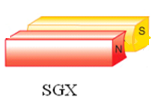
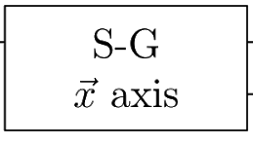
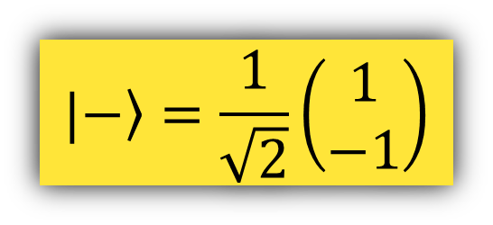
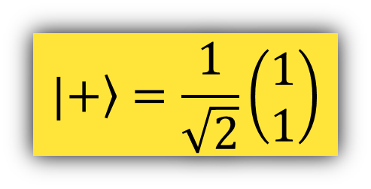
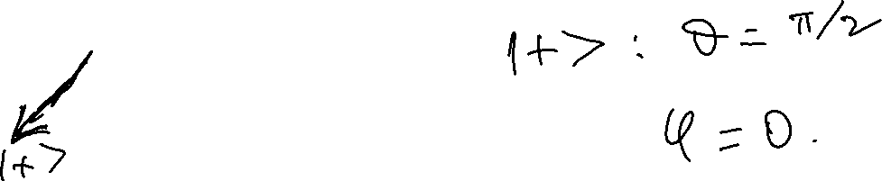
Locating points on a sphere
$$|\left.−\right\rangle =\frac{1}{\sqrt{2}}\left(\begin{aligned}1 \\ −1\end{aligned}\right)$$
electron
$$|\left.+\right\rangle =\frac{1}{\sqrt{2}}\left(\begin{aligned}1 \\ 1\end{aligned}\right)$$
Notes:
Here are the limits! There are what we need to capture every possible point. What are theta and phi for the points marked by the two empty circles? What about the point along the y axis (annotate with pen)?
We use this sphere to represent qubits! Its called the Bloch sphere. Remember how the x- and y- axes were the bases and we could describe any vector in the plane using them? A similar idea applies here. The basis vectors are still (1,0) and (0,1), and any other vector can be written as a combination of these two vectors, using the given equation.

Slide 13
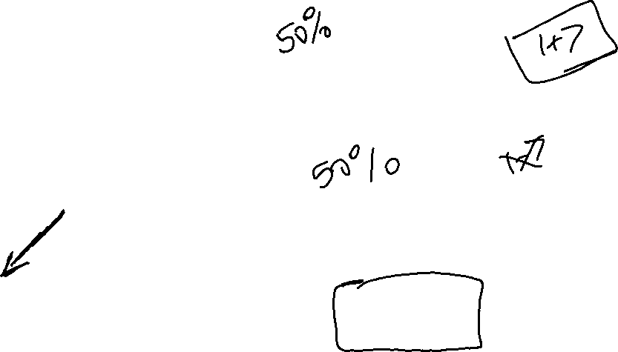
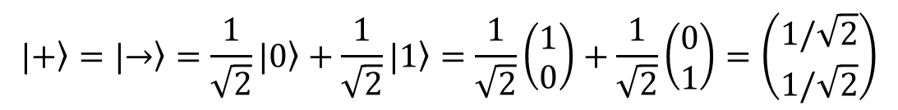
Locating points on a sphere
electron
$$|\left.+\right\rangle =|\left.→\right\rangle =\frac{1}{\sqrt{2}}|\left.0\right\rangle +\frac{1}{\sqrt{2}}|\left.1\right\rangle =\frac{1}{\sqrt{2}}\left(\begin{matrix}1 \\ 0\end{matrix}\right)+\frac{1}{\sqrt{2}}\left(\begin{matrix}0 \\ 1\end{matrix}\right)=\left(\begin{matrix}1/\sqrt{2} \\ 1/\sqrt{2}\end{matrix}\right)$$
Notes:
Here are the limits! There are what we need to capture every possible point. What are theta and phi for the points marked by the two empty circles? What about the point along the y axis (annotate with pen)?
We use this sphere to represent qubits! Its called the Bloch sphere. Remember how the x- and y- axes were the bases and we could describe any vector in the plane using them? A similar idea applies here. The basis vectors are still (1,0) and (0,1), and any other vector can be written as a combination of these two vectors, using the given equation.

Slide 14
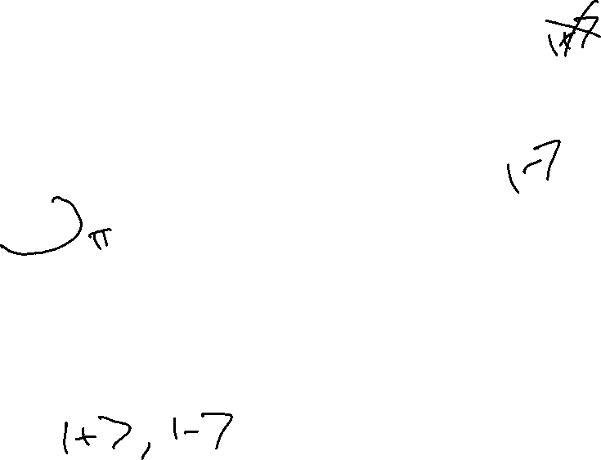
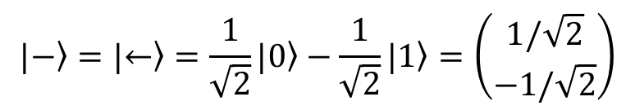
Locating points on a sphere
$$|\left.−\right\rangle =|\left.←\right\rangle =\frac{1}{\sqrt{2}}|\left.0\right\rangle −\frac{1}{\sqrt{2}}|\left.1\right\rangle =\left(\begin{matrix}1/\sqrt{2} \\ −1/\sqrt{2}\end{matrix}\right)$$
Notes:
Here are the limits! There are what we need to capture every possible point. What are theta and phi for the points marked by the two empty circles? What about the point along the y axis (annotate with pen)?
We use this sphere to represent qubits! Its called the Bloch sphere. Remember how the x- and y- axes were the bases and we could describe any vector in the plane using them? A similar idea applies here. The basis vectors are still (1,0) and (0,1), and any other vector can be written as a combination of these two vectors, using the given equation.

Slide 15
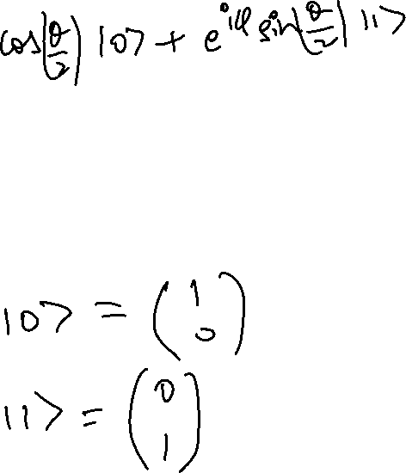
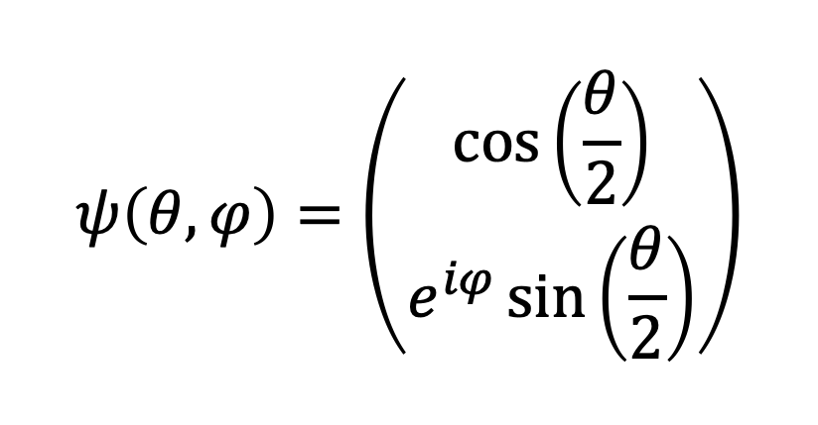

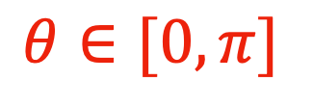
The bloch sphere
$$θ∈[0,π]$$
$$ψ\left(θ,φ\right)=\left(\begin{aligned}\cos\left(\frac{θ}{2}\right) \\ e^{iφ}\sin\left(\frac{θ}{2}\right)\end{aligned}\right)$$
$$φ∈[0,2π]$$
Notes:
We use this sphere to represent qubits! Its called the Bloch sphere. Remember how the x- and y- axes were the bases and we could describe any vector in the plane using them? A similar idea applies here. The basis vectors are still (1,0) and (0,1), and any other vector can be written as a combination of these two vectors, using the given equation.
Verify that putting in the values of theta and phi they had given for the two empty points gives the correct vectors. Also point out the vector for the y-axis point using the theta and phi values for that point.
Also point out that students will see this content again next semester, so if they don’t understand fully right now, that’s ok!

Slide 16
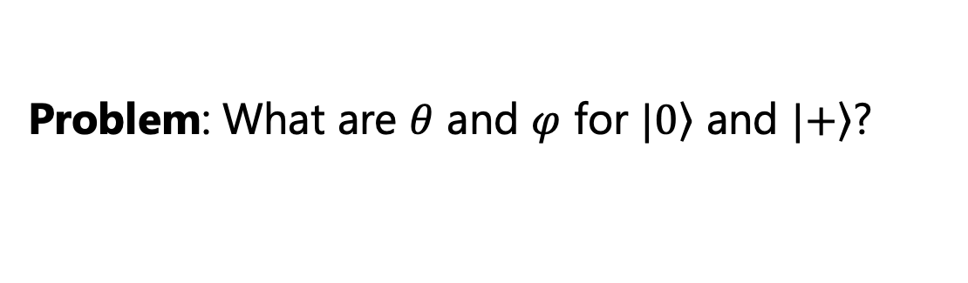


The bloch sphere
$$θ∈[0,π]$$
$$ψ\left(θ,φ\right)=\left(\begin{aligned}\cos\left(\frac{θ}{2}\right) \\ e^{iφ}\sin\left(\frac{θ}{2}\right)\end{aligned}\right)$$
$$φ∈[0,2π]$$
Problem: What are $θ$ and $φ$ for $|\left.0\right\rangle$ and $|\left.+\right\rangle$?

Slide 17
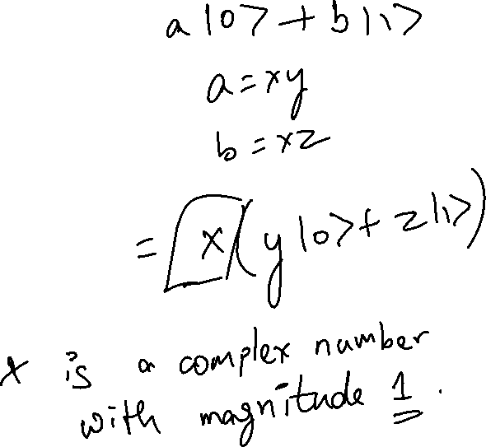
Questions?
Questions on content so far?

Slide 18
Quantum Gates
So far, we’ve seen single qubit states and visualized them on the Bloch sphere
How do we change qubit states? By applying gates to them

Slide 19
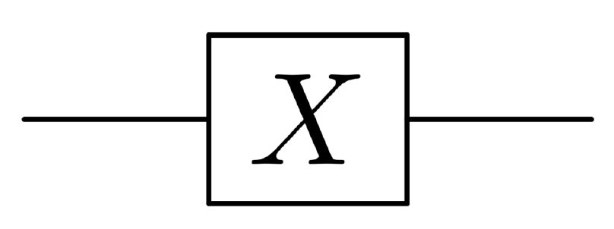
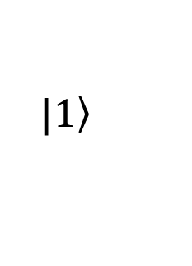
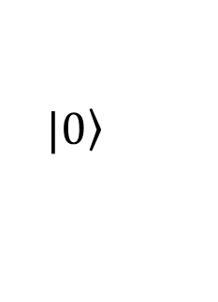
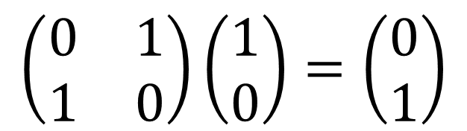
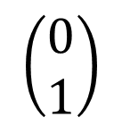
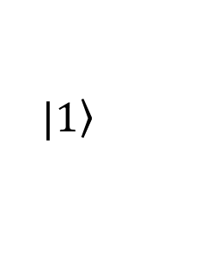
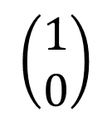
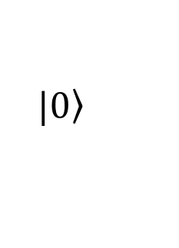
Applying gates to states
$$|\left.1\right\rangle$$
$$|\left.0\right\rangle$$
$$\left(\begin{matrix}1 \\ 0\end{matrix}\right)$$
$$\left(\begin{matrix}0 \\ 1\end{matrix}\right)$$
$$\left(\begin{matrix}0 & 1 \\ 1 & 0\end{matrix}\right)\left(\begin{matrix}1 \\ 0\end{matrix}\right)=\left(\begin{matrix}0 \\ 1\end{matrix}\right)$$
X-gate matrix
$$|\left.0\right\rangle$$
$$|\left.1\right\rangle$$

Slide 20
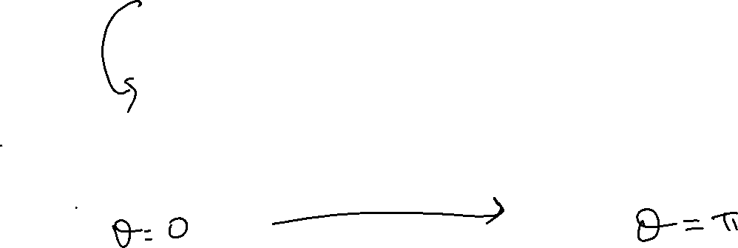
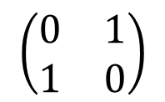
Applying the X Gate
$$\left(\begin{matrix}0 & 1 \\ 1 & 0\end{matrix}\right)$$
Notes:
Indicate the rotation path
Indicate at the bottom that X rotates by 180 degrees

Slide 21


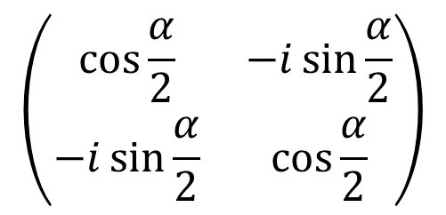
General x-rotation gate
$$α$$
$$R_{X}(α)$$
$$\left(\begin{matrix}\cos{\frac{α}{2}} & −i\sin{\frac{α}{2}} \\ −i\sin{\frac{α}{2}} & \cos{\frac{α}{2}}\end{matrix}\right)$$

Slide 22
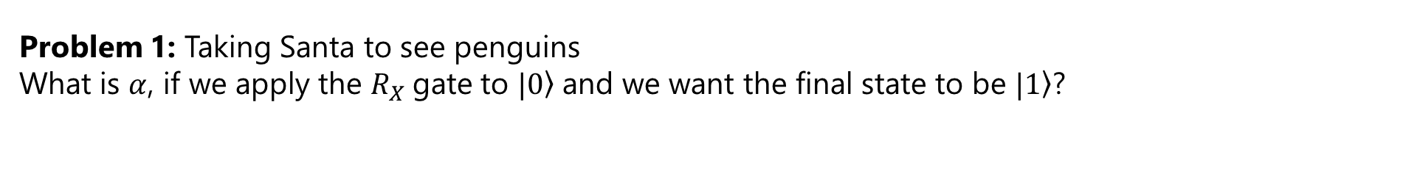
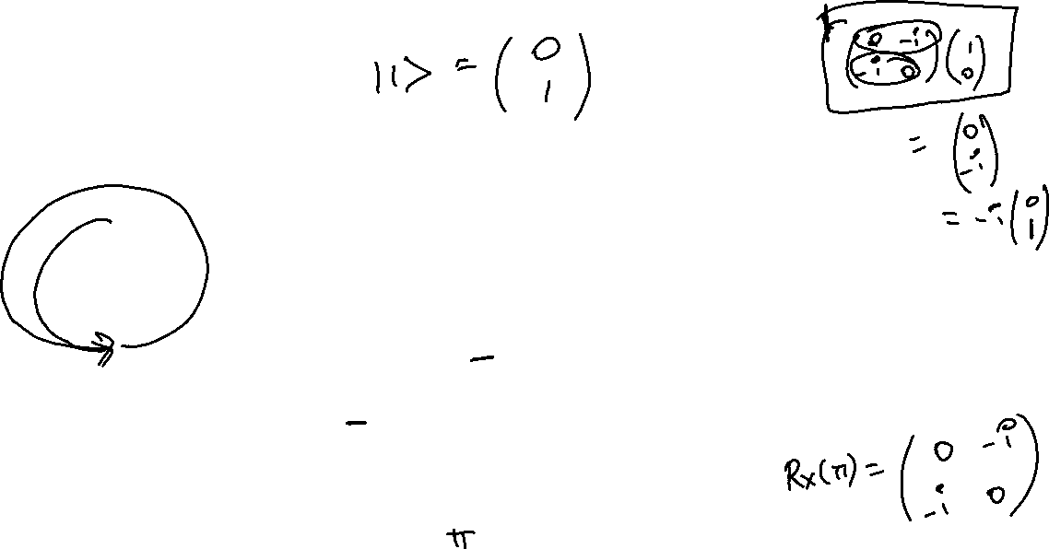
General x-rotation gate
$$R_{X}(α)$$
$$\left(\begin{matrix}\cos{\frac{α}{2}} & −i\sin{\frac{α}{2}} \\ −i\sin{\frac{α}{2}} & \cos{\frac{α}{2}}\end{matrix}\right)$$
Problem 1: Taking Santa to see penguins
What is $α$, if we apply the $R_{X}$gate to $|\left.0\right\rangle$and we want the final state to be $|\left.1\right\rangle$?

Slide 23
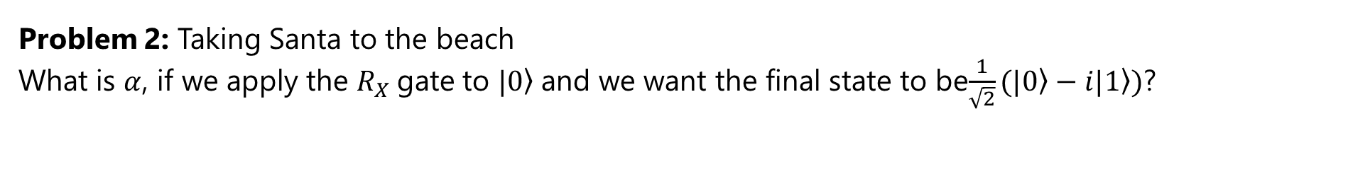
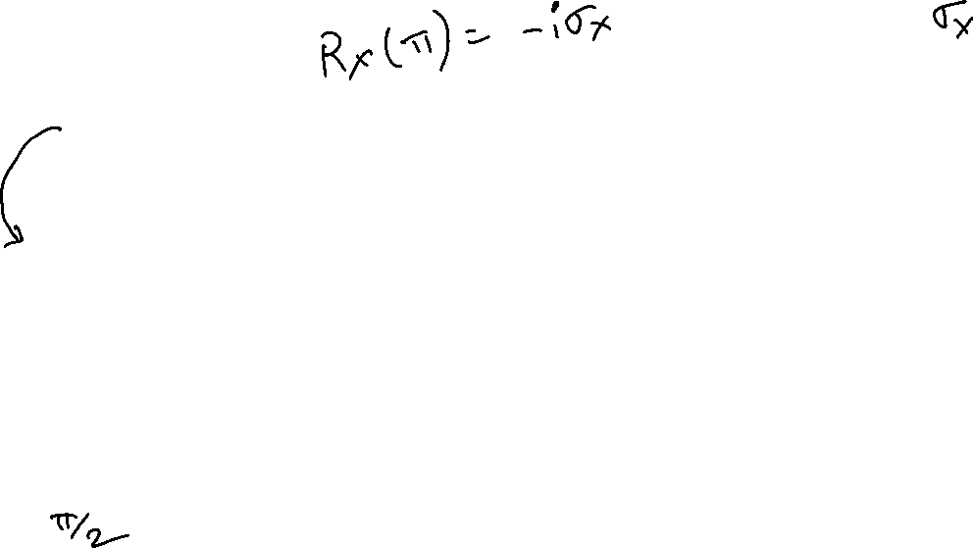
General x-rotation gate
$$R_{X}(α)$$
$$\left(\begin{matrix}\cos{\frac{α}{2}} & −i\sin{\frac{α}{2}} \\ −i\sin{\frac{α}{2}} & \cos{\frac{α}{2}}\end{matrix}\right)$$
Problem 2: Taking Santa to the beach
What is $α$, if we apply the $R_{X}$gate to $|\left.0\right\rangle$and we want the final state to be$\frac{1}{\sqrt{2}}(|\left.0\right\rangle −i|\left.1\right\rangle )$?

Slide 24
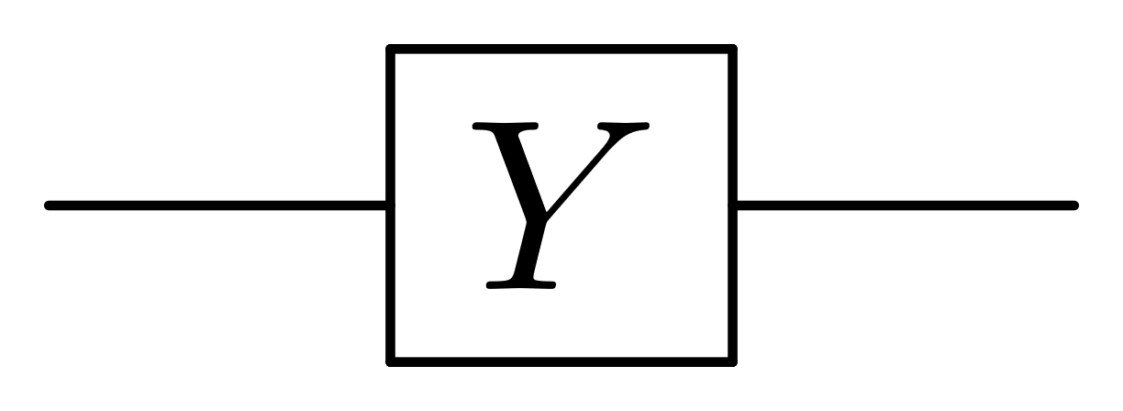
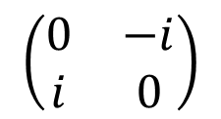
Applying the Y Gate
$$\left(\begin{matrix}0 & −i \\ i & 0\end{matrix}\right)$$

Slide 25


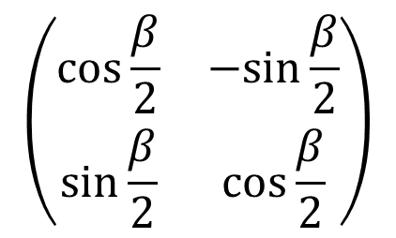
General Y-rotation gate
$$R_{Y}(β)$$
$$β$$
$$\left(\begin{matrix}\cos{\frac{β}{2}} & −sin{\frac{β}{2}} \\ \sin{\frac{β}{2}} & \cos{\frac{β}{2}}\end{matrix}\right)$$

Slide 26
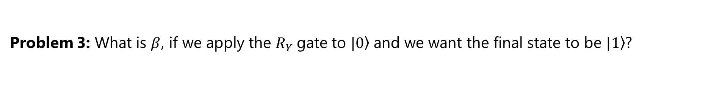
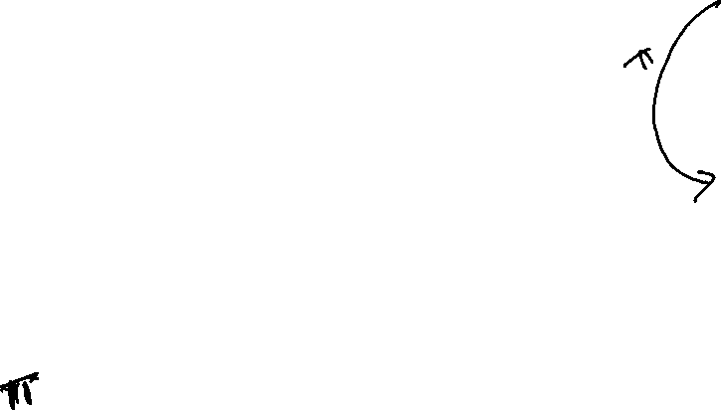
General Y-rotation gate
$$R_{Y}(β)$$
$$\left(\begin{matrix}\cos{\frac{β}{2}} & −sin{\frac{β}{2}} \\ \sin{\frac{β}{2}} & \cos{\frac{β}{2}}\end{matrix}\right)$$
Problem 3: What is $β$, if we apply the $R_{Y}$gate to $|\left.0\right\rangle$and we want the final state to be $|\left.1\right\rangle$?

Slide 27

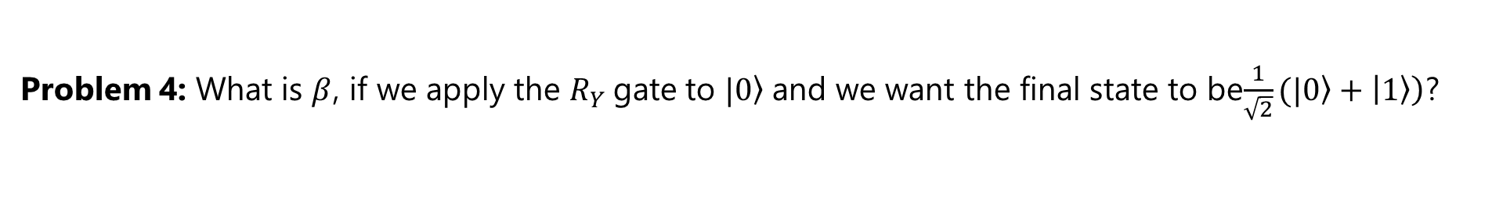
General Y-rotation gate
$$R_{Y}(β)$$
$$\left(\begin{matrix}\cos{\frac{β}{2}} & −sin{\frac{β}{2}} \\ \sin{\frac{β}{2}} & \cos{\frac{β}{2}}\end{matrix}\right)$$
Problem 4: What is $β$, if we apply the $R_{Y}$gate to $|\left.0\right\rangle$and we want the final state to be$\frac{1}{\sqrt{2}}(|\left.0\right\rangle +\left|\left.1\right\rangle \right)$?
Notes:
Point out that this is the H gate

Slide 28



Applying the Z Gate
$$\left(\begin{matrix}1 & 0 \\ 0 & −1\end{matrix}\right)$$

Slide 29



General Z-rotation gate
$$R_{z}(γ)$$
$$\left(\begin{matrix}e^{−iγ/2} & 0 \\ 0 & e^{iγ/2}\end{matrix}\right)$$
$$γ$$
Notes:
Verify that it makes sense that this operator does not affect 0 and 1 states

Slide 30


General Z-rotation gate
$$R_{z}(γ)$$
$$\left(\begin{matrix}e^{−iγ/2} & 0 \\ 0 & e^{iγ/2}\end{matrix}\right)$$
Problem 5: What is $γ$, if we apply the $R_{Z}$gate to $|\left.+\right\rangle$and we want the final state to be$|\left.−\right\rangle$?

Slide 31

Key Takeaways
The Bloch sphere is used to represent single qubit states
Applying a gate to a single qubit is equivalent to rotating the qubit on the Bloch sphere
The rotation gates along x, y, and z-axes generalize the X, Y, and Z gates.
By combining $R_{X}, R_{Y},$ and $R_{Z}$ gates, we can make any arbitrary qubit transformation

Slide 32
Coming up …
Next week: IBM Quantum Experience
Applying gates to qubits
Combining gates
Visualizing the result of applying gates on qubits
Creating circuits for superposition, entanglement, etc.
In two weeks: Qiskit
Writing code to define qubits states and gates
Applying gates to qubits
Developing code to implement quantum algorithms

Slide 33
Further Reading and resources
https://www.youtube.com/watch?v=MBnnXbOM5S4 – 3Blue1Brown video on the uncertainty principle, as it applies to ripples
https://www.youtube.com/watch?v=vUVkS1XZVCc – Lecture on the Bloch sphere by Prof. Umesh Vazirani
https://www.scottaaronson.com/blog/?p=4021 – Blog post by Prof. Scott Aaronson on why quantum amplitudes use complex numbers
Notes:
https://www.youtube.com/watch?v=MBnnXbOM5S4

Slide 34
Questions?
Questions on content so far?

Slide 35
Post-LAB Zoom FEEDBACK
After this lab, on a scale of 1 to 5, how would you rate your understanding of this week’s content?
1 –Did not understand anything
2 – Understood some parts
3 – Understood most of the content
4 – Understood all of the content
5 – The content was easy for me/I already knew all of the content

Slide 36
Optional content

Slide 37



Describing the Ripple With eigenfunctions
The ripple can be “reconstructed” by adding up the modes
a $∗$
+
actual shape of string
=
b $∗$
+
fixed
fixed
c $∗$
+ ….
Notes:
Now here’s a really cool result – it turns out that you can describe any of these shapes that you force the string into, as a combination of the same modes that we saw earlier! The ripple that we create can be reconstructed by adding up the different modes.

Slide 38



The violin vs the piano

Slide 39

Violin vs piano modes

Slide 40
Contribution of modes to wavefunctions
The same note played on the violin and piano is different, because the relative contributions (amplitudes) of the different modes (eigenstates) are different
By changing the relative contribution of the eigenstates in a qubit, we can change the qubit state (wavefuction)

