Slide 1
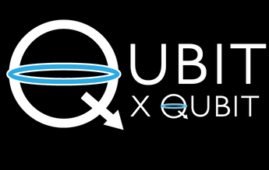

INTRO TO QUANTUM COMPUTING
Week 17 Lab
TENSOR PRODUCTS AND QASM
Aman Bansal
6th March 2021
© 2021 The Coding School

Slide 2
PROGRAM FOR TODAY
Canvas attendance quiz
Pre-lab zoom feedback
Canvas quiz from last week
Lab content
Post-lab zoom feedback

Slide 3
Canvas attendance quiz
Please log into Canvas and answer your lab section’s quiz (using the password posted below and in the chat).
This is lab number: 12A
Passcode: 2389
Question: Do you read the weekly announcements posted on Canvas? (Please be honest, but we really hope you do!)
This quiz is not graded, but counts for your lab attendance!

Slide 4
PRE-LAB Zoom FEEDBACK
On a scale of 1 to 5, how would you rate your understanding of this week’s content?
1 –Did not understand anything
2 – Understood some parts
3 – Understood most of the content
4 – Understood all of the content
5 – The content was easy for me/I already knew all of the content
In lecture this week, we discussed multi-qubit states and tensor products

Slide 5

Canvas quiz from last week
Quantum states can be represented by vectors, whose direction gives us information about the probabilities of different measurement results - True
When a quantum state is measured, it can change as a result of the measurement - True
Quantum states always stay the same; they never change - False
Quantum states can be represented by a single number (a scalar), and a measurement of the state gives us that number as the result - False

Slide 6
Learning objectives FOR LAB 17
Demystifying tensor products
Taking tensor products by hand
Using numpy to calculate tensor products
Using QASM simulator
Creating Phi- Bell state
Running the Phi- circuit using QASM simulator
Circuit Composer widget*
*Optional content

Slide 7
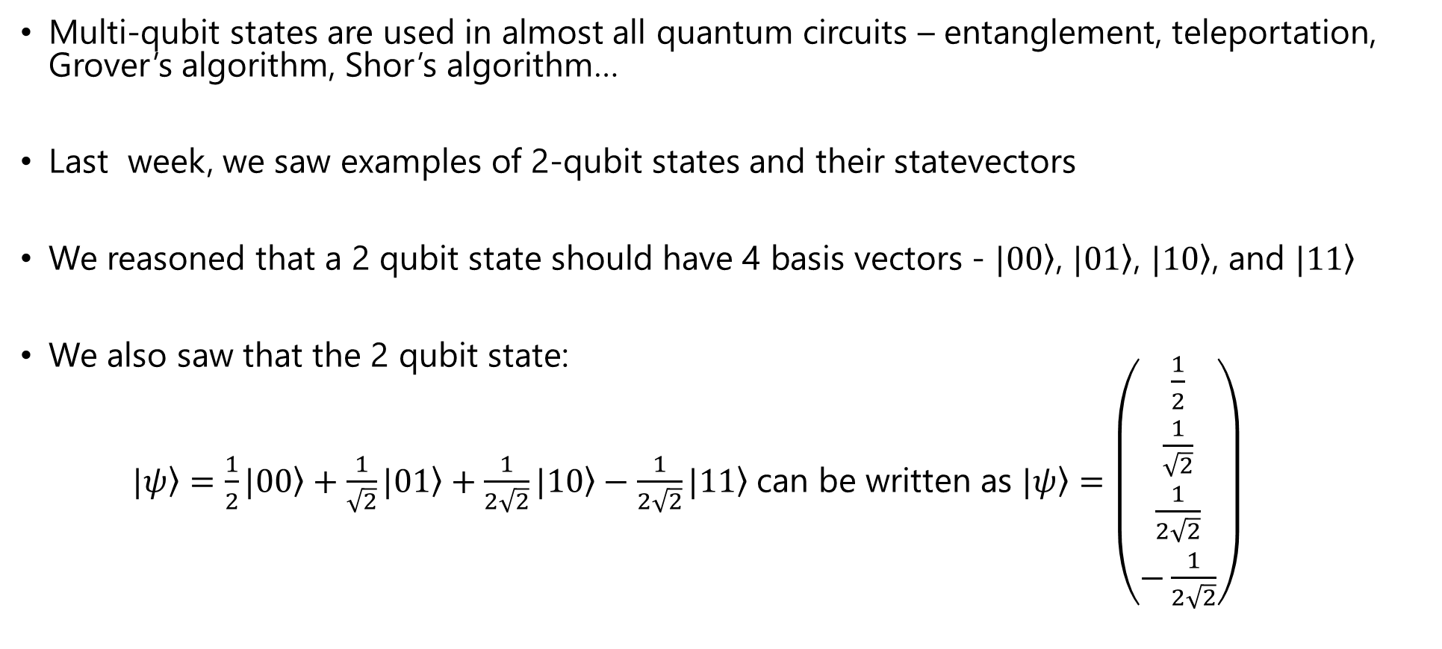
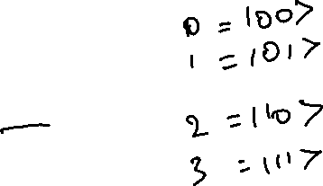
Writing multi-qubit states
Multi-qubit states are used in almost all quantum circuits – entanglement, teleportation, Grover’s algorithm, Shor’s algorithm…
Last week, we saw examples of 2-qubit states and their statevectors
We reasoned that a 2 qubit state should have 4 basis vectors - $|\left.00\right\rangle$, $|\left.01\right\rangle$, $|\left.10\right\rangle$, and $|\left.11\right\rangle$
We also saw that the 2 qubit state:
$|\left.ψ\right\rangle =\frac{1}{2}|\left.00\right\rangle +\frac{1}{\sqrt{2}}|\left.01\right\rangle +\frac{1}{2\sqrt{2}}|\left.10\right\rangle −\frac{1}{2\sqrt{2}}|\left.11\right\rangle$can be written as $|\left.ψ\right\rangle =\left(\begin{matrix}\frac{1}{2} \\ \frac{1}{\sqrt{2}} \\ \begin{aligned}\frac{1}{2\sqrt{2}} \\ −\frac{1}{2\sqrt{2}}\end{aligned}\end{matrix}\right)$

Slide 8
Writing multi-qubit states
Can we generalize this?
How do we know which order to write higher-number qubit states in?
We will use the tensor product to express multi-qubit states
To understand tensor products, let’s join Phil and Aman for dinner

Slide 9
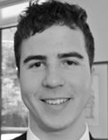
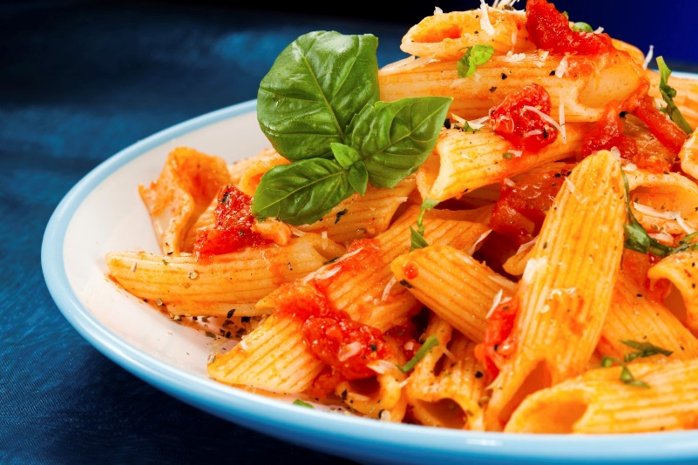

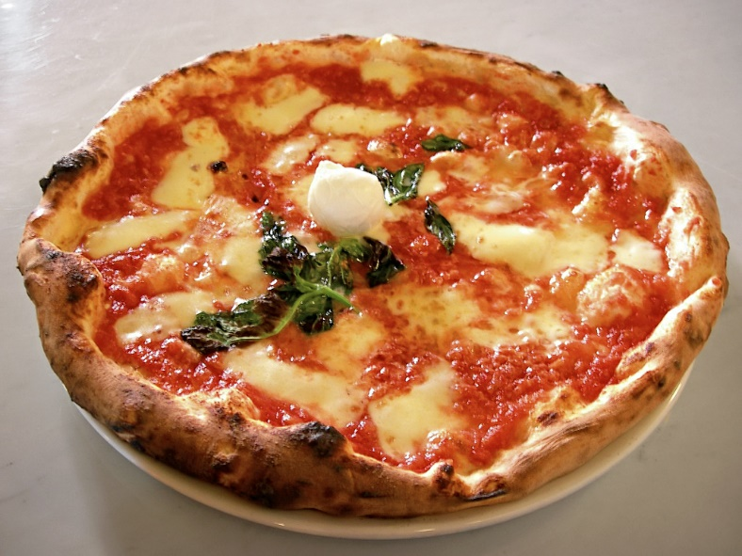
Tensor products at dinner
Phil and Aman go out to get dinner at an Italian restaurant. They have two options – pasta and pizza
can eat
They want to know – What are all the combinations of our dinner options?
Notes:
Analogy – 2 Tas, pasta and pizza

Slide 10




Tensor products at dinner
Here’s how they decide to organize the possibilities.
can eat
can eat
can eat
can eat
can eat
Note the horizontal ordering. The human can eat the food; the food can’t eat the human!
Note the vertical ordering. First we listed Phil’s combinations, then Aman’s.

Slide 11
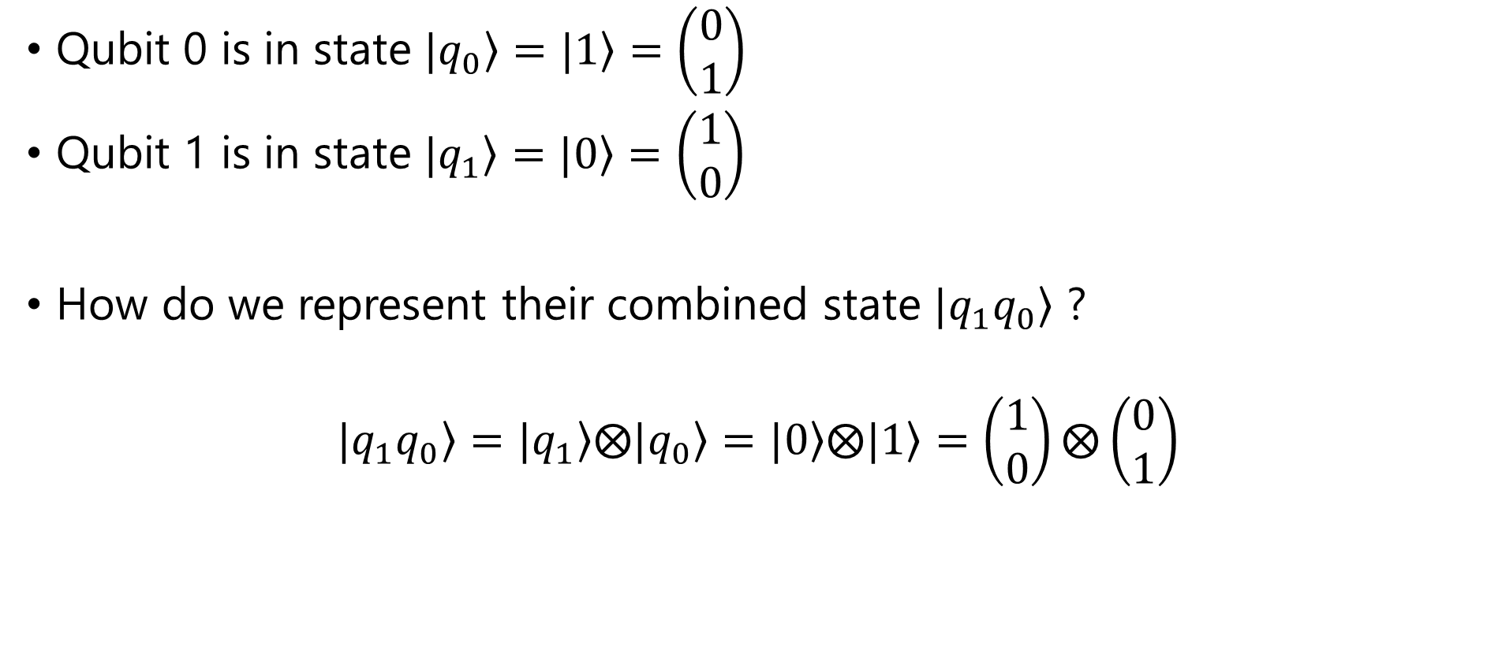
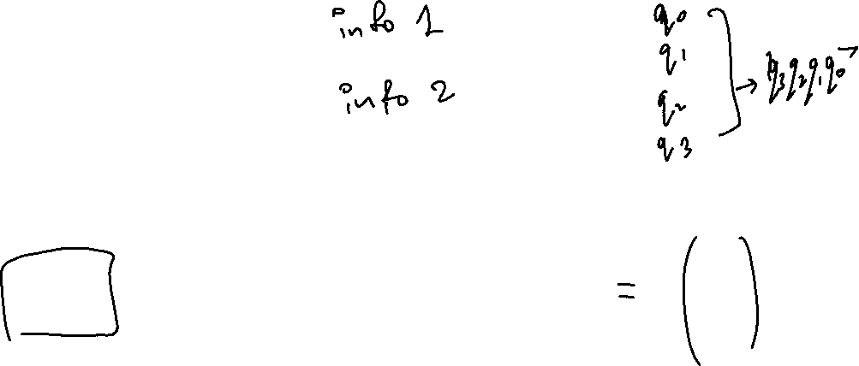
Tensor products For 2 qubits
Qubit 0 is in state $|\left.q_{0}\right\rangle =|\left.1\right\rangle =\left(\begin{matrix}0 \\ 1\end{matrix}\right)$
Qubit 1 is in state $|\left.q_{1}\right\rangle =|\left.0\right\rangle =\left(\begin{matrix}1 \\ 0\end{matrix}\right)$
How do we represent their combined state $|\left.q_{1}q_{0}\right\rangle$ ?
$$|\left.q_{1}q_{0}\right\rangle =|\left.q_{1}\right\rangle ⨂|\left.q_{0}\right\rangle =|\left.0\right\rangle ⨂|\left.1\right\rangle =\left(\begin{matrix}1 \\ 0\end{matrix}\right)⨂\left(\begin{matrix}0 \\ 1\end{matrix}\right)$$
Tensor product
Note that we will use the convention of right indexing, i.e., qubit 0 will always be the rightmost qubit when we write multi-qubit states. This is also the convention used in qiskit (but other languages/books may use left indexing).

Slide 12



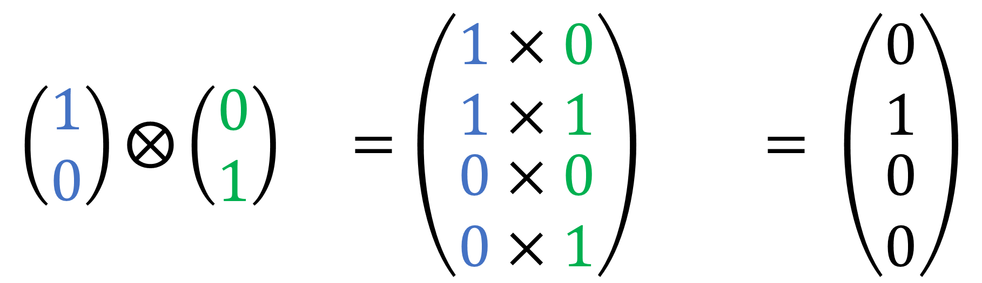
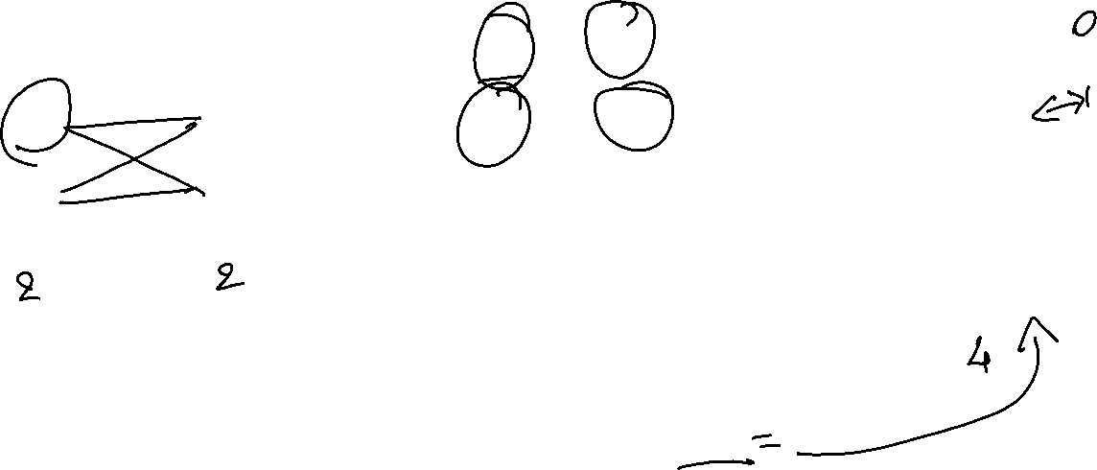
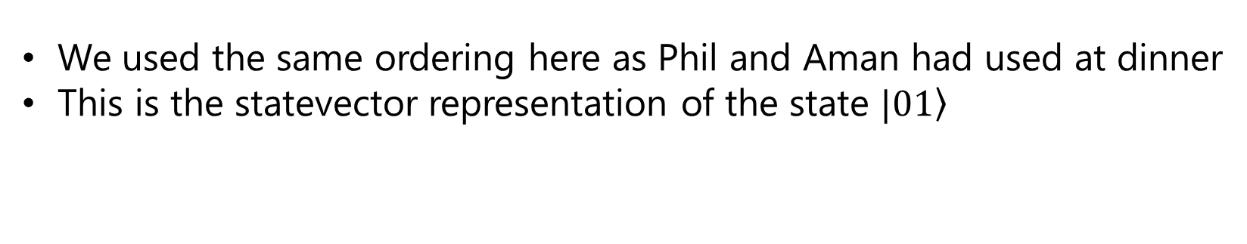
Tensor products For 2 qubits
$$\left(\begin{matrix}1 \\ 0\end{matrix}\right)⨂\left(\begin{matrix}0 \\ 1\end{matrix}\right) =\left(\begin{matrix}1×0 \\ 1×1 \\ \begin{aligned}0×0 \\ 0×1\end{aligned}\end{matrix}\right) = \left(\begin{matrix}0 \\ 1 \\ \begin{aligned}0 \\ 0\end{aligned}\end{matrix}\right)$$
qubit 1
qubit 0
We used the same ordering here as Phil and Aman had used at dinner
This is the statevector representation of the state $|\left.01\right\rangle$

Slide 13
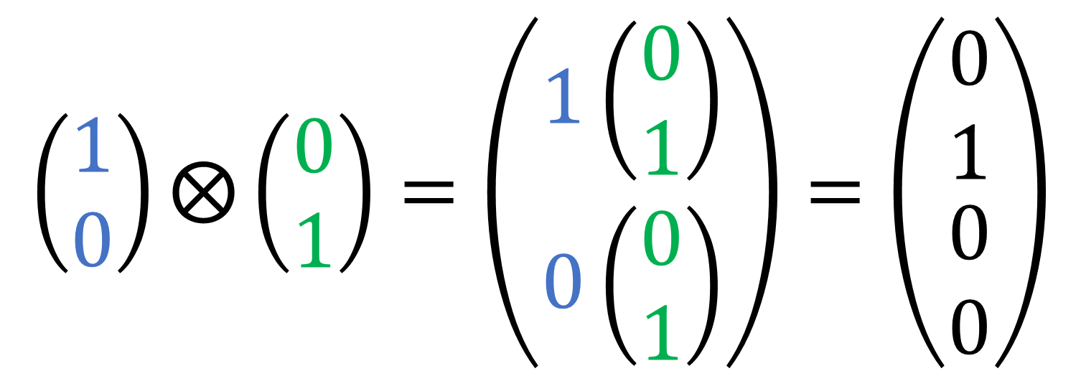
Tensor products For 2 qubits
Alternative way of thinking about the tensor product
$$\left(\begin{matrix}1 \\ 0\end{matrix}\right)⨂\left(\begin{matrix}0 \\ 1\end{matrix}\right)=\left(\begin{matrix}1\left(\begin{matrix}0 \\ 1\end{matrix}\right) \\ 0\left(\begin{matrix}0 \\ 1\end{matrix}\right)\end{matrix}\right)=\left(\begin{matrix}0 \\ 1 \\ \begin{aligned}0 \\ 0\end{aligned}\end{matrix}\right)$$
qubit 1
qubit 0
We used the same ordering here as Phil and Aman had used at dinner
This is the statevector representation of the state $|\left.01\right\rangle$

Slide 14
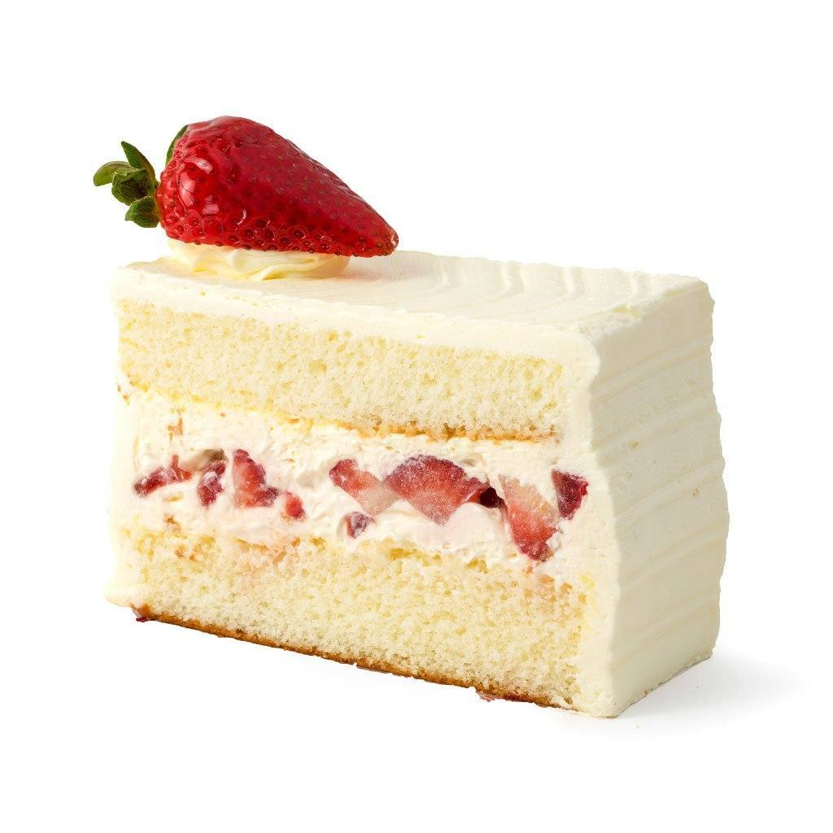
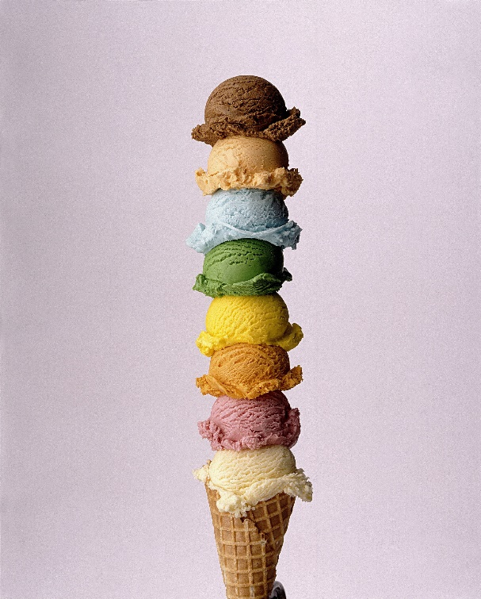
More tensor products at dinner
Rejoicing after listing down all their dinner options, Aman and Phil suddenly realize that they forgot all about dessert! They have two dessert options – cake and ice cream
can eat
and

Slide 15


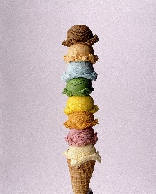


More tensor products at dinner
Here is how they decide to list out their dinner options
can eat
and
can eat
and
can eat
and
can eat
and
can eat
and
can eat
and
can eat
and
can eat
and
can eat
and
Again, order matters! No dessert before dinner

Slide 16
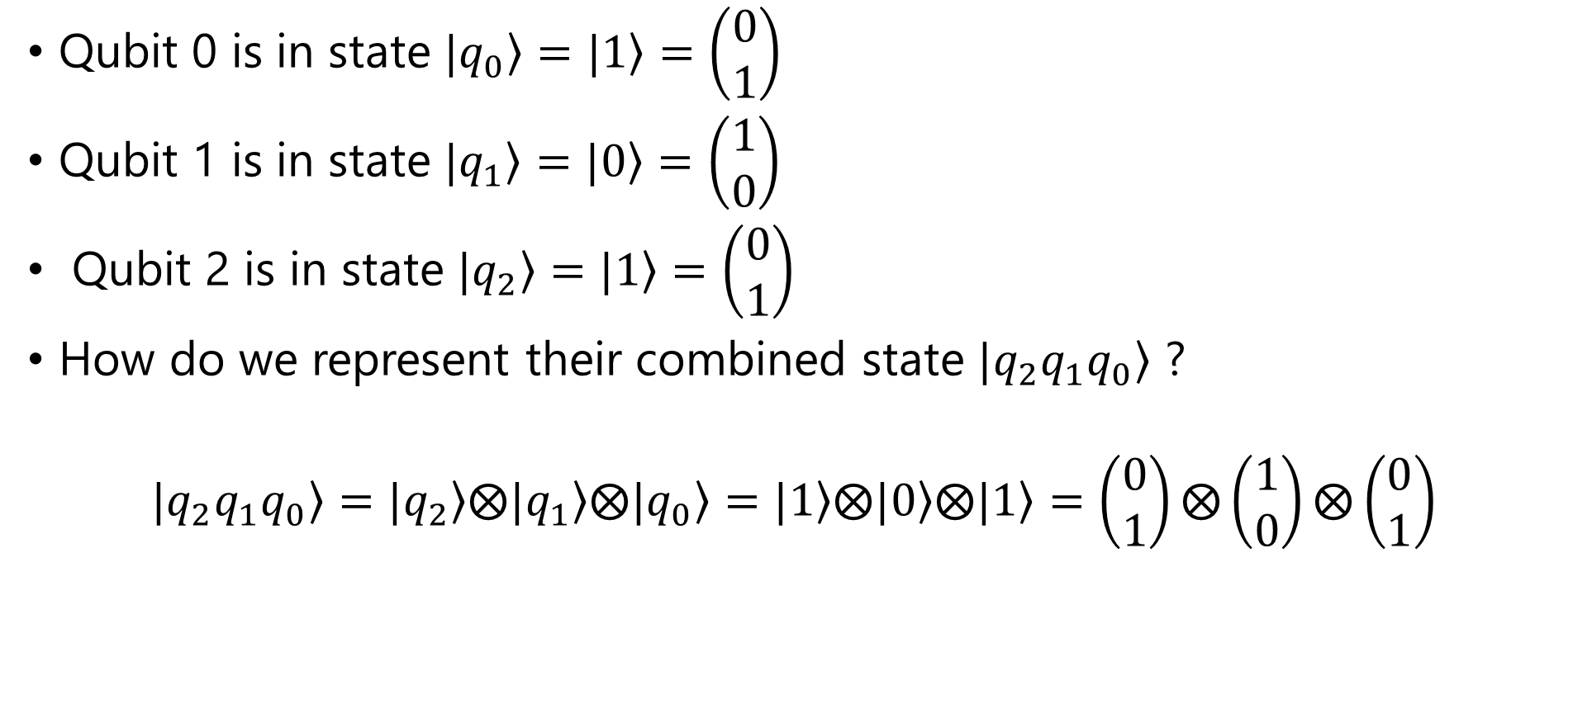
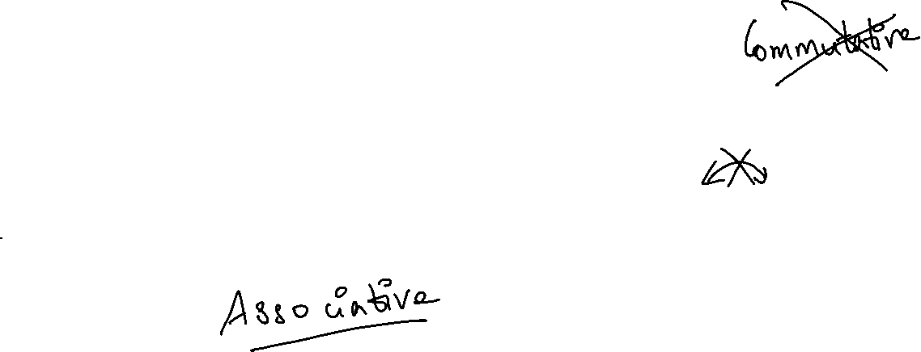
tensor products for 3 qubits
Qubit 0 is in state $|\left.q_{0}\right\rangle =|\left.1\right\rangle =\left(\begin{matrix}0 \\ 1\end{matrix}\right)$
Qubit 1 is in state $|\left.q_{1}\right\rangle =|\left.0\right\rangle =\left(\begin{matrix}1 \\ 0\end{matrix}\right)$
Qubit 2 is in state $|\left.q_{2}\right\rangle =|\left.1\right\rangle =\left(\begin{matrix}0 \\ 1\end{matrix}\right)$
How do we represent their combined state $|\left.{q_{2}q}_{1}q_{0}\right\rangle$ ?
$$|\left.{q_{2}q}_{1}q_{0}\right\rangle =|\left.q_{2}\right\rangle ⨂|\left.q_{1}\right\rangle ⨂|\left.q_{0}\right\rangle =|\left.1\right\rangle ⨂|\left.0\right\rangle ⨂|\left.1\right\rangle =\left(\begin{matrix}0 \\ 1\end{matrix}\right)⨂\left(\begin{matrix}1 \\ 0\end{matrix}\right)⨂\left(\begin{matrix}0 \\ 1\end{matrix}\right)$$

Slide 17
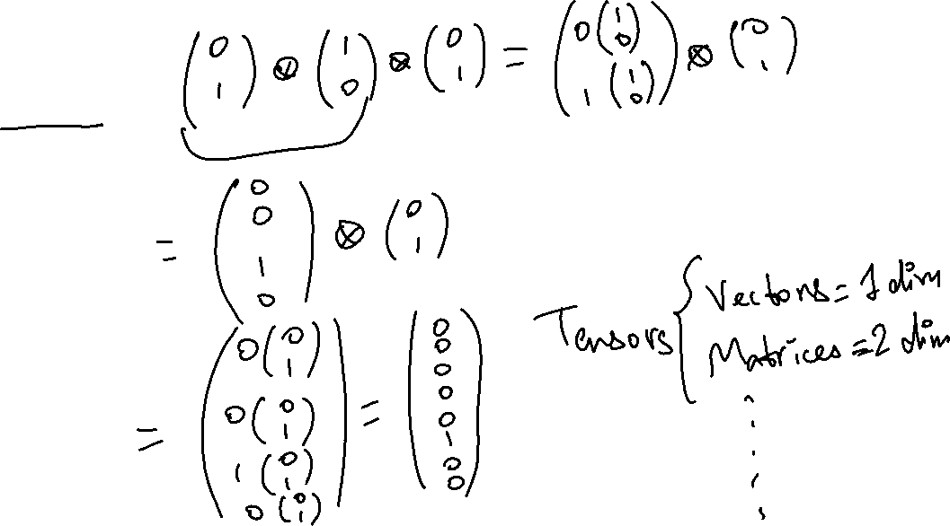
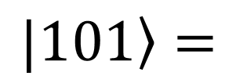
Tensor products for 3 qubits
$$|\left.101\right\rangle =$$

Slide 18
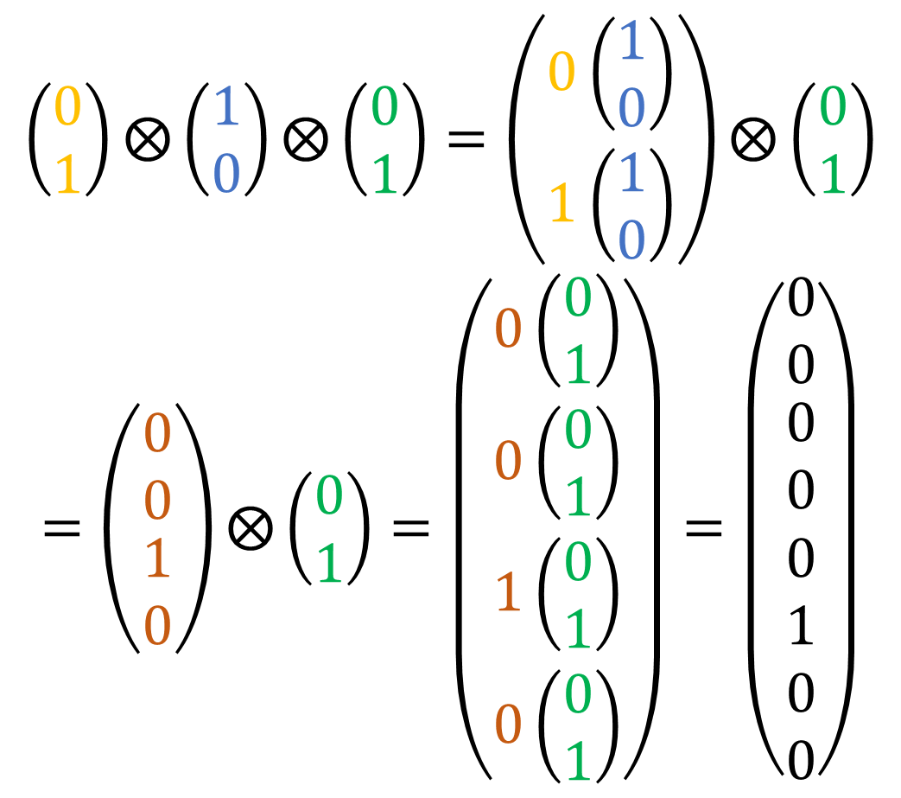
Tensor products for 3 qubits
$$\left(\begin{matrix}0 \\ 1\end{matrix}\right)⨂\left(\begin{matrix}1 \\ 0\end{matrix}\right)⨂\left(\begin{matrix}0 \\ 1\end{matrix}\right)=\left(\begin{matrix}0\left(\begin{matrix}1 \\ 0\end{matrix}\right) \\ 1\left(\begin{matrix}1 \\ 0\end{matrix}\right)\end{matrix}\right)⨂\left(\begin{matrix}0 \\ 1\end{matrix}\right)$$
$$=\left(\begin{matrix}0 \\ 0 \\ \begin{aligned}1 \\ 0\end{aligned}\end{matrix}\right)⨂\left(\begin{matrix}0 \\ 1\end{matrix}\right)=\left(\begin{matrix}0\left(\begin{matrix}0 \\ 1\end{matrix}\right) \\ 0\left(\begin{matrix}0 \\ 1\end{matrix}\right) \\ \begin{aligned}1\left(\begin{matrix}0 \\ 1\end{matrix}\right) \\ 0\left(\begin{matrix}0 \\ 1\end{matrix}\right)\end{aligned}\end{matrix}\right)=\left(\begin{matrix}0 \\ 0 \\ \begin{aligned}0 \\ 0 \\ 0 \\ 1 \\ 0 \\ 0\end{aligned}\end{matrix}\right)$$
$$|\left.101\right\rangle =$$

Slide 19
So much math ☹
This is going to become tedious!
We can use numpy to evalulate these multi-qubit statevectors
Also, qiskit evaluates statevector for us, and we can check them using statevector simulator
Let’s see this on numpy, and then on qiskit!

Slide 20
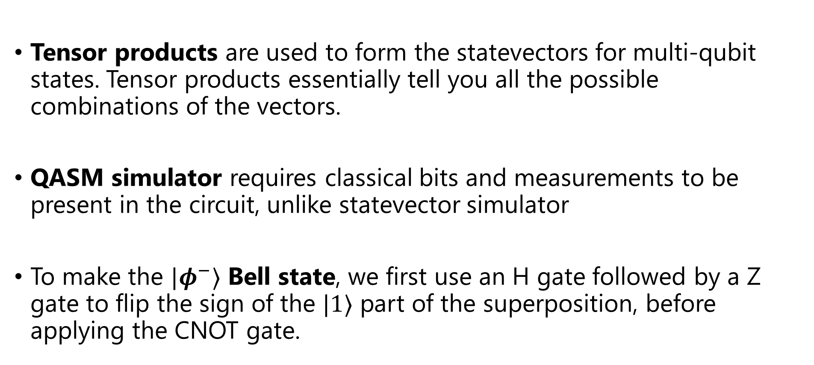
Key Takeaways
Tensor products are used to form the statevectors for multi-qubit states. Tensor products essentially tell you all the possible combinations of the vectors.
QASM simulator requires classical bits and measurements to be present in the circuit, unlike statevector simulator
To make the $|φ^{−}⟩$ Bell state, we first use an H gate followed by a Z gate to flip the sign of the $|1⟩$ part of the superposition, before applying the CNOT gate.

Slide 21
Further Reading and resources
Tensor products demystified
Lecture on tensor products and 2 qubit gates
More on bell states
Introductory notes on quantum computing
QC lectures from Prof. John Preskill

Slide 22
Post-LAB Zoom FEEDBACK
After this lab, on a scale of 1 to 5, how would you rate your understanding of this week’s content?
1 –Did not understand anything
2 – Understood some parts
3 – Understood most of the content
4 – Understood all of the content
5 – The content was easy for me/I already knew all of the content

