Slide 1
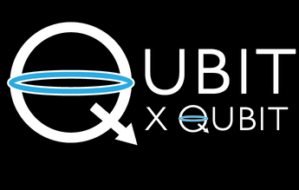

INTRO TO QUANTUM COMPUTING
Week 12 Lab
QUANTUM MECHANICS - 2
Aman Bansal
30th January 2021
© 2020 The Coding School
Notes:
1

Slide 2
PROGRAM FOR TODAY
Canvas attendance quiz
Pre-lab zoom feedback
Lab content
Post-lab zoom feedback
-2-

Slide 3
Canvas attendance quiz
Please log into Canvas and answer your lab section’s quiz (using the password posted below and in the chat).
  This is lab number: 12A
  Passcode: 5605
Thinking back to the first semester, how would you describe your experience learning the math that was introduced?
On a scale of 1-5, how did you feel about the pace of the math content?
This quiz not graded, but counts for your lab attendance!
-3-
Notes:
3

Slide 4
PRE-LAB Zoom FEEDBACK
On a scale of 1 to 5, how would you rate your understanding of this week’s content?
  1 –Did not understand anything
  2 – Understood some parts
  3 – Understood most of the content
  4 – Understood all of the content
  5 – The content was easy for me/I already knew all of the content
-4-
Notes:
4

Slide 5

Learning objectives FOR LAB 12
Answered and unanswered questions in quantum mechanics
Understanding measurement in quantum mechanics
  Double-silt experiment with electrons
  Which slit does the electron go through?
  Classical vs quantum measurement
Demystifying the Stern-Gerlach (SG) experiment
  Electron spin
  SG experiment setup
  SG experiment examples
Two-level systems*
*Optional content
-5-
Notes:
5

Slide 6
What do we not know?
The why questions
Why do electrons seem to interfere with themselves in the double-slit experiment?
Why can’t we know for sure the results of some types of experiments?
Why do electrons have spin?
…..
-6-
Notes:
These are some of the questions that we just don’t have good answers to right now. They are completely valid and legitimate questions to ask, and researchers are trying to answer them. For now, though, we only have some competing hypotheses.
6

Slide 7

What do we know?
What are the possible results we can get in an experiment with electrons/atoms/ions etc.?
What is the probability of getting each of the possible results?
How can we manipulate the probability of getting the result we want?
……
-7-
Notes:
These are questions that we do have answers to. Most of them have to do with prediction of the average results of experiments – if we run an experiment many times, how many times on average would we get a particular result? Can we change that number, and how? We know how to do all this, and you will see these answers in this class.
The set of questions that we have answers to is expanding. For example – the question “why do particles have mass” now has a partial answer – the Higgs field!
7

Slide 8
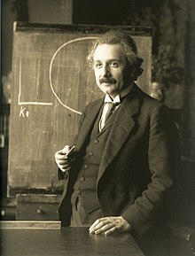


SO what do we do now?
Do the unanswered questions make you uncomfortable?
Yes, and I need to know the answers – Become a physicist and work on the foundations of quantum theory
Albert Einstein
Fabiola Gianotti
Nima Arkani-Hamed
-8-
Notes:
So, where do you lie? Do the unanswered questions make you deeply uncomfortable? If yes, you can become a physicist and work on finding those answers. Here are some people (past and present) who are in the same boat as you.
8

Slide 9


SO what do we do now?
Do the unanswered questions make you uncomfortable?
Maybe, but I want to work on applications – Become a physicist/engineer and develop uses of quantum theory (such as quantum computing!)
….and some of the TAs!
Clarice D. Aiello
Subir Sachdev
-9-
Notes:
Maybe you want to focus more on applying the answers we already have to new fields, and developing new applications of quantum theory. Again, you’re in great company!
9

Slide 10
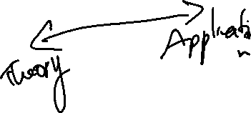
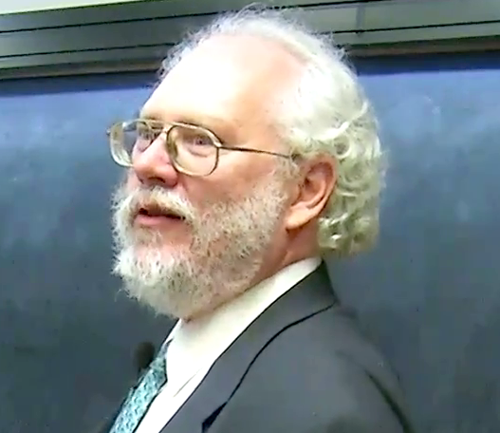

SO what do we do now?
Do the unanswered questions make you uncomfortable?
No, I just want to run Shor’s algorithm – Become a quantum computer scientist!
….and some of the TAs!
Peter Shor
Lov Grover
Zoom Poll
-10-
Notes:
Or, maybe you don’t care about foundational questions and just want to get on with quantum computing. That’s okay too! We’re not saying that the people in these images don’t care about the foundational questions, just that their work is much more about developing quantum algorithms for specific computing tasks. (Tas can ask students where they lie, and describe their own perspective).
Also, these are not the only responses. People are often in between these different stances – they are in a superposition!
10

Slide 11

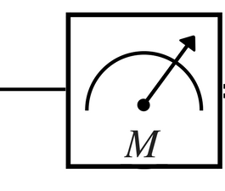
Measurement in computing
Measurement is the final step of any computation (classical or quantum)
Classical computing
Output
“1”
Result
“1”
measurement
Quantum computing
Output state
Result
measurement
-11-
Notes:
In this lab, we’ll discuss measurement. In the classical world, we don’t think about measurement because its pretty straightforward- what you see is what you get. We don’t really think about measuring the bit at the end of a classical computation, although that step is always there. In the quantum world, things are trickier – measurement can affects the outcome of the experiment! So we have to be very careful when we make the measurement.
11

Slide 12
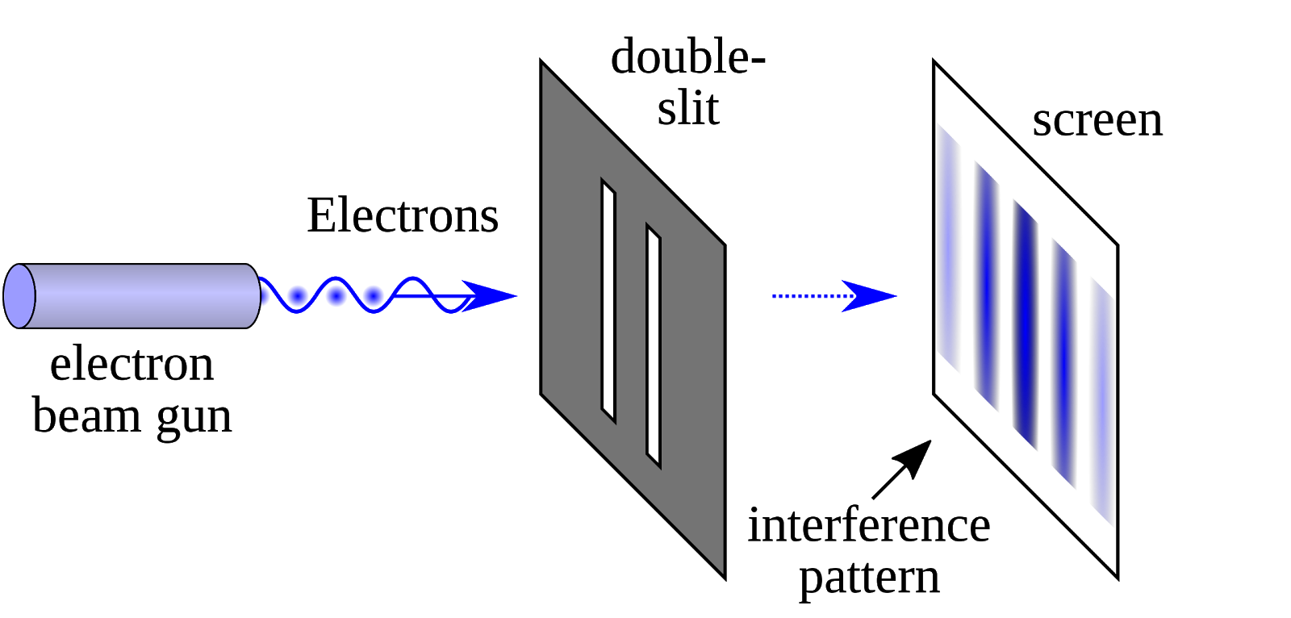
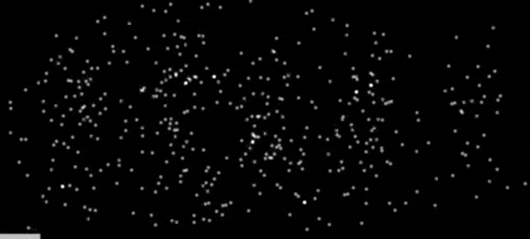
Double-slit experiment revisited
We can send the electrons one-by-one through the double slit
We still get the interference pattern!
Screen
-12-
Notes:
Here’s the double slit experiment we saw last week. As we had discussed in the optional content, we can send the electrons through the experiment one-by-one, and we still get the intereference pattern! You can see that in this gif. A question you might ask is – which slit did the electron take? What path did it take between the gun and the screen?
12

Slide 13
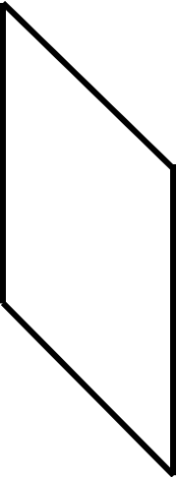

Which path does the marble take?
screen
1
2
Gumball gun
left
right
Did the gumballs go through the left slit or the right slit?
-13-
Notes:
Well, let’s think about a shooting a gumball gun at two slits. We have two gumballs on the screen -1 and 2. 1 is a bit on the left, and 2 is a bit on the right. Which slit did 1 take, and which slit did 2 take?
13

Slide 14
Which path does the Electron take?
screen
1
2
left
right
Did the electrons go through the left slit or the right slit?
-14-
Notes:
If we swap out the gumball gun for electrons, could we apply the same logic? Can we say that 1 took the left slit and 2 the right?
14

Slide 15
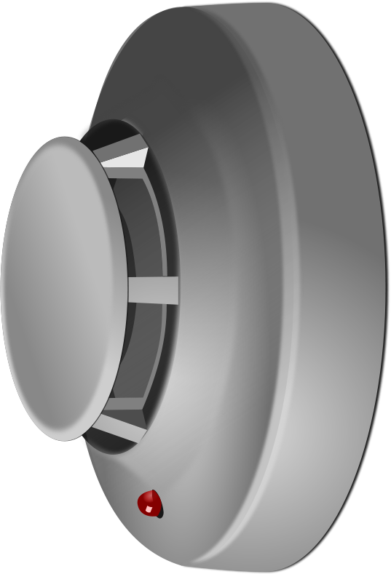
Let’s find out!
If the left slit electron sensor senses an electron zipping by, it beeps
If the right slit electron sensor senses an electron zipping by, it beeps
Left slit electron sensor
Right slit electron sensor
-15-
Notes:
We can find out! Let’s put a little electron sensor next to the slits. The job of this sensor is to give a beep when it senses an electron passing by. These sensors are like smore detectors – when they detect the presence of an electron, they beep.
15

Slide 16

Let’s find out
screen
1
2
left
right
As each electron goes through the slits, either the left slit or the right slit detector beeps
Yay! We did it! We can now tell for sure which slit each electron goes through
-16-
Notes:
We can run this experiment, and it works! We can now tell which slit each electron passed through – the left or the right. We can now say that 1 passed through the left slit and 2 the right. We did it!
16

Slide 17

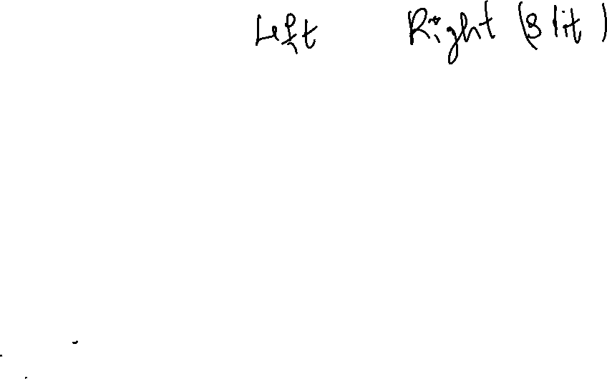
…and what happens at the screen?
What do you notice?
-17-
Notes:
And what’s happening at the screen? Let’s take a look.
The pattern changes! Instead of multiple bright and dark lines, we only get 2. We now just have a shadow of the slits – the same result that we would get with gumballs. The interference is no longer there!
17

Slide 18
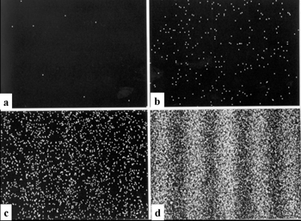
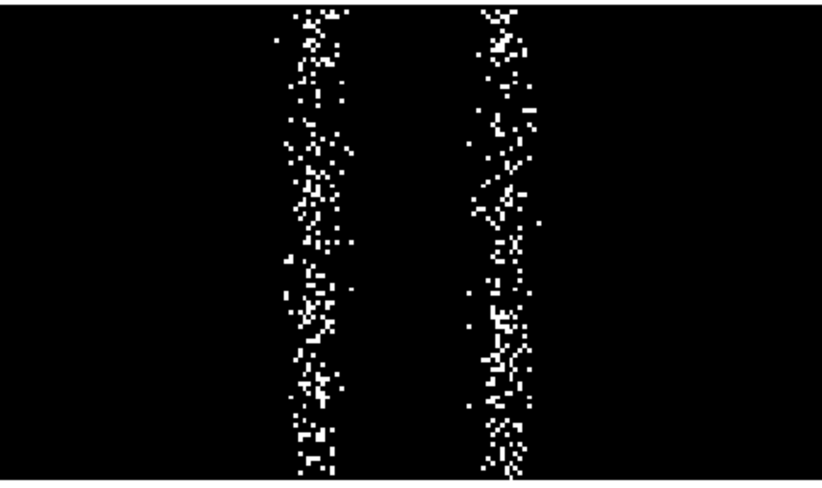
Measurement changes the outcome!!
Without electron sensors
With electron sensors
Trying to find out which slit the electrons went through changed the outcome of the experiment!
Measurement changes the state of each electron
-18-
Notes:
So, to summarize, without the electrons sensors we had our beautiful interference pattern. With the sensors, the pattern disappeared and we just got the shadow of the slits! This is what’s weird about measurement with quantum objects – it changes the state of the thing you’re trying to measure. It affects the result you get!
18

Slide 19
With gumballs
Without gumball sensors
With gumball sensors
No change in outcome of experiment if you check which slit the gumball takes
-19-
Notes:
This is not true with gumballs! If you have a friend check which slit each gumball went through, that’s not going to change what you get. You’ll just get 2 lumps of gumballs each time.
19

Slide 20
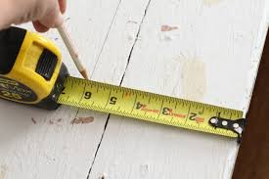
Everyday life vs quantum
Everyday life
Quantum
Measurement does not affect the thing being measured – everyday objects
Measurement can affect the state of the thing being measured – quantum objects (qubits)
-20-
Notes:
In summary, in our everyday experience, measurement does not affect what is being measured. But in the quantum world this is no longer true – measurement can affect the thing being measured. So, when we measure qubits, that measurement affects their state! We have to be very careful when we make such a measurement.
20

Slide 21
Questions?
Questions on content so far?
-21-

Slide 22
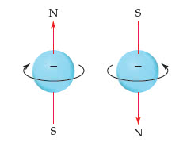

Electron spin
Fundamental properties of an electron (and other particles):
  Mass
  Charge
  Magnetic field (spin)
  ….
Spin does not correspond to actual spinning
….misleading
-22-
Notes:
Let’s look at an example of measurement on something that can be used as a qubit – the spin of an electron. Spin is just a little bit of magnetic field that all electrons have. It is as fundamental a property as mass and charge. Analogy - humans have properties (weight, height, thoughts), so do fundamental particles. Importantly, spin does not correspond to electrons actually spinning. You can think of it as just a small bar magnet, pointed in a particular direction.
22

Slide 23
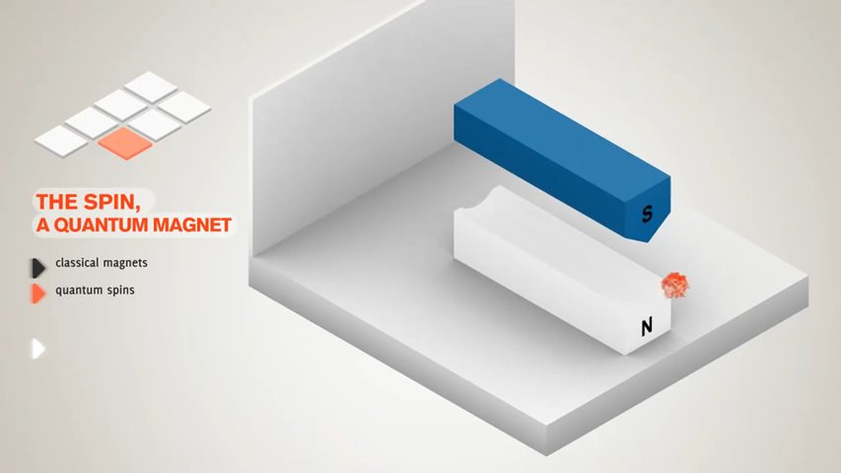

Measuring spin – the stern Gerlach expt.
Since spin corresponds to a small magnetic field, we can use another magnet to measure it!
When measured, spin always has two directions – one along the direction of the magnetic field and one opposite to it
screen
Stern-Gerlach magnets
electron
-23-
Notes:
The stern Gerlach experiment that you saw in lecture this week is meant to measure this spin. Since spin is a magnetic field, we can use another external field to measure it! This is like when you play with two magnets – they either attract or repel, and you can get a sense of how strong the magnets are by how much they attract or repel each other. Importantly, when spin is measured, the little magnetic field only ever shows two directions – it either points in the same direction as the external field, or the opposite direction.
23

Slide 24
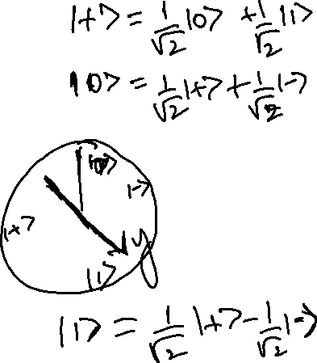
Note on notation
Measurement along z (vertical) axis:
Measurement along x (horizontal) axis:
“spin-up”
z-axis
“spin-down”
x-axis
“spin-right”
“spin-left”
-24-
Notes:
Before we do some examples, a quick note on notation. We can measure spin along any direction – in lecture, you saw examples of it being measured along z and x. When we say “the spin is measured along z”, we mean that the SG magnets are oriented such that their magnetic field is along z, as shown here. It points vertically! As we discussed before, we get two results from this measurement – the electron spin either points in the direction of +z, which we call up spin or zero, or opposite to the direction of z, which we call down spin or 1. We’ve already introduced the vector notation for these states in the previous semester. Instead of orienting the magnets vertically, we could orient them side to side along the x axis! Then, we’d again get two results, which we call spin right and left, or + and -.
24

Slide 25
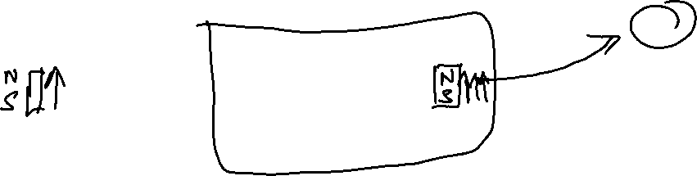
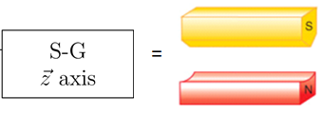
Stern Gerlach Experiment
Where does the electron go?
z-axis
1
4
2
5
x-axis
electron state:
(spin pointing up along z)
3
-25-
Notes:
So, let’s look at an electron that we have prepared to be in the state with its spin pointing up along the z direction. We pass it through an SG magnet with its field also aligned along z. It will go to point 1 on the screen.
25

Slide 26
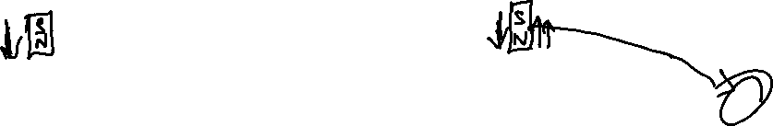
Stern Gerlach Experiment
Where does the electron go?
z-axis
1
4
2
5
x-axis
electron state:
(spin pointing down along z)
3
Zoom Poll
-26-
Notes:
What about if the spin was pointing down along the z direction – where would the electron go?
26

Slide 27
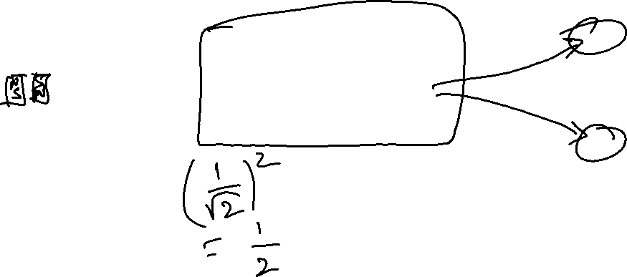
Stern Gerlach Experiment
Where does the electron go?
z-axis
1
4
2
5
x-axis
electron state:
(spin combination of up and down along z)
3
Zoom Poll
-27-
Notes:
What if the state was a combination of up and down? We know that such combination or superposition states are what make qubits special. Where would this electron go?
We can’t predict the result of this experiment! We can only say that the electron would go to 1 with prob. ½ and to 3 with prob. ½. Point out that it would be true for any combination – always get either 1 or 3.
27

Slide 28
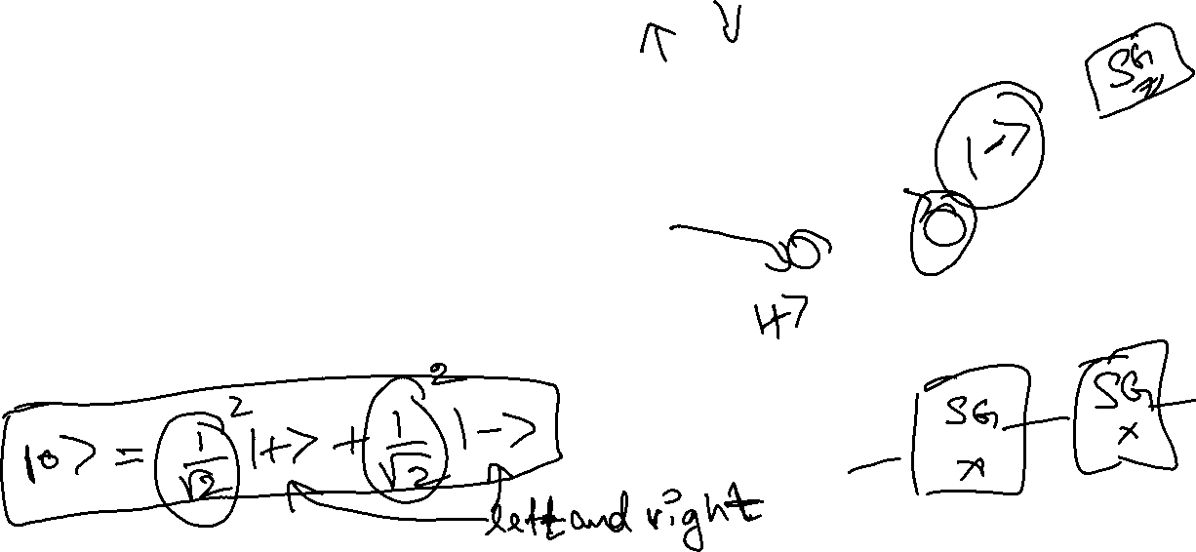
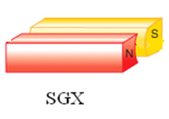
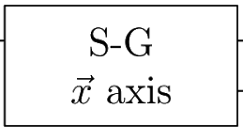
Stern Gerlach Experiment
Where does the electron go?
z-axis
1
4
2
5
x-axis
electron state:
(spin pointing up along z)
3
Zoom Poll
-28-
Notes:
Ok, now let’s rotate the magnet. Again, we have the electron in the same state of spin pointing along the positive z direction, but now the SG magnet is oriented side to side, and points along x. Where does this electron go?
Again, we can’t be sure! We can only say that it goes to 2 half the time and to 4 the other half of the time. TAs can write the implication – the up state can be expressed as a combination of + and -.
This is another example of how measurement affects the result we get! We have the same state 0, but depending on how the magnet is oriented, we get different results.
28

Slide 29
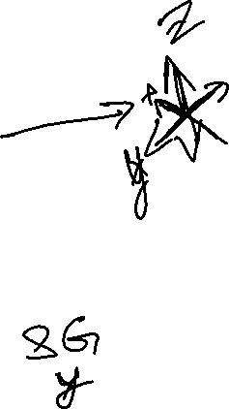
Key Takeaways
Measurement in the quantum world is different from everyday life
  Measurement affects the state of the quantum system being measured
  Results from different ways of measurement may not always agree
  Interference pattern disappears if you try to find out which slit the electron takes!
The Stern-Gerlach experiment measures the spin of the electron/quantum system
  When measured, spin always has two directions – one along the direction of the external magnetic field, and one opposite to the direction
  The result depends on the orientation of the SG magnet!
-29-

Slide 30
Further Reading and resources
https://www.youtube.com/watch?v=b_ddt6J1Bio – Series of videos introducing quantum mechanics
https://www.youtube.com/watch?v=NW7VUFgwqg8 – Quantum systems might aid bird navigation
https://ocw.mit.edu/courses/physics/8-04-quantum-physics-i-spring-2013/lecture-videos/lecture-1/ - Lecture on measurement and its implications, with analogies from our everyday experience
https://cp3.irmp.ucl.ac.be/~maltoni/PHY1222/mermin_moon.pdf - Accessible paper on measurement, entanglement, and their implications
-30-

Slide 31
Questions?
Questions on content so far?
-31-

Slide 32
Post-LAB Zoom FEEDBACK
After this lab, on a scale of 1 to 5, how would you rate your understanding of this week’s content?
  1 –Did not understand anything
  2 – Understood some parts
  3 – Understood most of the content
  4 – Understood all of the content
  5 – The content was easy for me/I already knew all of the content
-32-
Notes:
32

Slide 33
Optional content
-33-

Slide 34
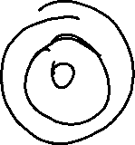
Two-level systems
Why do we care about two-level systems in quantum computing?
Qubits are two-level systems!
Analogous to classical bits, than can be 0 or 1
Wouldn’t 3 or more-level systems be even better? Yes! But really hard to control more than 2 states in experiments
-34-
Notes:
Why should you care about two level systems in QC? Because all qubits are 2 level systems!
Wouldn’t having 3 or more levels be better? Theoretically, yes! But it is really hard to do practically – controlling quantum system with many levels is a hard engineering problem. Think of it like a piano – if you had a piano with just 2 keys, its pretty easy to play. If you had one with many more keys, it is much more complex to play, although in principle you can make much more beautiful music out of it.
34

Slide 35
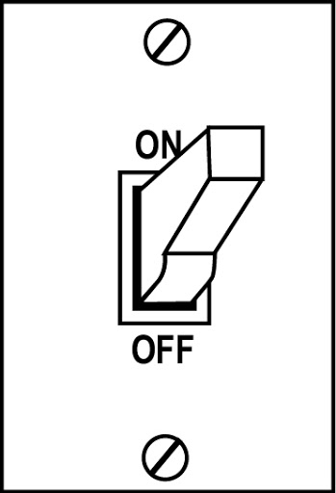
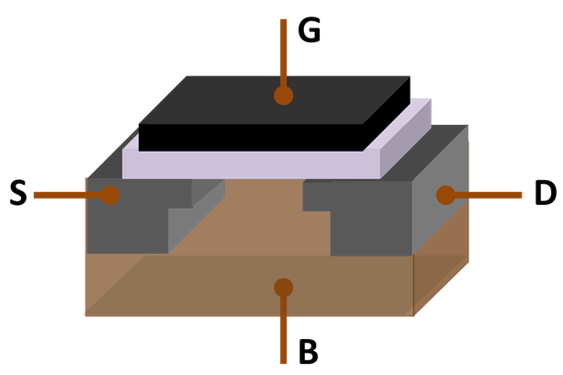
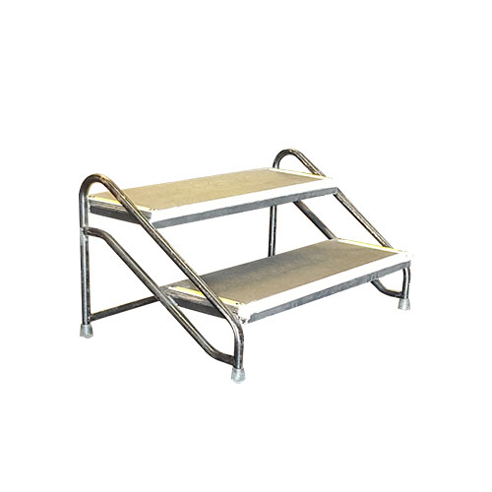
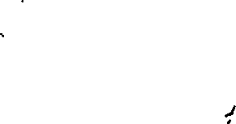
2 level-systems around us
Transistor
-35-
Notes:
Here are some examples of 2 level systems around us. These are “classical”
35

Slide 36
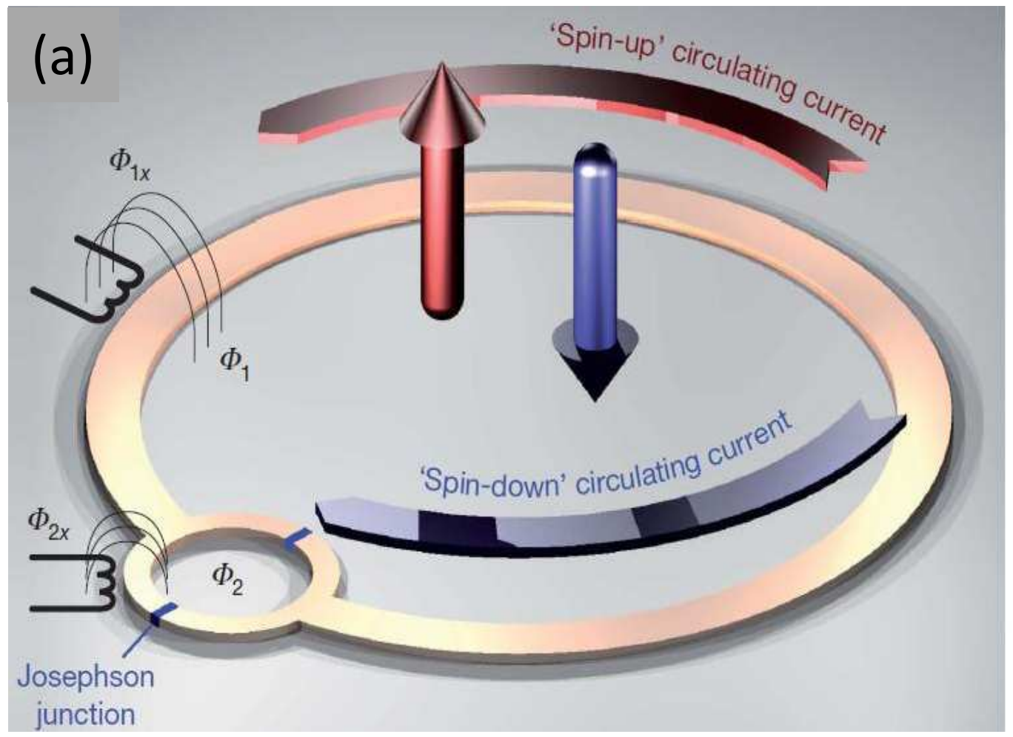
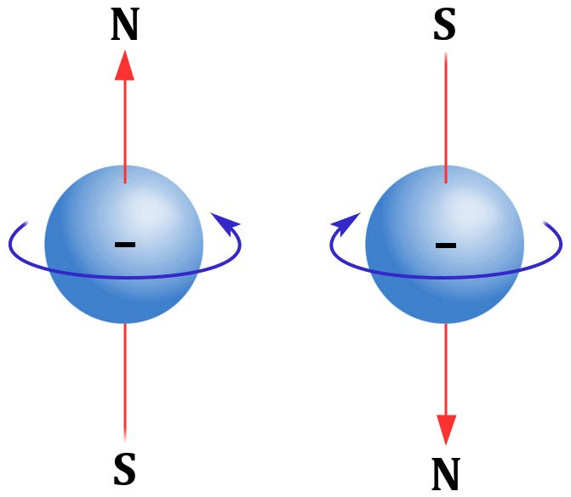
2 level systems in the quantum world
Double-slit experiment
Current in a superconducting circuit
Electron spin
Image from Smelyanskiy et al., arXiv:1204.2821v2 [quant-ph]
-36-
Notes:
Here are some quantum 2 level systems. What’s different about them is that they can exist in a combination of the two levels, which classical ones can’t.
36

Slide 37
Quantum vs Classical 2 level systems
Quantum
Classical
Either 1 or 0
ON: 1
OFF: 0
Either 1, or 0, or a combination of both!
Only spin pointing down:
Only spin pointing up:
Combination of both:
-37-
Notes:
37

Slide 38

Quantum vs Classical 2 level systems
Quantum
Classical
Either 1 or 0
ON: 1
OFF: 0
Either 1, or 0, or a combination of both!
Only Shankar plays:
Only Menuhin plays:
Both play together:
-38-
Notes:
Quantum 2 level systems are kinda like 2 musicians collaborating – each can play individually, but they can play together as a combination, and that increases the possibilities!
38

