Slide 1
Video Streaming System
CIT3495 · PROJECT 1 · OPTION 2
Containerised microservices: upload, authenticate, store and stream video with Docker Compose
Node.js · Python · MySQL 8.4
Notes:
Introduce the project: we chose option 2, the video streaming system. Five containers, two programming languages (Node.js and Python), one Compose file. The talk covers what it does, how it is built and secured, and the evidence: failure tests, persistence, performance and CI/CD. Then a live demo.

Slide 2





Five services, one Compose file
Upload Video web app
Video Streaming web app
Node.js 22 · port 8081
Node.js 22 · port 8082
Login, streamed uploads, content checks, admin users
Catalogue from MySQL, playback with seeking
Authentication Service
File System Service
Python 3.12 · internal
Node.js 22 · internal
scrypt passwords, JWT, roles, login lockout
Atomic writes and Range reads on a volume
MySQL database
Users and video metadata, one least-privilege account per service, data on a named volume
MySQL 8.4 · internal · official image
Notes:
Five services: four we wrote plus MySQL from the official image, matching the five boxes in the brief. Walk through why each language: Node.js for the three I/O-heavy services (both web apps and the file service), because its streams handle uploads and Range downloads with backpressure; the file service uses no npm packages at all. Python for auth because of mature JWT and hashing libraries. MySQL stores users and video metadata.

Slide 3
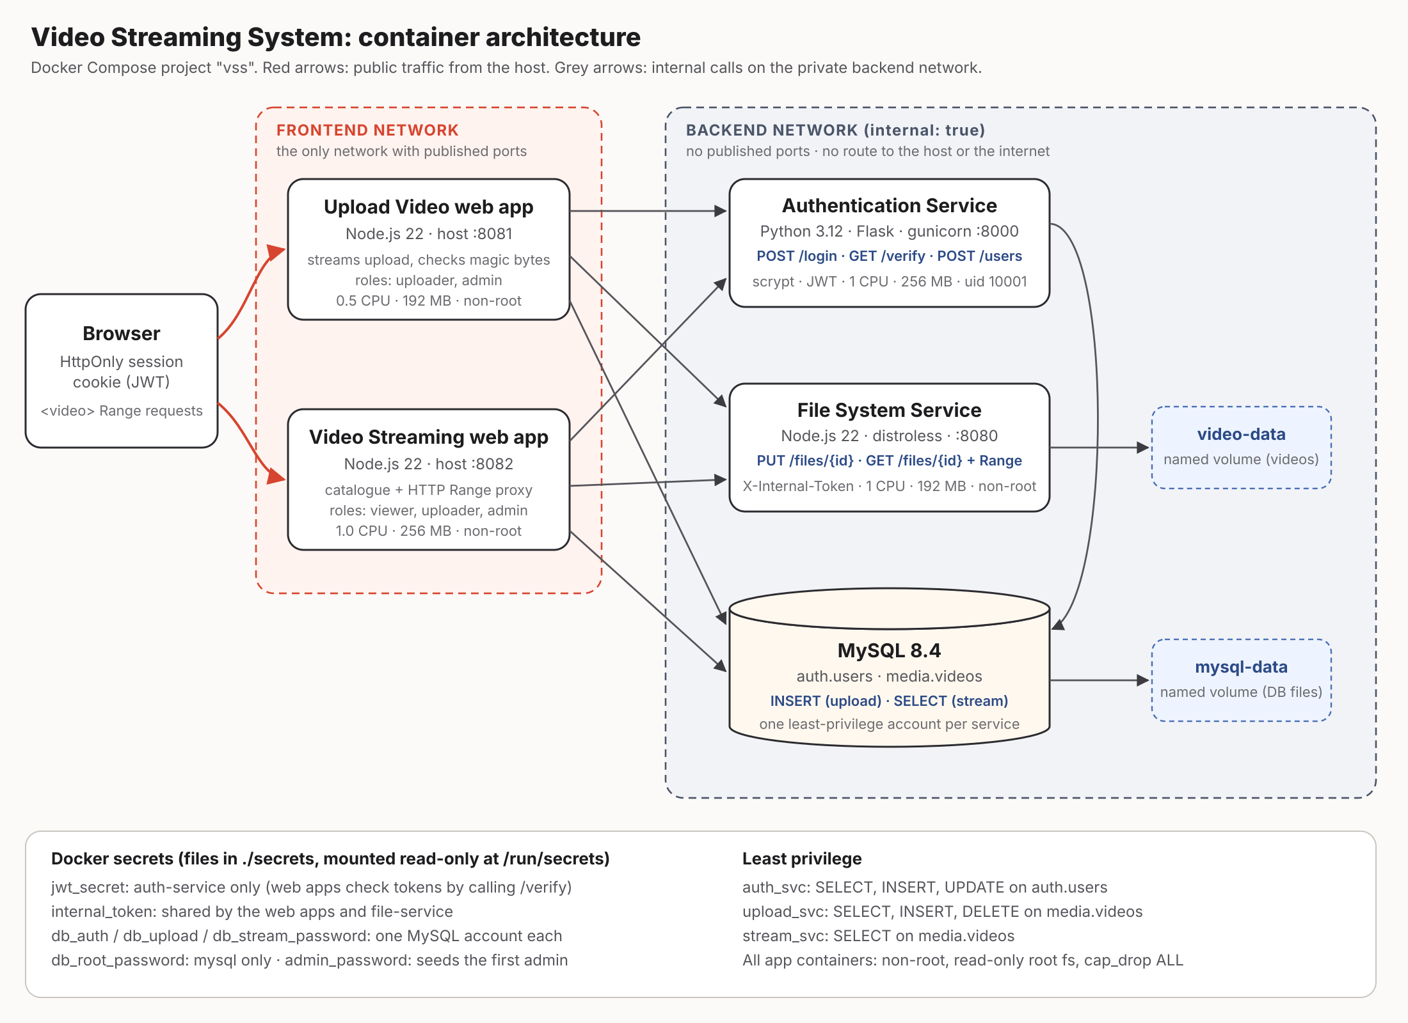
Architecture
Two networks
Only the web apps join the public frontend network
backend is internal
MySQL, auth and file service have no published ports and no internet route
Secrets as files
Seven Docker secrets mounted at /run/secrets
Notes:
Explain the diagram. Red arrows are the only traffic that reaches the system from outside: ports 8081 and 8082. Everything else sits on the backend network, which is internal: true, so it cannot be reached from the host and cannot reach the internet. The web apps are the only bridge. Web apps validate sessions by calling the auth service, so only auth holds the JWT signing key.

Slide 4
How a video moves through the system
1
2
3
4
5
Upload
Check session and role
Validate title, type, size
Check magic bytes
Stream to file service
Insert metadata (or roll back)
1
2
3
4
5
Watch
Check session
List videos from MySQL
Browser sends Range
Forward Range to file service
Pipe 206 bytes back
The video is streamed end to end and is never held whole in memory.
Notes:
Upload: the browser sends the raw file; metadata travels in headers so the body can be streamed. A magic-byte check rejects a renamed .exe after the first 12 bytes. The file service writes to a temp file, fsyncs, and publishes it atomically with a hard link, which can never overwrite an existing video. If the MySQL insert fails, the file is deleted again: a compensating action so storage and metadata never disagree. Watch: the video tag sends Range requests; we forward Range to the file service, which answers 206 Partial Content, so seeking works without downloading the whole file.

Slide 5
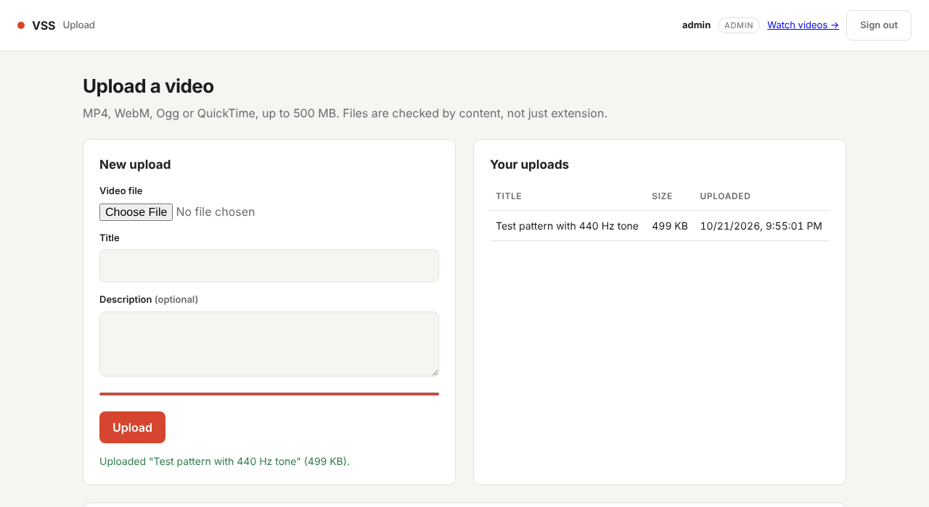
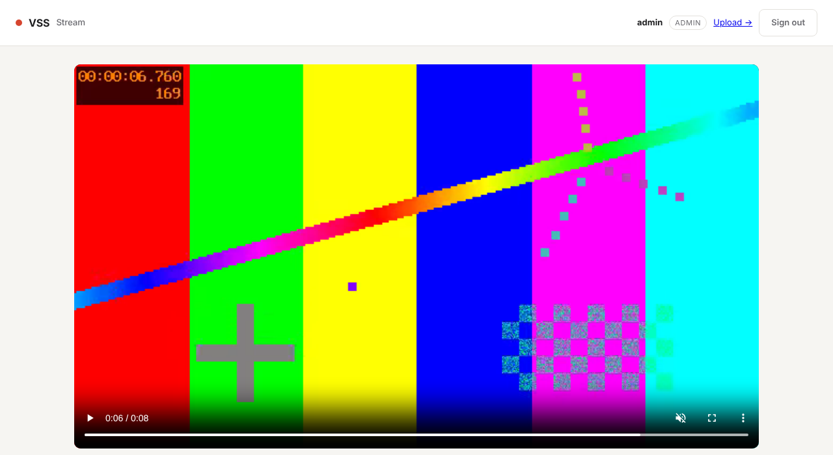
The two web apps
Upload app :8081
Streaming app :8082
Upload with progress, list of your uploads, admin form to create uploader accounts
Paged library and HTML5 player; seeking triggers Range requests
Notes:
These screenshots come from a real browser run: a WebM test video was uploaded through the UI, then played and seeked in the streaming app. Switch to the live demo here if time allows: log in as admin, create an uploader, upload, then watch as a self-registered viewer and show that the viewer gets 403 on upload.

Slide 6






Dockerfiles built for size, speed and safety
Multi-stage, all 4 images
Small bases
Cache-friendly layers
build → test → runtime; only the runtime stage ships
distroless Node for the file service, alpine for the web apps (npm removed), slim for Python
Dependency manifests copied before source, plus BuildKit cache mounts
amd64 + arm64
Non-root
Health checks
buildx multi-arch; every base image exists for both, no native modules to compile
uid 10001, node, distroless nonroot; read-only root fs, cap_drop ALL
Built into each image; no curl needed, a small Node script probes /healthz
Notes:
Every Dockerfile has a test stage, so CI tests the image exactly as built. Layer ordering: package files are copied and installed first, so editing code does not reinstall dependencies. Multi-arch: buildx builds amd64 and arm64; all dependencies are pure JavaScript or pure Python, so nothing is compiled per architecture.

Slide 7
Optimisation: naive vs optimised Dockerfile
 | Dockerfile.naive | Dockerfile (optimised)
Base image | node:22 (full Debian image) | distroless Node / node:22-alpine
Stages | One: npm, compilers and shell ship | Build, test, runtime
Layer order | COPY . . then install | Manifests first, deps cached
Runs as | root | Non-root, read-only fs
Size / build time | Your measured number | Your measured number
Run ./scripts/measure-images.sh and paste the size and build-time numbers from results/image-metrics.md
Notes:
IMPORTANT: replace the red "Your measured number" cells with the output of scripts/measure-images.sh before presenting. It builds both Dockerfiles cold (--no-cache), edits one source line and rebuilds warm, and records the image size. Expect the file-service image to drop from roughly 1 GB (full Debian node:22) to a fraction of that on distroless Node, and the warm rebuild of the naive Node image to re-run npm install while the optimised one reuses the cached layer.

Slide 8

Private by default, data that survives
Networking
Persistence
Only ports 8081 and 8082 are published
backend network is internal: true
File service also requires an internal token
e2e test proves 3306, 8000, 8080 refuse from the host
mysql-data volume: users and metadata
video-data volume: the video files
Test: delete and recreate mysql + file-service containers
Login works, metadata listed, same sha256
Notes:
Networking: Docker gives an internal network no gateway, so MySQL, auth and the file service are unreachable from outside. Persistence: scripts/persistence-test.sh uploads a file, records its sha256, removes the stateful containers with docker compose rm, brings them back, and checks that the user, metadata and exact bytes survived. Show results/persistence-test.txt.

Slide 9





Security in layers
No hard-coded secrets
Least-privilege DB
Roles enforced server-side
Random secrets generated locally, mounted as Docker secrets, git-ignored
One MySQL account per service; streaming is SELECT-only
viewer, uploader, admin; 401 vs 403 tested
Sessions
Input validation
Scanned images
HttpOnly SameSite=Strict cookie, scrypt hashes, lockout after 5 failures
Type allow-list, magic bytes, size caps, UUID ids, parameterised SQL
Trivy in CI; fixable CRITICAL findings fail the build
Notes:
Secrets are files, not environment variables, so they do not show in docker inspect. Self-registration always creates a viewer, even if the request asks for admin. Forged, expired and alg:none tokens are rejected (unit-tested). CSRF: SameSite=Strict plus a required X-Requested-With header. Validation errors return field names only, never the submitted password. Scan results: paste the table from scripts/scan.sh into the report and be ready to explain any remaining findings.

Slide 10
Failure tests: degrade, then recover
Situation | Catalogue | Stream | Login | Recovery
All up | 200 | 206 | 401* | -
Auth down | 200 | 206 | 503 | Signed-in users keep working (30 s cache)
Auth + files down | 200 | 503 | 503 | Catalogue still served
Files restarted | 200 | 206 | 503 | Streaming back in 1 s, no app restart
MySQL stopped (Docker) | 503 | - | 503 | Pools reconnect when MySQL returns
* 401 = wrong password correctly rejected, so auth is healthy. Measured on native processes; ./scripts/failure-test.sh reruns it in Docker and times recovery.
Notes:
Key design point: Docker health checks use liveness, not readiness. If a web app reported unhealthy whenever MySQL was down, every container would go unhealthy and restarts would cascade. Instead /readyz shows which dependency is down, and the apps return 503 with a clear message and reconnect on their own. Scenario 3 in the Docker script kills the auth process and shows Docker's restart policy bringing it back (RestartCount increments).

Slide 11
Resource limits and logs
Service | CPU | Memory | Why
mysql | 1.0 | 768 MB | 256 MB buffer pool
auth-service | 1.0 | 256 MB | scrypt is CPU-bound; ≤61 MB/worker
file-service | 1.0 | 192 MB | ≤120 MB measured peak
upload-web | 0.5 | 192 MB | Uploads streamed
streaming-web | 1.0 | 256 MB | Busiest service
Structured JSON logs
Request ID follows a request across all services
No bodies, cookies or tokens logged
0 secret values found in any log
Rotation: 3 × 10 MB per container
"msg":"auth service unreachable", "err":"ECONNREFUSED"
Notes:
Limits are justified by measured memory: the file service peaked at about 120 MB with 8 parallel full-file downloads, so its limit was raised from 128 to 192 MB; auth peaked at 61 MB per worker. Every container also has a pids limit of 100. Logs are one JSON line per event; the web apps pass X-Request-ID to auth and file service, so grep for one id shows a whole user action.

Slide 12
Two changes, 3× the throughput
0 %
errors in every run
−67 %
average latency (38.2 → 12.5 ms)
63 % → 0 %
auth CPU: the bottleneck removed
Notes:
Method: the same k6 script and seed data, one change per run. In the baseline every request called the auth service, and that single Python process hit 63% CPU: it was the bottleneck. Caching successful verifications for 30 seconds removed auth from the hot path: 2.6x. Keep-alive connection reuse to internal services then gave another 18% and cut p95 latency by 24%. Measured on native processes on a 2-vCPU VM with an in-memory store instead of MySQL; scripts/loadtest.sh repeats it in Docker. Trade-off to mention: a disabled account keeps access for up to 30 s.

Slide 13
Faster file reads, lower latency
Improvement 3: read buffer
+73 %
throughput, −42 % latency, same CPU
Normal load (0.2 s think time)
3.9 → 1.3 ms
average latency with the verify cache (p95 8.7 → 3.1 ms)
Notes:
Third improvement: Node file streams read 64 KiB at a time by default, so an 8 MB video costs 128 trips through the event loop. Reading 1 MiB at a time means 16x fewer chunks: the same CPU (one event loop at ~100%) moves 73% more data with 42% lower latency. Memory barely changed because it is dominated by socket buffers. Right: under normal load with think time, throughput is set by the users, so the cache shows up as latency, down two thirds. Keep-alive made no measurable difference at this light load; its benefit appears at saturation (previous slide).

Slide 14
CI/CD pipeline on every push
01
02
03
04
05
06
Test
Test stage
Build
Scan
Tag
Publish
Python and Node unit tests
Tests run inside each image
buildx, layer cache
Trivy: SARIF + CRITICAL gate
sha-xxxx, branch, semver, latest
GHCR, amd64 + arm64, SBOM
Parallel e2e job
Starts the full stack with docker compose up --wait and real MySQL, then runs e2e.sh, persistence-test.sh and failure-test.sh. Results are uploaded as a build artifact.
Notes:
Pull requests run everything but push nothing. Pushes to main publish images tagged with the short commit SHA (immutable and traceable), the branch name, and latest; v* git tags add semver tags. Login uses the per-run GITHUB_TOKEN, so there are no stored credentials. Show a screenshot of a green run and the GHCR package page with both architectures.

Slide 15
What the tests prove
35
17
1
unit tests
end-to-end checks
browser flow
Auth 13 · files 7 · upload 10 · streaming 5
All real services, including 401 / 403 / 415 cases
Chromium: upload real video, play, seek
Highlights: forged and alg:none tokens rejected · an .exe renamed to .mp4 rejected · failed DB insert removes the stored file · oversize upload leaves no partial file · path traversal blocked
Notes:
All passing at hand-in. Unit tests need no database: repositories are injected, with in-memory fakes. The end-to-end smoke test runs inside the Compose network in Docker, so it also checks that internal services cannot be reached from the frontend network.

Slide 16
Run it from a clean machine
./scripts/init-secrets.sh --show-admin
docker compose up -d --build --wait
open localhost:8081 (upload) and localhost:8082 (watch)
Questions?
Notes:
Likely questions: Why not validate JWTs locally? It would share the signing key with every web app and lose instant revocation; the 30 s cache gives most of the speed. Why a token on the file service if the network is private? Defence in depth. What if the DB insert fails after upload? The file is deleted and the user gets 503. How would it scale? The web apps are stateless: scale them behind a load balancer, and move files to object storage behind the same API. Production? TLS with COOKIE_SECURE=true, orchestrator secrets, restart on unhealthy, HLS transcoding.

