Slide 1
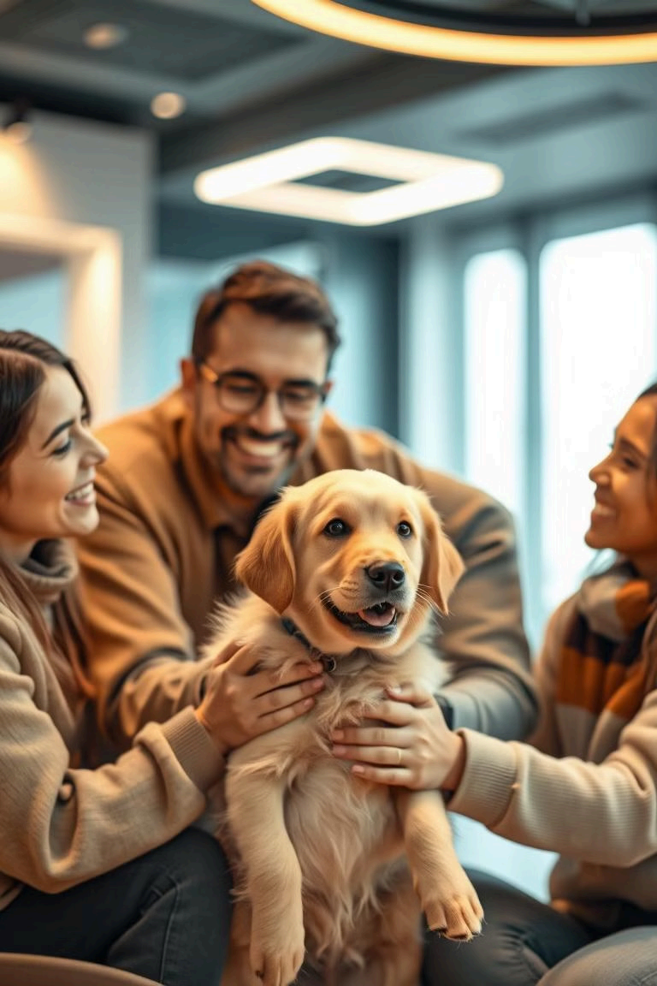
Submitted by: Arshdeep 2210991364 Arshdeep Singh 2210991366 Ishika 2210991686 Ishika 2210991688
Pet Adoption System: A MERN
Project
Submitted to :-
Dr. Rahul Singh Rajput

Slide 2

Problem Statement
Every year, millions of animals end up in shelters, with many struggling to find a loving home. Traditional pet adoption processes are often inefficient, relying on outdated methods like in-person visits, paper applications, and limited outreach.

Slide 3

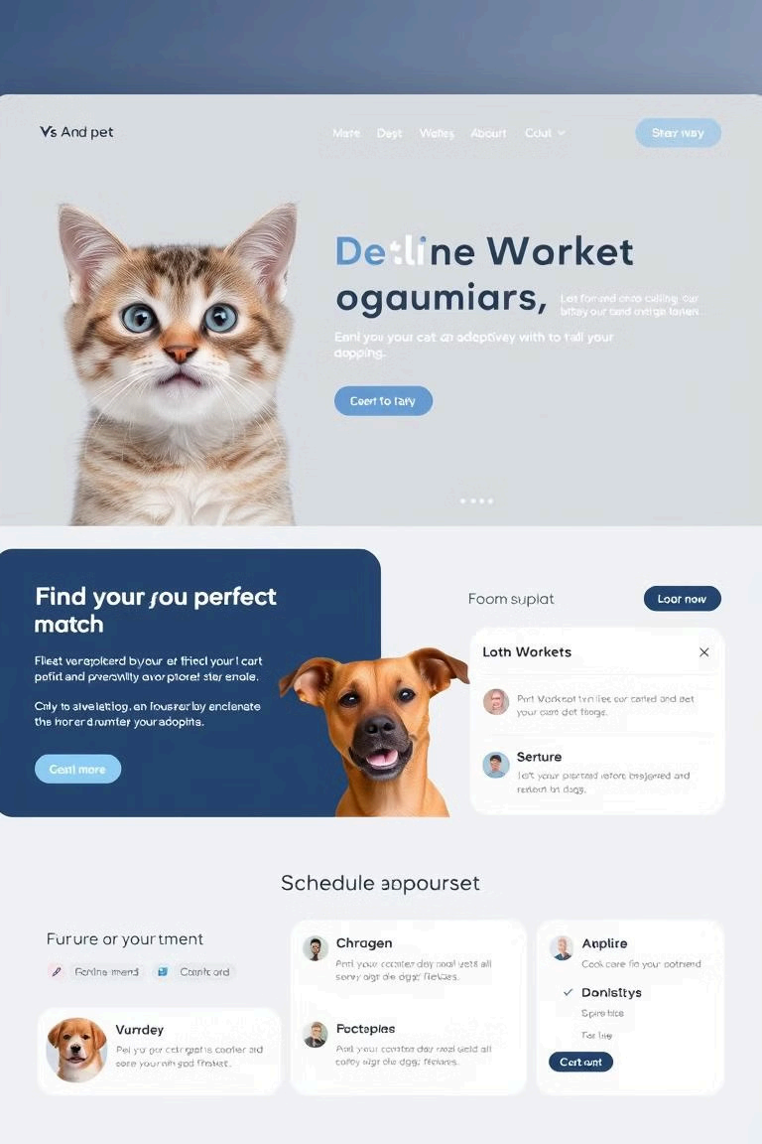
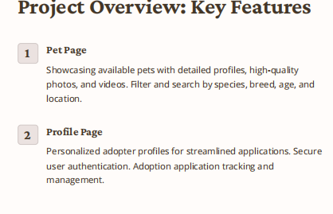

Slide 4
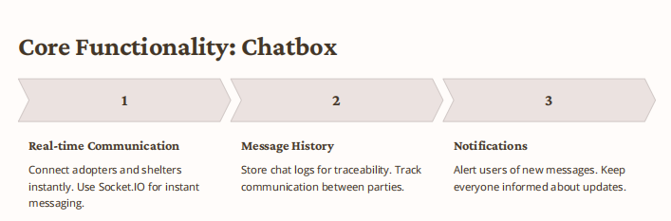

Slide 5


Slide 6
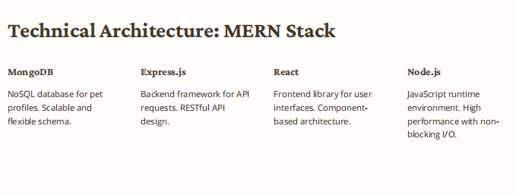

Slide 7
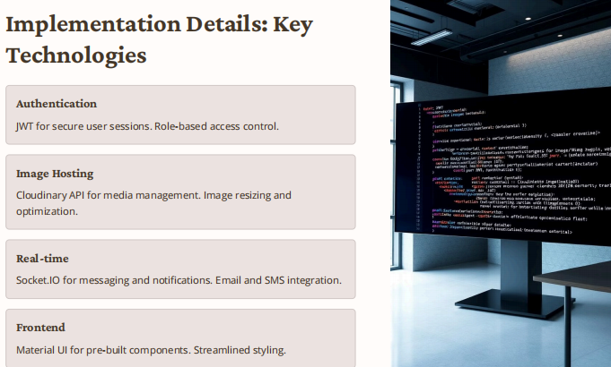

Slide 8
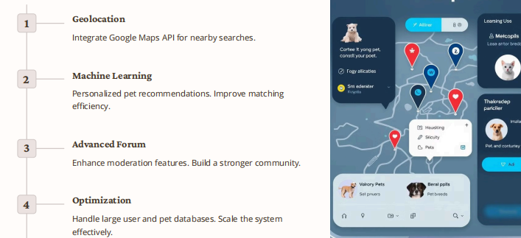
Future Enhancements and Scalability

Slide 9
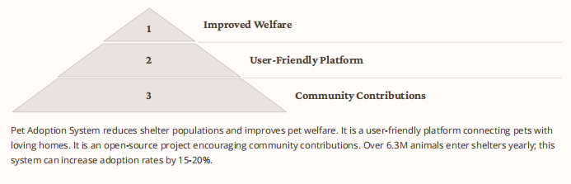
Conclusion: Making a Difference

Slide 10
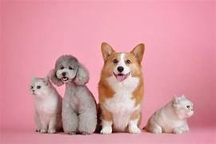
THANK YOU

