Slide 1

Descriptive Data Mining on World Data
Ang Dorje Sherpa
Cristian C Noriega M
Omotoyosi Ezekiel
Arshdeep Singh

Slide 2
Descriptive Data Mining
Descriptive Data Mining
Association Rule
Sequence Mining
Clustering Analysis

Slide 3
World Data & Continent Data
World Data consists of numerous data related to countries such as population, land area, Birth rate, etc.
World Data and continent data are merged.
Using descriptive data mining, the world data is analyzed to establish relationships between various attributes.

Slide 4
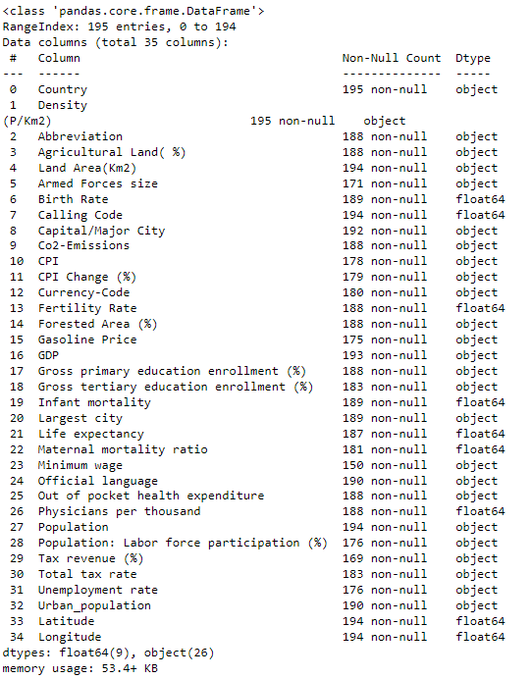
World Data Description
Population Data: Birth Rate, Fertility Rate, Infant Mortality, Life Expectancy, Maternal Mortality Ratio, Physician per thousand, Density, Population, Labor Participation, Unemployment Rate, Urban Population,

Slide 5
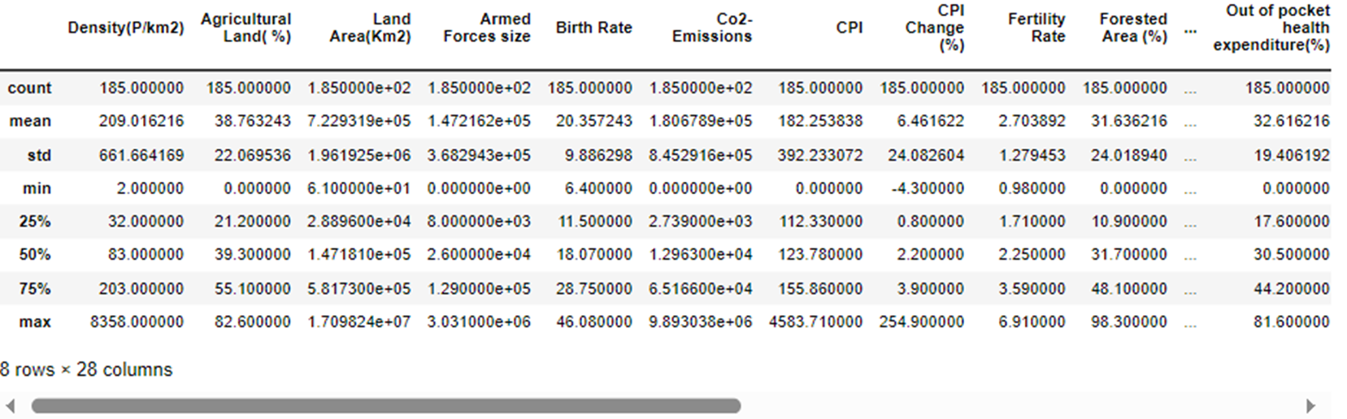
Descriptive Data Summary
We can also obtain a statistical summary of the numeric columns and see that the range of values vary widely between columns
This shows us that standardization will be useful as a part of the preprocessing procedure

Slide 6
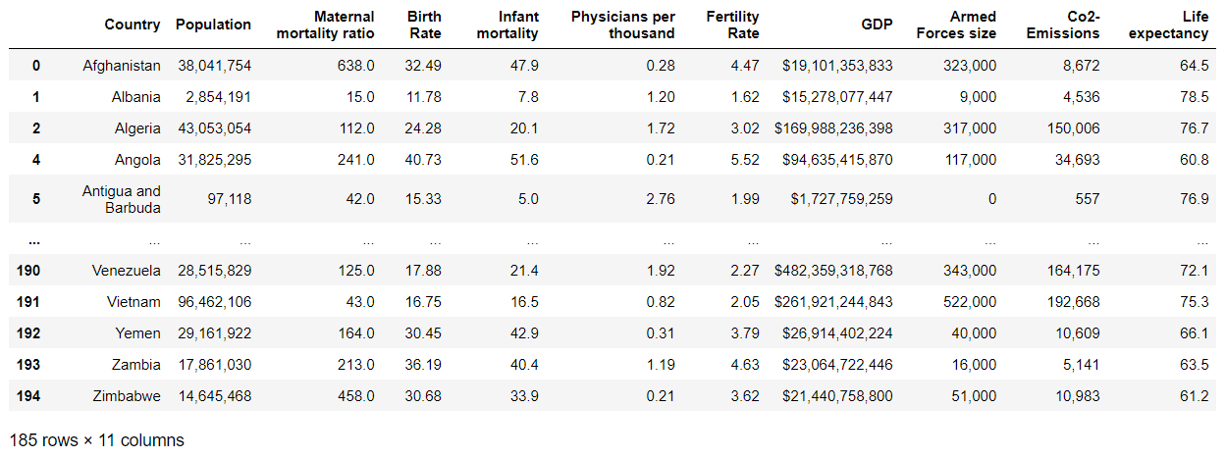
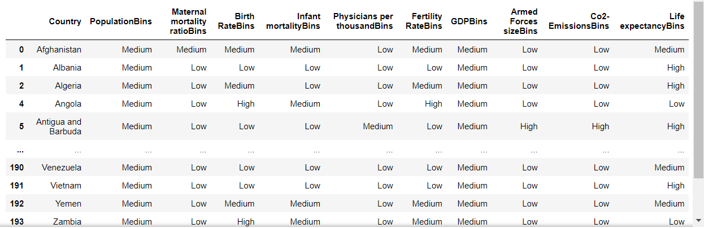
Descriptive Data Mining Method (Association Rule)

Slide 7
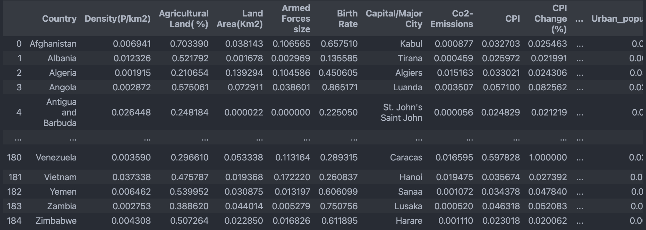
Standardization
We scaled our data using Min Max Scalar to bring it to a consistent scale as some columns were in millions (Armed Forces size) while others were between 0 and 100 (UE Rate). This helps standardization.

Slide 8
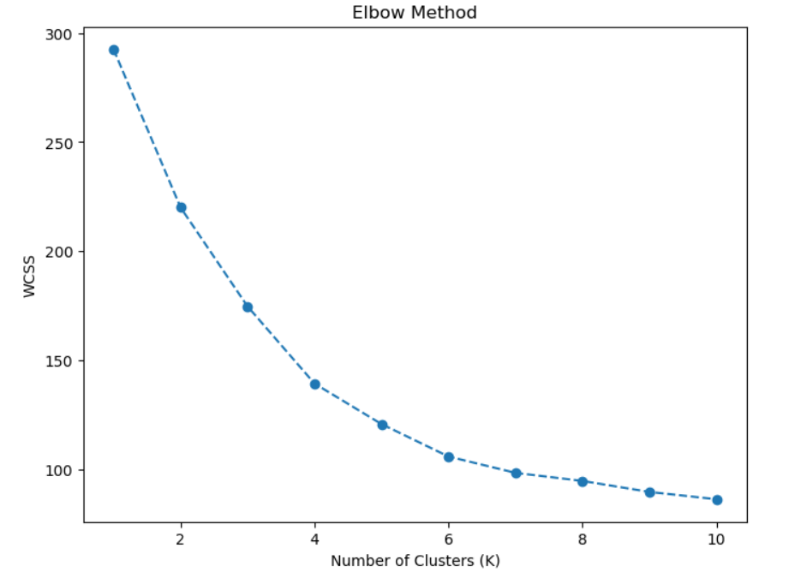
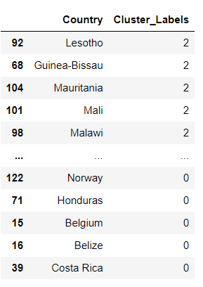
Descriptive Data Mining Method (Clustering Analysis)

Slide 9
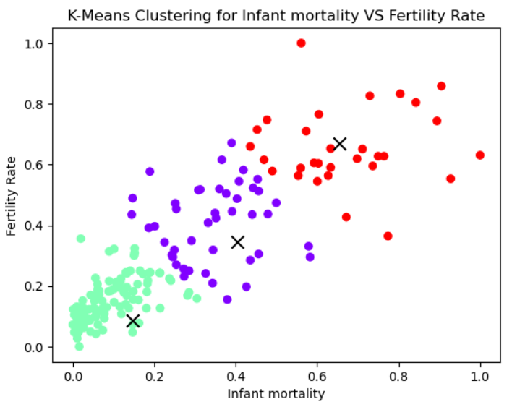
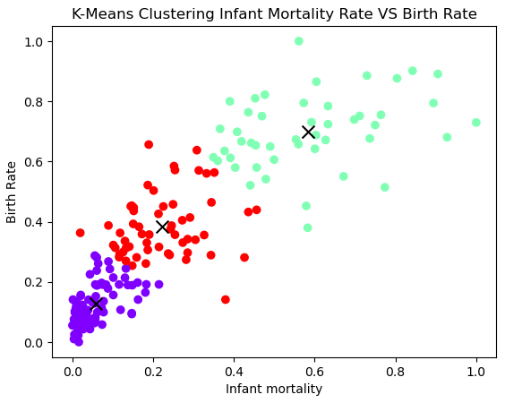
Descriptive Data Mining Method (Clustering Analysis)

Slide 10
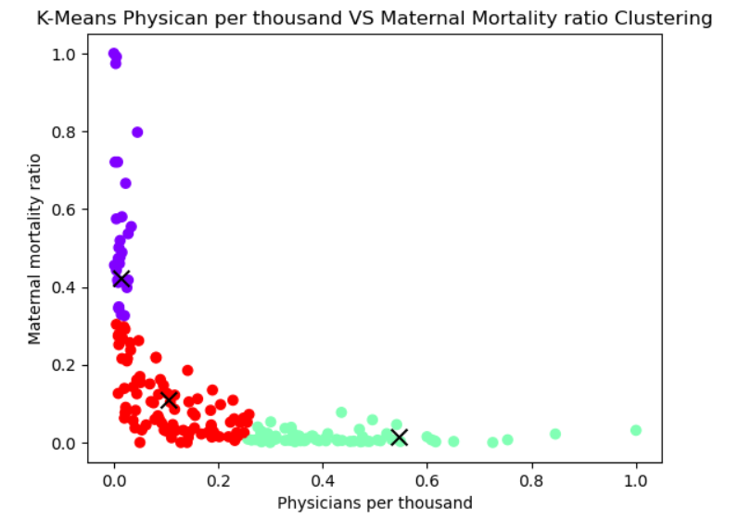
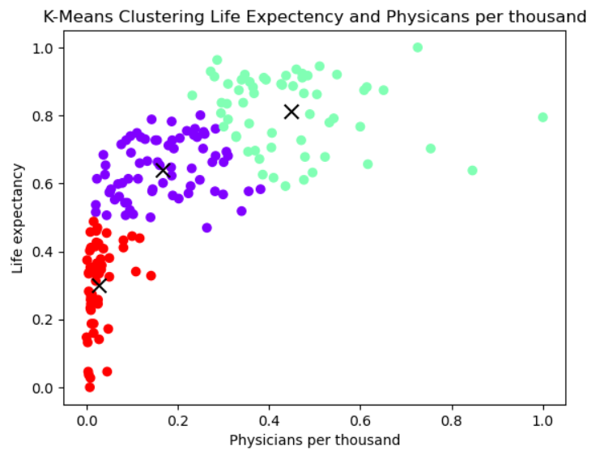
Descriptive Data Mining Method (Clustering Analysis)

Slide 11
Conclusion
The Apriori algorithm applies only to binary data which is not applicable for the population data.
K-means is an effective algorithm to categorize the data and derive the relationship among the attributes.

Slide 12
References
[1] A. Sss, “Global Country Information Dataset 2023,” Kaggle, https://www.kaggle.com/datasets/nelgiriyewithana/countries-of-the-world-2023 (accessed Oct. 1, 2023).
[2] A. Sss, “Continent list for 2021 Olympics in Tokyo dataset,” Kaggle, https://www.kaggle.com/datasets/arvinthsss/continent-list-for-2021-olympics-in-tokyo-dataset (accessed Oct. 4, 2023).
[3] “Folium#,” Folium - Folium 0.1.dev1+g9ab63f7 documentation, https://python-visualization.github.io/folium/latest/ (accessed Oct. 3, 2023).

