Slide 1
DATA XLABS - INTERNSHIP
Task 3 - Dashboard Design
Walmart Sales Performance Analysis Dashboard
Prepared By:
Arshu Sheerin H M

Slide 2
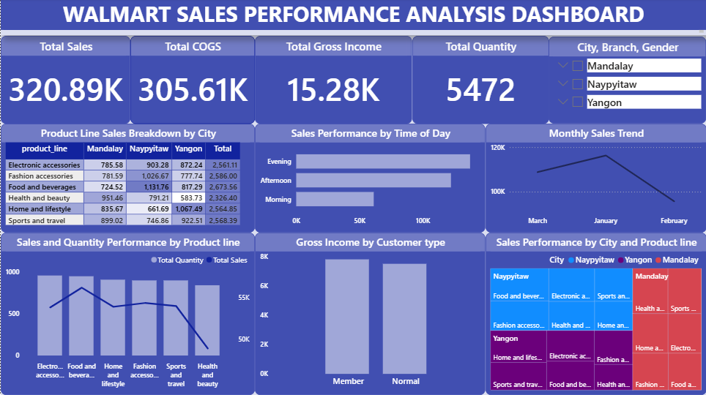
Dashboard Overview

Slide 3
Key Business Insights
• Total Sales reached 320.89K.
• Naypyitaw generated the highest sales among all cities.
• Food & Beverages and Fashion Accessories were strong performing categories.
• Evening sales recorded higher performance than morning sales.
• Member customers generated slightly higher gross income than normal customers.
• Monthly sales trends indicate strong business performance across the analyzed period.

Slide 4
Skills Demonstrated
• KPI Reporting
• Data Storytelling
• Data Visualization
• Interactive Filtering
• Business Intelligence
• Stakeholder Reporting
• Sales Performance Analysis
• Power BI Dashboard Design

