Slide 1
Microservices
Shiv Kumar

Slide 2
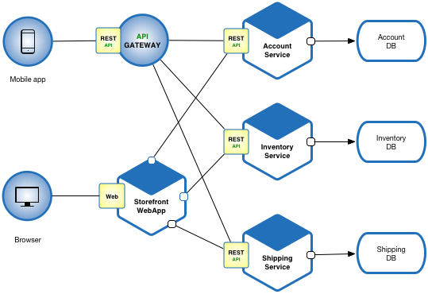
Microservices
This Photo by Unknown Author is licensed under CC BY-NC
This Photo by Unknown Author is licensed under CC BY-NC

Slide 3
Microservices
Decomposition of Applications: Microservices advocate breaking down large, monolithic applications into smaller, loosely coupled services, each responsible for a specific business function.
Independently Deployable: Each microservice can be developed, deployed, and scaled independently. This allows teams to release updates and new features more frequently without affecting other parts of the system.
Single Responsibility Principle: Microservices follow the principle of single responsibility, where each service focuses on doing one thing well. This makes the services easier to understand, develop, and maintain.
Communication via APIs: Microservices communicate with each other over well-defined APIs (Application Programming Interfaces). This communication can happen synchronously (e.g., RESTful APIs) or asynchronously (e.g., message queues).
Technology Diversity: Microservices allow teams to choose the best technology stack for each service. This flexibility enables using different programming languages, frameworks, and data storage technologies based on individual service requirements.

Slide 4
Microservices contd…
Scalability: Microservices enable horizontal scaling by replicating individual services as needed. This ensures that only the specific parts of the application experiencing high demand need to be scaled, rather than the entire monolith.
Fault Isolation: Failure in one microservice doesn't necessarily bring down the entire system. Since services are isolated from each other, failures are contained within the affected service, reducing the impact on the overall application.
DevOps Culture: Microservices are often closely associated with DevOps practices. Automation, continuous integration, continuous delivery (CI/CD), and infrastructure as code (IaC) are commonly used to streamline the development, deployment, and operation of microservices-based applications.
Monitoring and Observability: With a distributed architecture, monitoring and observability become crucial. Tools for logging, monitoring, and tracing (e.g., Prometheus, Grafana, Jaeger) are essential for understanding the behavior of microservices and diagnosing issues.
Challenges: While microservices offer numerous benefits, they also introduce challenges such as increased complexity in deployment and management, distributed data management, ensuring consistency across services, and network latency.

Slide 5
Why karate
Simplicity and Expressiveness: Karate's syntax is simple and expressive, making it easy to write and understand test scenarios. Its DSL (Domain-Specific Language) allows testers and developers to write tests in a readable, concise format, reducing the learning curve and enhancing productivity.
Behavior-Driven Development (BDD) Approach: Karate follows a BDD approach, where test scenarios are written in a human-readable format using Given-When-Then syntax. This encourages collaboration between stakeholders (testers, developers, business analysts) and helps ensure that tests align with business requirements.
Integrated Testing Capabilities: Karate supports end-to-end testing by allowing you to make HTTP requests, perform assertions, and interact with JSON/XML payloads seamlessly within the same test scenario. It also supports data-driven testing, parallel execution, and scenario outlines, enhancing test coverage and efficiency.
Rich Assertion Library: Karate includes a rich assertion library that supports various types of validations, including JSONPath, XPath, and regular expressions. This enables you to verify the correctness of API responses, ensuring that microservices behave as expected under different conditions.

Slide 6
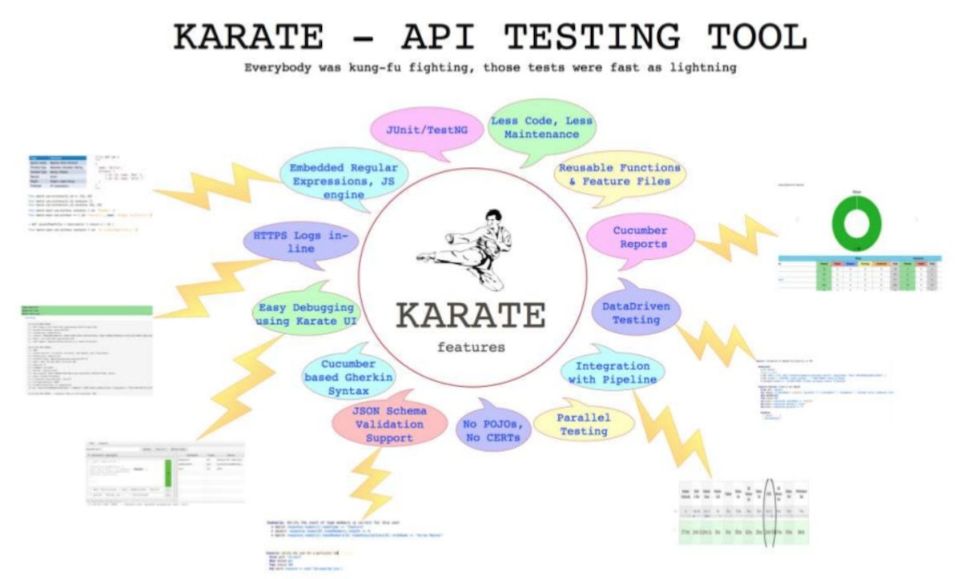
Why karate

Slide 7
How Karate
Prerequisites:
Eclipse IDE installed on your local machine (you can download it from https://www.eclipse.org/)
Java Development Kit (JDK) installed (Karate requires JDK 8 or later)
Step 1: Install Eclipse
Step 2: Set up a New Java Project
Step 3: Configure Java Build Path
Step 4: Add Karate Libraries
Step 5: Create a Karate Test File
Step 6: Write Karate Test Scenarios
Step 7: Run Karate Tests

Slide 8
Sample karate
Feature: User Management Microservice Testing
Background:
* url 'http://localhost:8080/api' # Assuming the base URL of the microservice
Scenario: Create a new user
Given path '/users'
And request { username: 'testuser', email: 'test@example.com' }
When method post
Then status 201
And match response == { id: '#number', username: 'testuser', email: 'test@example.com' }

Slide 9
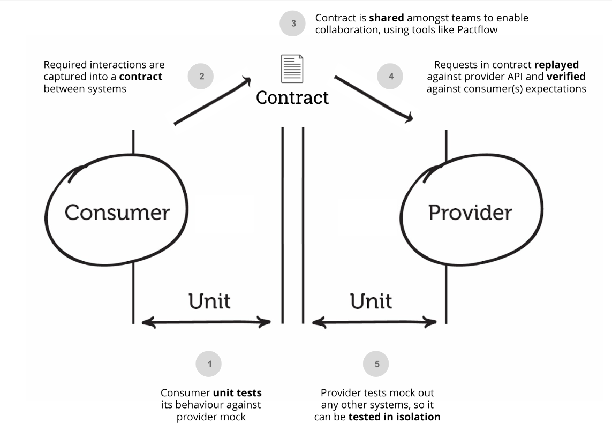
Pact

Slide 10
Why Pact
Ensures Compatibility: Pact framework enables contract testing, ensuring that the provider and consumer services are compatible with each other. This helps in avoiding integration issues that may arise due to changes in APIs.
Fast Feedback Loop: Pact facilitates a fast feedback loop between teams developing provider and consumer services. Any changes made to the provider service are quickly tested against the consumer's expectations, providing immediate feedback on compatibility.
Decouples Development: Pact allows teams developing provider and consumer services to work independently. They can define the contracts (expected interactions) between services, allowing parallel development without dependencies.
Documentation as Code: Pact contracts serve as living documentation for the APIs. They describe the expected interactions in a machine-readable format, which can be easily understood and updated by developers

Slide 11
Pact Contd..
Mock-Free Testing: Unlike traditional integration testing, Pact framework allows testing without the need for mocks or stubs. The tests use real interactions between services, providing more accurate results.
Detects Breaking Changes Early: Pact tests catch breaking changes early in the development process. By verifying that providers meet the expected contract, any deviations from the contract are identified before deployment, reducing the risk of failures in production.
Supports Consumer-Driven Contracts (CDC): Pact follows the Consumer-Driven Contracts approach, where consumers define the expected interactions with providers. This ensures that providers only implement what consumers actually need, promoting better alignment between teams.
Language and Platform Agnostic: Pact framework supports multiple programming languages and platforms, making it suitable for a wide range of projects and tech stacks.

Slide 12
Real time use cases:
E-commerce Platform:
Use Case: An e-commerce platform consists of multiple microservices such as product catalog, user authentication, and payment processing.
Pact Implementation: The product catalog service serves as a provider, while the user interface (UI) or mobile app acts as a consumer. Pact tests are written to ensure that the UI or mobile app can successfully retrieve product information from the catalog service without breaking changes.

Slide 13
Real time use cases:
Travel Booking System:
Use Case: A travel booking system comprises services for flights, hotels, and car rentals, all interacting to provide a seamless booking experience.
Pact Implementation: The flight booking service may expose APIs for searching and booking flights, which are consumed by the hotel booking service. Pact tests are written by the hotel booking service team to verify that the flight booking service continues to meet its contract, ensuring that any changes in flight booking APIs won't impact hotel bookings.

Slide 14
Real time use cases:
Social Media Platform:
Use Case: A social media platform comprises services for user profiles, posts, and notifications.
Pact Implementation: The post service serves as a provider, offering APIs for creating, fetching, and updating posts. The notification service consumes these APIs to send notifications to users when new posts are created. Pact tests are written by the notification service team to ensure that changes made to the post service APIs don't break the notification functionality.

Slide 15
Setup Pact framework
Define Consumer and Provider:
  Identify the consumer and provider services involved in the contract testing. The consumer is the service consuming the API, while the provider is the service providing the API.
Add Pact Dependencies:
  Include the Pact dependencies in your Java project. You'll need dependencies for both the consumer and provider projects.
Write Consumer Pact Tests:
  In the consumer project, write Pact tests to define the expected interactions with the provider. These tests specify the requests the consumer makes and the responses it expects to receive.
Verify Pact Tests:
  Run the consumer Pact tests to generate Pact contract files. These files contain the interactions between the consumer and provider.

Slide 16
Setup Pact framework contd..
Publish Pact Contracts:
  Publish the generated Pact contract files to a Pact Broker or a local file system. The Pact Broker is a centralized platform for storing and sharing Pact contracts between consumer and provider teams.
Write Provider Pact Tests:
  In the provider project, write Pact tests to verify that the provider satisfies the expectations defined in the Pact contracts. These tests simulate requests from the consumer and validate the responses returned by the provider.
Run Provider Pact Tests:
  Execute the provider Pact tests, which will verify that the provider implementation aligns with the Pact contracts published by the consumer.

Slide 17
Why Circuit breaker
Fault Isolation: Microservices architecture involves multiple services communicating with each other. If one service fails, it can potentially affect the entire system. Circuit breakers help isolate faults by stopping the propagation of failures to other services, thereby containing the impact of failures within a service boundary.
Resilience: Circuit breakers contribute to the overall resilience of the system by providing mechanisms to handle failures gracefully. Instead of allowing a failing service to continue consuming resources and potentially causing cascading failures, circuit breakers can quickly detect and respond to failures, allowing the system to recover more efficiently.
Fail-Fast Principle: Circuit breakers adhere to the fail-fast principle, which emphasizes quickly detecting and responding to failures. By monitoring the health of downstream services and tripping the circuit when necessary, circuit breakers prevent wasting resources on requests that are likely to fail, enabling faster recovery and better resource utilization.

Slide 18
Why Circuit breaker
Timeout Handling: Microservices often communicate over networks, which can be unreliable and prone to latency. Circuit breakers help in managing timeouts by setting thresholds for acceptable response times. If a service takes too long to respond, the circuit breaker can open, preventing further requests to the slow service and allowing the system to maintain responsiveness.
Load Shedding: In scenarios where a service is experiencing high load or is degraded, circuit breakers can facilitate load shedding by temporarily stopping requests to that service. Fallback Mechanisms: Circuit breakers often incorporate fallback mechanisms, which provide alternative responses when a service is unavailable. These fallbacks can be predefined responses, cached data, or alternative service endpoints. Testing these fallback mechanisms ensures that the system can gracefully degrade functionality when necessary, maintaining a satisfactory user experience during failures.
Monitoring and Metrics: Circuit breakers typically provide metrics and monitoring capabilities that allow teams to track the health and behavior of their services.

Slide 19
Real time use cases:
Third-Party Service Integration:
Scenario: Your microservice relies on external APIs or third-party services for certain functionalities, such as payment processing or geolocation services.
Use Case: Implement a circuit breaker to monitor the health and responsiveness of these external services. If the service experiences downtime or becomes unresponsive, the circuit breaker can open, preventing your microservice from making additional requests to the failing service and potentially causing cascading failures.

Slide 20
Real time use cases:
Database Access:
Scenario: Multiple microservices share a common database. A database outage or high latency can significantly impact the performance of these microservices.
Use Case: Introduce a circuit breaker to monitor database connectivity and response times. If the database becomes overloaded or experiences connectivity issues, the circuit breaker can open, temporarily halting database access for affected microservices and preventing them from overwhelming the database further.

Slide 21
Real time use cases:
Internal Service Dependencies:
Scenario: Your microservice architecture comprises several interconnected services, where each service depends on others to fulfill certain requests.
Use Case: Implement circuit breakers between services to isolate faults and prevent cascading failures. If a downstream service experiences performance degradation or becomes unresponsive, the circuit breaker can open, temporarily halting requests to the failing service and allowing the system to maintain overall responsiveness.

Slide 22
Real time use cases:
Load Balancing:
Scenario: Your microservices are deployed across multiple instances or nodes, and a load balancer distributes incoming requests among them.
Use Case: Use circuit breakers to monitor the health and performance of individual instances or nodes. If an instance becomes overloaded or starts returning errors, the circuit breaker can open, temporarily diverting traffic away from the affected instance and redistributing it among healthy instances, thereby preventing overloading and ensuring optimal performance.

Slide 23
Real time use cases:
External Service Degradation:
Scenario: Your microservice relies on external services for critical functionalities, such as email delivery or SMS notifications.
Use Case: Implement circuit breakers to detect and handle degradation in external service performance. If the external service experiences latency or reduced capacity, the circuit breaker can open, allowing your microservice to gracefully degrade its functionality by, for example, queuing messages for later delivery or providing alternative communication channels.

Slide 24
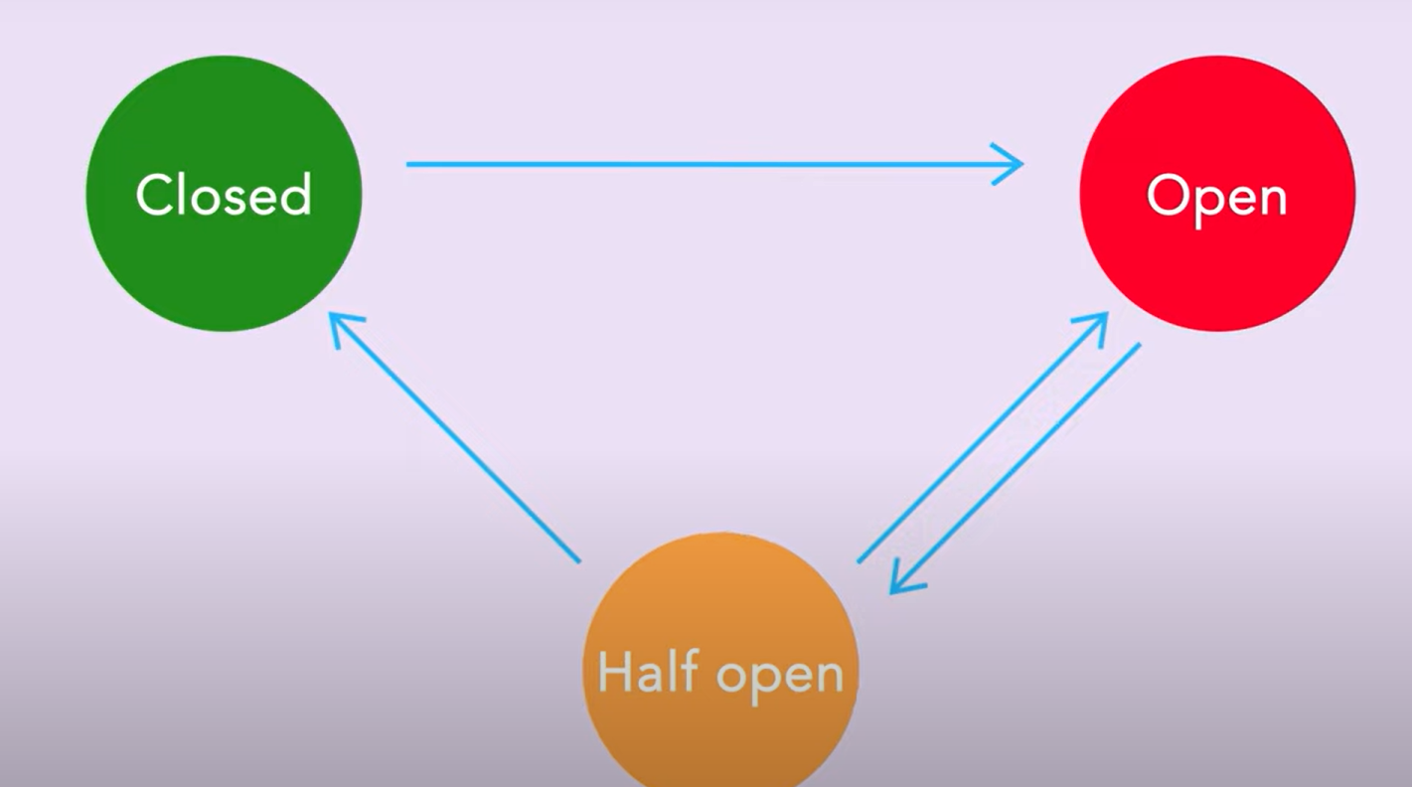
implementation

Slide 25
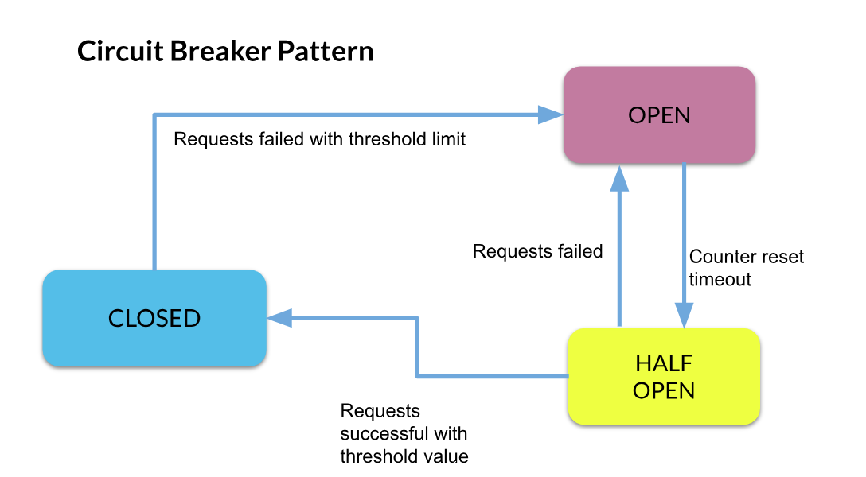
How it works

Slide 26
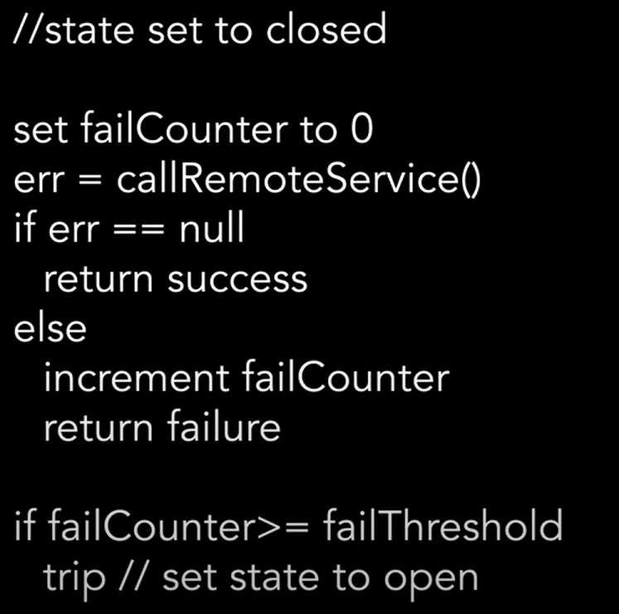
Real time use cases:

